Slide 1

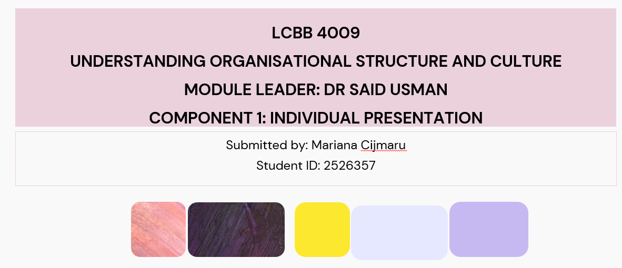

Slide 2
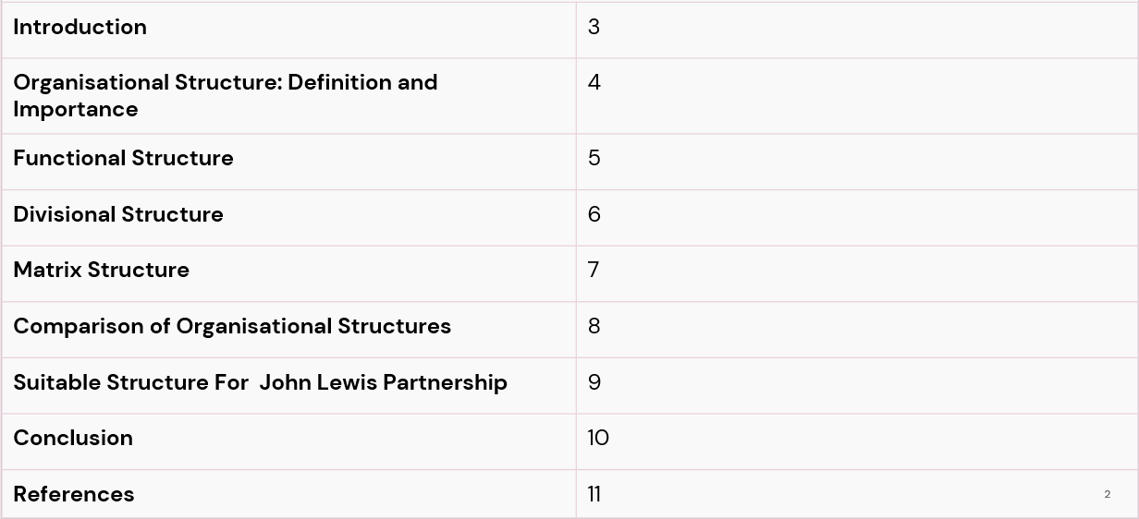
Table Of Contents

Slide 3

Introduction
Organisational structure influences the working, communication and performance of people (Jerab and Mabrouk, 2023).
The John Lewis Partnership (JLP) is a good case study of a retailer.
The presentation will discuss 3 designs of structures and their organisational implications.
Retail organisations must have clarity of organisational structure to ensure consistency in service quality.
The aims are to compare, evaluate and recommend for JLP.
Notes:
The organisational structure dictates the functions of responsibility, communication and decision making within a business (Jerab and Mabrouk, 2023). John Lewis Partnership is an example of how a successful business structure contributes to retail success. This presentation explores three organisational structures, their strengths and weaknesses and proposes the most suitable organisational structure for achieving organisational performance.

Slide 4
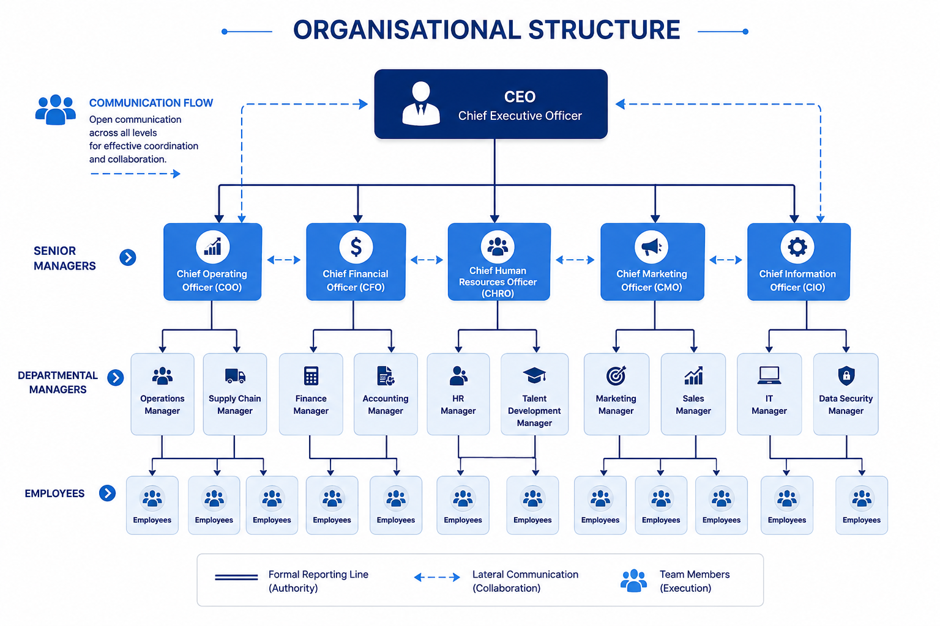
Organisational Structure: Definition and Importance
Organisational structure refers to the formal structure of roles and responsibilities (Wood et al., 2024).
Organisational charts clearly illustrate reporting relationships and hierarchy.
They increase employee's awareness of authority, accountability and communication lines.
Structure is a pattern coordinating organisational activities effectively (Caniago, 2024).
Good structure enhances efficiency, decision-making and co-ordination of work overall performance.
Poor structure leads to confusion, delays and miscommunication between teams often.
Notes:
Organisational structure is the formal relationships, roles, and responsibilities of organisations (Wood et al., 2024). Organisational charts are diagrams that illustrate lines of authority and communication. Mintzberg states that good structures provide efficient coordination of activities by fostering better collaboration, accountability, decision-making, productivity, and organisational performance while minimising confusion (Caniago, 2024).

Slide 5
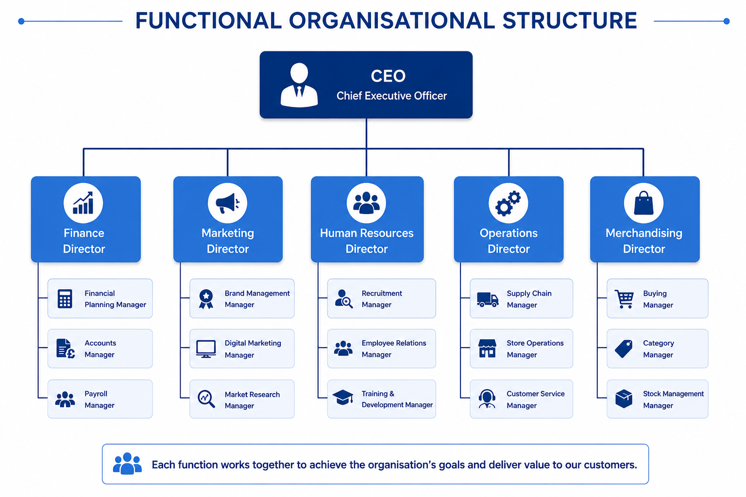
Functional Structure
The functional structure is an organisational structure that brings together employees with a specific skill or work unit (Attah et al., 2024).
Each department only covers one main business activity each day.
This design promotes the specialisation and effective performance of tasks in departments.
It can substantially boost control, expertise and operational uniformity company-wide.
But sometimes, communication among departments can get slowed down or be fragmented.
JLP could use this for merchandising, finance or HR purposes.
Notes:
A functional structure organises employees into specialisation based on areas of the business, such as finance, marketing, operations, human resources, etc. This technique builds up competencies, optimises performance, and enhances management (Attah et al., 2024). But as communication between departments may take longer, it may also be less possible to communicate and be flexible with the organisation during change.

Slide 6
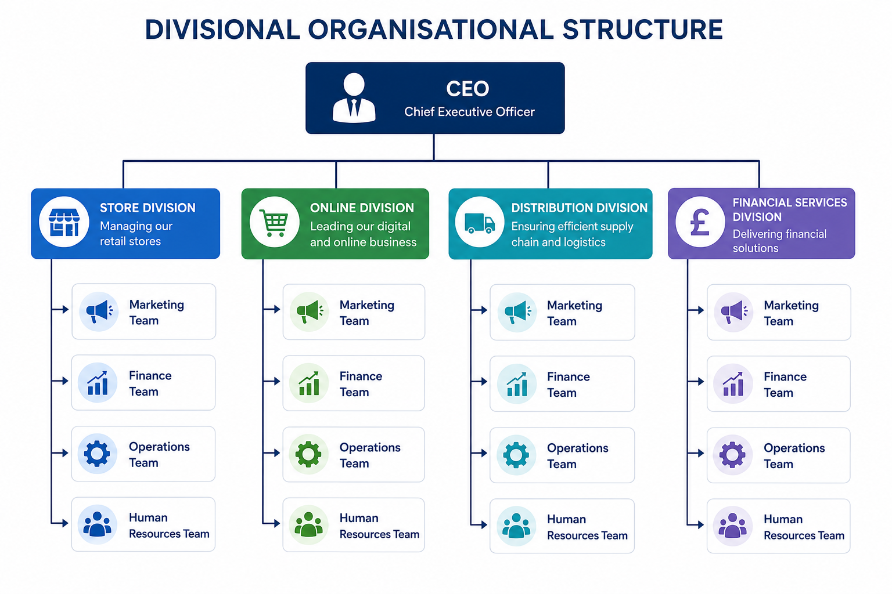
Divisional Structure
Divisional structure is based on product, region or market segments (Yamazaki, 2024).
Each division is somewhat autonomous and accountable at the local level.
This enhances responsiveness to various customer requirements and markets promptly.
Replicate resources and is very cost consuming.
JLP could be split into stores, online and services divisions.
This is where growth is allowed when it is most needed among the divisions.
Notes:
Divisional structures structure businesses by product, market, service or geographical region. Every division is autonomous, ensuring increased responsiveness and customer focus (Yamazaki, 2024). This boosts flexibility and accountability, but can lead to significant operational costs throughout the organisation due to duplicated resource and management functions.

Slide 7
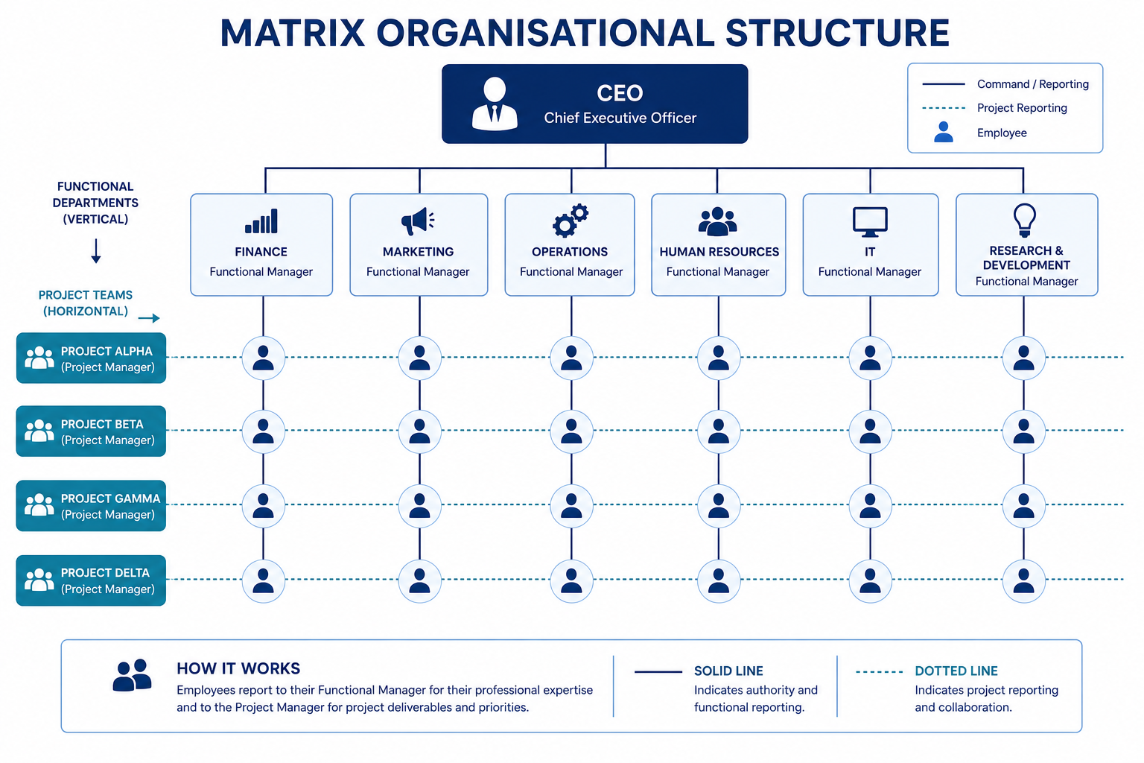
Matrix Structure
The matrix structure is a blend of functional expertise and project or product teams (Gonzalez, 2022).
Each employee has two bosses, giving rise to two lines of authority at the same time.
Leads to better flexibility, coordination and inter-functional communication between departments effectively.
Suited for complex organisations that are able to work on multiple priorities at the same time and do so efficiently.
Conflicting instructions may lead to confusion, stress, and delay in decision making.
JLP could roll out matrix working across the business for transformation projects.
Notes:
Matrix structures are a blend between functional departments and project teams with two lines of reporting for employees. This promotes collaboration, innovation, and effective resource sharing (Gonzalez, 2022). But, with dual reporting lines, there is a potential for role ambiguity, communication issues and delayed decision-making when accountability is not clear.

Slide 8
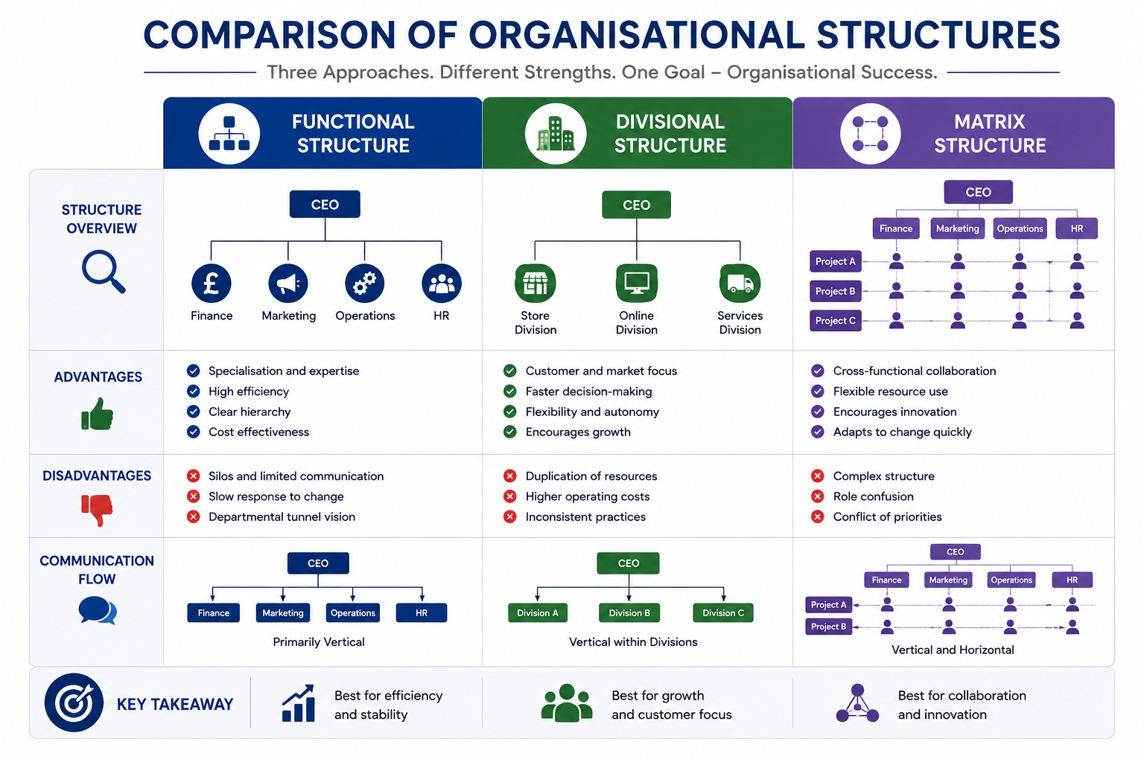
Comparison of the Three Organisational Structures
Functional structure is geared toward expertise, divisional structure is geared toward market focus.
Matrix organisation focuses on both cross-functional and cross-divisional collaboration, effectively.
Clear functional communication, faster divisional communication locally usually.
Matrix provides flexibility, with accountability sometimes being less direct.
Divisional structures work for a variety of operations, function structure work well for standardised operations overall.
JLP should make a careful choice as to complexity and strategy.
Notes:
Specialisation and divisional structures maximise efficiency, matrix structures foster collaboration and innovation, and customer-responsive structures enhance customer responsiveness (Venkataramani and Tang, 2024). Each design has its own set of pros and cons in the context of the goals, complexity, communication needs, and strategic considerations of today's competitive retail landscape.

Slide 9
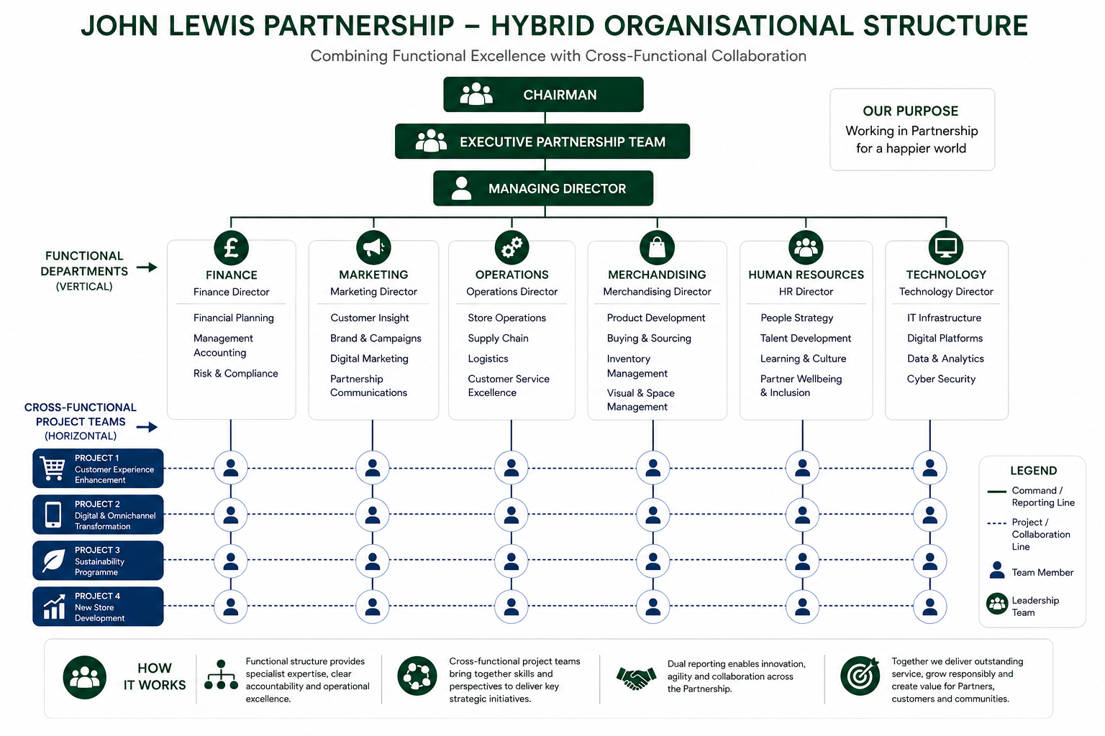
Best Suitable Structure For John Lewis Partnership
Proper balance between control, flexibility and coordination is needed for JLP.
Functional structure provides efficiency but can restrain responsiveness b/w divisions in some instances.
Structure of divisions enhances local decision-making and customer focus (Lueg and Ilieva, 2024).
Matrix structure is a strong enabler of collaboration, innovation and project-based change.
A hybrid model might be the most feasible for John Lewis.
This merges departmental control and cross functional flexibility.
Notes:
A hybrid model with a combination of functional efficiency and matrix collaboration works best for John Lewis Partnership. This approach enhances the capability of departments and facilitates cross-functional collaboration, innovation, flexibility and communication to ensure sustainable performance of the organisation and customer satisfaction in the retail operations.

Slide 10
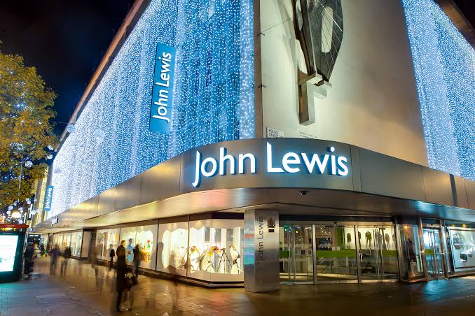
Conclusion
Communication, efficiency and performance outcomes are heavily dictated by organisational structure.
JLP has been blessed through structure that aligns to their strategy.
Functional, divisional, and matrix designs each have their own set of advantages.
Proper structure can make a huge difference and promote accountability and collaboration.
JLP needs to use structure that is best for their customer service.
Structure is still key to sustainable retail success overall today.
Notes:
Organisational structure plays a critical role in communication, accountability, efficiency and success of the organisation. Each of the three organisational structures – functional, divisional, and matrix – offers specific benefits. The right choice of structure will allow John Lewis Partnership to achieve sustainable enhancements to collaboration, operational effectiveness, customer satisfaction and competitive advantage.

Slide 11
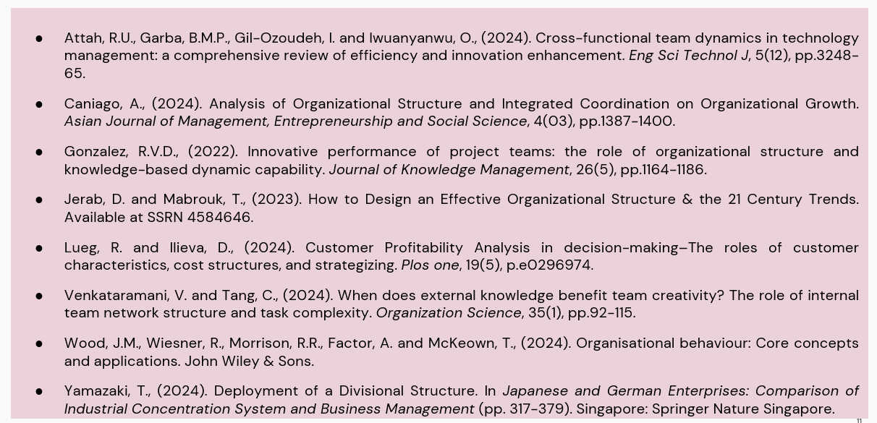
References

