Slide 1
Medieval Astrology
A few concepts
Bernadette Brady

Slide 2
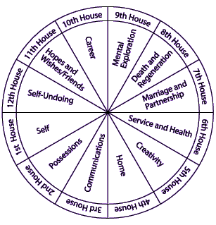
Angular,
Succedent
or Cadent
Houses provide an accidental dignity

Slide 3
The Essential Dignities by Nature (sign)
 | Rules | Detriment | Exaltation | Fall
N | E | K | A | G
M | D | J | B | H
O | C F | I L | F | L
P | B G | A H | L | F
Q | A H | B G | J | D
R | I L | C F | D | J
S | J K | D E | G | A

Slide 4
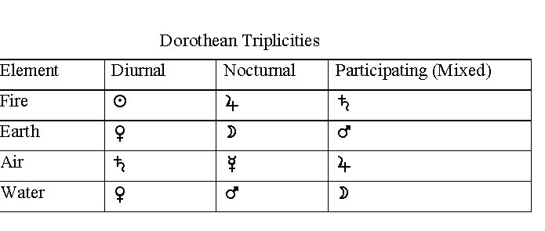
The Triplicities
As used by Dorotheus of Sidon, 1st century C.E.

Slide 5
Triplicity Rulerships of Houses
Three Trip rulers of the :
1st house - The three periods of life
2nd house – Wealth in the three periods of life
3rd house – 1st Ruler, Elder sibling - 2nd Ruler, Middle sibling- 3rd Ruler Younger sibling
4th house - 1st = Father and inheritance, 2nd = Home , 3rd = How one ends things – death.
5th house - 1st = Children , 2nd = Sensual Pleasures , 3rd = Honours you received .
6th house - 1st = Illness, 2nd = Servants, slaves , 3rd = Success from one’s own work.

Slide 6
Triplicity Rulerships of Houses
Three Trip rulers of the :
7th house – 1st = Intimate relationships, - 2nd = Conflicts, 3rd = Associations
8th house – 1st = Signifies the death, - 2nd = Ancestors, 3rd = Money from others
9th house – 1^{st =} Journeys- 2nd = Faith and Religion, 3rd = Wisdom and seeing the future
10 house - 1st = Work and Status, 2nd = Leadership skills, 3rd = Stability of Career
11th house - 1st = Faith , 2nd = Friends, 3rd = Success of ventures.
12th house - 1st = Hidden Enemies, 2nd = Labours, 3rd = One’s nation and culture – influence of.

Slide 7
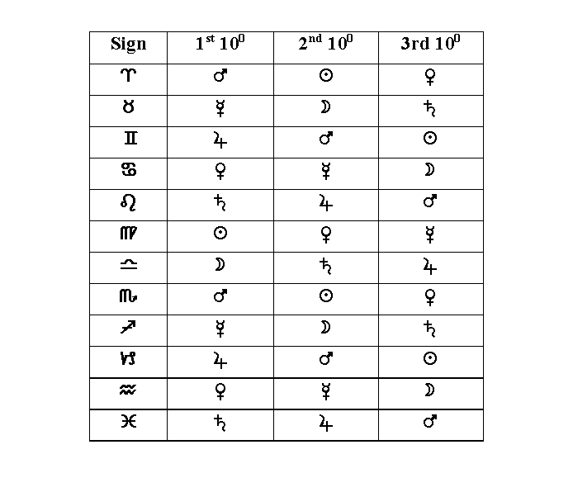
Face

Slide 8
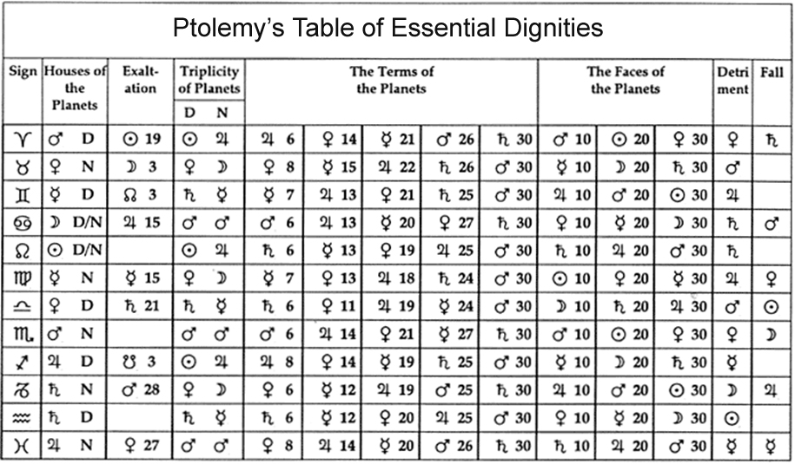

Slide 9
Aspecting in medieval astrology differs in three major way to contemporary western astrology
The Aspects
The Orbs
Reception – aspecting with personality

Slide 10
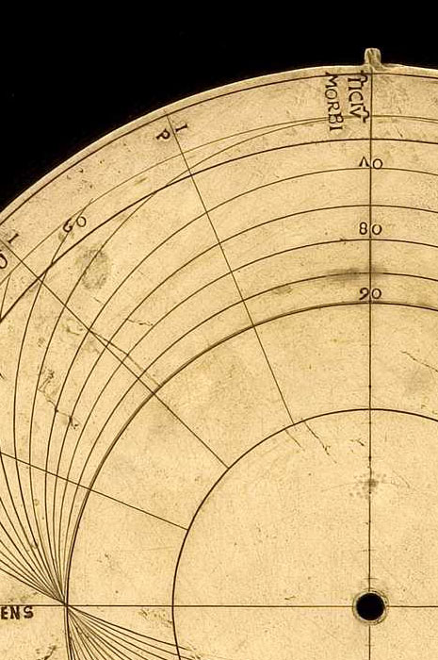
The Aspects
The Five Ptolemaic Aspects
The Conjunction – joining 0⁰
The Sextile – 60⁰ “Medium Friendship”
The Square – 90⁰ “Medium enmity”
The Trine – 120⁰ “Unbroken and complete friendship”
The opposition – 180⁰ “a destroying and evil aspect”
Bonatti’s definitions

Slide 11
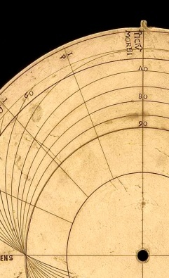
The Orbs
The use of Moiety
S ... has an orb of 9⁰ for any aspect 4⁰ 30’ in modern terms
R ... has an orb of 9⁰ for any aspect 4⁰ 30’ in modern terms
Q ... has an orb of 8⁰ for any aspect 4⁰ in modern terms
N ... has an orb of 15⁰ for any aspect 7⁰ 30’ in modern terms
P ... has an orb of 7⁰ for any aspect 3⁰ 30’ in modern terms
O ... has an orb of 7⁰ for any aspect 3⁰ 30’ in modern terms
M ... has an orb of 12⁰ for any aspect 6⁰ in modern terms
The planets have the agency not the aspects

Slide 12
N
M
12⁰
15⁰
S
R
9⁰
Q
8⁰
O
P
7⁰

Slide 13
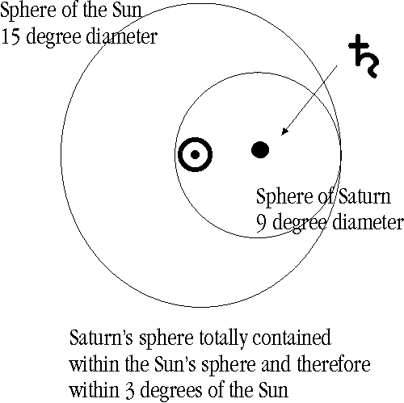
The planets have the agency not the aspects
The Orbs - the use of Moiety
S ... has an orb of 9⁰
N ... has an orb of 15⁰
3⁰
Sphere of the Sun (15⁰⁾ – Sphere of Saturn (9⁰ ) = 6⁰
half of this = 3⁰

Slide 14
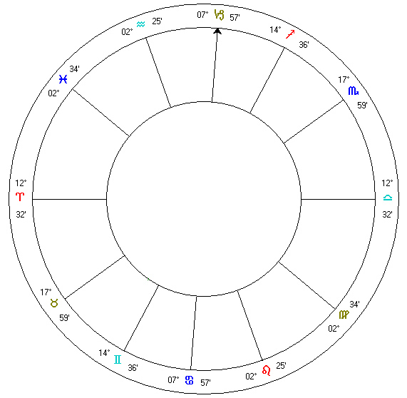
Planets place “rays” in the chart
into which other planets will be
located at birth OR will be
directed.
S
S

Slide 15
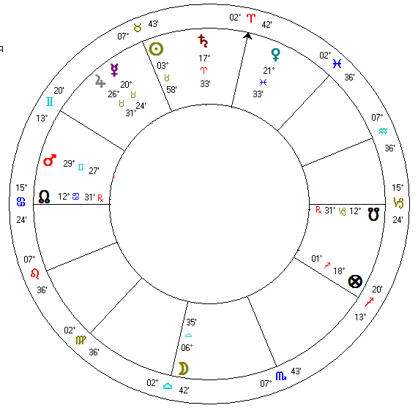
Sahl bin Bishr
Chart for 21 April 791
“A certain man asked whether he
Would acquire a kingdom in
that year or not.”
“Therefore, I looked in this question at the Lord of the Ascendant, which was the Moon, whom I found joined to Saturn from his exaltation in Libra. And Saturn received the Moon from his exaltation and signified the effecting of the matter (by the command of God), since Saturn was receiving the Moon…”

Slide 16
Sahl bin Bishr
“ But this will not be until it is striven for by the master of the question, and there will be some difficulty or labour there, because Saturn receives the Moon from opposition or contrariety; and the mind of the one striving for the matter will be made anxious on account of his place, because Saturn, who receives the Moon, is in his descension (or fall), and in [a place of] worthlessness: so Saturn is restricted in his own place.”

Slide 17
Sahl bin Bishr
“For this reason, we saw that this man will be restricted in his work, and will hate it on account of Saturn’s hatred which he has towards his own place. Because Saturn is the one who destroys the kingdom to him (by command of God), and [the querent’s] nature and condition is just like the nature of Saturn and the condition of Saturn ”
(Sahl, bin Bishr. "Introduction " In Works of Sahl & Masha'allah. (2008) Trans. B. Dykes. Golden Valley, Minnesota: The Cazimi Press. P. 478 )

Slide 18
Almutens and Lots

Slide 19
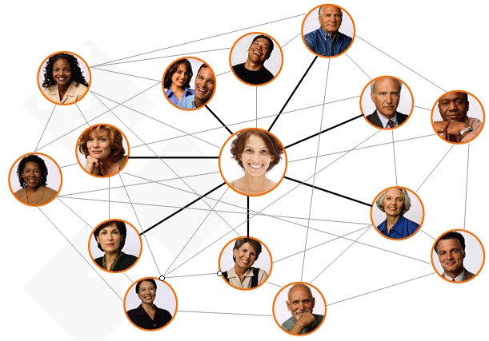
The horoscope considered like a community of individual’s , a small or large village.
Within this village the Lots are an exploration of arcs, based on one planet and its relationship to all the others.
Part of Spirit = Asc +Sun – Moon (diurnal)
Part of Fortune = Asc +Moon – Sun (diurnal)
This is the world according to the view
of one planet. The village according to the view of one individual.

Slide 20
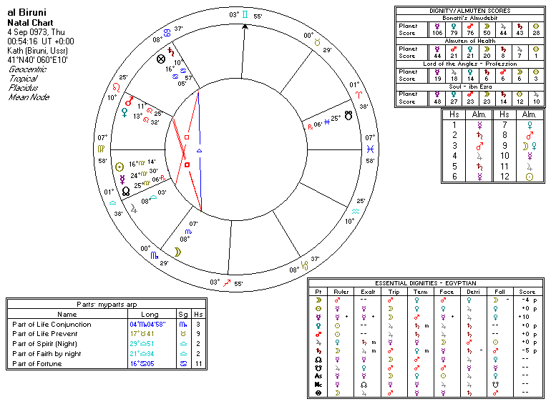
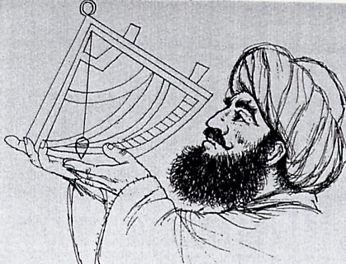

Slide 21
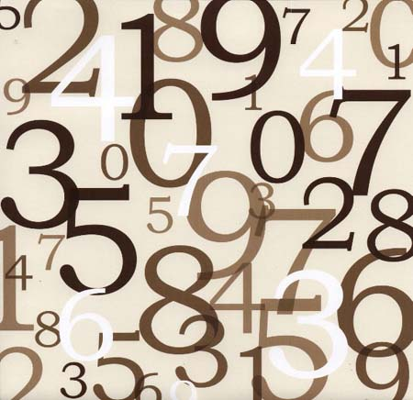
Almutens
reductionism in medieval astrology
Saturday Morning Lecture 4 – Bernadette Brady: The extension of Aristotle’s thinking of causation and determinism into the idea of almutens and lots and the consistent application of the principle of this technique from 9th to 14th centuries with examples charts.
In contemporary western astrology it is considered that the planet that rules a sign has the greatest influence over a particular house or angle.
However, when the full technique of the essential dignities was employed it was considered that while a planet ruled a sign, another planet could be exalted in that sign while other planets would be the triplicity, term and face rulers. Rulership was considered a shared situation with a group of planets sitting almost like a team or a council which held the power or fate of the area of life signified by the house, if the ruler failed in its role then the next in line, in terms of its influence would take over and seek to provide for the person the fulfilment of the house or situation.

Slide 22
Omar of Tiberius
8th - 9th century
“And he also said that whichever planet has the most dignity in the Ascendant and in the [place of the] luminaries, and in the Part of Fortune, or in the degree of the conjunction or prevention which is prior to the nativity, that planet is the most worthy to rule.
But if there is a planet which has dignity in three or four of the places, or in two of the places, namely those described above, we will make that planet the Almuten, [the planet] which has rulership over the nativity, that is, which has dominion.”
Saturday Morning Lecture 4 – Bernadette Brady: The extension of Aristotle’s thinking of causation and determinism into the idea of almutens and lots and the consistent application of the principle of this technique from 9th to 14th centuries with examples charts.
(Three Book of Nativities, 1997:13)

Slide 23
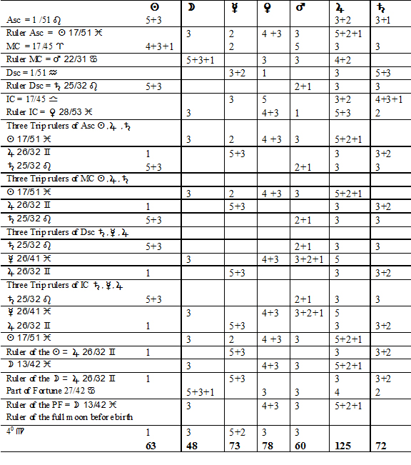
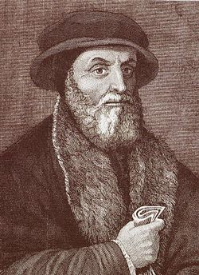
Guido
Bonatti
The Almudebit
“Whether the child will live”

Slide 24
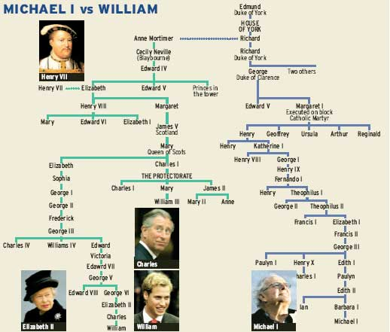
The horoscope considered like a community of individual’s , a small or large village.
Almutens and compound almutens are the finding of the planet or “person” that has the most ownership or the most influence over a particular concept.
Almutens are about ownership and authority
over a particular resource.

Slide 26
Trip Rulers MC =
Mercury = Work and Status
Saturn = Leadership skills
Jupiter = Stability in career

