Slide 1



Stress in the UK
Student Number: 2026278
Name: Oana Elena Golici
Module name: Problem Solving and Decision Making
Module code: BMSW 4004
Lecturer: Yohan Mendis

Slide 2


Introduction
Stress is defined in many ways:
The response to environmental change
Is the biggest issues at the workplace
It has a big impact on worker health and organizational performance adversely.
Negative impact on employment, family relationships, and the health and well-being.
Any influence that disturbs the natural equilibrium of the living
It is caused by loss/low income, health conditions, pressure, etc.
The common response on the attack (Seyle 1936)

Slide 3
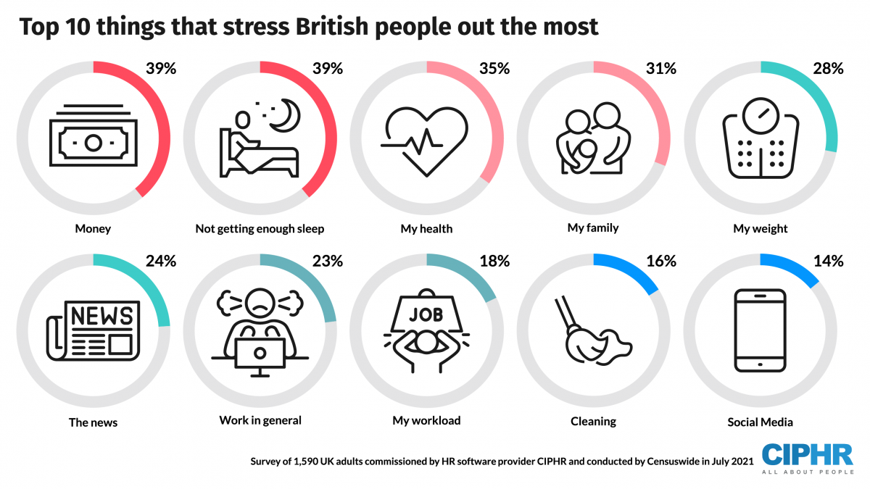
A surveys and investigations around the topic of stress made by CIPHR in 2021

Slide 4
Environment Analysis- PESTLE
 | External Factors | Factors affecting within population
Political | Government policy, Government resources allocations, Rising the taxes, Brexit | Brexit hit the businesses and growth the insecurity on daily living, affected the tourism, new politics introduced.
Economical | Costs of living, redundancy, labor/material costs, debts. | The demand for houses, increase the rate of rent, the labor cost in the UK is increased, many businesses were closed.
Social | Marriage, career, growing family, work-life balance, divorce, illness, the level of education. | Growing families in some areas, the divorce rate was increased in the last decade, demand for education and in the health system.

Slide 5
PESTLE
 | External Factors | Factors affecting within population
Technology | Artificial Intelligence, new technology, green technology, lack of renewable energy/green houses. | Needs to improve the technology to be ease accessible by older people as well, the green energy should be cheaper and achievable for everyone, more green houses.
Legal | Employment law, Health and safety regulations, Data Protection. | Wage rates and National Minimum Wage should increase yearly. Health & Safety system should have a strong and effective implementation, effectiveness at the workplace.
Environmental | Covid-19, Future pandemic, Climate change, Pollution, Natural disaster. | People were forced to work from home, the transport was reduced, illness (COVID). Climate change and natural disasters can affect direct or indirect populations.

Slide 6
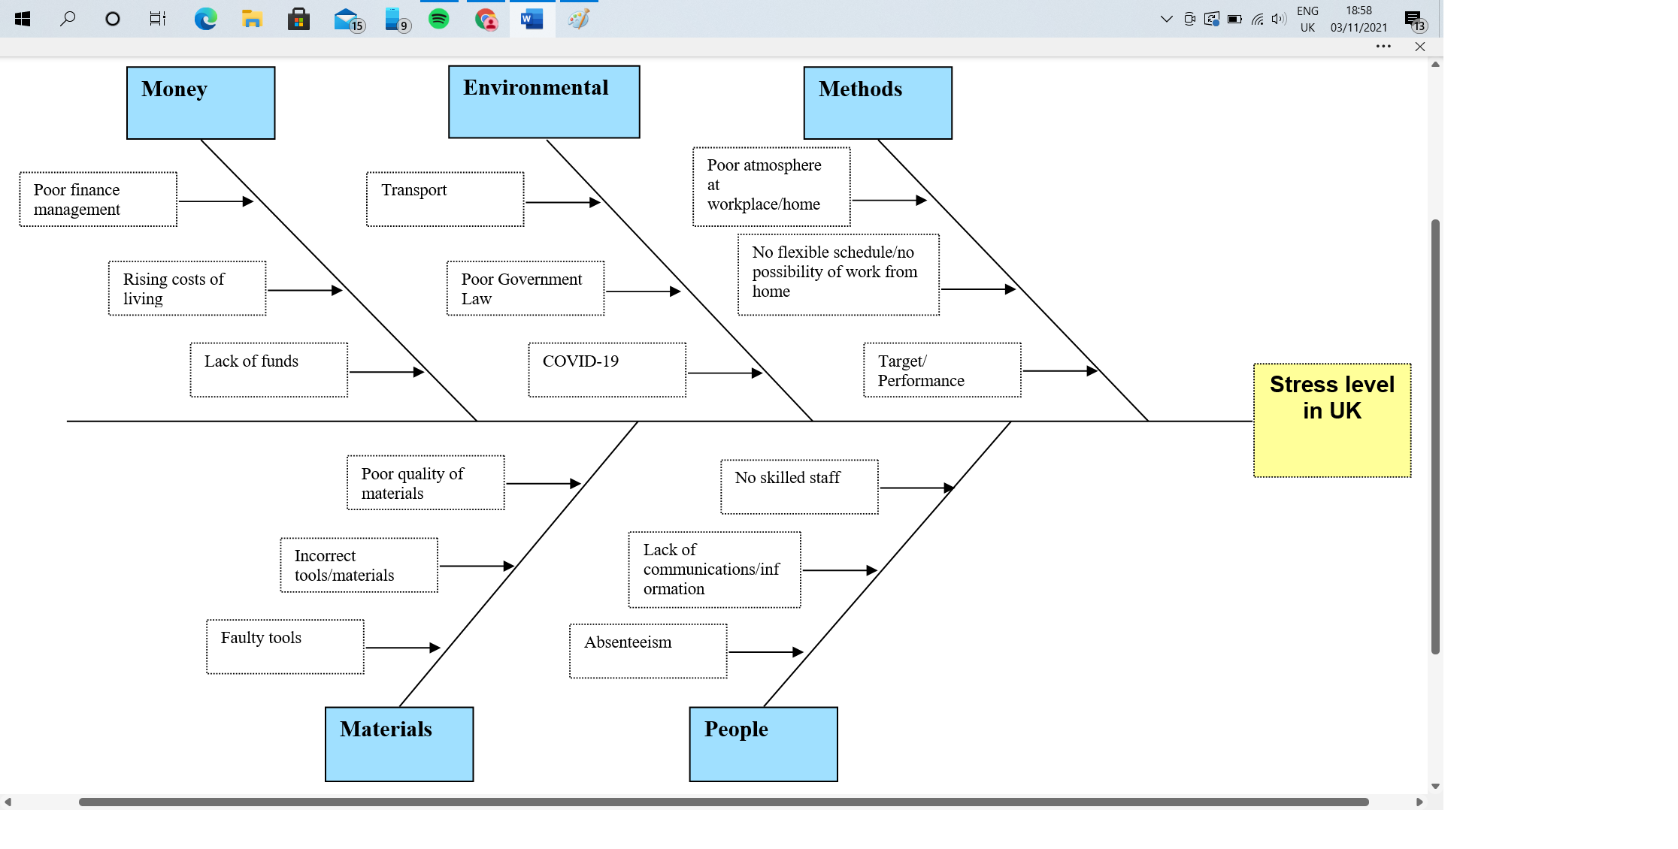
Cause and Effect Analysis - Fishbone Diagram

Slide 7
The solutions are 4 in total, and they will be analyzed using PMI & Grid Analysis tools
Work from home/ flexible hours
Better living standards
Skilled staff
Improving the communication

Slide 8
PMI
Solution 1 – Flexible hours/Work from home
Plus | Minus | Interesting
Better work-life balance (5) | Spend more money on bills/tools (-2) | Decrease the rate of absenteeism (+4)
No time-consuming (4) | Poor atmosphere at home (-1) | More time for family/manage own time (+5)
Quiet environment (2) | Not human interactions (-5) | Savings (+3)
Less money spend on clothes/transport (3) | Incapacity to solve some problems (-3)
More flexibility (1) | Not enough support from manager (-4)
Total: 15 | Total: -15 | Total: 11
Total Grand: 11

Slide 9
Solution 2 – Better living standard
Plus | Minus | Interesting
Safe financial situation (5) | Incapacity to organize money (-4) | Opportunity to open own business (4)
Less stress regarding the daily life (3) | Lack of adaptability (-4) | Expand/Grow the family (5)
Mobility in choosing option (2) | Possibility to lose the essential things in life (-3) | The amount of money can drop (-3)
Access to the higher education for kids (4) | Adopt the wrong attitude (-1)
More savings (3) | The high standard can fall (-3)
Total:17 | Total: -15 | Total: 6
Total Grand: 8

Slide 10
Solution 3 – Skilled staff
Plus | Minus | Interesting
Easy to achieve the task (5) | Focus more on activity and less on people (-3) | Love what they do (+5)
Offer information (3) | Can intimidate other staff (-5) | Achievable target(+3)
Highly motivated (4) | Other cannot have the opportunity to develop skills (-2) | Pressure in the colleagues (-4)
Improve the quality of work/team (3) | They can get bored doing the same thing (-4) | Always eager to share information (+2)
Closer to team management (1) | Motivation can be for a short time (-1)
Total: 16 | Total: -15 | Total: 6
Total Grand: 7

Slide 11
Solution 4 – Improving the communication
Plus | Minus | Interesting
Individuals understand the main things/task (4) | They can bump in each other personal life (-5) | Focus on task/goal (+4)
Closer team (1) | Can become informal expressing themself (-2) | Can express and share in a good manner the information (+5)
Easy to focus on goal (3) | Can be superficial at some point (-2) | To pay attention to other life (-5)
Deliver better work (5) | Easy to refuse/delay task/things in life (-3)
Adopt new responsibilities (2) | Over-thinking (-2)
Total: 15 | Total:-14 | Total: 4
Total Grand: 5

Slide 12
Grid analysis
Criteria | Cost | Time management | Effectiveness | Environment | Social Interactions | Total
Weight | 5 | 4 | 3 | 2 | 1
Flexible schedule/Work from home | 5 25 | 3 12 | 4 12 | 5 10 | 1 1 | 60
Better living standards | 3 15 | 0 0 | 3 9 | 2 4 | 4 4 | 32
Improving the communication | 3 15 | 3 12 | 3 9 | 3 6 | 4 4 | 46
Skilled staff | 4 20 | 2 8 | 5 15 | 2 4 | 3 3 | 54
Total Grand: | 60

Slide 13

Plan to reduce stress
The Government should adopt the law to reduce the cost for childcare
Families should support members to reduce the stress
Friendly environment at the workplace/home
Organization should provide efficient tools to help people to work from home
Capacity of organizations to implement part-time/flexible hours for employees

Slide 14
Summary and Conclusions
Stress is a feeling of being under abnormal pressure
The common factors which caused stress are money matter, work, lack of sleep, and family relationship.
To reduce the stress the individuals should follow few steps:
  Realize the problem
  Identify the cause
  Review your lifestyle/ current situation
Implementing the right decision members will be able to prevent the stress.

Slide 15


THANK YOU

