Slide 1


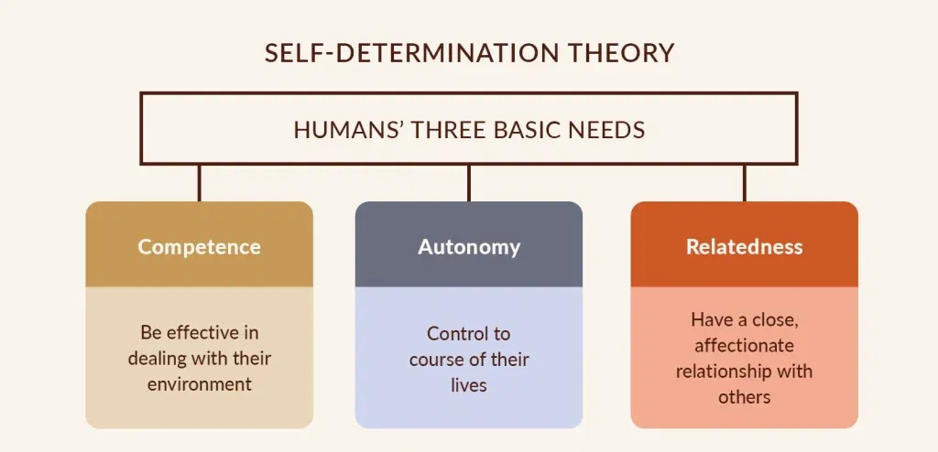
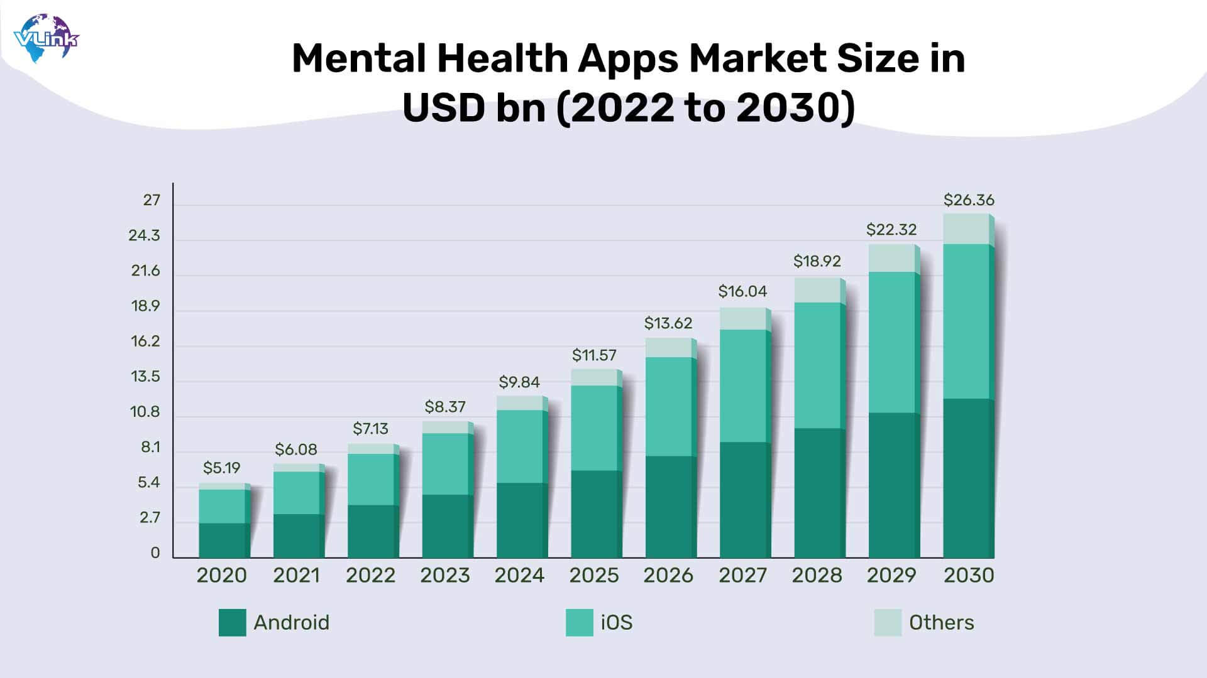
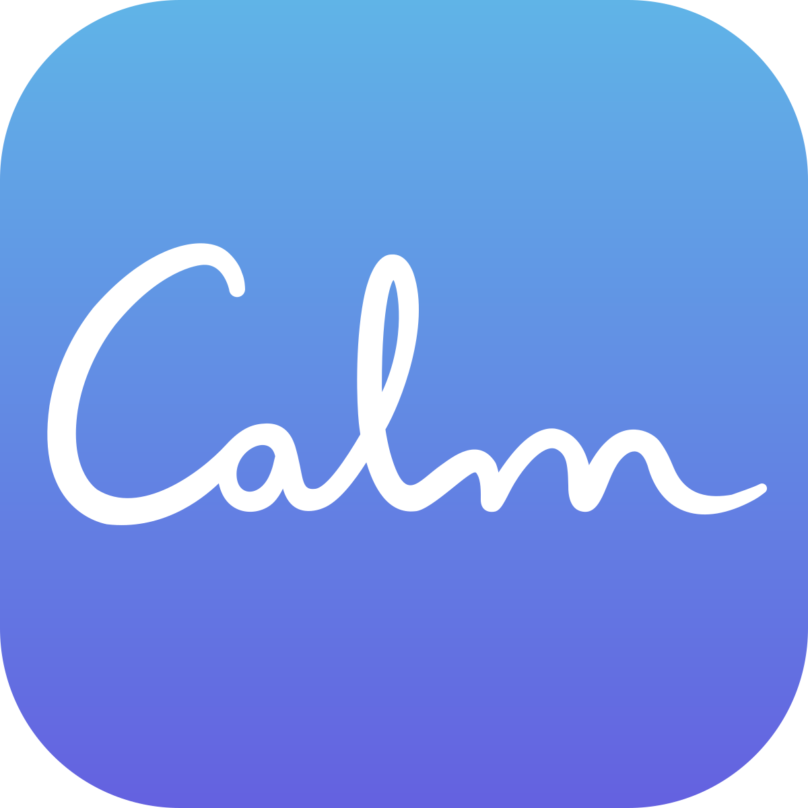
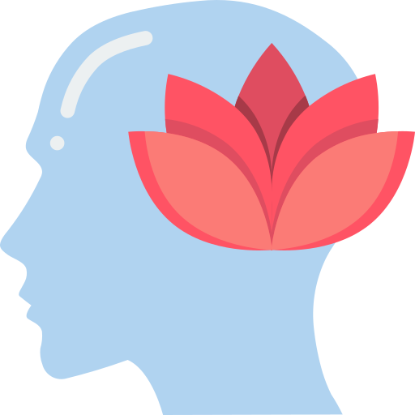
Evaluation of Calm App in Health Promotion
Background
Behaviour Change Theory – Self-Determination Theory
Anxiety, stress, along with sleep disturbance are considered a global burden. Those are known for adversely affecting the personal well-being and professional performance of millions of individuals (Alwhaibi and Al Aloola, 2023). Traditional psychological services are also known to remain inaccessible due to several factors, such as higher costs, longer waiting lists, along with stigma (Cohen et al., 2021; Wainberg et al., 2017). E-health offerings are rapidly expanding, along with presenting promising opportunities and alternatives (Löchner et al., 2025). The mental health apps market size is known to have grown from $5.19 billion in 2020 to $9.84 billion in 2024 and is projected to grow to $26.36 billion by 2030 (Patel, 2023). Calm is considered one of the leading mindfulness apps alongside sleep apps. It is known for offering various features such as guided meditations, breathing exercises, sleep stories, movement sessions, and music tracks that are mainly designed for reducing overall stress and improving the quality of sleep (Calm, 2025).
Self-Determination Theory is known for representing a wider framework for the study of human motivation, alongside personality. It is known as a formal theory, defining both intrinsic and varied extrinsic sources of motivation. The theory states that sustained behaviour change occurs when autonomy, competence, and relatedness are satisfied (SDT, 2025). Various interventions that are known for meeting such needs result in fostering intrinsic motivation and long-term adherence. Calm is known for showcasing significant strengths in supporting autonomy alongside competence. However, the app lacks overall relatedness.
Autonomy: Users are able to choose from a wide range of medications along with sleep stories and masterclasses across several categories. The categories range from anxiety to gratitude, among many more. Overall, sessions are known for ranging from long (1 hour) to short (2 minutes) (Calm, 2023). Users are also able to control overall frequency alongside goals without prescribptive schedules. This results in contrasting with directive clinical interventions, along with also align with the emphasis of SDT on self-endorsed activity.
Competence: The app is known for having a structured series. For example, it utilises “Daily Calm,” which is a mindfulness for beginners, found free on YouTube (Calm, 2016). After that, users are able to explore more. This also helps in providing a gradual difficulty progression and immediate feedback. There are also various celebratory animations alongside mastery-focused language that significantly help in improving perceived capability. This is essential due to it being an essential driver of continued practice (Li, 2024).
Relatedness: The app’s weakest area is relatedness. The app does not have an in-app community, along with live group sessions or social accountability features. Compared to Calm, its major competitors, such as Insight Timer, have such features, which proves as a greater advantage (Insight Timer, 2025). Although sharing options exist, they are external. It is essential to note that mindfulness plays an essential role in human connection, and without shared experiences, it is challenging to normalise struggles and provide emotional support (Weave the People, 2018).
(Source: Patel, 2023)
Health Promotion Values and Principles
Health promotion is known for being the process of enabling people to increase control over, and to improve their overall health (WHO, 2025). Calm is known for aligning with various core values. The app focuses on supporting autonomy, mainly by allowing users to select their preferred content along with duration and timing that suit their schedules and preferences (Calm, 2025). This helps in developing a sense of volition, compared to external pressure. The app is also able to promote self-efficacy through various structured programs, such as the “7 Days of Calm” (Huberty et al., 2019). The program includes the basics of mindfulness meditation, with brief segments that help individuals with busy schedules (Levitt, 2025). This also helps in providing transparent skill-building pathways in mindfulness alongside relaxation techniques.
However, one major concern is overall equity. The platform is known for operating on a freemium model, along with having its high-quality content being only accessible to users with an annual subscription, which is quite high (Calm, 2024). This results in developing a financial barrier for users with low income. On the other hand, the app also has a limited cultural representation as several of its narrators, alongside examples, are known for reflecting Western perspectives. This results in reducing overall relevance for diverse populations. The app also requires a reliable internet connection alongside smartphone access, despite having various free content. This results in excluding individuals with low-resource settings (Calm, 2024). It is essential to note that legitimate health promotion is known for requiring addressing such structural inequalities for ensuring that overall benefits reach even to various marginalised groups (Mamun and Alam, 2025).
Applying SDT suggests targeted Enhancements
By applying SDT, clear and evidence-informed opportunities are revealed regarding Calm for evolving from a strong autonomy into a platform that could satisfy all three above-mentioned psychological needs:
Social Features: In order to address the present relatedness challenge, the platform is recommended to introduce optional along with moderated community forums. The platform could also implement a “mindfulness buddy” matching system for connecting with other individuals with the same match. Calm could also implement live guided group meditations, scheduling according to various time zones. Such features will be able to develop a sense of belonging. It is essential to note that social support and interaction features help in predicting sustained engagement in various digital behaviour-change interventions (Saleem et al., 2021)
Personalised Pathways: By implementing machine learning and focusing on deeper personalisation, it will be possible to improve autonomy alongside competence. The app could provide adaptive pathways that will be able to recommend content-based suggestions to users, which will be based on their mood-check-ins, sleep data, and listening history. Users will also be able to accept, modify or even reject such recommendations, which will help in preserving overall volition while at the same time also enhancing perceived relevance and mastery.
Culturally Tailored Voices/Content: The app could focus on expanding narrator diversity, along with offering various medications in additional languages. It could also incorporate various contemplative traditions that are non-Western in nature. This will significantly help in improving overall Equity and cultural relatedness (Manganello and Baldacci, 2024).
Conclusion
Expected Outcome
It can be stated that Calm significantly represents a promising digital health promotion tool. It also has significantly strong foundations in both competence support and autonomy, which is also backed by various mental health benefits along with sleep benefits. However, the app has several limitations, such as its limited relatedness features along with subscription barriers and also insufficient cultural diversity. These result in restricting its overall long-term impact along with equitable reach. By applying the Self-Determination Theory, various methods are highlighted that could be utilised for improving such limitations. The app is suggested to integrate social connection elements along with implementing deep personalisation and also expand its accessible and inclusive content. A strong priority should be placed upon subsidised or free access models. The app is also suggested to integrate with various public health services, along with clinical signposting for cases that are severe in nature. However, it is essential to note that future research will require evaluating long-term outcomes alongside diverse populations to confirm whether or not the informed redesigns of SDT will be able to result in sustained real-world outcomes.
By improving autonomy alongside competence through already existing and refined features, it is expected that the app will be able to deliver improvements in sleep quality, anxiety symptoms and also perceived stress. It is also expected that long-term retention, along with depth of practice, will also be improved via improving overall relatedness, which could be accomplished via social connection tools (Holt‐Lunstad, 2024). This will help users to feel supported rather than isolated. Achieving greater cultural inclusivity, along with expanding low-cost tiers or free tiers, will also be able to improve overall equity (Bernat, 2025). This will also help in expanding the wider population reach, along with also reducing various health disparities. As per SDT, by satisfying all three psychological needs, it will be possible to transform extrinsic motivation (SDT, 2025). For example, an individual would go from “I should meditate” to “Meditation is meaningful to me, that is why I do it.” This will also result in achieving more sustainable mental health behaviour change across a diverse range of groups.
References
Alwhaibi, M. and Al Aloola, N.A. (2023). Associations between Stress, Anxiety, Depression and Sleep Quality among Healthcare Students. Journal of Clinical Medicine, [online] 12(13), p.4340. doi:https://doi.org/10.3390/jcm12134340.
Bernat, K. (2025). The Importance of Cultural Diversity and How it Impacts Advertising. [online] Ocean Media. Available at: https://www.oceanmediainc.com/cultural-diversity-advertising/ [Accessed 19 Nov. 2025].
Calm (2016). Daily Calm | 10 Minute Mindfulness Meditation | Be Present. YouTube. Available at: https://www.youtube.com/watch?v=ZToicYcHIOU [Accessed 19 Nov. 2025].
Calm (2023). Long and Short Meditations. [online] Calm Help Center. Available at: https://support.calm.com/hc/en-us/articles/360000084794-Long-and-Short-Meditations [Accessed 19 Nov. 2025].
Calm (2024). Calm - Subscription Plans. [online] www.calm.com. Available at: https://www.calm.com/freetrial/plans [Accessed 19 Nov. 2025].
Calm (2025). Calm your mind. Change your life. [online] Calm. Available at: https://www.calm.com/ [Accessed 19 Nov. 2025].
Cohen, K.A., Stiles-Shields, C., Winquist, N. and Lattie, E.G. (2021). Traditional and Nontraditional Mental Healthcare Services: Usage and Preferences Among Adolescents and Younger Adults. The Journal of Behavioral Health Services & Research, 48(4), pp.537–553. doi:https://doi.org/10.1007/s11414-020-09746-w.
Holt‐Lunstad, J. (2024). Social connection as a critical factor for mental and physical health: evidence, trends, challenges, and future implications. World Psychiatry, [online] 23(3), pp.312–332. doi:https://doi.org/10.1002/wps.21224.
Huberty, J., Green, J., Glissmann, C., Larkey, L., Puzia, M. and Lee, C. (2019). Efficacy of the Mindfulness Meditation Mobile App ‘Calm’ to Reduce Stress among College Students: Randomized Controlled Trial. JMIR mHealth and uHealth, [online] 7(6), p.e14273. doi:https://doi.org/10.2196/14273.
Insight Timer (2025). Insight Timer - #1 Free Meditation App for Sleep, Relax & More. [online] Insighttimer.com. Available at: https://insighttimer.com/hashtag/community [Accessed 19 Nov. 2025].
Levitt, T. (2025). Listen to 7 Days of Calm by Tamara Levitt. [online] @calm. Available at: https://www.calm.com/app/program/qK3IeqhiJP [Accessed 19 Nov. 2025].
Li, L. (2024). What are the Key Drivers to Promote Continuance Intention of Undergraduates in Mobile Learning? A Multi-perspective Framework. Sage Open, 14(4). doi:https://doi.org/10.1177/21582440241280656.
Löchner, J., Carlbring, P., Schuller, B., Torous, J. and Sander, L. (2025). Digital interventions in mental health: An overview and future perspectives. Internet Interventions, [online] 40(100824), p.100824. doi:https://doi.org/10.1016/j.invent.2025.100824.
Mamun, A.A. and Alam, M. (2025). Promoting Equity in Public Health: Addressing Inequality and Social Disparities. Health science reports, [online] 8(5), p.e70821. doi:https://doi.org/10.1002/hsr2.70821.
Manganello, F. and Baldacci, M. (2024). Digital Stories and Inclusive Cultures at School: A Research Study in an Italian Primary Multicultural Classroom. Education Sciences, 14(10), p.1108. doi:https://doi.org/10.3390/educsci14101108.
Patel, S. (2023). 7 Trending Mental Health App Ideas for Startups. [online] VLink. Available at: https://vlinkinfo.com/blog/trending-mental-health-app-ideas-for-startups [Accessed 19 Nov. 2025].
Saleem, M., Kühne, L., De Santis, K.K., Brand, T. and Busse, H. (2021). Understanding Engagement Strategies in Digital Interventions for Mental Health Promotion: A Scoping Review (Preprint). JMIR Mental Health, 8(12). doi:https://doi.org/10.2196/30000.
SDT (2025). Self-Determination Theory. [online] Selfdeterminationtheory.org. Available at: https://selfdeterminationtheory.org/theory/ [Accessed 19 Nov. 2025].
Wainberg, M.L., Scorza, P., Shultz, J.M., Helpman, L., Mootz, J.J., Johnson, K.A., Neria, Y., Bradford, J.-M.E., Oquendo, M.A. and Arbuckle, M.R. (2017). Challenges and Opportunities in Global Mental Health: a Research-to-Practice Perspective. Current Psychiatry Reports, [online] 19(5). doi:https://doi.org/10.1007/s11920-017-0780-z.
Weave the People (2018). How Mindfulness Helps Us Connect - Weave The People. [online] Weave The People. Available at: https://weavethepeople.com/wisdomposts/mindfulness-helps-us-connect/ [Accessed 19 Nov. 2025].
WHO (2025). Health Promotion. [online] World Health Organization. Available at: https://www.who.int/health-topics/health-promotion#tab=tab_1 [Accessed 19 Nov. 2025].

