Slide 1
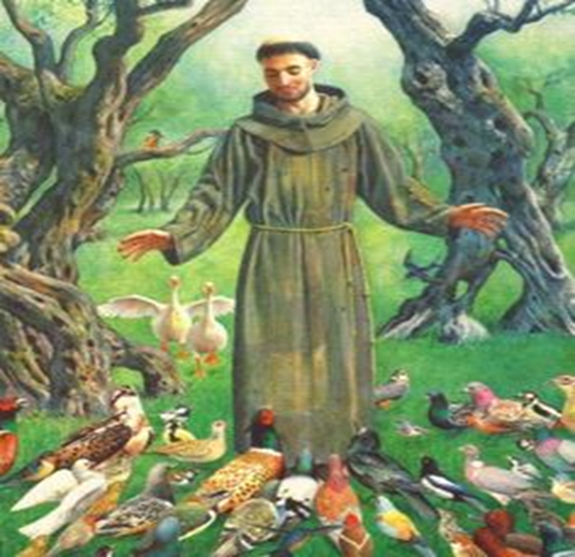
The ecological legacy and relevance of St Francis of Assisi Today
Cameron Watson 1604872
What can the example of St Francis of Assisi teach us about the environment?

Slide 2
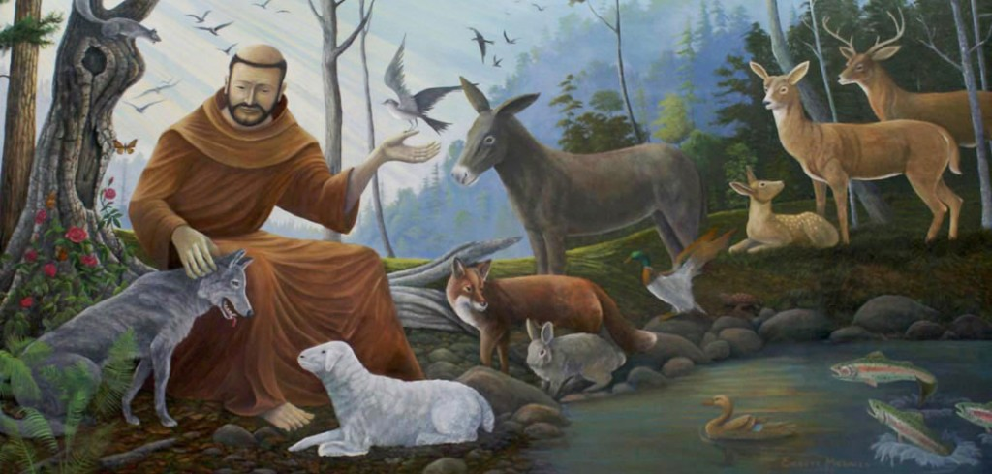
Who was St Francis?

Slide 3
What is a Saint?
“Saints are not freaks or exceptions. They are the standard operating model for human beings.” “A saint is a friend and lover of the world.” “A saint conquers himself. “ “A saint embraces heroic suffering out of heroic love. A saint also embraces heroic joy” Charles Peguy put it, "life holds only one tragedy, ultimately: not to have been a saint.“ Peter Kreeft, Ph.D, professor of philosophy at Boston College.
Saint, holy person, believed to have a special relationship to the sacred as well as moral perfection or exceptional teaching abilities.
To be canonized one must have demonstrated great joy in life.

Slide 4
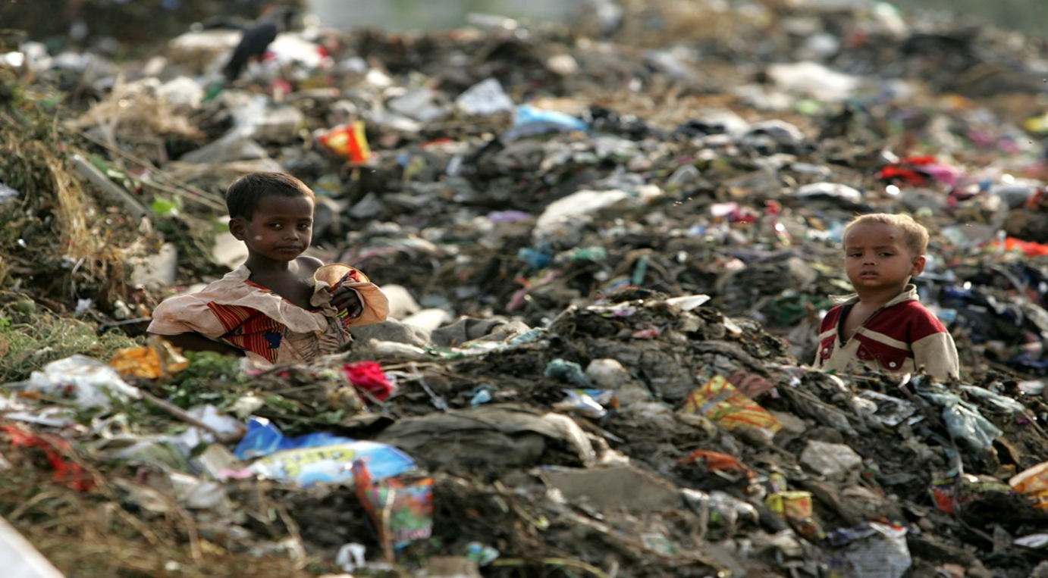
The Environment
How did we get to this?
Climate change/pollution/deforestation

Slide 5
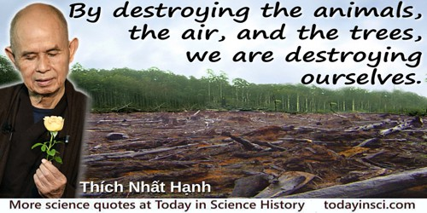
Is this quote True?

Slide 6
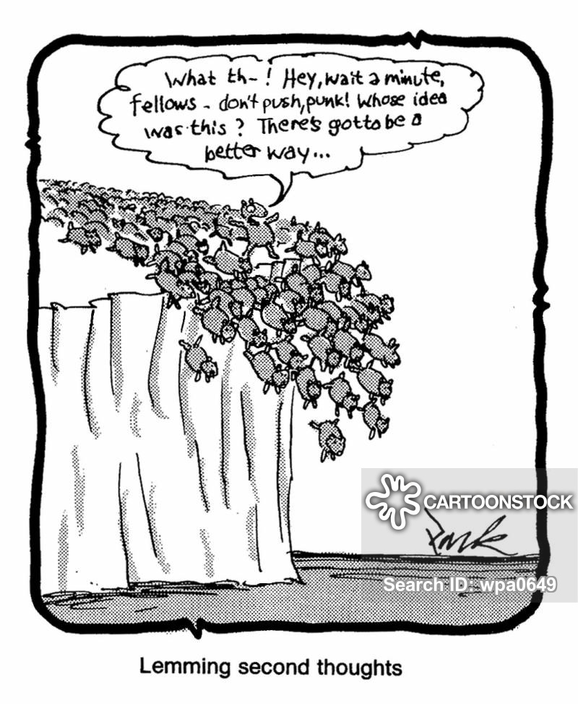

We seem to be doing this

Slide 7
Back ground and context
Modern environmental movement began in the 1970s in the UK
We are facing possible annihilation through rapid use of resources, climate change, pollution, species extinction.
We need to find a way through and to see if St Francis’s example has anything to offer by way of guidance

Slide 8
Why should we look back 1000 years to a Monk for environmental guidance?
Is it just a desperate attempt by Christianity to appear green?
What could we possibly learn from someone from an entirely different context
What about non-Christians? Might be a turn off.
“Praise to you, O Lord, and all blessing,. We give you thanks and serve you with great humility.” The Canticle of the Creatures. Not everyone wants to serve a divine being that they cannot see.
We could argue fine points and controversies, views and opinions forever, but what is actually helpful.

Slide 9
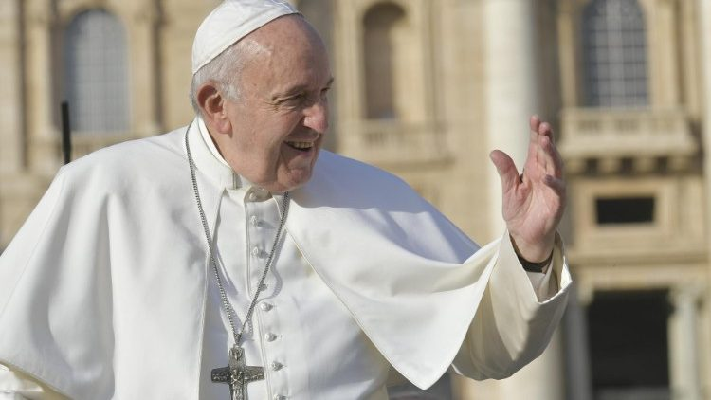
Christians use St Francis as an environmental role model
The Current Pope Francis put out the first Environmental encyclical in 2015. With 1.2 billion Catholics that’s a big influence. He said quote…“As stewards of God’s creation, we are called to make the earth a beautiful garden for the human family. When we destroy our forests, ravage our soil and pollute our seas, we betray that noble calling.” —Speech, Manila, Philippines, January 18, 2015
In 1979 Pope John II make him patron St of Ecology.
The Green bible likes to use St Francis to shore up its weak attempt at greening the Bible.
St Francis is very famous and popular.

Slide 10
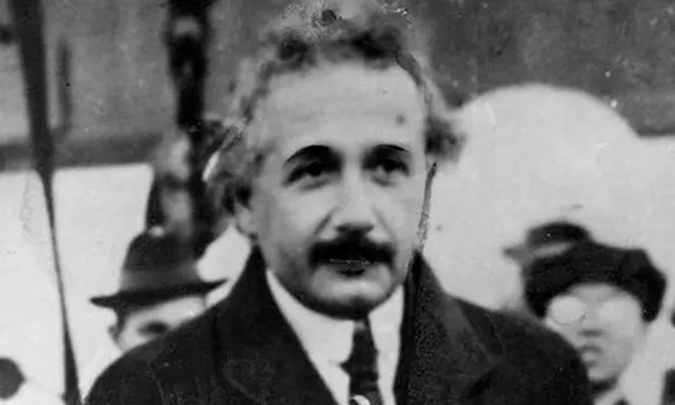
So what are we to do and can St Francis help?
“We cannot solve our problems with the same level of thinking that created them” Einstein
How do we get to that higher level of thinking?
Wisdom is the use of one’s intelligence and experience as mediated by values toward the achievement of a common good. Sternberg
Wisdom – the capacity to act appropriately on knowledge, information and experience.

Slide 11
Is it True?
The planet is being destroyed which means we are destroying ourselves?
Is it true that what Einstein says?
The saint is not a freak of nature, but we are all capable of such love and wisdom?

Slide 12
Legacy
St Francis legacy is that he proved that it is possible to love and care that much for the environment and we can aspire to do the same.
His joy derived inwardly (by whatever means) rather than outwardly means he is not looking to use the worlds resources for pleasure and comfort. Contentment / peace
His vow of poverty means he consumed minimally that is a good example.
Question is, how to make that change to a higher level of thinking, being that embodies the wisdom capable of having a significant effect. St Francis found his way through Christianity.
There are other ways to do this and it remains likely unless we too evolve to higher levels of being, saving this beautiful planet from our actions is some way off.

Slide 13
References
References
Armstrong, E, A, St Francis: Nature Mystic (Berkely California: University of Califronia Press Ltd, 1976)
Kreeft, Peter, ‘What Is a Saint?’, National Catholic Register, 1987 <https://www.catholiceducation.org/en/culture/catholic-contributions/what-is-a-saint.html> [accessed 24 January 2020]
Pew Research Center <https://www.pewresearch.org/fact-tank/2017/04/05/christians-remain-worlds-largest-religious-group-but-they-are-declining-in-europe/> [accessed 30 January 2020]
Pew Research Center’s Religion & Public Life Project, 2013 <https://www.pewforum.org/2013/02/13/the-global-catholic-population/> [accessed 30 January 2020]
Pappas, W, ‘The Patron Saint of Animals and Ecology’, Earth Day, 2016 <https://www.earthday.org/patron-saint-animals-ecology/> [accessed 27 January 2020]
Prendiville, Brendan, ‘British Environmentalism : A Party in Movement ?’, Revue LISA/LISA e-Journal. Littératures, Histoire Des Idées, Images, Sociétés Du Monde Anglophone – Literature, History of Ideas, Images and Societies of the English-Speaking World, vol. XII-n°8, 2014 <https://doi.org/10.4000/lisa.7119>
‘Saint’, Encyclopedia Britannica <https://www.britannica.com/topic/saint> [accessed 24 January 2020]
Salinas, Taryn, ‘Nature Never Forgives: 7 of Pope Francis’s Greenest Quotes’, National Geographic News, 2015 <https://www.nationalgeographic.com/news/2015/09/120150920-pope-francis-environment-climate-quotes/> [accessed 28 January 2020]
Sternberg, Robert J., ‘What Is Wisdom and How Can We Develop It?’, The ANNALS of the American Academy of Political and Social Science, 591.1 (2004), 164–74 <https://doi.org/10.1177/0002716203260097>
Sweeney, J, M, St Framcis of Assisi - The Essential Writings (Paraclete Press, 2013)
The Green Bible: A Priceless Message That Doesn’t Cost the Earth (Collins, 2008)
White, Lynn, ‘The Historical Roots of Our Ecologic Crisis’, Science, New Series, 155.3767 (1967), 1203–7

