Slide 1
Module Title: Introduction to Leadership and Management
Module Code: LCBB4015
Assignment Title: Component 1
Practical Group Presentation
Student Name & Student ID Number:
Muhammad Touseef - 2319373
Adrian Merisan - 2226309
Mehnaz Salim - 2319371
Lecturer’s Name: Roopa Aruvanahalli Nagaraju

Slide 2

Introduction
By creating computer software, personal computers, mobile tablets, smartphones, and computer accessories, Apple Inc., an American multinational corporation, transformed the technology industry.
One of the most well-known companies in the world, Apple was the first to introduce the graphical user interface (GUI) to the public and to produce the first commercially successful personal computer.
Apple, which was founded in 1976 by Steve Jobs and Steve Wozniak, established new standards for multiproduct integration, user-centric functionality, design and aesthetics, and product innovation. Apple revolutionised the capabilities of contemporary computing. By creating a marketplace ecosystem for independent application developers, Apple further revolutionised the market and used this emerging market to boost its market share and add new features to its devices. Cupertino, California is home to the company's headquarters.
• The five essential management functions of organising, planning, commanding, coordinating, and controlling were introduced by Henri Fayol (1841–1925). Modern management theory is based on these ideas.
• Apple Inc. a leader in innovation and technology worldwide, makes a perfect case study for examining Fayol's traditional management concepts in a contemporary setting.

Slide 3
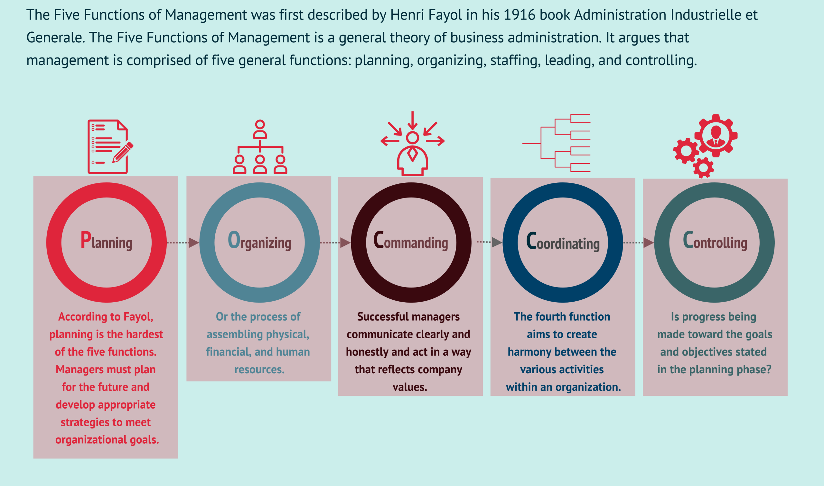
Henri Fayol’s Management Functions

Slide 4
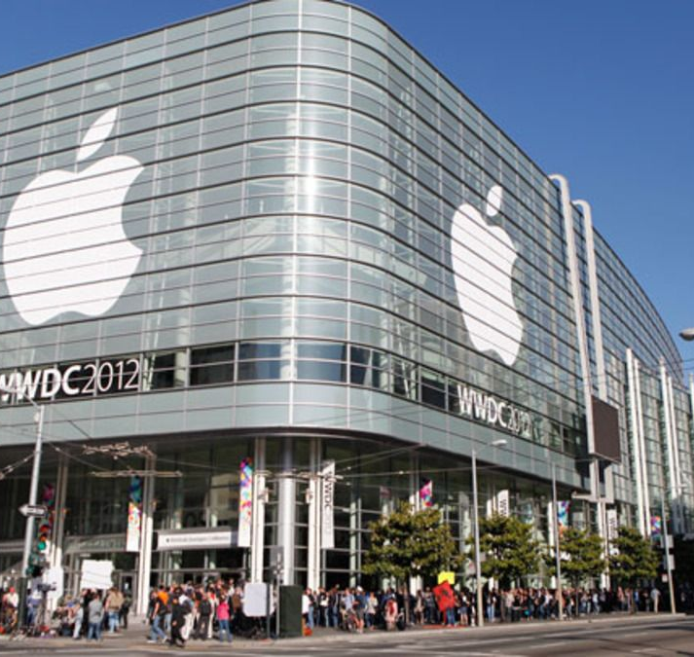
Why Planning at Apple Inc.
• According to Fayol, planning entails goal-setting and foresight.
• Innovation, product development, and sustainability are the main focusses of Apple's strategic planning.
• Managers match Apple's long-term vision with departmental goals.
• For instance, yearly planning for R&D expenditures and the introduction of new iPhone models.
(Bedeian, 2002; Pryor & Taneja, 2010)

Slide 5

Why Organising at Apple Inc.
• Fayol placed a strong emphasis on developing a framework for efficient resource allocation.
• Innovation and competence are supported by Apple's well-functioning organisational structure.
• Product lines (e.g., Mac, iPhone, Services) are used to group teams.
• Effective decision-making and accountability are made possible by distinct lines of power.
(Jones and George, 2021; Edwards, 2019)

Slide 6
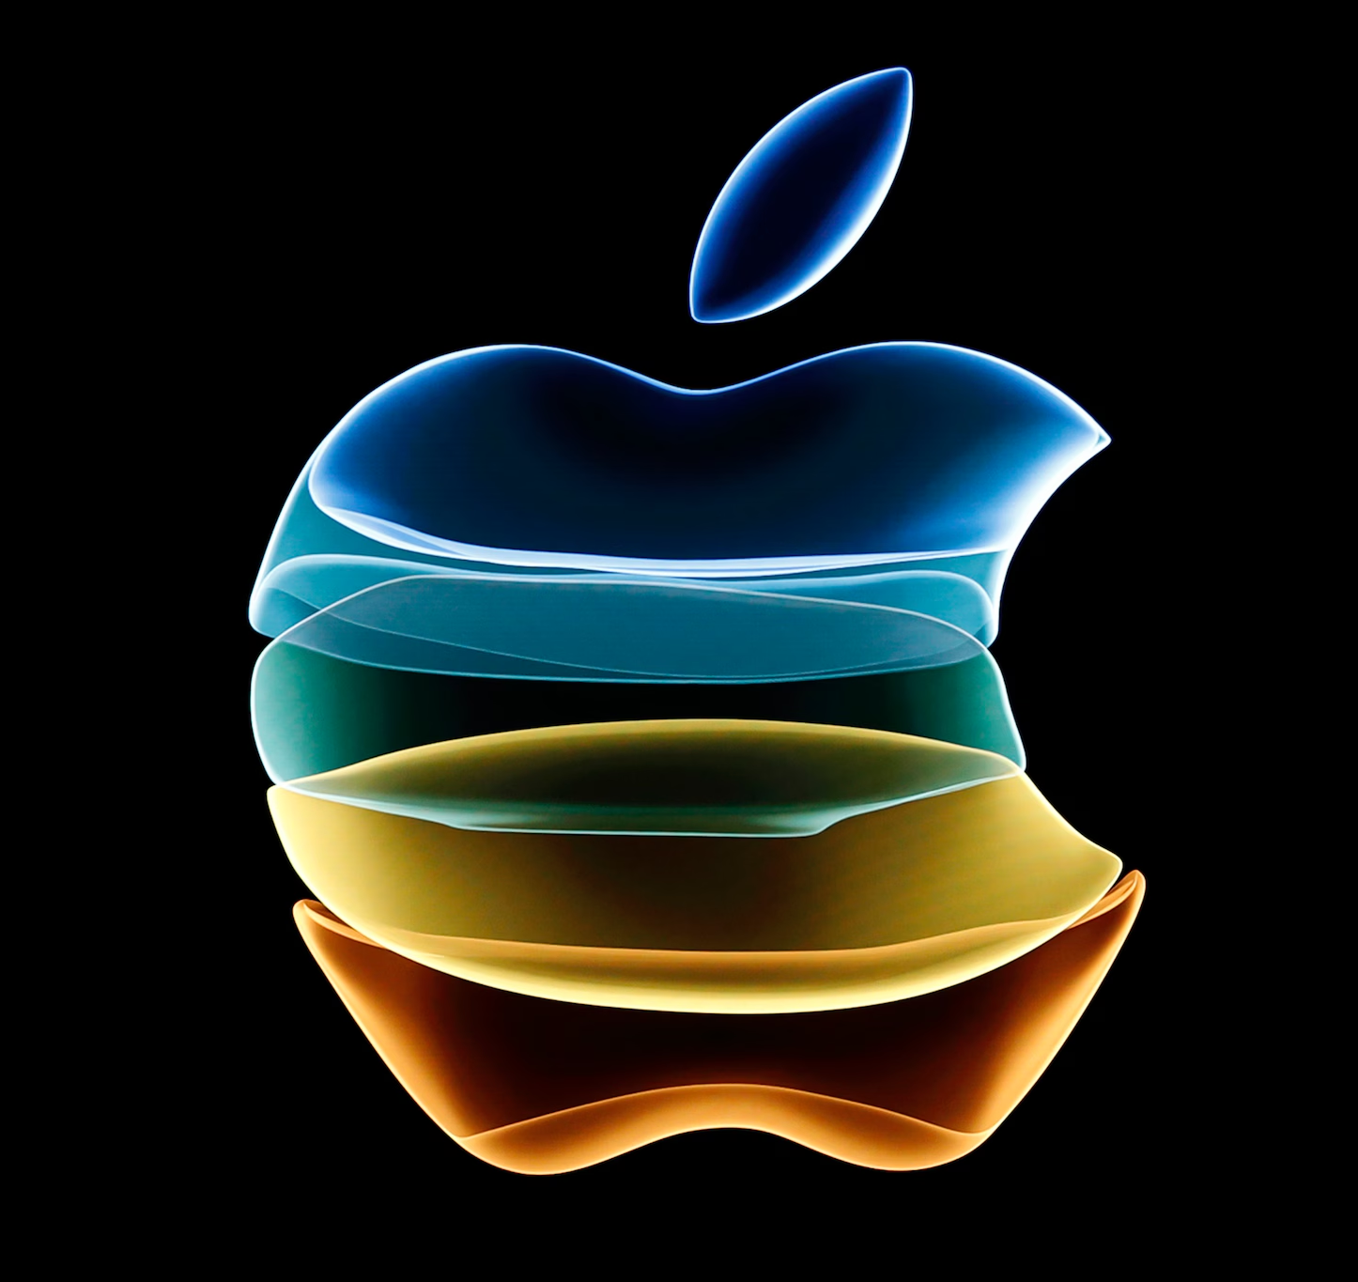
Why Leading and Commanding at Apple Inc.
• According to Fayol, leadership is about inspiring and guiding staff members.
• Tim Cook and other Apple executives motivate others with their vision and transformative leadership.
• A focus on excellence, teamwork, and creativity.
• Innovation is fuelled by leadership, which keeps Apple ahead of the competition.
(From Fayol's Mechanistic to Organic Functions, 2014; Pryor & Taneja, 2010)

Slide 7

Why Coordinating at Apple Inc.
• Coordination guarantees the smooth operation of many departments.
• Apple launches integrated products using cross-functional teams (marketing, design, and engineering).
Across all operations, synergy is fostered by effective internal communication.
• One example is the smooth coordination of international product launches.
Jones and George (2021) and Bedeian (2002)

Slide 8
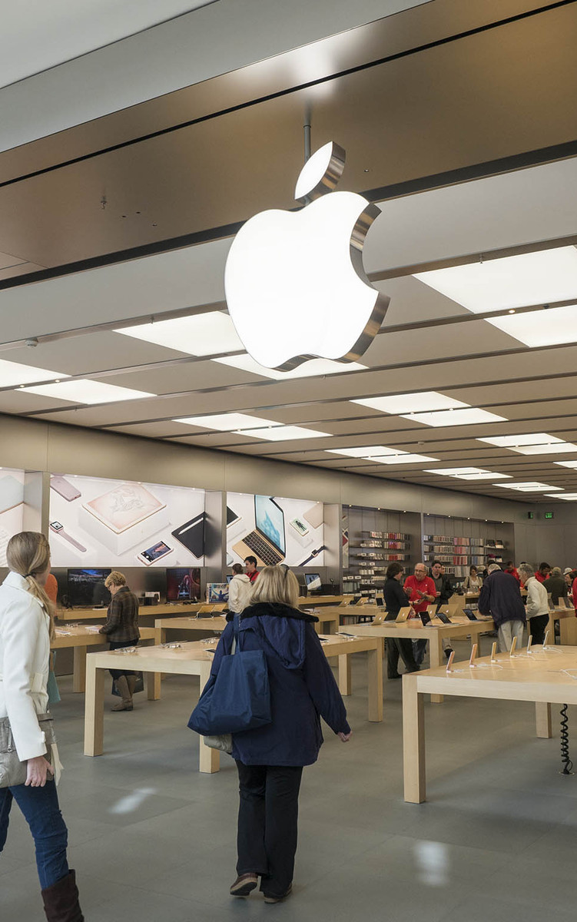
Why Controlling at Apple Inc.
• According to Fayol, control entails keeping an eye on performance and putting remedial measures in place.
• The management of Apple keeps an eye on consumer satisfaction, financial performance, and product quality.
KPIs and performance dashboards guarantee accountability.
• A culture of constant improvement fosters excellence.
(Badeian, 2002; Edwards, 2019)

Slide 9
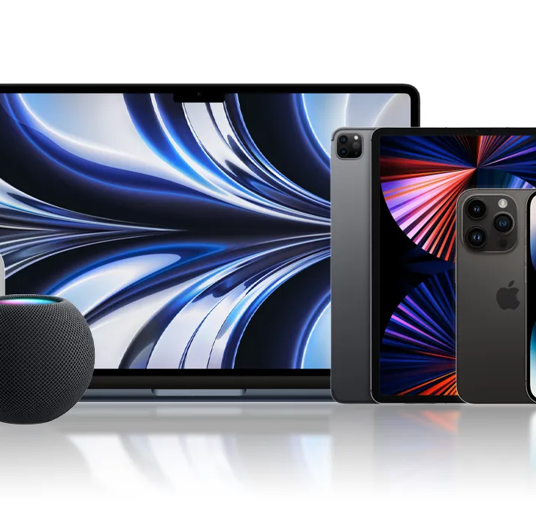
Interrelation of Fayol’s Functions
• Fayol's functions are cyclical and interrelated.
• Planning directs organisation; control and leadership guarantee that plans are carried out successfully.
• This interdependence promotes alignment and flexibility at Apple.
• As an illustration, future planning is informed by market input (control).

Slide 10

Relevance in Today’s Business Environment
• Fayol's functions are cyclical and interrelated.
• Planning directs organisation; control and leadership guarantee that plans are carried out successfully.
• This interdependence promotes alignment and flexibility at Apple.
• As an illustration, future planning is informed by market input (control).

Slide 11

Key Managering Skills for Apple Managers
• Strategic thinking and foresight.
• Emotional intelligence and leadership.
• Technological literacy and data-driven decision-making.
• Change management and adaptability.
• Ethical leadership and sustainability awareness.
(Emerald Insight, 2023; Edwards, 2019)

Slide 12
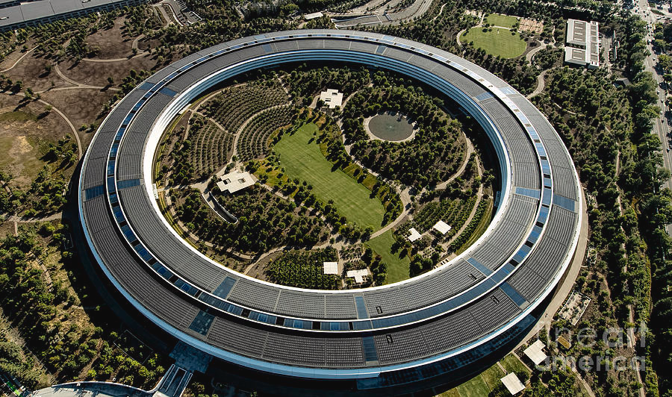
Conclusion
To sum up, Henri Fayol's five fundamental management tasks and organizing, planning, commanding, coordinating, and controlling remain a crucial cornerstone of successful management in the contemporary business environment. Even though these ideas were created more than a century ago, they are still relevant and applicable today when looking at multinational corporations like Apple Inc.
Fayol's traditional ideas may be modified to satisfy the needs of a technologically advanced, fast-paced world, as Apple's success story illustrates. Apple makes sure that sustainability and innovation are at the forefront of its long-term strategic strategy by carefully planning.
The companies clearly defined organizational structure encourages accountability amongst various product teams and permits effective resource allocation. In terms of commanding and leadership, Tim Cook, and other Apple executives exemplify transformational leadership by inspiring staff to attain greatness and cultivating a collaborative and innovative culture.

Slide 13
References
Bedeian, A. G. (2002) ‘The foundations of Henri Fayol’s administrative theory’, Management Decision , 40(9), pp. 906–918.
Edwards, R. (2019) ‘An Elaboration of the Administrative Theory of the 14 Principles of Management by Henri Fayol’, International Journal of Educational and Economic Research , 3(2), pp. 41‑51.
Pryor, M. G. and Taneja, S. (2010) ‘Henri Fayol, practitioner and theoretician – revered and reviled’, Journal of Management History , 16(4), pp. 489–503.
‘From Fayol’s Mechanistic to Today’s Organic Functions of Management’ (2014), ERIC
‘A Case Study of Fayol’s Principles’ (2023), Emerald Insight
‘What Henri Fayol Couldn’t Know’ (2023), ScienceDirect
Levy, S. and Montevirgen, K. (2025, October 12). Apple Inc.. Encyclopedia Britannica. https://www.britannica.com/money/Apple-Inc

Slide 14
THANK YOU FOR LISTENING

