Slide 1
Problem Solving and Decision Making
LCLM4004_LON
Viktoria Vlokh
Student ID: 2534078
Lecturer: Charles Obinwa
Assignment 1: Presentation

Slide 2
OVERVIEW
Indroduction
Company background
Nature and scope of the problem
5W2H analysis
PESTLE analysis
Fishdome diagram
Key findings
References

Slide 3
Introduction
What is this presentation about?
This presentation analyses Basil’s Bakery and the reason why its sales have stopped growing.
Business analysis tools:
5W2H
PESTLE Analysis
Fishbone Diagram

Slide 4
Company background
Basil’s Bakery:
Founded in 2015
Owned by artisan baker Basil
Sells organic cakes, pastries and bread
Sales increased until 2019 but are now around 25% lower than before COVID-19

Slide 5
Problem: nature and scope
What?
Sales down by 25%
Why?
Less customers
Higher costs
Who?
Basil & customers
Where?
Covetry retail park
When?
Since COVID-19 (2020-2025)
How?
Lower footfall
No delivery service
How much?
Sales remain 25% below 2019

Slide 6
PESTLE ANALYSIS: Basil’s Bakery
Political
Food safety regulations must be followed.
Business rates and government policies increase operating costs.
Economic
Inflation has increased ingredient prices.
Higher ret, energy bills and insurance reduce profit.
Social
More people work from home.
Customers want convenient services such as delivery and online ordering.

Slide 7
PESTLE ANALYSIS: Basil’s Bakery
Technological
No online ordering system.
No delivery service or mobile app.
Legal
Must follow food hygiene regulations.
Must follow employment and health & safety laws.
Enviromental
Organic ingredients are affected by poor harvests.
Climate conditions make supply and prices unpredictable.

Slide 8
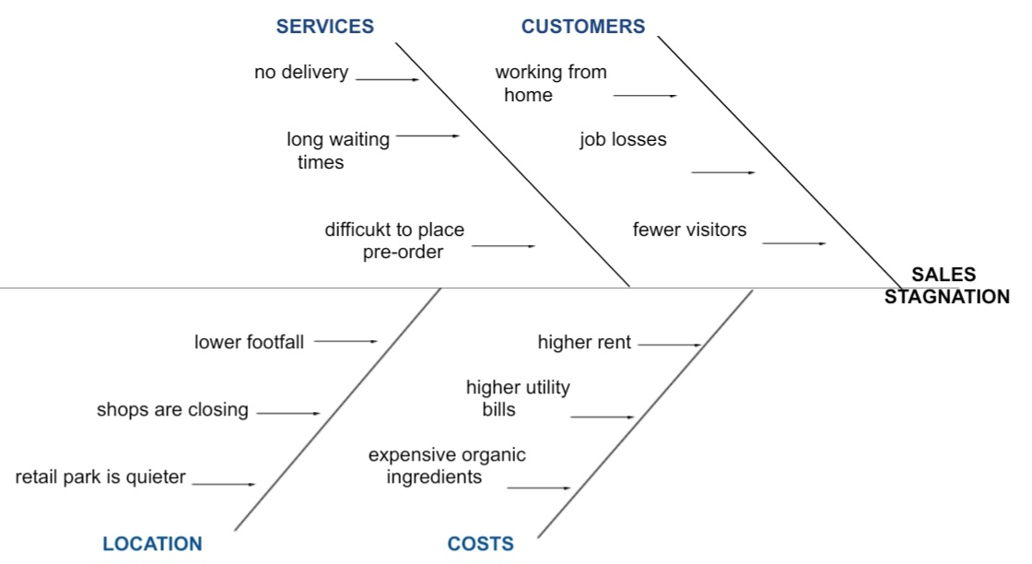
Cause and effect analysis (Fishbone diagram)

Slide 9
Conclusion (Key Findings)
Sales have remained below pre-pandemic levels.
Customer behaviour has changed after COVID-19.
Rising costs reduce profitability.
Lack of delivery and online ordering limits sales.
Introducing digital services and improving customers convenience could help increase revenue.

Slide 10
References
Baines, P., Fill, C. and Rosengren, S. (2022) Marketing. Oxford: Oxford University Press.
University of Wales Trinity Saint David (2026). Basil’s Bakery Case Study. Available on: UWTSD Moodle. (Accessed: 12 July 2026).
University of Wales Trinity Saint David (2026). Fishbone Diagram Lecture Notes. Module materials. Available on: UWTSD Moodle. (Accessed: 12 July 2026).
Mind Tools (2024) PESTLE Analysis. Available at: http://www.mindtools.com (Accessed: 12 July 2026).
Mind Tools (2024) 5W2H Analysis. Available at: http://www.mindtools.com (Accessed 12 July 2026).

Slide 11

Questions

