Slide 1


Business Manager
Andrea Mohai 2111480
Module code : BMSW4001
Lecturer – Sylvia Hoffmann

Slide 2
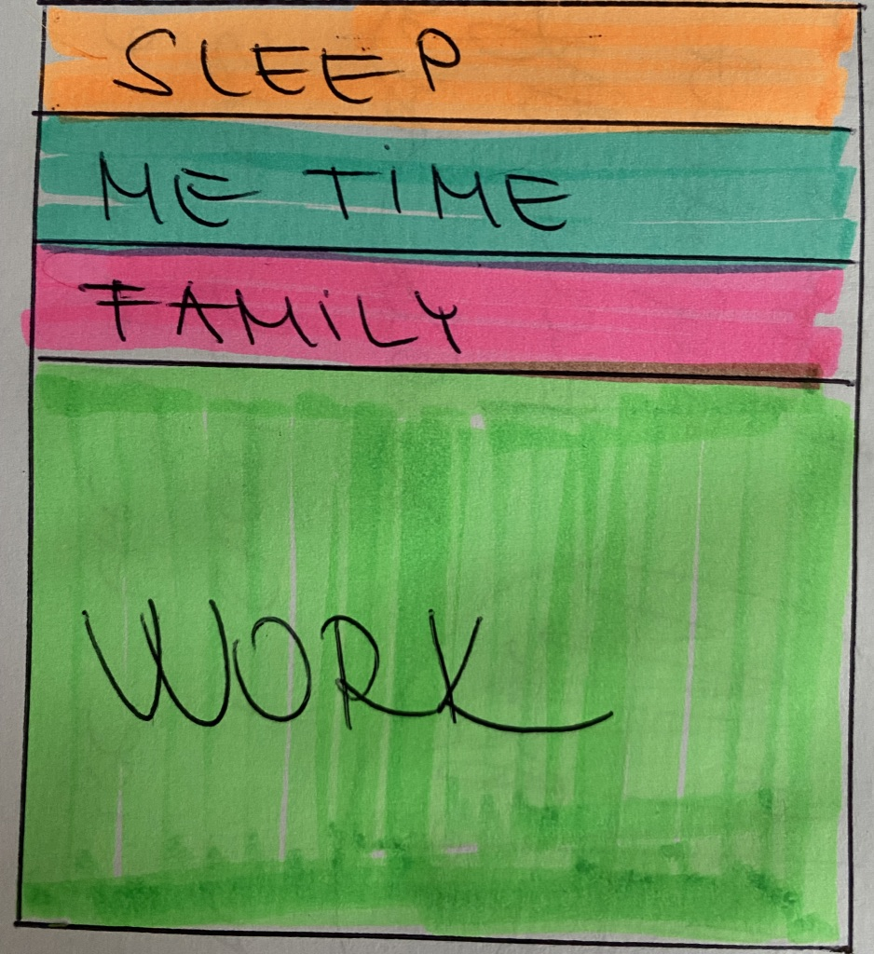
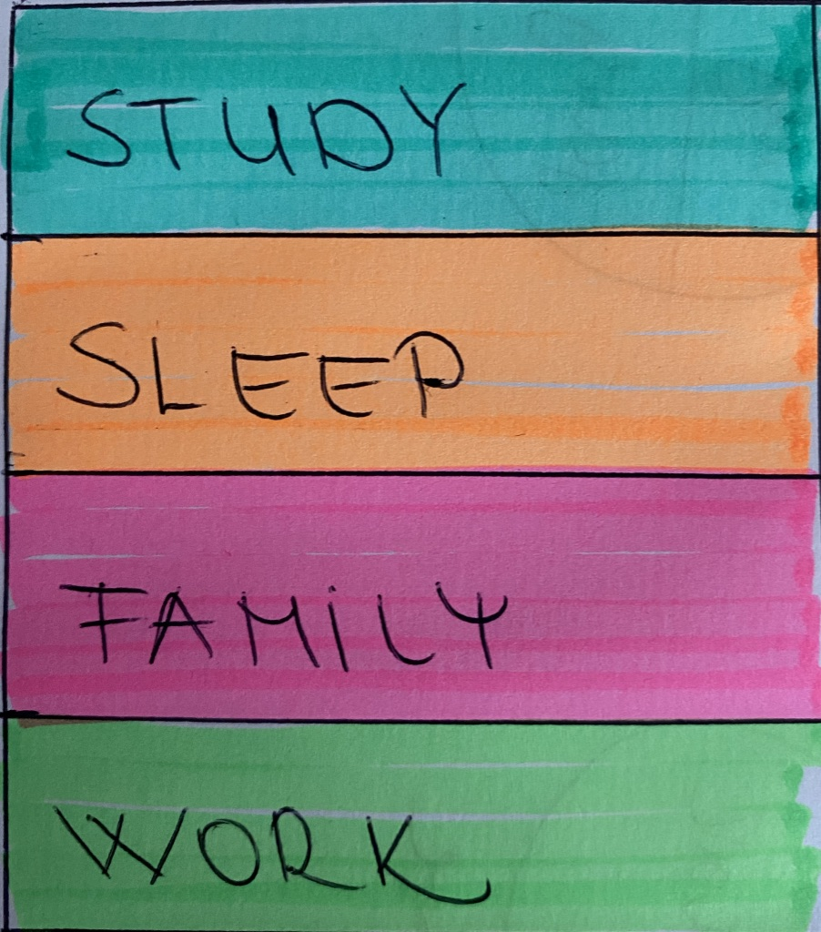
Time Management
Before
-I haven't used my time efficiently
- never used any time
Management tools
-haven't tracked &
monitored my result
Now/ Future
-Effective time management by keeping track
-daily/weekly/monthly to do list
-prioritise

Slide 3
SWOT ANALYSIS
STRENGHTS -POSITIVE -PATIENT -HONEST -RESPONSIBLE | OPPORTUNITIES -IMPROVE MY SPEAKING SKILLS -IMPROVE MY BUSINESS
WEAKNESSES - VERY SHY AND NERVOUS -SPEAKING SKILL IS NOT GOOD -PUBLIC SPEAKING | THREATS -MY AGE -MY POOR ENGLISH -I HAVE FAMILY ( BUSY MUM)
-HELPFUL
HARMFUL

Slide 4

PERSONAL DEVELOP PLAN
Where you are to where you want to be
CREATING PLAN
CURRENT POSITION
GOALS

Slide 5
REFERNCES
Cottrell, S., 2015. Skills for success : personal development and employability, London: Macmillan Education UK.
Cottrell, S., 2017. Critical thinking skills : effective analysis, argument and reflection, London: Palgrave Macmillan.
Bradbury, A., 2006. Successful presentation skills, London: Kogan Page.
Richard Pears, G. S., 2019. Cite them right: the essential referencing guide, London: Red Globe Press /Macmillan International Higher E.

