Slide 1
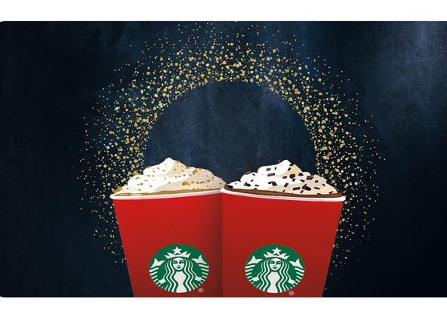
Starbucks

Slide 2
Strengths and weaknesses
Well-known brand with a reputation for quality and customer service.
Global presence with thousands of locations worldwide.
Diverse product offerings catering to various preferences.
Commitment to sustainability and ethical practices.
Sales decline in some markets due to potential market saturation or changing consumer preferences.
Premium pricing may deter budget-conscious consumers
Heavy reliance on physical stores.

Slide 3
Opportunities and threats
Expand digital presence to meet demand for convenience and accessibility.
Diversify product offerings to align with evolving consumer preferences.
For strategic partnerships to drive innovation and tap into new customer segments.
Intense competition in the coffee and beverage industry.
Economic instability affecting consumer spending on premium products.
Changing consumer tastes requiring product and marketing strategy adaptations.

