Slide 1
JL Knowledge Management
Key of an organisation

Slide 2
Benefit from Knowledge Management on John Lewis
Sharing Knowledge, profit and power
Increasing customers satisfaction
Providing outstanding services
Happy employees and happy customers

Slide 3
Drawbacks from Knowledge Management
Give to information to your competitors
Lose your customer
Difficult to decision making

Slide 4
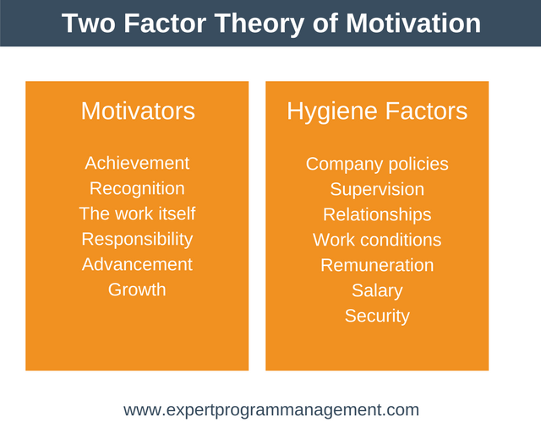
Motivation
John Lewis applying Herzberg Two motivation factor theory

Slide 5
Further development in required in terms of motivation
Flexible hour
Need to perfect in a one role
Management need to be friendly
Need to redundancy old stakeholders
Seven day trading
Not performance related pay

Slide 6
Further development required in terms of others
Focus on online businesses
Market trend
Think about brand

Slide 7
Recommendations
Size of the physical store need to make a smaller
Invest more on online
Customer like to visit physical store when goods are not access online thus physical store should sale focus on goods which is not available online
Need to watch global market
Need to change old supplier
No need to focus on little things
Flexible hour

