Slide 1
Digital Transformation in the Health and Care Professions (BMHP6026)
Component 2 Assessment
Student name: Larry Osei Kofi
Student ID: 2308809

Slide 2
AI USE Acknowledgement
I hereby attest that I have not utilised any artificial intelligence systems in the course of my research and preparation for this exercise. I hereby attest that I have not submitted any artificial intelligence-generated materials as my work. I hereby attest that I have access to copies of my drafts and other materials that I utilised for this work.

Slide 3

overview
Introduction
Impact On Workforce
Impact On Service Delivery
Impact On Patients
Impact On Community
Challenges Of The Innovation
Recommendations
Conclusion
References

Slide 4
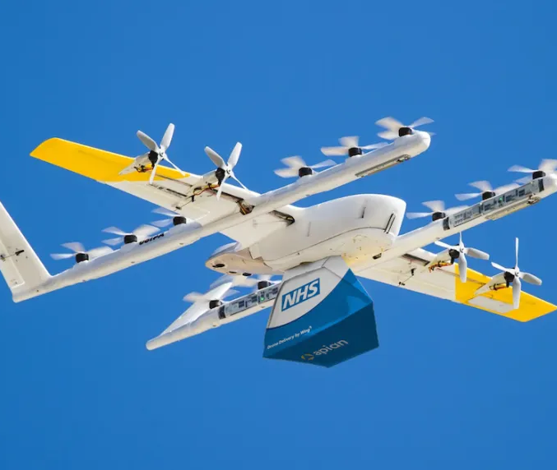
Introduction
(Eddy, 2024)
This presentation will examine the concept of medical delivery drones in the United Kingdom healthcare environment with a focus on the ‘NHS Apian Wing Drone’ project.
The purpose is to enhance the rate of blood sample, medicine, pathology supplies, and smaller medical item transportation (Guy's and St Thomas' NHS Foundation Trust, 2024)

Slide 5
A Brief Video
https://www.youtube.com/watch?v=iXY7e5wnSh8

Slide 6

Impact on Workforce
It has brought a collaboration between different sectors (Sollof, 2024).
Increases the efficiency of lab workflow due to the faster turnaround times of the samples in the lab.
Requires new skill sets in monitoring and tracking drones and handling data therefore has introduced New technology posts in NHS trusts. (Apian, 2025).

Slide 7

Impact on service delivery
It significantly reduces the delivery times of pathology specimens, emergency drugs, and small equipment (NHS Blood and Transplant, 2024).
Assists with service delivery in remote areas (Porter, Cherrett and Oakey, 2025).
Promotes teamwork among the hospital, lab, and pharmacy staff.
(Health Tech, 2024)

Slide 8

Impact on patients
It enables faster delivery of the sample for diagnosis and treatment purposes (Ioanna Lykiardopoulou, 2024) .
Reduces wait times for required medications and lab work, especially in urgent care settings (User, 2025)
It reduces treatment disruptions due to reliable supply chains (User, 2025)
(Guy's and St Thomas' NHS Foundation Trust, 2024)

Slide 9

Impact on community
Helps in decreasing road traffic and overall carbon emissions, thereby promoting sustainable living (Guy's and St Thomas' NHS Foundation Trust, 2025).
Supports families and carers by providing care continuity.
Assists in promoting the confidence in digital transformation within the local community (Stierlin, Risch and Risch, 2024)

Slide 10
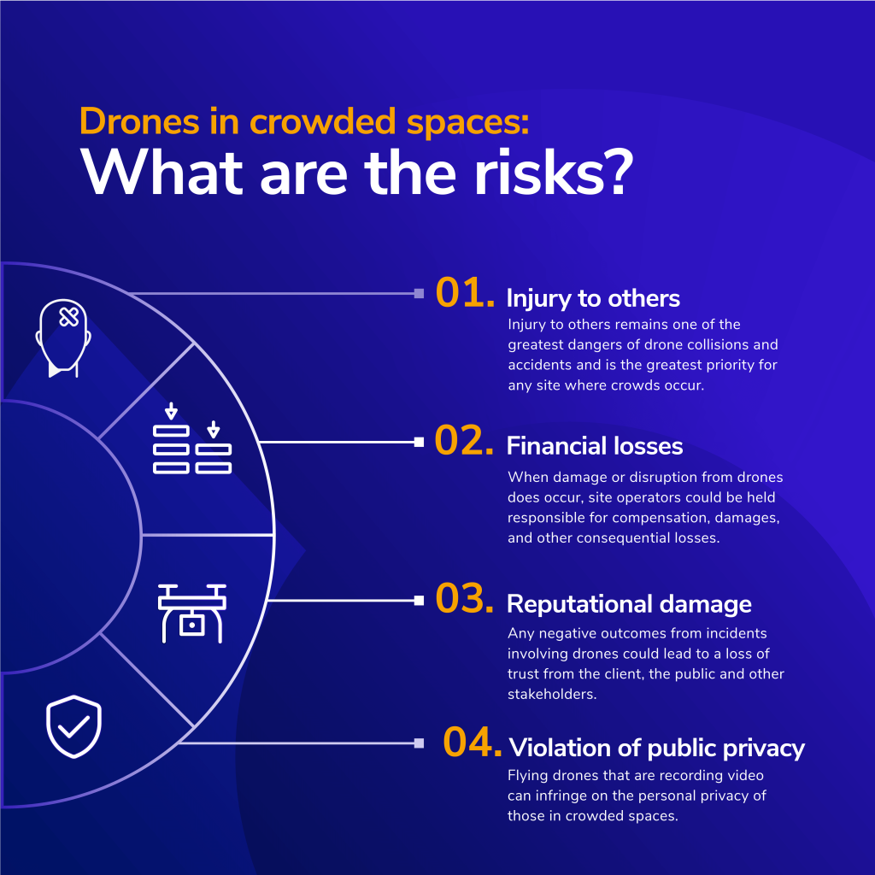
Challenges of the innovation
High start-up costs related to drone technology and expertise (Julián Estévez, 2020).
Other climate factors may include strong wind/storms, which can postpone a flight (Julián Estévez, 2020).
Carrying capacity is small; it is meant for use with light equipment only.
Generic concern about the impact of environmental noise and other safety considerations (King, 2025).
(Operational Solutions Ltd, 2023)

Slide 11

Recommendations
Increase usage of drones in NHS operations because drones are capable of delivering medical samples and medicines much faster compared to road transport (Apian London, 2019)
Safety and flight regulations followed (Porter, Cherrett and Oakey, 2025).
NHS staff should be trained on the use of the drone system (Clarke, 2022)
(kari, 2016)

Slide 12
Conclusion
The NHS Apian Wing Drone is a revolutionary advancement in the healthcare sector in the UK.
Although some limitations may be associated with these technologies, including cost and legal complexities, the potential offered by these tools is immense in terms of benefits for patients, services, and society.
With continuous development investment, these drone delivery services may be mainstreamed within the NHS setup.

Slide 13
References
Apian (2025) Apian. Available at: https://www.apian.health (Accessed: 29 November 2025).
Apian London (2019) Apian. Available at: https://www.apian.health/london (Accessed: 1 December 2025).
Clarke, O. (2022) Using Drones in Health and Safety Inspections. Available at: https://www.osborneclarke.com/insights/using-drones-health-and-safety-inspections (Accessed: 1 December 2025).
Eddy, N. (2024) NHS Partners with Alphabet’s Wing, Apian for Drone Blood Sample Delivery. Available at: https://www.mobihealthnews.com/news/nhs-partners-alphabets-wing-apian-drone-blood-sample-delivery (Accessed: 27 November 2025).
Guy's and St Thomas' NHS Foundation Trust (2024) NHS blood samples to be delivered by drones in London first. Available at: https://www.guysandstthomas.nhs.uk/news/nhs-blood-samples-be-delivered-drones-london-first (Accessed: 27 November 2025).
Guy's and St Thomas' NHS Foundation Trust (2025) NHS Delivery Drones Take Flight Offering Faster and Greener Patient Care. Available at: https://www.guysandstthomas.nhs.uk/news/nhs-delivery-drones-take-flight-offering-faster-and-greener-patient-care (Accessed: 29 November 2025).
Health Tech (2024) Is Drone Delivery the Future? Practice Business. Available at: https://practicebusiness.co.uk/is-drone-delivery-the-future?cn-reloaded=1 (Accessed: 27 November 2025).
Ioanna Lykiardopoulou (2024) Apian and Alphabet’s Wing to Fly NHS Blood Samples by Drone in London First. Available at: https://thenextweb.com/news/apian-wing-fly-nhs-blood-samples-drone-london-first (Accessed: 27 November 2025).

Slide 14
Kari (2016) Recommendations are Highly Recommended: Part 2. The Mauler Institute. Available at: https://www.themaulerinstitute.com/recommendations-are-highly-recommended-part-2/ (Accessed: 1 December 2025).
Julián Estévez (2020) The Limitations of Drones for Medicine Delivery - Mapping Ignorance. Available at: https://mappingignorance.org/2020/09/09/the-limitations-of-drones-for-medicine-delivery/#note-7181-2 (Accessed: 29 November 2025).
King, J. (2025) NHS blood-carrying Drones Plan Branded Crazy by Londoners. Available at: https://metro.co.uk/2025/07/08/nhs-blood-carrying-drones-plan-branded-crazy-londoners-23611263/ (Accessed: 29 November 2025).
NHS Blood and Transplant (2024) Drones successfully fly blood packs in longest ever ‘beyond visual line of sight’ flights in UK first. Available at: https://www.nhsbt.nhs.uk/news/drones-successfully-fly-blood-packs-in-longest-ever-beyond-visual-line-of-sight-flights-in-uk-first/ (Accessed: 29 November 2025).
Operational Solutions Ltd (2023) Top 5 Dangers of Drones in Crowded Spaces. Available at: https://www.osltechnology.com/resources/exploring-the-risks-of-drones-in-crowded-spaces (Accessed: 27 November 2025).
Sollof, J. (2024) Drones deliver urgent blood samples for Guy’s and St Thomas’. Available at: https://www.digitalhealth.net/2024/11/drones-deliver-urgent-blood-samples-for-guys-and-st-thomas/ (Accessed: 29 November 2025).
Kari (2016) Recommendations are Highly Recommended: Part 2. Available at: https://www.themaulerinstitute.com/recommendations-are-highly-recommended-part-2/ (Accessed: 1 December 2025).
Stierlin, N., Risch, M. and Risch, L. (2024). Current Advancements in Drone Technology for Medical Sample Transportation. Logistics, 8(4), p.104. doi: https://doi.org/10.3390/logistics8040104
User (2025) Drones for Emergency Blood Delivery. Available at: https://www.ecourier.co.uk/drones-for-emergency-blood/ (Accessed: 1 December 2025).

