Slide 1
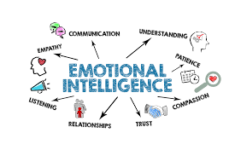
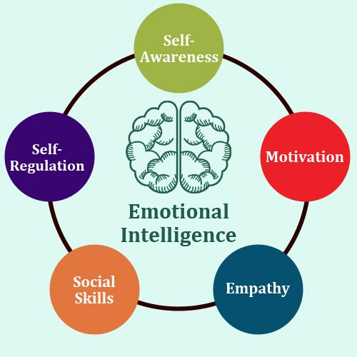
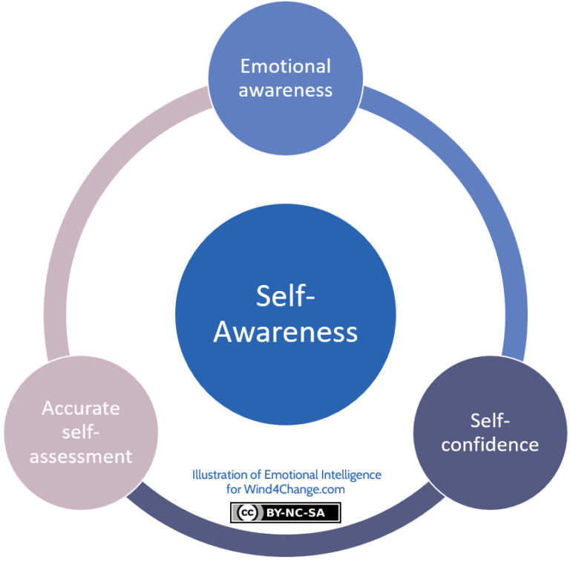

Poster Title
Leading Group Projects with Emotional Intelligence
Introduction
What is EI? The ability to understand and manage your own emotions, while accurately recognizing and responding to the emotions of others.
Why it Matters in Group Projects: Deadlines and different working styles naturally create tension. EI acts as a bridge, turning friction into productive teamwork and helping students overcome frustration and disengagement.
Section 1: EI in Teamwork Applying core EI skills transforms how a group handles pressure: Self-Awareness: Noticing when your own stress causes you to dominate discussions. Self-Regulation: Taking a breath to cool down before snapping at critical feedback. Motivation: Encouraging peers and maintaining momentum when energy drops. Empathy: Validating a teammate’s struggles instead of rushing to judge them. Social Skills: Communicating clearly and negotiating fair compromises.
Section 2: Managing Your Own Emotions Strategies to stay productive and reduce stress. Tactical Pausing: Stepping back (e.g., waiting an hour before replying to a frustrating group text). Mindfulness: Staying grounded during tense meetings rather than panicking about the final grade. Reflection: Looking back at what triggered your stress to help you respond better next time. The Emotion Flowchart: Trigger (Missed Deadline) Intervention (Pause & Breathe) Regulated Response (Collaborative Problem-Solving)
Section 3: Understanding Others’ Emotions How empathy improves communication and team success. Active Listening: Fully focusing on your teammate and summarizing their point, not just waiting for your turn to speak. Perspective-Taking: Recognizing that a quiet team member might be overwhelmed with other classes, rather than assuming they do not care. Constructive Feedback: Assessing the work, not the person. Method/Reflection: I developed this poster using a combination of personal experience from group projects, academic research on emotional intelligence, and observation of how students respond to pressure and feedback.
Conclusion & Recommendations EI is not just a "soft skill“ it is a strategic academic tool that shifts group dynamics away from conflict and toward shared success. Practical Tips: Establish Check-Ins: Start meetings by asking how everyone is managing their workload. Assume Positive Intent: Give peers the benefit of the doubt before getting upset. Reflect and Adapt: After the project, evaluate how you handled frustration.
References Goleman, D. (1995) Emotional Intelligence: Why It Can Matter More Than IQ. New York: Bantam Books. Mayer, J.D. and Salovey, P. (1997) 'What is emotional intelligence?', in Salovey, P. and Sluyter, D.J. (eds.) Emotional Development and Emotional Intelligence: Educational Implications. New York: Basic Books, pp. 3-31.
This Photo by Unknown Author is licensed under CC BY

