Slide 1
PRACTICE-BASED RESEARCH
Writing a Research Proposal
&
Assessment Workshop C1
Created by: Dr Aishat Bakre
Modified by: Dr Zeno Leung

Slide 2
Aims of the Session
To understand
The term Research Proposal
Components of a Research proposal
How to write a Research proposal

Slide 3

What is a Research proposal?

Slide 4
Research Proposal
A research proposal is a concise and coherent summary of your proposed research.
It sets out the central issues or questions that you intend to address.
It outlines the general area of study within which your research falls, referring to the current state of knowledge and any recent debates on the topic.
It also demonstrates the originality of your proposed research.

Slide 5
Research Proposal
It is a written formal proposal/ plan of how you intend to undertake a piece of research.
Intended to identify a problem(s), its significance and planned procedures for solving the problem(s) and then sharing these with relevant parties.
It is an essential part of the research process
(Polit and Hungler, 1991)

Slide 6
Why do we write a research proposals?

Slide 7
Reason for writing a proposal
Writing a proposal is a problem-solving activity
Which involves working out the
What? Why? How? When? Who? Of your research.
(Schneider and Fuller, 2018)

Slide 8
Reason for writing a proposal
A research proposals allows (as a student) your supervisor or (as a researcher) your funder to ensure that you understand:
- what will be researched.
- why it is relevant to do this research.
- how you will carry out the research.
- when you will carry out the research
- who you will involve in your sample.
A proposal also needs to show you are ethical in your data collection.
(Schneider and Fuller, 2018, p6)

Slide 9
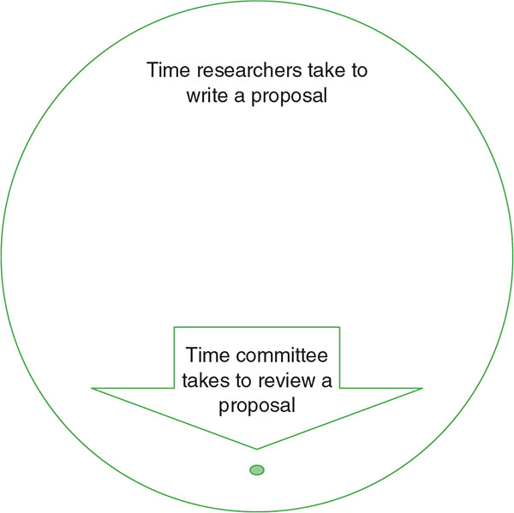

Slide 10
How long is a research proposal?

Slide 11
Length of the Proposal
A standard research proposal should be between
1500-3000 words
Note: This word counts can vary in some cases and institutions
Notes:
But this still depends on any given specification

Slide 12
What must the Proposal slides contain?

Slide 13
Research starts with a Research Proposal
A typical Research Proposal should include:
Topic
Introduction/Background
Brief review of literature and rationale
Research aims & objectives
Research Question or hypotheses
Research methodology
Ethical consideration
Include a time schedule of various stages
Reference list

Slide 14
Components of a Research Proposal

Slide 15
Title/Topic of Study
Your title should give a clear indication of your proposed research approach or key question.
It should be specific
Notes:
The context and background of the research topic / issue, as well as the rationale for undertaking the research, should be outlined in the introduction section. Reference to key literature should be included to strengthen the rationale for conducting the research. This will enable the reader to understand what the research will be about and why it is important.

Slide 16
Title/Topic of Study
For example
The effects of smoking on respiration
The effects of smoking on respiration in older people
The effects of smoking on respiration in older people with chronic bronchitis.
The effects of smoking on respiration in older people (aged > 45) with chronic bronchitis.
Note: increasing specificity is the goal

Slide 17
Introduction/Background
You should include:
the background and issues of your proposed research
a short/brief literature review
a summary of key debates and developments in the field

Slide 18
Brief literature review
Collection of relevant literature using a systematic approach: electronic and manual searches.
Critiquing this literature: Give a brief synopsis/summary of some of these studies (i.e. methodology used, sample size, location with whom
Identify if appropriate theories of conceptual frameworks/methodologies
Compare and contrast these studies: identifying the research problems and gaps.
From the literature search then identify a researchable Aim then narrow this to a good objective(s)
Clearly state the research aims and objectives

Slide 19
Aims/Objective/Hypothesis
Aim: General and broad statement about what you intend to study
“To examine the determinants and impacts of vegetable consumption on the incidence and mortality of depression in older people.
Objective: More specifically what you intend to study that is specific steps to achieve broad aim
“To examine the determinants of vegetable consumption in older people”.
To examine the impact of vegetable consumption on the incidence of depression in older people.
Hypothesis: Only required in experiments (a statement of prediction)
“Does smoking cause lung cancer in men aged 40 years plus living in England”.

Slide 20
Example of Aim and objectives
Aim:
To explore the evidence base of health visiting practice in England.
Objectives:
To examine aspects of health visiting practice which are based on research evidence and those which are not
To identify other sources of knowledge which are accessed in decision making by HV’s
To describe HV’s attitudes towards the use of research evidence.

Slide 21
Research Aims and Questions
The proposal should set out the central aims and questions that will guide your research.
Before writing your proposal, you should take time to reflect on the key questions that you are seeking to answer.
Many research proposals are too broad, so reflecting on your key research questions is a good way to make sure that your project is sufficiently narrow and feasible (i.e. one that is likely to be completed within the normal period for a Master degree programme).
Notes:
The research aims and research questions should be used to guide your research.
The aims of the research relate to the purpose of conducting the research and what you specifically want to achieve. The research questions should be formulated to show how you will achieve the aims of the research and what you want to find out.

Slide 22
Research Questions
You should formulate these clearly, giving an explanation as to what problems and issues are to be explored and why they are worth exploring.
The research aims and questions can be stated at the end of the introduction

Slide 23
Importance of Research questions
Type of question points to appropriate research design
Scope of question determines focus of study
Clarity of question gives strength to study

Slide 24
Activity
Working independently write a research question related to a specific topic
Feedback your answer to the whole class
Notes:
What are the factors influencing the consumption of vegetable in older people?
What is the impact of vegetable consumption on the incidence of depression?

Slide 25
Rationale/Justification for Research
The proposal should demonstrate the originality of your intended research.
You should therefore explain why your research is important
For example, by explaining how your research builds on and adds to the current state of knowledge in the field or by setting out reasons why it is timely to research your proposed topic.
Notes:
Reasons why the specific topic / issue is important

Slide 26
Proposed Methodology
You should provide an outline of:
the theoretical resources to be drawn on
the research approach (theoretical framework)
the research methods appropriate for the proposed research that is
Research design including data collection, analysis, samples and sampling technique
a discussion of advantages as well as limits of particular approaches and methods
Notes:
The methodology section of the proposal should outline how the research will be conducted. This should generally include a description and justification of: sample / participants, methods, data collection and analysis, and ethical considerations.

Slide 27
Proposed Methodology
Methodology explorations:
Best approaches (qualitative/quantitative/mixed)
The approaches philosophical viewpoint
Alternative/adequate paradigms/worldviews
Participants (sample): You must indicates the number of participants (N). How N was selected and provide inclusion/exclusion criteria
Materials and methods: You must describe the methods of data collection( i.e., questionnaires, interview schedules, participants information and consent letters)

Slide 28
Proposed Methodology
Data Analysis: The types of statistics employed within a quantitative study or the type of analysis used in qualitative study.
Procedure: This is the step-by-step account of how you would conduct your study.

Slide 29
Proposed Methodology
Traditionally, when the methodology of a research study/article are reported, the following sub-sections must be provided:
Study Participants – how many people took part, what was their demographic information etc.
Design – was a quali/quanti approach adopted. What specific method(s) was used and why?
Data collection methods/Procedure – how was the study conducted? What processes were followed?
Data Analysis – how were the data analysed?
Notes:
• Research Design
• Recruitment, Sampling & Study Participants.
• Materials/Data Collection Method(s)/procedure
o What questions will you ask? Who will you ask? How will you ask?
• Proposed data analysis technique

Slide 30
Activity
Working independently look for an article related to your topic on google scholar and read the method/data analysis section.
Find out:
The participants that took part in the study
The research design that was used
How the data were collected and analysed. Then
Feedback your findings to the whole class

Slide 31
For example
Data analysis will be conducted using:
Descriptive statistics
Binomial logistic regression models
Multivariate adjusted binary logistic regression models
Multivariate adjusted Cox regression models
Thematic analysis

Slide 32
Ethical considerations
Main principles and knowledge of ethical issues in research must be well explained in relation to your proposed research.
Make it clear to your audience what ethical considerations are and how you will ensure that your data is collected and analysed in an ethical way.
Notes:
You need to identify the ethical issues that may arise from your study and provide solutions to how you hope to overcome these

Slide 33
Activity
Working independently highlight all the ethical issues that must be considered in any research and what each entails.
Feedback your findings to the whole class
Notes:
Confidentiality
Anonymity
Inform consent

Slide 34
Implication of research
To conclude the proposal explore the potential implications of your research. Emphasise what you aim to contribute to knowledge and the significance
Keep this brief – don’t make assumptions because you are not actually doing the research so cannot presume what you will find

Slide 35
Implication of research
For example, your results might have implications to:
Improve best practices/quality of care
Reduce risk
Inform policymaking decisions
Strengthen a theory or model
Change/improve poor practice
Create a basis for future research

Slide 36
Plan of Work and Time Schedule
A research timeline helps to show when you plan to conduct your data collection, analysis and final report write-up.
State what is planned for each of the weeks.
You should include an outline of the various stages and corresponding timelines for developing and implementing the research, including writing up your report (thesis/dissertation).

Slide 37
Timelines
List your planned activities – write down everything you need to do (turn your methodology into a step-by-step plan)
Note the time available (deadlines) - estimate a time for each item on your list
Prioritise activities
Use a GANTT chart (using Excel, Microsoft Project etc)

Slide 38
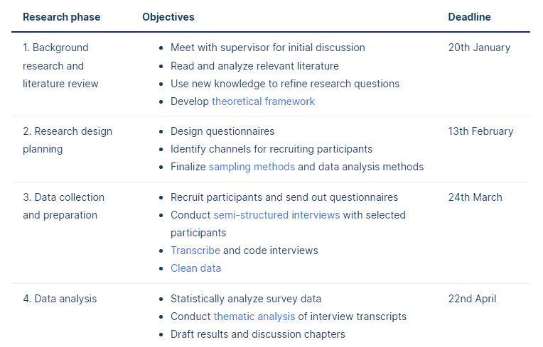
Example of Research Timeline
Notes:
You may be required to include a schedule or plan of how you intend to conduct the research within a specified timeframe. This can be presented in a variety of ways but should generally include specific milestones (e.g. collection of data, analysis of findings) and intended completion dates.

Slide 39
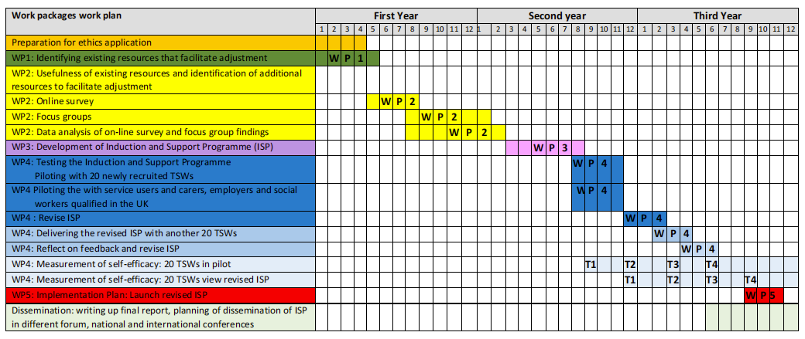
Example of Gantt Chart

Slide 40
References
You should include:
a list of references to key articles and texts discussed within your research proposal
Ensure you select appropriate sources that are relevant to the proposed research.

Slide 41
Arrangement of Individual Presentation
Time limit: 15 mins @
Suggested slides no.: 8-12
Submission deadlines
  Email to Zeno: Feb 26 (Mon)
  Turnitin: 2pm, Mar 1 (Fri)
Feb 27 (Tue)
Time slot | Presenter
1400-1415
1415-1430
1430-1445
1445-1500
1500-1515 | Break
1515-1530
1530-1545
1545-1600
Feb 28 (Wed)
Time slot | Presenter
1400-1415
1415-1430
1430-1445
1445-1500
1500-1515 | Break
1515-1530
1530-1545
1545-1600
Notes:
6th week

Slide 42
Suggested work schedule
Research topic & question(s) (focus, specific, narrow down)
Week 3 & 4
Literature review, overall research design
Week 4 & 5
Research method, sampling, tools, and ethics.
Finalise powerpoint proposal
Week 6

Slide 43
General Submission Guidance
All your presentation must include a title page that clearly states your names, your student numbers, the module code and title, your lecturer’s name, and your assignment title.
All your submissions should be typed in Arial font size at least 18 or more, using 1.5 line spacing.
All presentation must have a reference list and citations should be used throughout your work/slides using Harvard referencing.

Slide 44
General Submission Guidance
Some golden rules to remember:
    The slide background should not compete with the content (Duarte, 2008, p118)
    Maintain a consistent background colour/design throughout.
    Maintain a consistent font style throughout.
    Do not overcrowd your slides, limit text to key points.
    Show your creativity and skill in creating your individual presentation.

Slide 45
General Submission Guidance
It is essential that you follow the University’s Harvard referencing requirements.
Ensure you provide a reference list which is in alphabetical order, includes all the author details and the date of publication.
It is important that you check your work, proofread the contents, spell check it and look at punctuation and grammar so that your assignment reads clearly.
Notes:
https://www.ucl.ac.uk/ioe-writing-centre/plan-your-assignment/write-a-research-proposal

Slide 46
References
Duarte, N. (2008) Slide:ology : the art and science of creating great presentations. First edition. Sebastopol, California: O’Reilly Media.
Denscombe, M. (2012) Research Proposal: A Practical guide, Open University Press.
McCombes, S. & George, T. (2022, October 12). How to Write a Research Proposal | Examples & Templates. Scribbr. Available at: https://www.scribbr.com/research-process/research-proposal/ (Accessed date December 29, 2022).
Schneider, Z.M. and Fuller, J. (2018) Writing research proposals in the health sciences : a step-by-step guide. London: SAGE Publications Ltd.
Notes:
https://www.westminster.ac.uk/study/postgraduate/research-degrees/entry-requirements/how-to-write-your-research-proposal
https://www.birmingham.ac.uk/schools/law/courses/research/research-proposal.aspx
How to write a research proposal | 301 | The University of Sheffield
Develop a Research Proposal | IOE Writing Centre - UCL – University College London

