Slide 1
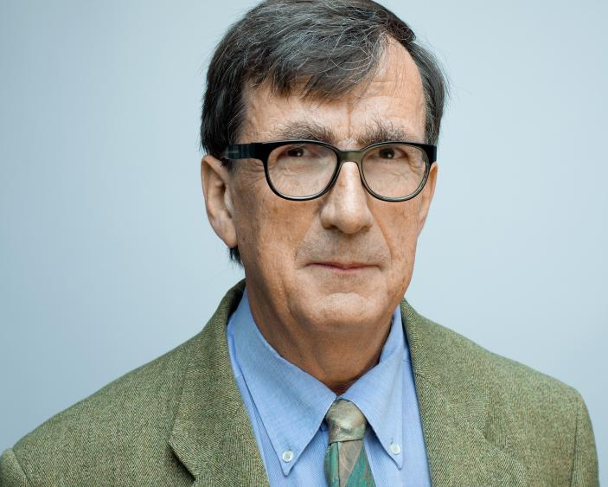
Bruno Latour
1947 -
“I think I never had any other interest than the exploration of the many ways there are to find the truth of a situation.” (Latour, 2013)
Bruno Latour, anthropologist and sociologist, Holberg Prize laureate 2013.
Photo credit: Manuel Braun.
Notes:
Bruno Latour is a French Anthropologist and Sociologist whose primary interest is in finding the truth of a situation.

Slide 2
Bruno Latour’s…
Key Principles
Specific Terminologies
Influences
Notes:
This presentation will outline Latour’s key principles, specific terminologies regarding Latour’s research, and how his work has influenced other scholars and research fields.

Slide 3

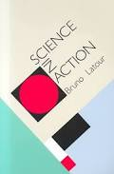
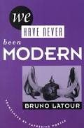
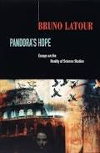
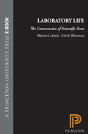
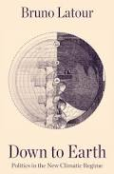
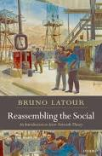
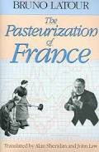
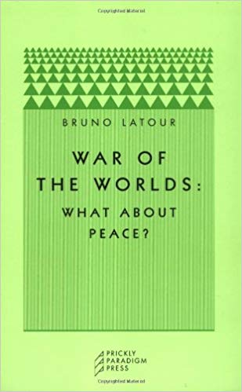
Recipient of the Holberg Prize in 2013
Emeritus professor at Sciences Po
  helped launch the field of Science and Technology Studies (STS)
  Director of Medialab
Written and edited more than 20 books
Written more than 150 articles
Website http://www.bruno-latour.fr
Notes:
In 2013, Latour was awarded The Holberg Prize in Norway for outstanding contributions to research in the arts and humanities, social sciences, or a cross-curricular approach.
He is professor Emeritus at Sciences Po, a Parisian Institute and there he helped to create Science and Technology Studies (STS).

Slide 4
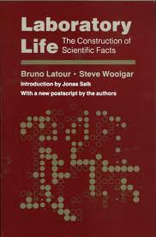
Laboratory Life (with Steve Woolgar, 1979)
and
Science in Action (1987)
1979
1987
Controversial and contentious
Scientific research is just inscription
Facts are merely constructed based on evidence that scientists want to use, discarding any other truths if they do not fit
Scientists themselves influence the whole experiment process (they are not impartial actors at all)
The ‘Actor-Network Theory’ or ANT
Notes:
Steve Woolgar worked with Latour in the 1970s and together they raised questions of reflexivity for science studies
Latour worked with Callon and Law to develop the Actor-Network Theory or ANT. This was highly controversial and upset many scientists and scholars.
This was ground-breaking work as it brought into focus the social influences in scientific experiments and material culture.
The work was perceived to be quite damming of scientists as it suggested that they in effect fabricated results by discounting the information they didn’t want to take into account.

Slide 5
Actor Network Theory (ANT)
A theoretical and methodological approach to understanding social relations.
Network
Relations
Actants
Notes:
In the early 1980’s, Actor–network theory (ANT) was published
An methodological approach to understanding social relations.
Everything exists in a network, and nothing exists but in the relations between actors in the network.
The actors are called actants rather than actors, because this removes the association with the word actor being a human. Actants can be human or non-human. Non-human actants can actually be a place or an object. All actants have the capability to exert an affect onto the network and they can perform or act of themselves or to others.

Slide 6
Generalized symmetry
Actor Network Theory (ANT)
Equal treatment of human and non-human actants.
All actants in a network are to be described in the same terms.
No a priori experience / knowledge for the actants
Notes:
ANT insists on the equal treatment of human and non-human actants. This is called Generalised Symmetry.

Slide 7
Actor Network Theory (ANT)
Translation
1986 study of how marine biologists try to restock the St Brieuc Bay in order to produce more scallops - Michel Callon
A forum – all agree to work together to create and maintain it.
Stability / equilibrium
Notes:
Translation is the mechanism by which the social and natural worlds progressively take form. The result is a situation in which certain entities control others.
In 1986, Callon’s work with marine biologists to restock scallops formed an excellent case study for the ANT. It showed how the network relied upon each actant doing their bit and it proved that performance of one actant can destabilise the network – to the extent that it collapses or breaks down.
One analogy for ANT is Christmas tree fairy lights. If you look at just one, it doesn’t really look very much at all. If you sever one however, the whole network of lights goes out.

Slide 8
The Pasteurization of France, 1988
1988
“We are no longer dealing with construction, social or otherwise: there is no stable prime-mover, social or individual, to construct anything, no builder, no puppeteer. Pasteur, we have seen, is an effect rather than a cause.” (Law, 2007)
Notes:
Latour’s studies have nearly always created controversies. He concluded that Louis Pasteur was not in fact a genius individual, solely responsible for discovering microbes – Pasteur was merely an actor in a network. A network of many actants all of whom contributed to the ultimate discovery.

Slide 9
Reassembling the Social
An Introduction to Actor-Network Theory 2005
2005
Redefines the social
Explores the meaning of sociology
Revisits the ANT
Recognises the difficulties / problems with the theory
Notes:
In his book, Reassembling the Social in 2005, Latour attempts to redefine the social and he picks apart the word sociology. He revisits the ANT and admits that it is not a theory at all, but a methodology. A way of understanding objects and all that is social in the world.

Slide 10
Relativism
2005
The relativist researcher "learns the actors' language," records what they say about what they do, and does not appeal to a higher "structure" to "explain" the actor's motivations.
(Latour, 2005)
Notes:
Latour is a relativist.
He says “ The relativist researcher "learns the actors' language," records what they say about what they do, and does not appeal to a higher "structure" to "explain" the actor's motivations.

Slide 11
Describe, not explain
Actor Network Theory (ANT)
Social activity should be "described" rather than "explained"
Only after this can one introduce the concept of social forces, and only as an abstract theoretical concept, not something which genuinely exists in the world.
(Latour, 2005)
Notes:
He posits that explanations are not necessary, or rather that a description is essential before any analysis can be undertaken.

Slide 12
1991
Our view of Nature is that it is an external category, subject to quantification and domination. Science has increasingly been put in charge of defining what Nature is, where we should encounter it and how we should deal with it. Nature is perceived through experts, who tell us what to look for and why (Latour, 2004).
Notes:
In the Book “We have never been modern,”, Latour attempts to break down the nature / science dichotomy. He says,
“Our view of Nature is that it is an external category, subject to quantification and domination. Science has increasingly been put in charge of defining what Nature is, where we should encounter it and how we should deal with it. Nature is perceived through experts, who tell us what to look for and why.”
Latour is again perceived to be damming of scientists.
The conventional view of Nature, Latour claims, has little to do with how we interact with Nature (or how it interacts with us). He asserts that human existence is ingrained in Nature and that Human existence cannot be understood by looking at humans alone.
Latour expresses the need to look at the interactions with Nature, between scientists and nature – the relations between human and non-human actants.

Slide 13
Hybrids
1991
Hybrids – the collapse and intertwining of different categories
Exposes and Defines the categories that we hold on to
Notes:
According to Latour, we define categories for groups, actions, objects, and maintain them as distinct entities. However, when a category collapses or has a problem, it can merge with another – Latour calls this hybrids.
The example given is when Politicians discuss global warming it has an effect on the economy.

Slide 14
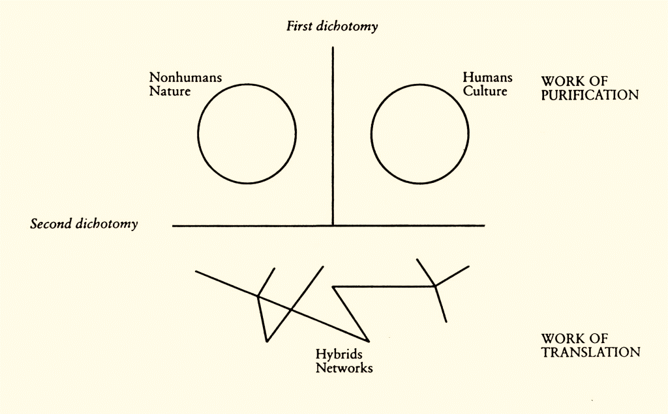
“The Modern Constitution”, diagram by Bruno Latour
From We Have Never Been Modern, Harvard University Press, 1993
Notes:
This diagram, drawn by Latour, illustrates the current ecological crisis – society, nature and technology are all interlinked. The purification at the top refers to the scientists in their labs, keeping separate the categories around them. Translation, as we’ve mentioned, is the action, the performance of actants in a network – here, the hybrids not only come together but become different within it.

Slide 15
Pandora’s Hope, 1999
1999
Questions the authority and reliability of scientific knowledge
Global warming
the spread of mad cow disease,
carcinogenic effects of smoking
Notes:
In Pandora’s Hope, published in 1999, Latour continues to address contemporary issues, and no doubt you will notice the theme here, that he again questions the authority and reliability of scientific knowledge.
These three issues of global warming, the spread of mad cow disease and the problems of smoking are all attacked in the book, but in Latour’s style and approach – specifically focussing on the importance of the relational nature of these situations.

Slide 16
“New topics, that’s what you need ANT for.”
(Latour, 2005 p.142)
Notes:
Latour in 2005, prompted scholars to find new topics to use Actor-network theory for. He is still, even today, focussing on contemporary issues and is advocate for ecological resolutions to the planet’s nature crisis.

Slide 17
2019 winner
Professor Paul Gilroy
“Gilroy introduces a networked model of culture that displaces the organic metaphor of “roots” to show how group-belonging adapts under historical conditions.”
Holberg Committee, 2018
Notes:
Latour continues to influence scholars and academics. The ANT terminology can be seen in this year’s Holberg Prize winner’s work -

Slide 18
Summary
Process, acts of becoming, interactions
Challenges dichotomies object/subject; human/non-human
Breaks down categories, objects or units, focus on relations
Notes:
Latour traces and seeks out processes. He claims they are vital components in understanding how we view the world. If everything in the world is viewed as a process the focus shifts from viewing individual objects, to viewing their act of becoming into other objects. In other words the being/becoming metaphor suddenly becomes very essential and predominant.
Society is made of physical things, cultural things, but it is the interactions as a continual process that constitute and describe a society.
Latour insists on breaking down the world of categories and focus on relations.

Slide 19
References
Callon, M. (1999) ‘Some elements of a sociology of translation: Domestication of the scallops and the fishermen of St. Brieuc Bay BT - The science studies reader’, The science studies reader, pp. 67–83.
Latour, B. (1987) Science in Action. Cambridge: Harvard University Press.
Latour, B. (1999) Pandora’s Hope: Essays on the Reality of Science Studies. Cambridge: Harvard University Press.
Latour, B. (2004) We Have Never Been Modern. Cambridge: Harvard University Press.
Latour, B. (2005) Reassembling the Social An Introduction to Actor-Network-Theory. Oxford: Oxford University Press.

Slide 20
References
Law, J. ‘Actor Network Theory and Material Semiotics,’ version of 25th April 2007, available at http://www. heterogeneities.net/publications/Law2007ANTandMaterialSemiotics.pdf
Latour, Bruno. 'Reassembling the Social: An Introduction to Actor–Network Theory. Oxford, UK: Oxford UP, 2005
Latour, B. (1999). "Technology Is Society Made Durable". In Law, J., ed., Sociology of Monsters
Holberg Prize Committee 2019
https://www.holbergprisen.no/en/news/holberg-prize/2019-holberg-prize-and-nils-klim-prize-laureates-announced

