Slide 1

Module Code: BMIH6001
Module Name: Contemporary Themes in the Hotel and Hospitality Sector
Assignment Number: 2
Assignment Title: Conference Presentation
Student Name: Silvana Mihaela Lorencz
Student ID:2231303
Module Lead: Natalie Brailsford

Slide 2
Acknowledge Statement
I confirm that I have not used any AI tools in the research and creation of this assignment. I confirm that I have not presented any AI generated materials as my own work. I confirm I have copies of my drafts, notes, and other resources I used, which I may be asked to provide in evidence.

Slide 3
Table Of Contents
Introduction………………………………………………………………...03
Literature Review………………………………………………………04-05
Methods………………………………………………………………...06-09
Conclusion……………………………………………………………......10
Recommendations…………………………………………………………11
References…………………………………………………………………..12

Slide 4

Introduction
Sustainability in the hospitality sector is a very important aspect that has helped in protecting the environment as well as society.
On that account, reducing food waste is very necessary as this aspect helps in increasing operational efficiency, enhancing brand reputation as well as reducing food security.
Within this context, composting is one of the crucial strategies that can help hotels like Marriott and others.
This aspect helps in reducing landfills, improving soil quality as well as promoting the circular economy.
On that account, this presentation will highlight the contemporary issues in the hospitality sector.
(Lendon, 2021)
Notes:
Introduction
Sustainability in the hospitality sector is a very important aspect that has helped in protecting the environment as well as society. On that account, reducing food waste is very necessary as this aspect helps in increasing operational efficiency, enhancing brand reputation as well as reducing food security. Within this context, composting is one of the crucial strategies that can help hotels like Marriott and others. This aspect helps in reducing landfills, improving soil quality as well as promoting the circular economy. On that account, this presentation will highlight the contemporary issues in the hospitality sector. Using theories will help in discussing the key concepts and other aspects. The data analysis methods and tools will be highlighted along with industry-based knowledge about the theme.

Slide 5
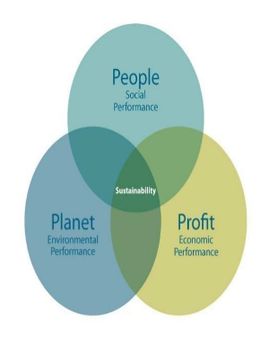
Literature Review
Application of the theories and concepts based on food waste and composting in the hospitality sector
Highlighting the Triple Bottomline Theory for analysing the benefits and challenges of food composting in the hospitality sector
Profit
According to Ozturkoglu et al. (2021) With the support of the Triple Bottom Line theory, the hospitality sector is able to several benefits by highlighting their contexts.
People
As opined by Bui and Filimonau (2021), by focusing on the context of People in TBL theory, the hospitality firms are able to improve their brand image and enhance public relations by being the socially responsible ones.
Planet
As stated Mattera and Gava (2022), by engaging the TBL theory with the hospitality sector, the companies are able to decrease the amount of organic waste that is sent to landfills.
(Mattera and Gava, 2022)
Notes:
Literature Review
Application of the theories and concepts based on food waste and composting in the hospitality sector
Highlighting the Triple Bottomline Theory for analysing the benefits and challenges of food composting in the hospitality sector
Profit
According to Ozturkoglu et al. (2021) With the support of the Triple Bottom Line theory, the hospitality sector is able to several benefits by highlighting their contexts. Therefore, the major benefits that the hospitality sector gains from food composting are reducing the costs of waste disposal. Further, the hospitality companies are also able to improve the operational efficacy, which includes better inventory management as well as portion control. However, the major issues are related to the effective infrastructure and the initial investment for the equipment and staff training for food composting. Another issue for the food composting that is highlighted by the TBL is the external costs required for space, energy as well as labour maintenance.
People
As opined by Bui and Filimonau (2021), by focusing on the context of People in TBL theory, the hospitality firms are able to improve their brand image and enhance public relations by being the socially responsible ones. Further, this theory is also helpful for companies in increasing employee engagement and their morale for their participation in the sustainability initiatives. Apart from the benefits of this theory, there are major challenges related to this context. Among them, the major issues are the requirement for educating the staff regarding the effective procedures of proper composting. Sometimes the composting is not managed properly, for which creates bad odours and offers negative perceptions of the customers regarding the reputation of the hotel.
Planet
As stated Mattera and Gava (2022), by engaging the TBL theory with the hospitality sector, the companies are able to decrease the amount of organic waste that is sent to landfills. Therefore, the process of composting is reducing the production of methane as well as other potential greenhouse gases. Further, the organisations are also focusing on enhancing the soil through creating valuable compost. Contrarily, the challenges within this process highlight the requirement for space for composting, specifically in urban areas. Further, measuring, along with reporting the environmental impact, is also complex for the companies.

Slide 6
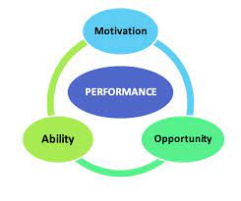
Contd…
Emphasising the Ability Motivation theory as a strategy to mitigate the issues in the food composting in the hospitality sector
As opined by Psimoulis et al. (2023), the Ability-Motivation Theory helps to focus on the internal as well as external factors in the organisations that will influence the performance of the employees.
Through offering the staff a comprehensive approach for overcoming the major composting challenges.
By focusing on this, the organisations can develop robust training programs regarding effective waste handling and their segregation.
(Psimoulis et al., 2023)
Notes:
Emphasising the Ability Motivation theory as a strategy to mitigate the issues in the food composting in the hospitality sector
As opined by Psimoulis et al. (2023), the Ability-Motivation Theory helps to focus on the internal as well as external factors in the organisations that will influence the performance of the employees. Through offering the staff a comprehensive approach for overcoming the major composting challenges. By focusing on this, the organisations can develop robust training programs regarding effective waste handling and their segregation. Reminding employees regarding the environmental impact of food waste will also help the staff in fostering knowledge of food waste.

Slide 7
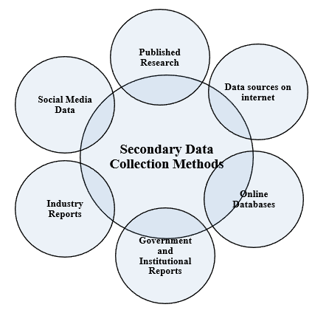
Methods
Data Collection procedures and Data Collection techniques
The ways through which the data has been collected and interpreted have been known as the Data collection techniques, and their analysis has been referred to as the procedure.
Therefore, within this conference paper, the researcher has majorly focused on the secondary thematic analysis over the primary quantitative analysis (Heath, 2023).
Through this implementation, a wide range of information has been found from the books, journals, and other scholarly articles.
(Heath, 2023)
Notes:
Methods
Data Collection procedures and Data Collection techniques
The ways through which the data has been collected and interpreted have been known as the Data collection techniques, and their analysis has been referred to as the procedure. Therefore, within this conference paper, the researcher has majorly focused on the secondary thematic analysis over the primary quantitative analysis (Heath, 2023). Through this implementation, a wide range of information has been found from the books, journals, and other scholarly articles. Due to this process, the study has reached to its deeper understanding regarding the challenges and their solutions in the food composting in the hospitality sector.

Slide 8
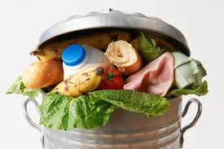
Contd…
PESTLE Analysis
Political
The government of the UK is keen to promote waste reduction by implementing voluntary agreements.
Emergence of COVID-19 and changes made in the trade policies are also influencing the food supply chains and availability of staff in the hotel sector.
Economic
Rising operating costs have become a major concern for the hospitality industry.
Besides this, huge financial losses are present from the wasted food and penalties for recycling legislation.
Social
People are now more environmentally conscious, which puts pressure on hotels to adopt green practices.
Demands and expectations of customers related to food quality, quantity and price are influential to the food waste management system in restaurants.
(Barnes et al., 2024)
Notes:
Political
The government of the UK is keen to promote waste reduction by implementing voluntary agreements. Legal obligations such as the Food and Drink Pact aim to minimise the food waste volume by 50% by 2030. Besides this, various government-led campaigns are supportive of reducing the waste level. Emergence of COVID-19 and changes made in the trade policies are also influencing the food supply chains and availability of staff in the hotel sector (Barnes et al., 2024).
Economic
Rising operating costs have become a major concern for the hospitality industry. Besides this, huge financial losses are present from the wasted food and penalties for recycling legislation. Moreover, the overall economic performance experienced a sharp fall during the pandemic, and the cost-of-living crisis is additional pressure for businesses to obey the sustainability guidelines. Indirect economic costs include environmental damage from the food waste and degradation of public health (Bulochova et al., 2024).
Social
There are rapid changes observed in the consumer attitude in the hospitality industry of the UK. People are now more environmentally conscious, which puts pressure on hotels to adopt green practices. Demands and expectations of customers related to food quality, quantity and price are influential to the food waste management system in restaurants. The value of locally sourced food has increased from before after the hit of pandemic, which might enhance waste production on costly products. The assumptions of TBL theory state that ethical labour practices should be promoted by businesses by giving fair wages and safe working conditions (Giousmpasoglou, 2024).

Slide 9
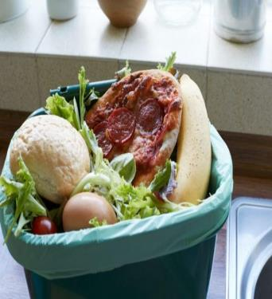
Contd…
Technological
The AI-driven waste tracking system, such as Smart Bins and predictive data analytics tools, is helpful to provide real-time insights to the customers.
Besides this, IoT and automated systems are also active to improve the efficiency of the waste tracking system.
Legal
The Food Safety Act and other legal guidelines imposed obligations on hoteliers to train staff members and reduce waste.
The voluntary agreement made by WRAP targets to decrease waste by 50% before the end of 2030.
Environmental
Climate change has a major influence on the supply chain of food, storage or production.
As per the principles of the TBL, inclusion of social, economic and environmental goals is considered by the hotels to save cost and ensure the well-being of the community.
(Camilleri, 2025)
Notes:
Technological
The AI-driven waste tracking system, such as Smart Bins and predictive data analytics tools, is helpful to provide real-time insights to the customers. Those tools are useful to identify the patterns and predict future demands. Besides this, IoT and automated systems are also active to improve the efficiency of the waste tracking system (Bulochova et al., 2024).
Legal
There are various legal obligations regarding waste disposal and regulations. The Food Safety Act and other legal guidelines imposed obligations on hoteliers to train staff members and reduce waste. The voluntary agreement made by WRAP targets to decrease waste by 50% before the end of 2030 (Barnes et al., 2024).
Environmental
Sustainability protocols are highly connected with the environmental guidelines and regulations in the hospitality industry. Climate change has a major influence on the supply chain of food, storage or production. The process also requires a huge volume of water while processing waste coming from hotels. Besides this, the energy required to process or recycle the wasted food has also become a challenge for the businesses. As per the principles of the TBL, inclusion of social, economic and environmental goals is considered by the hotels to save cost and ensure the well-being of the community (Camilleri, 2025).

Slide 10
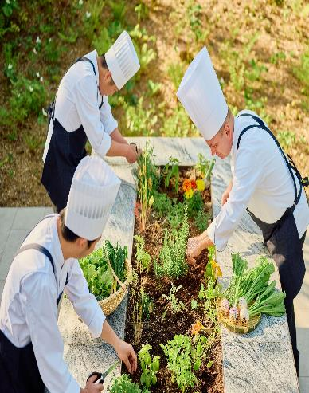
Contd…
Providing examples of the industry responses to the chosen contemporary issue and their impacts based on the strengths and limitations
Within this context, there are different strategies of competing that have been used by the hotels to reduce food waste.
Large hotels like Grand Hyatt have invested in automated units to process the food waste on-site.
This has helped in cost savings, reduced carbon footprint, as well as improved hygiene (Hyatt, 2025)
(Hyatt, 2025)
Notes:
Providing examples of the industry responses to the chosen contemporary issue and their impacts based on the strengths and limitations
Within this context, there are different strategies of competing that have been used by the hotels to reduce food waste. Large hotels like Grand Hyatt have invested in automated units to process the food waste on-site. This has helped in cost savings, reduced carbon footprint, as well as improved hygiene (Hyatt, 2025). However, this has also required a high upfront cost, affecting the overall process. Further, the UK’s robust waste management systems have helped the hospitality businesses to collaborate with third parties for off-site composting. Additionally, the pubs, hotels and restaurants have segregated the food waste and these third-party companies collect them for composting. The logistical simplicity of this process has lowered the upfront cost; however, hotels have no control over the ways through which the final compost is used (Lendon, 2021).

Slide 11

Conclusion
The sustainability aspects in terms of food waste in the hospitality sector are a very important matter that needs to be acknowledged.
Within this context, the above presentation has discussed these issues and the ways through which composting can help in reducing waste have also been highlighted.
Consequently, using TBL and other theories, the benefits and other aspects of these subjects have also been highlighted.
The presentation has also discussed the ways through which data has been collected.
(Lendon, 2021).
Notes:
Conclusion
The sustainability aspects in terms of food waste in the hospitality sector are a very important matter that needs to be acknowledged. Within this context, the above presentation has discussed these issues and the ways through which composting can help in reducing waste have also been highlighted. Consequently, using TBL and other theories, the benefits and other aspects of these subjects have also been highlighted. The presentation has also discussed the ways through which data has been collected. Lastly, the utilisation of PESTLE analysis to understand the influence of composting in reducing food waste and enhancing sustainability in the hotel industry has been discussed along with recommendations.

Slide 12
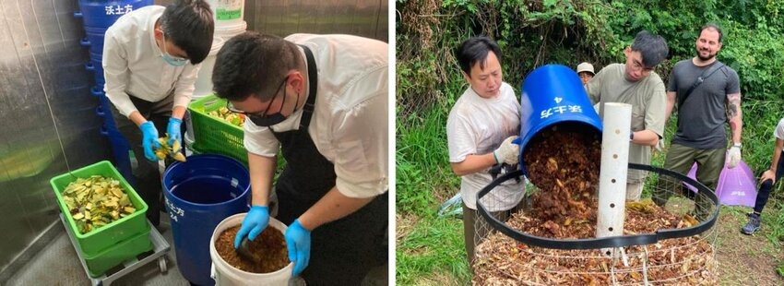
Recommendations
For the development of sustainability practices within the hospitality industry through composting, the hotels, pubs and restaurants within this sector need to adopt some crucial strategies.
On that account, the hotel needs to evaluate the needs and scale effectively so that they can develop a system that is needed.
For instance, a small hotel does not need full-scale systems for composting and pile or bin composting will be enough for them.
Additionally, choosing an appropriate method for composting by using the help of external service providers is also a very important method that should be adopted by hotels.
Lastly, training and educating the staff can also help the hotel with the on-site composting process (Mihai et al., 2023).
(Mihai et al., 2023)
Notes:
Recommendations
For the development of sustainability practices within the hospitality industry through composting, the hotels, pubs and restaurants within this sector need to adopt some crucial strategies. On that account, the hotel needs to evaluate the needs and scale effectively so that they can develop a system that is needed. For instance, a small hotel does not need full-scale systems for composting and pile or bin composting will be enough for them. Additionally, choosing an appropriate method for composting by using the help of external service providers is also a very important method that should be adopted by hotels. Lastly, training and educating the staff can also help the hotel with the on-site composting process (Mihai et al., 2023).

Slide 13


Slide 14
References
Barnes, J.B., Smith, J.C., Ross, K.E. and Whiley, H. (2024) ‘Performing food safety inspections.’ Food Control, 160, p.110329.
Bui, H.T. and Filimonau, V. (2021) ‘A recipe for sustainable development: assessing transition of commercial foodservices towards the goal of the triple bottom line sustainability.’ International Journal of Contemporary Hospitality Management, 33(10), pp.3535-3563.
Bulochova, V., Evans, E.W., Haven-Tang, C. and Redmond, E.C. (2024) ‘Methods and measures in food service food safety research: A review of the published literature.’ Heliyon, 10(4).
Camilleri, M.A. (2025) ‘Sustainability accounting and disclosures of responsible restaurant practices in environmental, social and governance (ESG) reports.’ International Journal of Hospitality Management, 126, p.104051.
Giousmpasoglou, C. (2024) ‘Working conditions in the hospitality industry: the case for a fair and decent work agenda.’ Sustainability, 16(19), p.8428.
Heath, C. (2023) Data collection in research: Your complete guide. [Online] Available at: https://dovetail.com/research/data-collection/ (Accessed 26 October 2025).
Hyatt. (2025) Caring for the Planet. [Online] Available at: https://www.hyatt.com/world-of-care/en-US/caring-for-the-planet (Accessed 26 October 2025).
Lendon, G. (2021) Food Waste in Hospitality - Where does the Food Waste go?. [Online] Available at: https://www.sustainologyuk.com/food-waste-in-hospitality-where-does-the-food-waste-go (Accessed 26 October 2025).
Mattera, M. and Gava, L. (2022) ‘Facing TBL with IoT: creating value and positively impacting business processes.’ Social Responsibility Journal, 18(1), pp.178-201.
Mihai, F.C., Plana, R., Arizmendiarrieta, J.S. and Irigoyen, I. (2023) ‘Business models of composting for a circular economy.’ In Current Developments in Biotechnology and Bioengineering (pp. 319-345). Elsevier.
Ozturkoglu, Y., Sari, F.O. and Saygili, E. (2021) ‘A new holistic conceptual framework for sustainability oriented hospitality innovation with triple bottom line perspective.’ Journal of Hospitality and Tourism Technology, 12(1), pp.39-57.
Psimoulis, M., Kakarougkas, C. and Stavrinoudis, T. (2023) August. ‘Motivating Human Resources in the Hospitality Industry. A Literature Review.’ In International Conference of the International Association of Cultural and Digital Tourism (pp. 359-373). Cham: Springer Nature Switzerland.
Notes:
References
Barnes, J.B., Smith, J.C., Ross, K.E. and Whiley, H. (2024) ‘Performing food safety inspections.’ Food Control, 160, p.110329.
Bui, H.T. and Filimonau, V. (2021) ‘A recipe for sustainable development: assessing transition of commercial foodservices towards the goal of the triple bottom line sustainability.’ International Journal of Contemporary Hospitality Management, 33(10), pp.3535-3563.
Bulochova, V., Evans, E.W., Haven-Tang, C. and Redmond, E.C. (2024) ‘Methods and measures in food service food safety research: A review of the published literature.’ Heliyon, 10(4).
Camilleri, M.A. (2025) ‘Sustainability accounting and disclosures of responsible restaurant practices in environmental, social and governance (ESG) reports.’ International Journal of Hospitality Management, 126, p.104051.
Giousmpasoglou, C. (2024) ‘Working conditions in the hospitality industry: the case for a fair and decent work agenda.’ Sustainability, 16(19), p.8428.
Heath, C. (2023) Data collection in research: Your complete guide. [Online] Available at: https://dovetail.com/research/data-collection/ (Accessed 26 October 2025).
Hyatt. (2025) Caring for the Planet. [Online] Available at: https://www.hyatt.com/world-of-care/en-US/caring-for-the-planet (Accessed 26 October 2025).
Lendon, G. (2021) Food Waste in Hospitality - Where does the Food Waste go?. [Online] Available at: https://www.sustainologyuk.com/food-waste-in-hospitality-where-does-the-food-waste-go (Accessed 26 October 2025).
Mattera, M. and Gava, L. (2022) ‘Facing TBL with IoT: creating value and positively impacting business processes.’ Social Responsibility Journal, 18(1), pp.178-201.
Mihai, F.C., Plana, R., Arizmendiarrieta, J.S. and Irigoyen, I. (2023) ‘Business models of composting for a circular economy.’ In Current Developments in Biotechnology and Bioengineering (pp. 319-345). Elsevier.
Ozturkoglu, Y., Sari, F.O. and Saygili, E. (2021) ‘A new holistic conceptual framework for sustainability oriented hospitality innovation with triple bottom line perspective.’ Journal of Hospitality and Tourism Technology, 12(1), pp.39-57.
Psimoulis, M., Kakarougkas, C. and Stavrinoudis, T. (2023) August. ‘Motivating Human Resources in the Hospitality Industry. A Literature Review.’ In International Conference of the International Association of Cultural and Digital Tourism (pp. 359-373). Cham: Springer Nature Switzerland.

