Slide 1

Villa des Oranger
Relai and chateaux

Slide 2
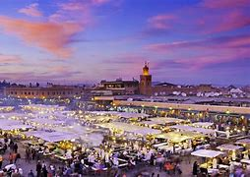
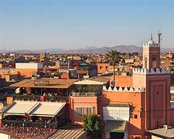
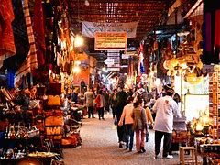
Morocco, beauty and history
Marakesh at night
Marakesh in the day
Shopping in marakesh

Slide 3
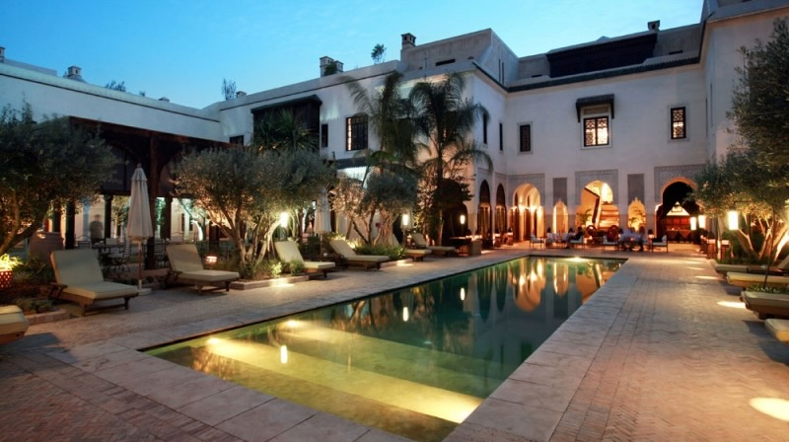
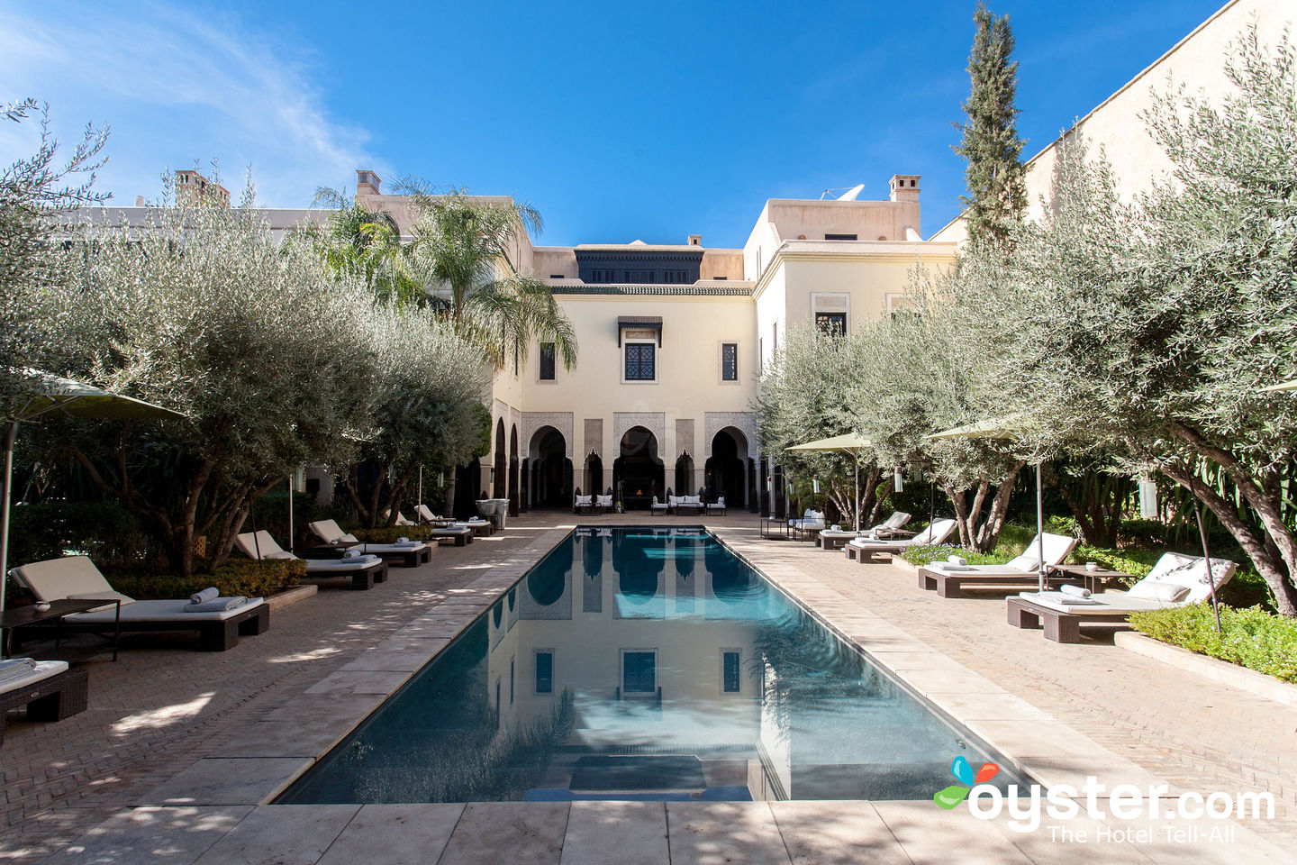
Hotel pools and views

Slide 4
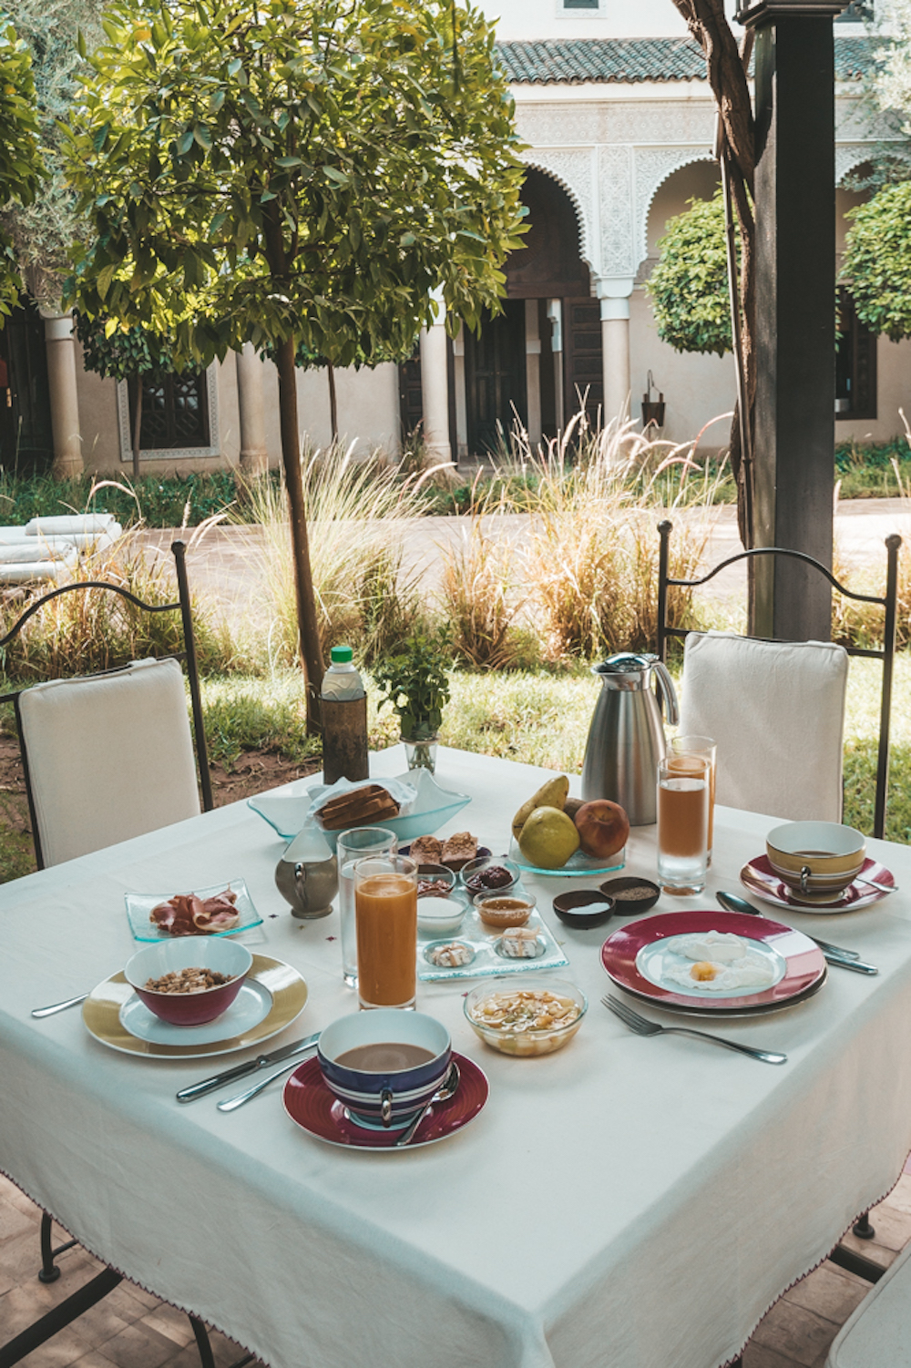
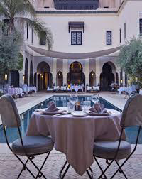
Dining
Outdoor dining
Using local ingredients
Preserving local culture using local dishes

Slide 5
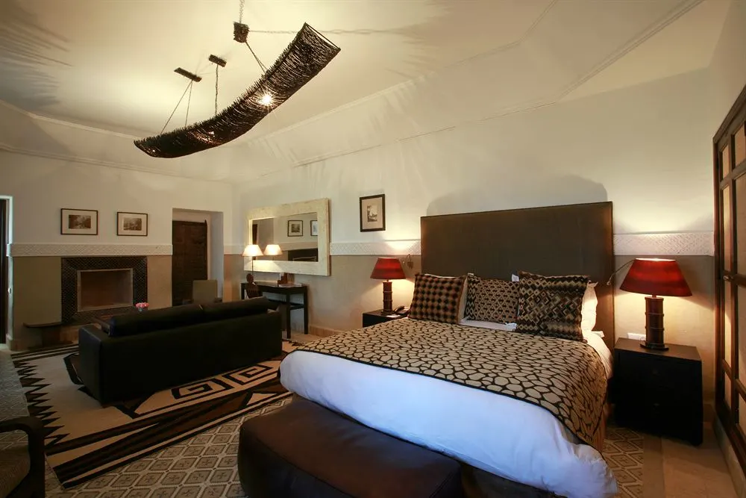
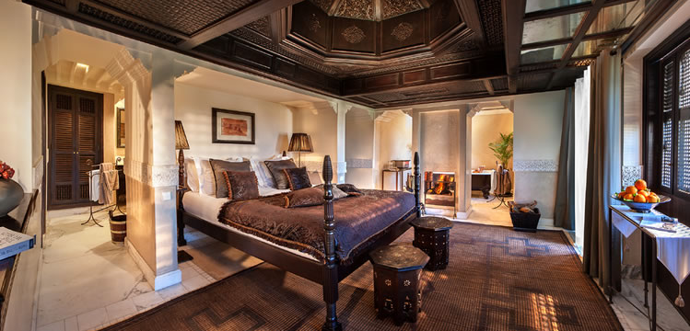
Rooms

Slide 6

Making the stay safe

Slide 7
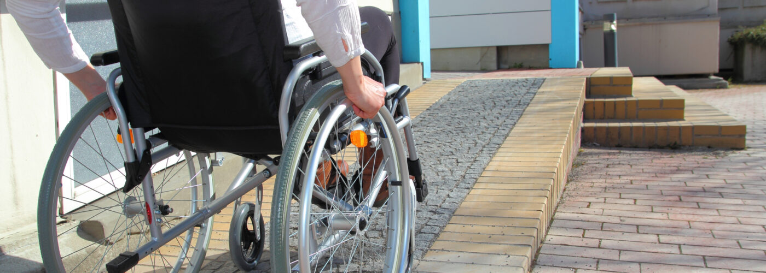
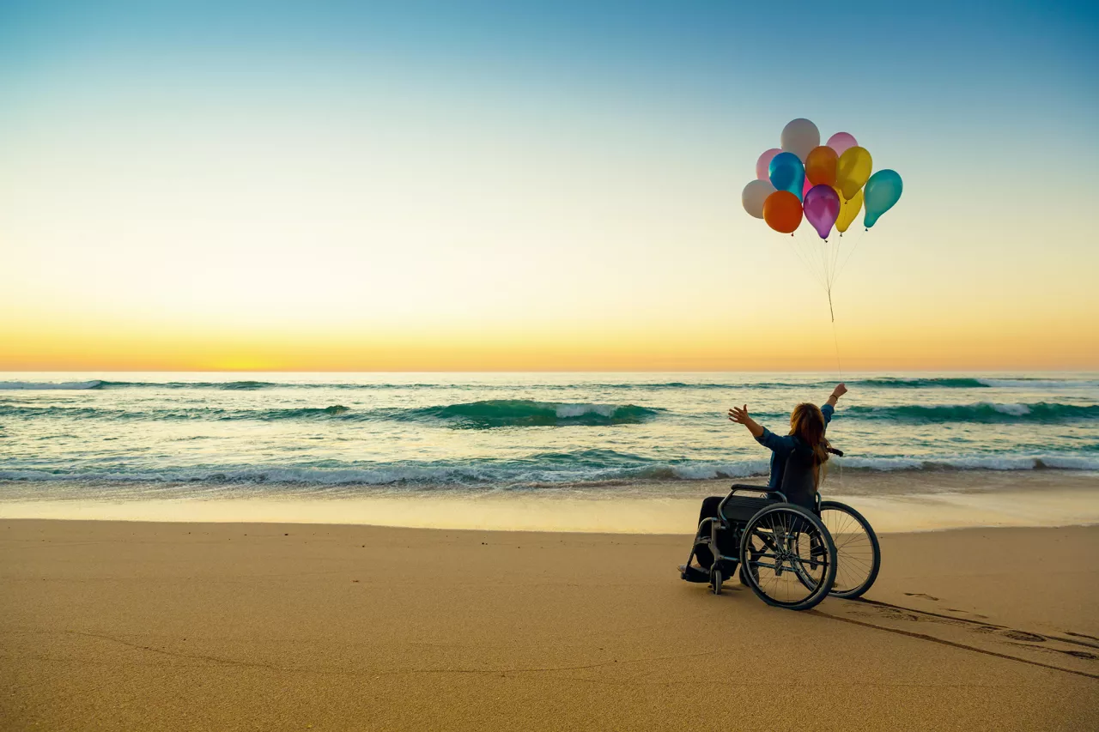
Making people with disabilities happy
Putting in ramps and lifts.
Making everyone’s stay a happy stay

Slide 8
Villa des Oranger is a exclusive hotel providing a 5* service to all that stay in the hotel from luxurious deluxe rooms with terraces to swimming pools private and communal, dining at its best proving local delicacies presented by a warm welcoming team.
Improvements and advertisements that could bring more holiday makers to the Villa des Oranger.
Although the hotel is build to a high standard is it not accessible to a large market of people with disabilities
Recommended marketing improvements.
Making improvements to hotel for access to costumers with disabilities.
Use social media influencers to promote the hotel, attracting more younger holiday makers.
Offer longer stays for a reduced price.
Use more of the local entertainment i.e singers, dancers and food preparers to host an event.
Using Facebook, YouTube, Instagram and tiktok advertise showing the improvements done to making the hotel covid 19 save and what measures that have been taking to ensure the safety of the guests and the welcoming of and guests with a disabilities.
* Improve food pricing to be more competitive while not losing the qualitie of food and standard.

