Slide 1
Name: Sheikh Md Shafiqur Rahman
Student Number: 2407925
Lecturer’s Name: Mudassar Hasan
LCLM 5002 Component 1
Assignment –
DEVELOPING AND MANAGING INDIVIDUALS AND TEAMS

Slide 2
Table of Content of Today’s Presentation
Overview
A short introduction of a ‘Student Consultancy Company’ based in Birmingham, UK
The whole recruitment process consist of job analysis, job description, and person specification
Investigate 3 various types of interviews for the recruiting process
Exploring different kinds of questioning technique
Identify comparison and difference between face to face and virtual online interview for the candidate
Conclusion
List of References

Slide 3


Overview
The term ‘Recruitment’ refers to the process of searching, hiring, and onboarding appropriate candidates for the specific roles of jobs (Breaugh, 2013), (Biron et al., 2024), (Markoulli et al., 2017), (Nikolaou, 2014).
Recruitment cycles, strategies, and systemic approaches falls under the duty of human resource management department within an organization (Buller et al., 2012), (Apascaritei et al., 2022), (Ateeq et al., 2024), (Alerasoul et al., 2022).
The human resource department within an organization is responsible for managing workforce people, talent hunting, development, and transforming any changes in the organization (Whittington et al., 2005), (Orlikowski, 1996), (Reilly, 2012), (Tsoukas et al., 2002), (Cappelli at al., 2014).

Slide 4

Overview
The human resource department of any organization’s another critical task is retaining the recruited talents for the betterment of the business by providing right amount of information, appropriate supports, trainings, bonuses, employee benefit perks, increased remunerations, and career development opportunities to the employees on a continuous basis (Das et al., 2013), (Azeez, 2017), (Al-Emadi et al., 2015), (Ashraf et al., 2008).
Another vital task of the human resource department in an organization is addressing the changes in any area of the businesses including business transformation, digital transformation, artificial intelligence (AI) adoption, and automation processes (Nadkarni et al., 2021), (Gilch et al., 2021), (Pereira et al., 2023).

Slide 5

Introduction of The Company
The name of the company is ‘Global Education Group Ltd’.
It is situated in Birmingham, UK and established in 2015.
This company provides students admissions solutions to local and international students into UK national universities and colleges.
This student consultancy company is a medium sized business consisting of around 25-30 employees.
The company has reputation for its right sourced and genuine admissions information and commitment to provide complete students recruitment solutions.
This company has partnerships with various UK national universities and colleges towards achieving a common goal of complete student admissions solutions.

Slide 6
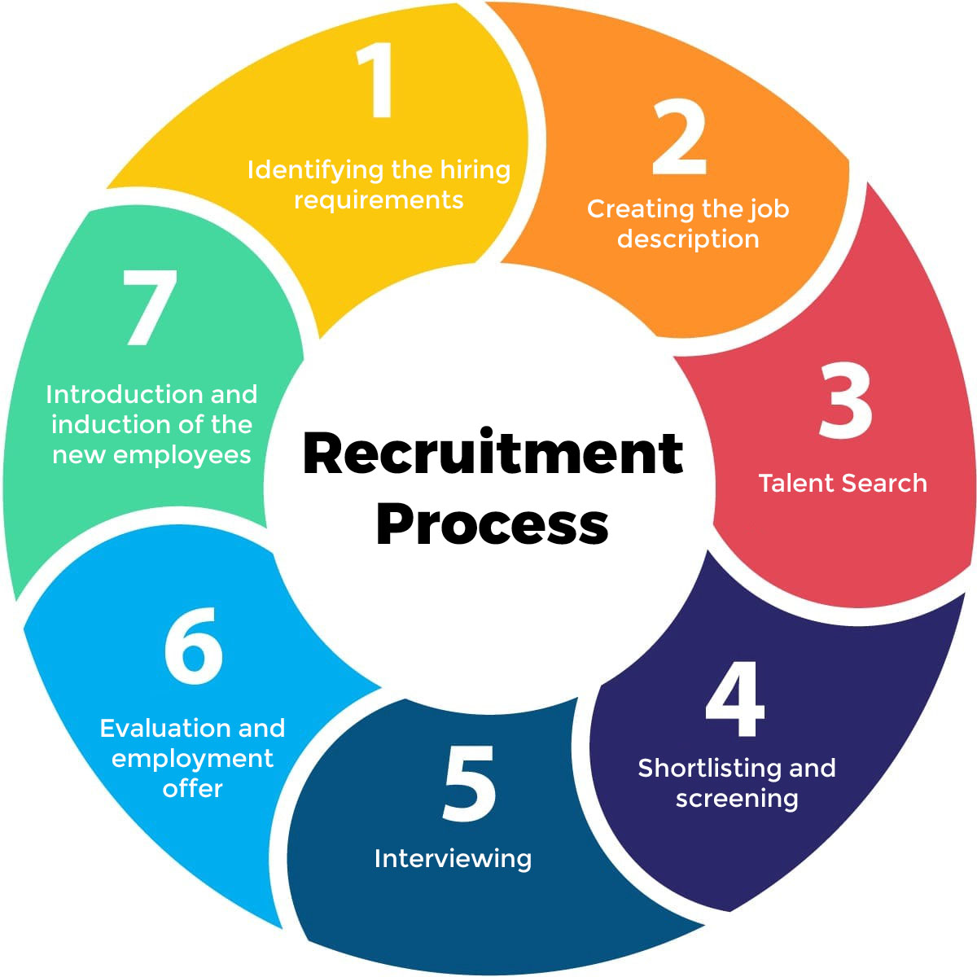
Recruitment Process Consist of Job Analysis, Job Description, and Person Specification
The job analysis of ‘Global Education Group Ltd’ shows the requirement of a new ‘Admission Manager’ to increase the student admissions capacity.
The job analysis identifies the vacancy as an external recruitment.
The job analysis suggests that the vacancy should be advertised in multiple UK national job portal websites.
The job description should include what duties and tasks the post-holder would need to do on a daily-basis.
The job description should also include the employee benefits, annual leaves, career development opportunities within the organization.
The person specification should include what personal attributes the post-holder must possess including educational-level, and various skills such as computer-literacy, time-management skills, data-entry, data-analysis, Microsoft Office 365 literacy, customer-service, strong organizational and interpersonal skills, ability to work individually and as a part of a team etc.

Slide 7

Exploring 3 Different Kinds Of Interviews For Recruiting The Admission Manager
Three different kinds of interviews include:
1. Structured Interview
2. Unstructured Interview
3. One-to-One Interview
Theses 3 different types of interview could be conducted through ‘Face to Face’ or via ‘Online’.

Slide 8

Structured Interview
Structured interview consist of a set identical predetermined questions.
The questions would be asked in the same order to each candidate for the job position.
Structured interview provides a fair comparisons among all the candidates.
For the ‘Admission Manager’ role in Global Education Group Ltd the ‘Structured Interview’ process should be used because this interview process provides the scopes to select a set of predetermined questions which are essential to find out the appropriate candidate for the job.
Structure interview would allow to find out the strengths and weaknesses of a candidate, and that is why this type of interview has been chosen for the ‘Admission Manager’ post.

Slide 9

Unstructured Interview
The unstructured interview consist of a conversation which is free-flowing and there is no predetermined set of questions.
Although unstructured interview allows for deeper exploration, but it makes difficulties for doing comparisons among the candidates.
To find the ‘Admission Manager’ for the Global Education Group Ltd the unstructured interview process is not an ideal means of choosing the perfect candidate, and that is why this process has not been selected for recruiting the ‘Admission Manager’.

Slide 10

One-to-One Interview
One-to-One interview is the most common and traditional interviewing process for recruiting a candidate for the job.
It allows one interviewer to speak with one candidate per session.
One-to-One interview process provides a good opportunity to judge the candidate and creates a better interactions.
To find the ‘Admission Manager’ One-to-One interview technique would provide a better insight of each candidate, and that is why One-to-One interview method has been selected as well for the recruiting process.

Slide 11

Justifying Appropriate Questioning Technique
There are various questioning techniques in the interviewing process. Such as:
1. Open or Socratic Questions – Consist of detailed and elaborative response.
2. Closed Questions – Consist of one word or short sentence answers.
3. Probing Questions – Consist of following up a response to elicit detail information about a situation.
4. Leading Questions – Consist of inquiries which suggest desired-answers or influencing a decision for the recruiting.
5. Clarifying Questions – Consist of recapping information by summarizing key-points which allow mutual-understandings.

Slide 12
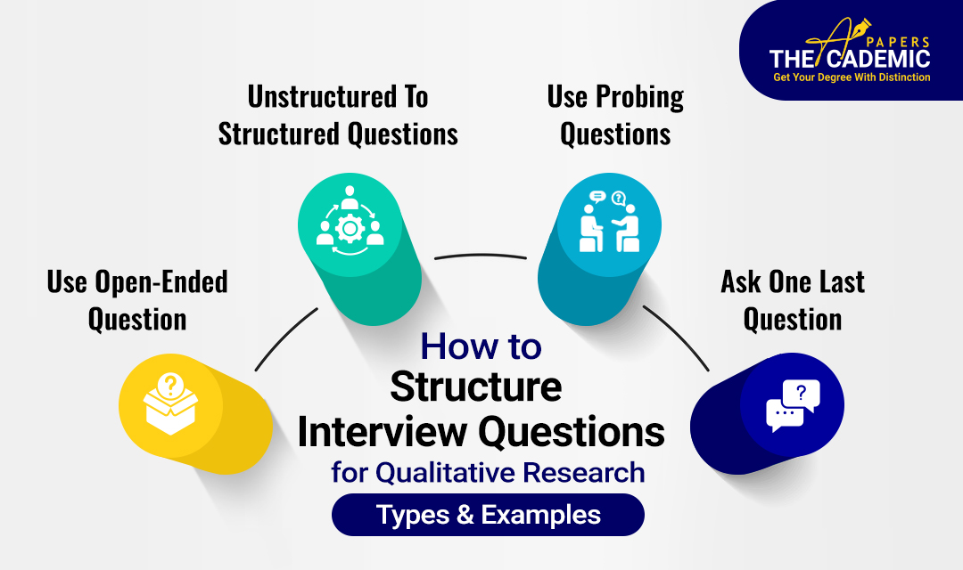
Selecting Appropriate Questioning Techniques For The ‘Admission Manager’ Role
To find out the ‘Admission Manager’ for the Global Education Group Ltd 3 types of questing techniques should be used as follows:
1. Open or Socratic Questions: It would allow detail elaborative responses from the candidates.
2. Probing Questions: It would allow following up a response from the candidates to elicit detail information about a scenario.
3. Clarifying Questions: It would allow recapping information from the candidates by rephrasing key-points.

Slide 13


The Comparison And Contrast Between Face-To-Face And Online Interview For The Admission Manager Role
For the ‘Admission Manager’ role face-to-face interview process provides distinctive features including physical presence, personal interactions, body language observation, formal settings, rapport building, professional connections, less technological issues, taking assessments for teamwork, individual tasks and interpersonal skills, sharing physical documents directly etc. Limitations include travel time and costs, scheduling could be challenging due to logistics, candidates feel more pressured in formal settings etc.
On contrast, online interview process provides several benefits including virtual platforms, no travel required, costs efficient, time savings, more flexible settings, initial screening, remote hiring, faster scheduling, usage of digital documents, screen sharing, candidates feel relaxed at their own places etc. Limitations include non-verbal cues, less physical interactions, lack of rapport through screens, dependent on internet and technologies, harder to verify digital documents etc.
By comparing and contrasting both interview techniques the Global Education Group Ltd. should administer face-to-face interview for the ‘Admission Manager’ role since this process would provide appropriate settings for the company to hire perfect candidate.

Slide 14

Conclusion
Firstly, today’s presentation provided an overview of the recruitment processes and the role of human resource development within an organization.
Secondly, a brief introduction of the student consultancy company has been described based in Birmingham, UK.
Thirdly, job analysis, job description, and personal specifications have been discussed for the required post of ‘Admission Manager’.
Fourth, 3 various types of interviews have been analysed for the hiring process.
Fifth, 3 different kinds of questing techniques have been assessed for interviewing the candidates.
Finally, the comparison and difference between face-to-face and online interviewing methods have been discussed for the job vacancy.

Slide 15

With Pleasure
Thanks for listening!

Slide 16

Questions?
Any Question?

Slide 17



List of References

Slide 18
List of References

