Slide 1
Elijah Thomas Slides

Slide 2


Slide 3
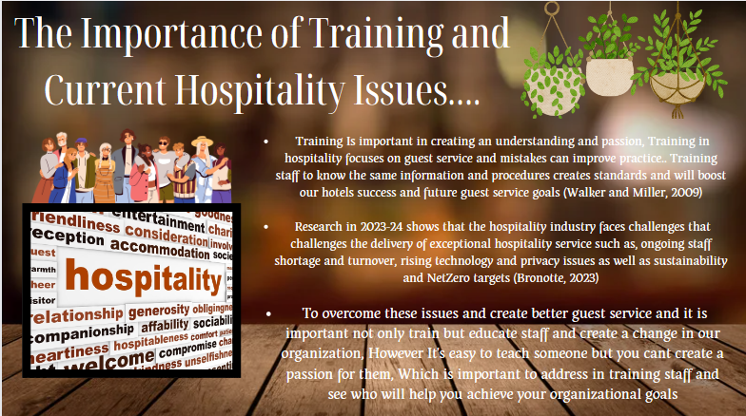

Slide 4
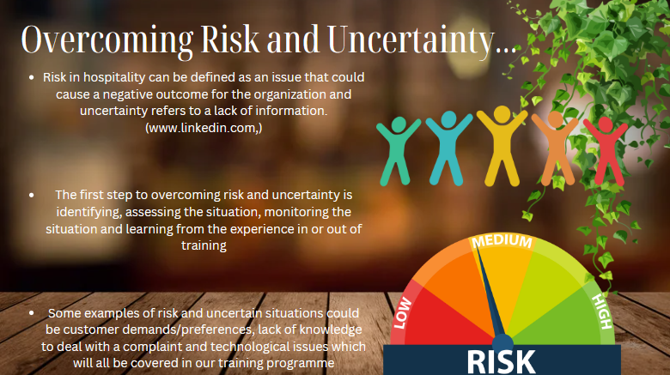

Slide 5
Reference List
Reference list
Ansar (2023). Training and Development Toolkit | Comprehensive Guide. [online] Teamhub | Project Management for small teams like yours. Available at: https://teamhub.com/blog/creating-a-comprehensive-training-and-development-toolkit/#:~:text=A%20well-designed%20and%20comprehensive%20training%20and%20development%20toolkit [Accessed 29 Apr. 2024].
Bronotte, M. (2023). The 7 biggest current issues in the Hospitality industry in 2023. [online] www.torrens.edu.au. Available at: https://www.torrens.edu.au/stories/blog/hospitality/current-issues-in-the-hospitality-industry.
Griffin, P. (n.d.). Ritz-Carlton Gold Standards of Customer Service. [online] Available at: https://cdn.ymaws.com/taspa.site-ym.com/resource/resmgr/2015_Fall_Conference_Presentations/Ritz-Carlton_Gold_Standards_.pdf.
https://hca-pro.com (n.d.). Luxury Service Training: The Ultimate Guide. [online] hca-pro.com. Available at: https://hca-pro.com/Luxury-Service-Training-Ultimate-Guide [Accessed 5 May 2024].
Lineup. (n.d.). HOME. [online] Available at: https://www.lineuphospitality.com/ [Accessed 5 May 2024].
Ro, H. and Chen, P.-J. (2011). Empowerment in hospitality organizations: Customer orientation and organizational support. [online] Available at: https://www.sciencedirect.com/science/article/pii/S0278431910001040.
Walker, J.R. and Miller, J.E. (2009). Supervision in the Hospitality Industry: Leading Human Resources. [online] Google Books. John Wiley and Sons. Available at: https://www.google.co.uk/books/edition/Supervision_in_the_Hospitality_Industry/3L-p-mhPkN4C?hl=en&gbpv=1&dq=Importance+of+training+in+hospitality&pg=PA237&printsec=frontcover [Accessed 24 Apr. 2024].
www.linkedin.com. (n.d.). How do you manage and mitigate the risks and uncertainties associated with hospitality development projects? [online] Available at: https://www.linkedin.com/advice/1/how-do-you-manage-mitigate-risks-uncertainties-1f.

