Slide 1
Christian-Muslim Relations in Contemporary Nigerian Politics
Wemimo B. Jaiyesimi
14 June, 2019

Slide 2
Relationship between ‘religion’ and ‘Politics’
Problems with defining religion.
Problems with defining ‘Politics’

Slide 3
Relationship Between Religion and Politics
Separation of Church and state.
1. Thomas Jefferson’s Virginia Statute for
Religious Freedom (1786)
2. First Amendment (1789)
3. 1648 ‘Westphalian Settlement’/ ‘Wars of Religion’
‘Traditional’ vs ‘Modern’ Societies

Slide 4
How Religion affects Politics
Political Parties
Pressure Groups
Mass of Citizens

Slide 5
‘Christian’ and ‘Muslim’ Approaches to Politics
Difficulty with the singular
From Islamic Politics to Muslim Politics
The ‘golden age’ of Islam (632-661)
Constantinian Christianity

Slide 6

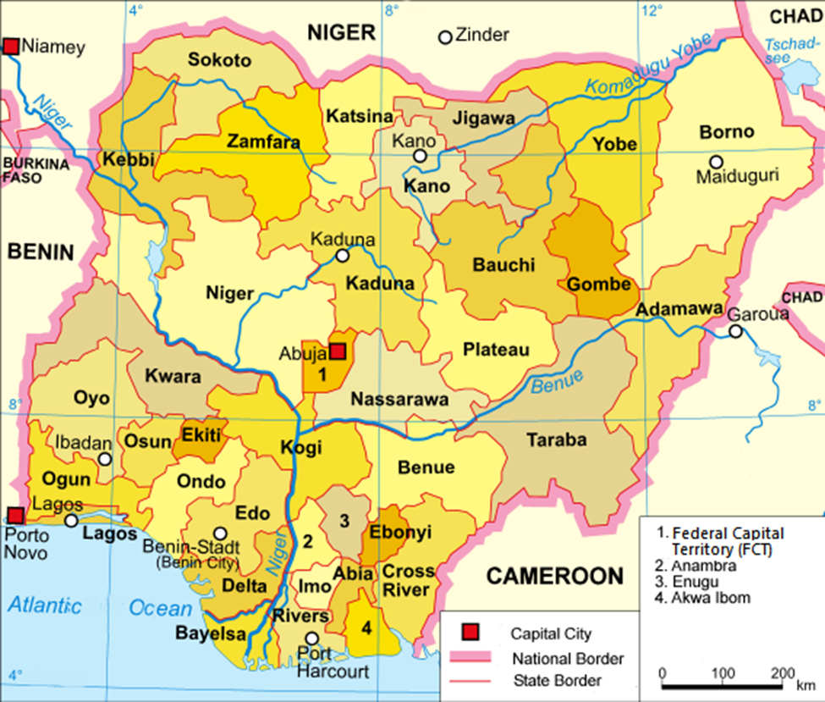
Map of Nigeria
Source:
https://en.wikipedia.org/wiki/Template:Nigeria_states_map

Slide 7

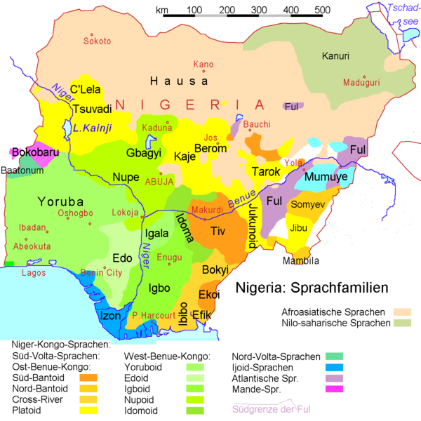



Source: Wikipedia Commons, https://commons.wikimedia.org/wiki/File:Nigeria_Sprachfamilien.png

Slide 8
Historical Background and Demographics of Christian-Muslim Relations in
Nigeria
Religion as critical to the shaping of the Nigerian polity
Nigeria’s population currently estimated at about 200 Million
Christians and Muslims distribution near-even.
Pew Research 2011, Christians at 80 Million and Muslims at 76 Million.
Northern part of Nigeria Predominantly Muslim
Southern part of Nigeria predominantly Christian.

Slide 9
Two Key Issues: 1. Christian-Muslim Struggles for State Power
Elections as sites where this struggles takes place.
Six general elections held since 1999 (The beginning of what is called the ‘Fourth Republic’)
‘Pentecostal Republic’
Segun Obasanjo (1999-2007) – Christian
Musa Yar’Adua (2007-2010) – Muslim
Goodluck Jonathan (2010-2015) – Christian
Mohammed Buhari (2015-present) - Muslim

Slide 10
Key Issues: 2. The Politics of Suspicion
Hegemonic politics in Northern Nigeria
Sharia Politics (1976-2000s)
OIC – 1986
Othering.
Ethnicity and Religion

Slide 11
Conclusion: What is the future of Christian-Muslim Relations in Nigeria’s Politics?
Persistence of the issues.
Boko-Haram and the politics of violence.
State failure and the ascendency of religion.
Weak National identity.

Slide 12
Thank you for Listening!

