Slide 1

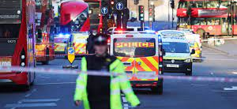
Public Protection & Counter-Terrorism
BMPL6014 2025
Week 1 – Introduction and Defining Terrorism
Jane Davies
J.davies2@uwtsd.ac.uk

Slide 2
Lesson Structure
Introductions
Ground rules and general info
Introduction to the course
Assessment 1
Defining Terrorism
Historical terrorism
Changing understandings of terrorism
Week 1 – Introduction and Defining Terrorism

Slide 3

Assignment 1
2,000-word Literature review (50%)
Submission date : 7th November 2025 by 23:59hrs
Choice of questions
Assignment 2 due 9th January 2026 - paper

Slide 4

Referencing
Level 6 – no excuse
Use UWTSD Harvard Referencing Handbook
Cite Them Right
Avoid platforms that reference for you.

Slide 5
Sources for assignments
Library – Books and Journals (British Journal Criminology/Police journals)
Webpages
CoP
PCC
CT policing / NCA
Policing Insight
Independent Office for Police Conduct - IOPC
National Police Chiefs Council- NPCC
Police Federation of England & Wales – PF
Government webpages/documents – Gov.uk (referencing error)

Slide 6


Class discussion
When you hear the word “Terrorism” what comes to mind?
  Words
  Images
  Events
  Feelings
Discuss with the people around you for 5 mins

Slide 7
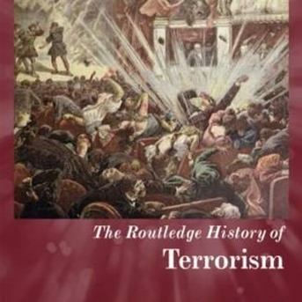
Terrorism – A Historical Context

Slide 8
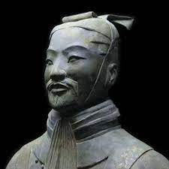
Terrorism – A Historical Context
'Kill one, frighten ten thousand’​
Sun Tzu – The Art of War (5th Century BC)​
The supreme art of war is to subdue the enemy without fighting.
If you are far from the enemy, make him believe you are near.
Quickness is the essence of the war.
Notes:
Kill one, frighten ten thousand" is a famous quote from Sun Tzu's "The Art of War," an ancient Chinese treatise on military strategy and tactics written in the 5th century BC. This quote encapsulates a key principle in Sun Tzu's teachings, which emphasizes the psychological aspect of warfare and the importance of using fear and intimidation as a strategic tool.
In the context of the quote, Sun Tzu is highlighting the idea that a single act of extreme violence or brutality can have a disproportionately significant impact on the enemy's morale and willingness to fight. By inflicting fear and terror through a single act, an army or commander can potentially deter a much larger force from engaging in battle or resistances.
The underlying principle is that the fear of suffering a similar fate to the one who was killed can be a powerful motivator or demotivator in warfare. This psychological aspect of war is considered just as important as physical strength and tactical prowess.
Overall, Sun Tzu's "The Art of War" emphasizes the strategic importance of understanding and manipulating the psychological elements of warfare to achieve victory while minimizing actual combat. It remains a highly influential work in the fields of military strategy, leadership, and conflict resolution.

Slide 9

Terrorism – A Brief History
The history of Terrorism stretches back over two thousand years
However, many see Terrorism as something new and fail to consider the historical context.
Often if the historical context is considered it is thought of through the lens of being unlike the global terrorism we see today.
https://www.visionofhumanity.org/wp-content/uploads/2020/11/GTI-2020-A3-map-poster.pdf
Notes:
The historical context of terrorism is complex and multifaceted, as terrorism has evolved over centuries in response to changing political, social, and technological dynamics. Here's an overview of the historical context of terrorism:
Origins and Early Forms:
Terrorism, as a tactic of violence and intimidation, has ancient roots. Historical accounts suggest that groups and individuals have employed terror as a means of achieving political, religious, or ideological objectives for centuries.
Some early examples of terrorism include the Sicarii, a Jewish extremist group active in the 1st century CE, and the Thuggee cult in India during the 19th century.
2. Nineteenth Century and Anarchist Movements:
The 19th century saw the emergence of anarchist movements in Europe and the Americas. Anarchist groups engaged in acts of political violence, including bombings and assassinations, to overthrow governments and challenge established authority.
Prominent events include the assassination of Archduke Franz Ferdinand of Austria in 1914, which triggered World War I, and the Haymarket affair in Chicago in 1886.
3. Decolonization and National Liberation Movements:
During the 20th century, decolonization and struggles for national liberation led to the rise of insurgent and guerrilla movements. Some of these movements, such as the Algerian National Liberation Front (FLN) and the Palestine Liberation Organization (PLO), used terrorism as a tactic to achieve their goals.
4. Cold War and State-Sponsored Terrorism:
The Cold War era saw the emergence of state-sponsored terrorism. Superpower rivalry and ideological conflicts fueled the support of proxy groups engaged in acts of terrorism. For example, the Soviet Union supported groups like the Popular Front for the Liberation of Palestine (PFLP), while the United States backed anti-communist groups in various regions.
5. Contemporary Terrorism:
The late 20th and early 21st centuries witnessed the rise of contemporary terrorism, characterized by non-state actors with global ambitions. Notable groups include Al-Qaeda, responsible for the 9/11 attacks in the United States, and ISIS (Islamic State of Iraq and Syria).
New technologies, such as the internet and social media, have facilitated the spread of extremist ideologies and the recruitment of individuals into terrorist groups.
6. Changing Tactics and Targets:
Terrorism has evolved in terms of tactics and targets. While bombings and hijackings remain common tactics, cyberterrorism and lone-wolf attacks have become more prevalent. Targets have shifted from purely political or military targets to include civilian populations and symbolic landmarks.
7. Counterterrorism Responses:
In response to the evolving threat of terrorism, nations have implemented various counterterrorism measures, including intelligence agencies, law enforcement, and international cooperation through organizations like INTERPOL and the United Nations.
It's important to note that terrorism is a dynamic and constantly changing phenomenon. Historical context provides insights into its evolution, but each period and region has unique dynamics and motivations that have contributed to the development of terrorist movements. Understanding the historical context of terrorism is crucial for developing effective strategies to counter it and address its root causes.

Slide 10
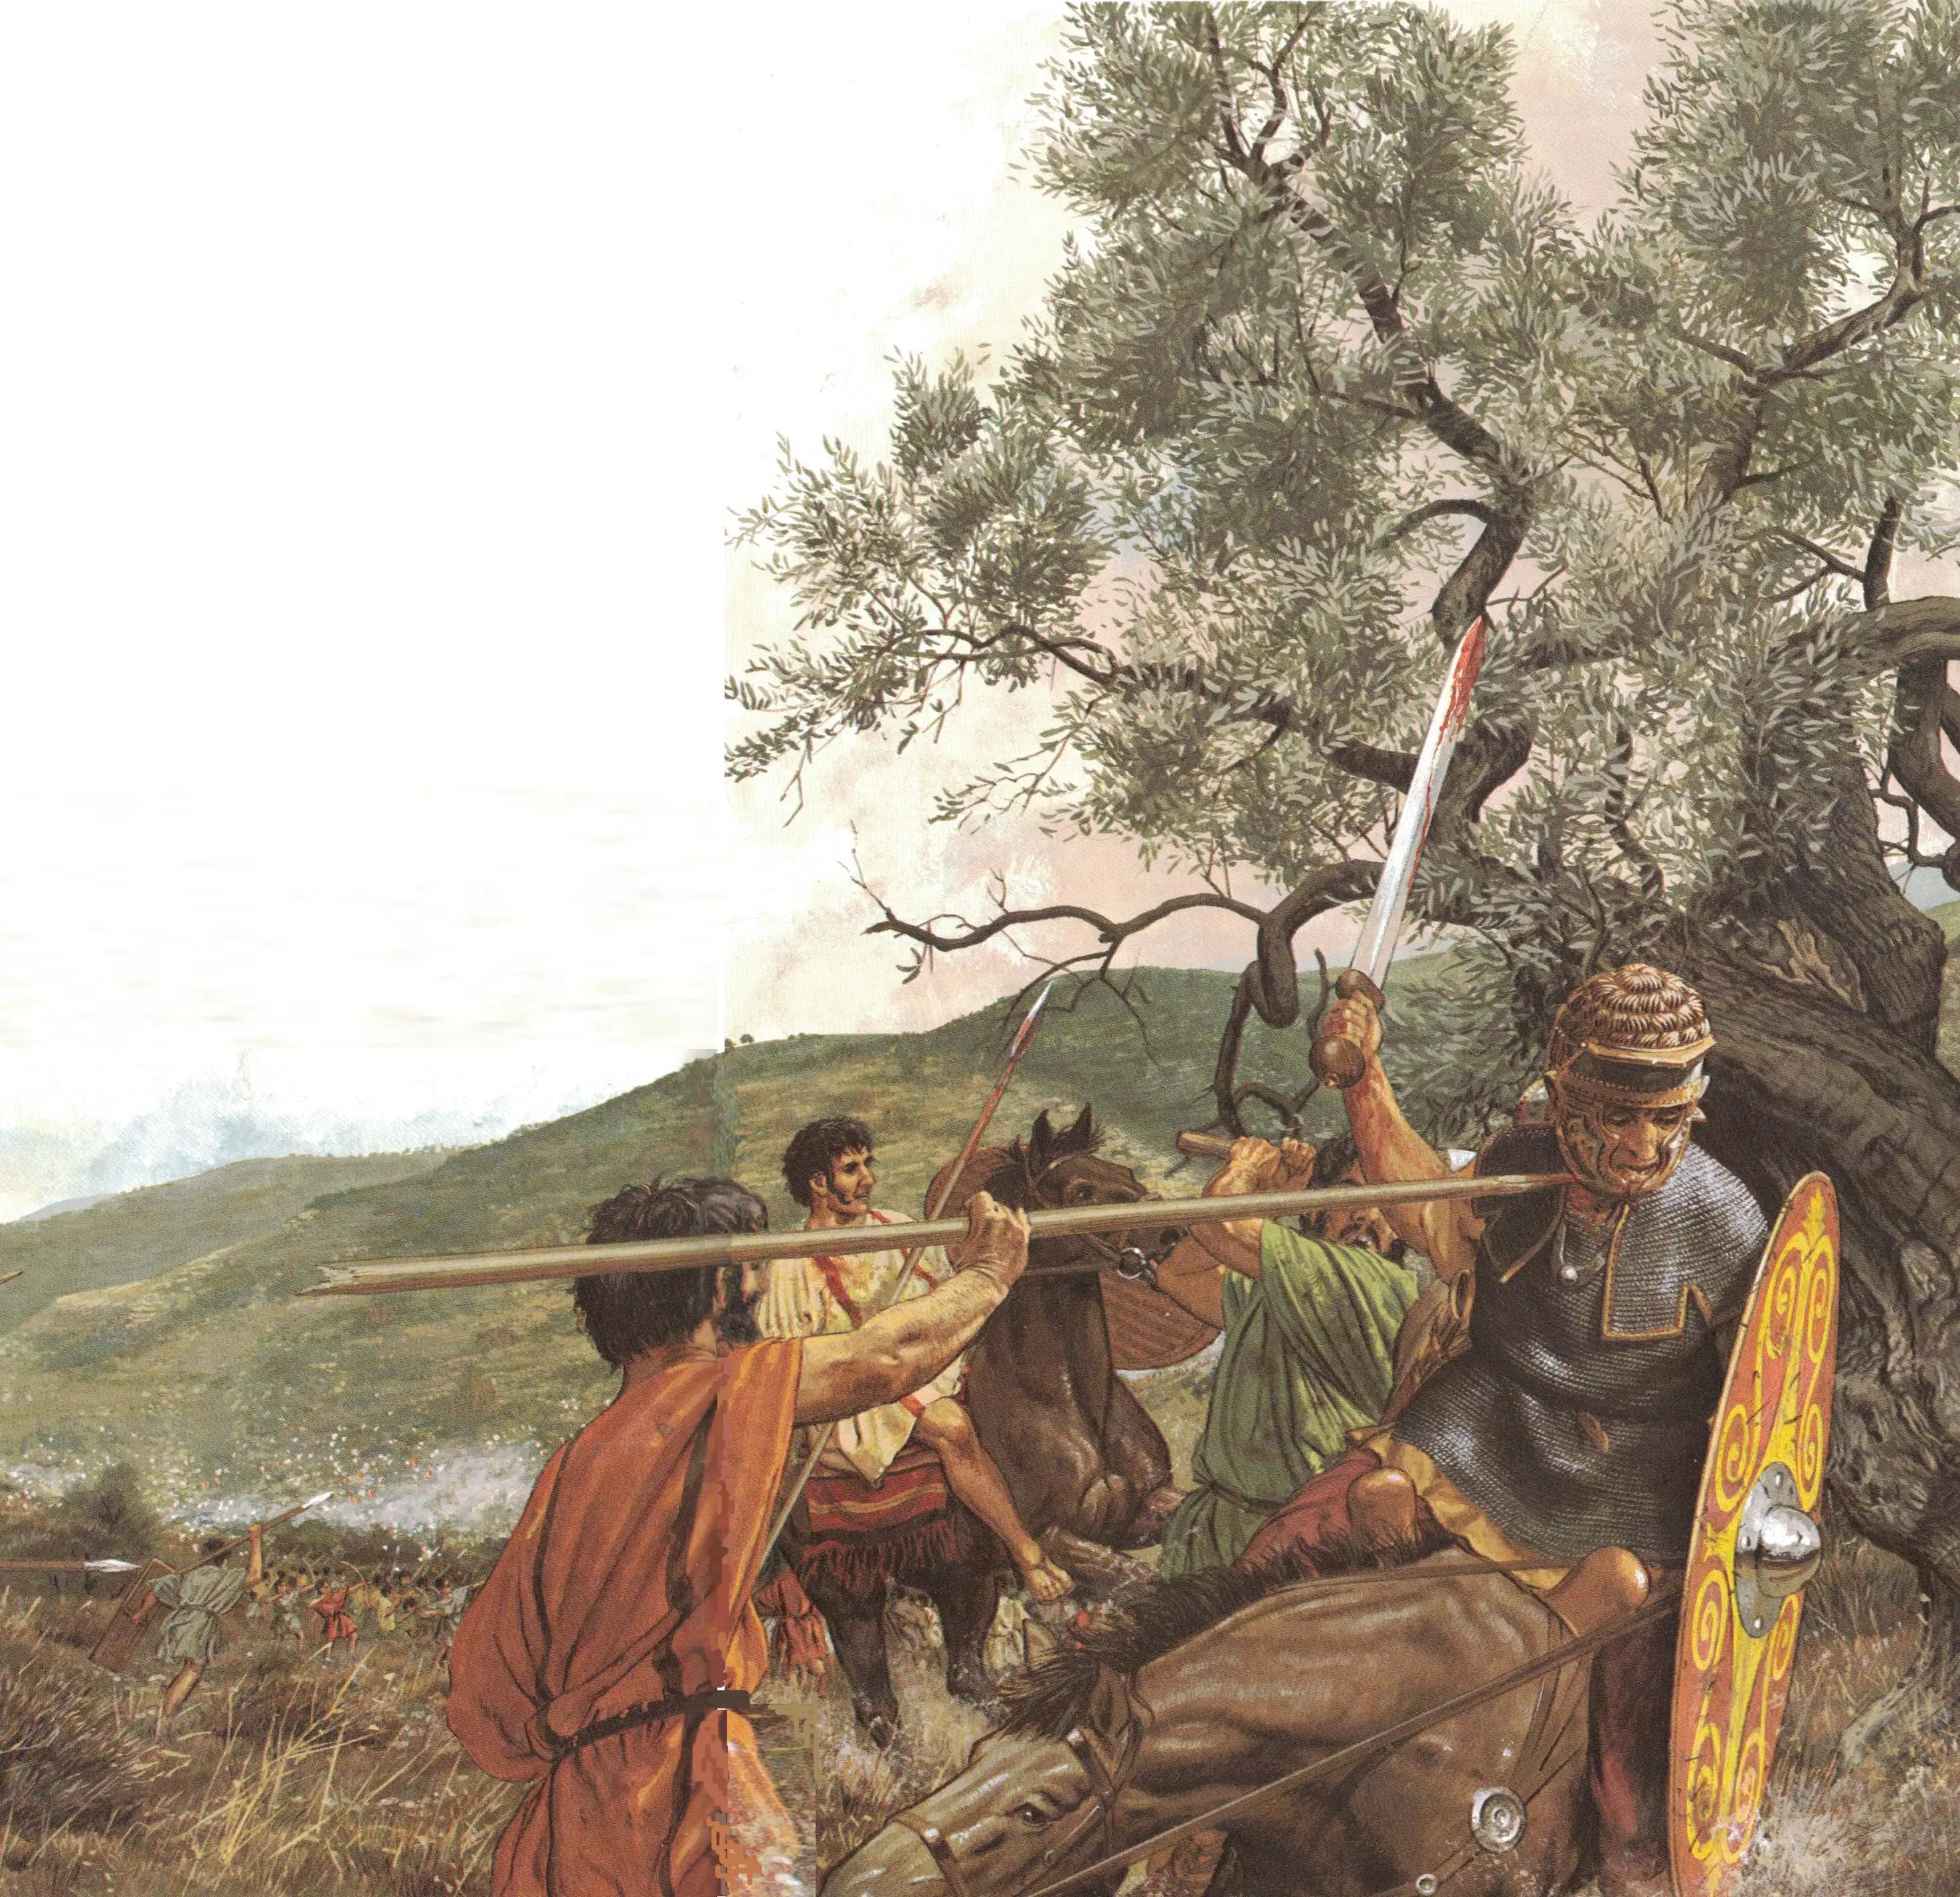
Sicarii – Ancient History
6AD Judea occupied by Roman Empire
Widespread belief that a Messiah would come to liberate the Jewish people
Some believed the they should ‘pave the way’ for this Messiah by igniting conflict with the Romans.
Notes:
The Sicarii were a Jewish extremist group active during the 1st century CE, primarily in Roman-occupied Judea (modern-day Israel and Palestine). While the Sicarii operated in a very different historical and cultural context from modern terrorism, their actions and motivations are sometimes referenced in discussions of terrorism for a few key reasons:
Use of Political Violence: The Sicarii were known for their use of political violence, including assassinations and acts of terror against Roman officials and collaborators. Their actions were aimed at resisting Roman rule and expelling the Romans from Judea.
Religious and Nationalistic Motivations: Like many modern terrorist groups, the Sicarii were driven by a combination of religious and nationalistic motivations. They saw their actions as a means of defending their faith and homeland against a foreign occupying power.
Impact on Public Perception: The actions of the Sicarii had a significant impact on the perceptions of the Jewish population, the Roman authorities, and the wider world. The use of violence and terror tactics by a radical minority group can influence how a broader community or society is perceived and can have implications for how that community is treated.
Historical Analogies: Scholars and analysts sometimes draw historical analogies to the Sicarii to better understand the motivations and strategies of modern terrorist groups. While the historical context and motivations may differ, there can be useful parallels drawn in terms of tactics, objectives, and the impact of extremist violence.
It's important to note that the Sicarii existed in a very different historical context, and the term "terrorism" as we understand it today did not exist during their time. Therefore, while there are some similarities in terms of the use of political violence and extremist ideologies, the concept of terrorism as we know it today is a modern phenomenon. Nevertheless, the historical study of groups like the Sicarii can provide valuable insights into the history of political violence and extremism.

Slide 11
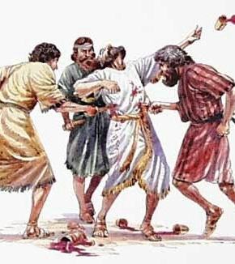
Sicarii
Aims
  Free Jewish people from Roman rule
Question:
  Does this aim classify their actions as terrorist? Why/Why not?

Slide 12
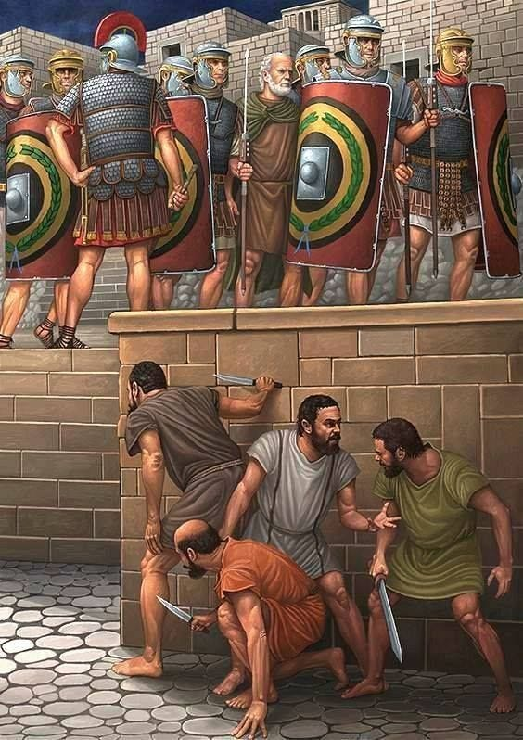
Tactics
  Targeted Romans and Jewish citizens who assisted the Romans, Jewish women who fraternized with Romans, Jews who worked for the Romans, shopkeepers that sold goods to Jews anyone who could be seen as collaborating with the Romans.
Question:
  Does this change your view of their activities as being terroristic?
  Does this inspire “terror”?
Notes:
The Sicarii employed a range of tactics to further their objectives of resisting Roman rule in Judea and fighting against perceived collaborators. Some of their primary tactics included:
Assassination: The Sicarii were infamous for carrying concealed weapons, particularly short swords or daggers called "sicae." They used these weapons to assassinate Roman officials, collaborators, and others whom they considered enemies. These assassinations were often carried out in crowded public places to maximize fear and uncertainty.
Infiltration: Members of the Sicarii sometimes infiltrated crowds or gatherings, posing as ordinary citizens or travelers. Once in position, they would carry out assassinations or acts of violence against their targets.
Ambushes: The Sicarii were known to set up ambushes along roads and in areas where Roman officials or sympathizers were likely to pass. They would then launch surprise attacks, often targeting individuals traveling with minimal protection.
Arson and Sabotage: In addition to assassinations, the Sicarii engaged in acts of arson and sabotage. They would target Roman property, infrastructure, and supply routes, aiming to disrupt Roman governance and control in the region.
Sieges: The Sicarii were responsible for the siege of the mountain fortress of Masada in 73-74 CE. They held out against Roman forces for several months before ultimately choosing mass suicide over capture.
Terror Tactics: The Sicarii's use of concealed weapons, assassinations, and public acts of violence aimed to create a climate of fear and uncertainty. This fear was intended to deter both Romans and those who were seen as collaborators from openly opposing the Sicarii's objectives.
Guerrilla Warfare: While their tactics included some elements of guerrilla warfare, the Sicarii did not engage in large-scale military confrontations with Roman forces. Instead, they relied on hit-and-run attacks and acts of terror to harass and disrupt Roman rule.
It's important to note that the Sicarii operated in a specific historical and regional context, and their tactics were tailored to the circumstances of their time. While there are parallels between the Sicarii's tactics and those employed by some modern terrorist groups, it's also important to recognize the differences in motivation, technology, and the political landscape between ancient Judea and the contemporary world.

Slide 13
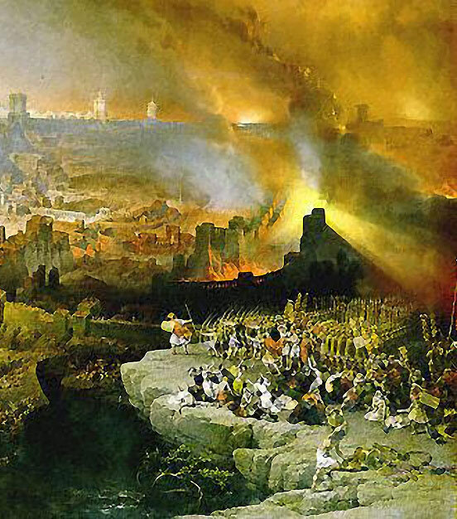
Sicarii
Outcomes
Notes:
The Sicarii did not win the hearts and minds of the majority of the Jewish population in Judea during their time. While they attracted support from some segments of the population who were opposed to Roman rule, their tactics of violence, assassination, and terrorism were divisive, and they often resorted to extreme measures that did not endear them to the broader community.
Here are some key factors contributing to their failure to win widespread support:
Violence and Terror Tactics: The Sicarii's use of violence and acts of terror, including assassinations in public places, created an atmosphere of fear and instability. Such tactics, while aimed at intimidating Roman authorities and collaborators, also had the effect of alienating and endangering innocent civilians.
Moderate Opposition: Many Jewish residents of Judea opposed Roman rule but did not necessarily support the extreme methods of the Sicarii. Moderate and diplomatic approaches to seeking independence or negotiating with Roman authorities were favored by some in the Jewish community.
Divisions Within the Resistance: The Jewish population in Judea was not monolithic, and there were various factions with differing views on how to resist Roman rule. The Sicarii's tactics and ideology were at odds with those of other groups, creating internal divisions within the resistance movement.
Limited Impact on Roman Rule: While the Sicarii were successful in disrupting Roman activities in certain areas, their actions did not significantly undermine Roman control of the region. The Roman Empire maintained a strong military presence, and the Jewish-Roman Wars continued until the eventual destruction of the Second Temple in 70 CE.
In the end, while the Sicarii were a notable and radical element of the resistance movement in Judea, they did not succeed in rallying the broader population to their cause. Their extreme methods and tactics contributed to divisions within the Jewish community, and the overall impact of their actions on the course of history in the region was limited.

Slide 14

“Party of the Narodnaya Volya”
“The Will of the People”
In 1873 a group of approximately 2500 young but highly educated Russians attempted to incite the downtrodden country’s peasantry to revolt.
These student moved into the countryside dressed as peasants and attempted to convince the poor the gospel of self help through revolution.
Notes:
The Narodnaya Volya (often translated as the People's Will), a Russian revolutionary organization in the late 19th century that played a significant role in the history of terrorism.
The Narodnaya Volya is known for its acts of political violence, including the assassination of government officials.
Background and Ideology:
The Narodnaya Volya was formed in Russia in 1879 as a revolutionary organization dedicated to overthrowing the autocratic Tsarist regime and establishing a socialist and democratic society.
The group's ideology was influenced by populist and socialist ideas, emphasizing the role of the peasantry in the revolution and the need for political change.
2. Key Objectives:
The primary goal of the Narodnaya Volya was to assassinate high-ranking government officials, including members of the imperial family and prominent ministers. They believed that by eliminating these figures, they could weaken the Tsarist regime and inspire a broader uprising.
3. Assassinations and Terrorism:
The group carried out a series of high-profile assassinations, including the assassination of Tsar Alexander II in 1881. They also targeted other government officials and functionaries.
Their use of terrorism as a tactic was intended to destabilize the government, create fear among the ruling elite, and incite popular rebellion.
4. Organizational Structure:
The Narodnaya Volya had a hierarchical organizational structure with a leadership committee. Members often operated in small cells to carry out specific tasks, including planning and executing assassinations.
5. Repression and Decline:
The Tsarist government responded with brutal repression. Many members were arrested, and the organization faced internal divisions and declining public support.
By the late 1880s, the Narodnaya Volya had largely ceased to exist as a coherent and effective organization.
6. Legacy:
The Narodnaya Volya is remembered for its radical tactics and its role in shaping the political landscape in Russia at the time. While it did not achieve its ultimate objectives, its actions had a lasting impact on Russian revolutionary movements.
Commonalities with Modern Terrorism:
The Narodnaya Volya's use of assassination and terrorism as tools to achieve political change shares commonalities with modern terrorist groups. These include the belief in the strategic value of violence, the targeting of government officials, and the desire to create fear and instability to achieve political objectives.
Key Figures:
Prominent figures associated with the Narodnaya Volya include Sofia Perovskaya, Andrei Zhelyabov, and Alexander Ulyanov (the older brother of Vladimir Lenin). These individuals were involved in planning and carrying out assassinations.
The Narodnaya Volya represents a significant historical example of a revolutionary group that used terrorism as a tactic in pursuit of political change. It played a role in the broader context of political and social upheaval in Russia during the late 19th century.

Slide 15

Attacks on the Tsar Alexander II
Trans Siberian Railway bomb attack – Tsar survived
Attack on Tsars palace – Tsar survived (he was not in the room bombed) 11 people were killed and 50 were injured.
Notes:
The assassination of Tsar Alexander II by the Narodnaya Volya is one of the most notable events in the history of the organization. Here's a detailed account of what happened:
Date and Location:
The assassination took place on March 1, 1881, in St. Petersburg, Russia.
The Plot:
The Narodnaya Volya had been planning the assassination of Tsar Alexander II for some time. They saw him as a symbol of autocracy and oppression and believed that his death would destabilize the Tsarist regime.
The Attack:
Tsar Alexander II was traveling in a closed carriage along the Catherine Canal when the attack occurred.
As the Tsar's carriage passed, a member of the Narodnaya Volya, Ignacy Hryniewiecki, threw a homemade bomb at the Tsar's carriage. The bomb exploded, damaging the carriage and injuring some of the Tsar's guards and bystanders.
The Tsar emerged from the damaged carriage, shaken but alive. He began to walk towards the injured and wounded.
The Second Bomb:
At this point, another member of the Narodnaya Volya, Grigory Goldenberg, threw a second bomb at the Tsar. This bomb detonated near the Tsar, causing severe injuries to him.
Tsar Alexander II was critically wounded, and despite efforts to save his life, he succumbed to his injuries a short time later.
Aftermath:
The assassination of Tsar Alexander II had a profound impact on Russia and its political landscape. It led to a period of increased repression, with a crackdown on revolutionary and dissenting movements.
Alexander III, the successor to the slain Tsar, adopted even more authoritarian policies in response to the assassination.
The Narodnaya Volya achieved its immediate goal of assassinating the Tsar, but it did not achieve its broader objectives of political change in Russia.
The assassination of Tsar Alexander II marked a significant turning point in Russian history, and it had repercussions for years to come. It is remembered as one of the most dramatic and consequential acts of political violence carried out by a revolutionary organization during that period.

Slide 16
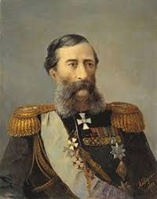
Resolving the Terrorist problem
Tsar appoints Minister of Interior Loris-Malikov who introduced a two pronged strategy:
  (i) Security Crackdown
  (ii) Tackle the root causes of terrorism by addressing the genuine grievances of the population.
Notes:
Following the assassination of Tsar Alexander II and in response to the broader terrorist and revolutionary activities of various groups, including the Narodnaya Volya, the Russian government, under Tsar Alexander III and later his son Tsar Nicholas II, implemented a series of repressive measures and policies aimed at suppressing dissent and maintaining control. Here are some key ways in which the Tsars addressed terrorist and revolutionary issues:
1. Increased Repression:
The Russian government significantly increased its repression of political dissent and revolutionary activities. This included the use of secret police agencies like the Okhrana to infiltrate and monitor revolutionary organizations.
2. The Okhrana:
The Okhrana was the Tsarist secret police, established to counter revolutionary movements. It engaged in extensive surveillance, infiltration of revolutionary groups, and the arrest and imprisonment of suspected revolutionaries.
3. Censorship:
Strict censorship of newspapers, literature, and public discourse was enforced to prevent the spread of revolutionary ideas and propaganda.
4. Arrests and Executions:
Thousands of individuals suspected of involvement in revolutionary activities were arrested, imprisoned, or executed. Show trials and harsh sentences were used to suppress dissent.
5. Siberian Exile:
Many political prisoners were exiled to Siberia, a remote region of Russia, as a means of isolating and neutralizing revolutionary elements.
6. Russification Policies:
The government implemented policies to promote Russification, which aimed to assimilate non-Russian ethnic groups into Russian culture and suppress their national identities. This was seen as a means of preventing nationalist or separatist movements.
7. Economic and Social Policies:
The government pursued conservative economic and social policies that favored the nobility and maintained a strict hierarchical social structure. This was intended to maintain the existing order and reduce the appeal of revolutionary ideologies.
8. Secret Police Activities:
The government used informants and agents to infiltrate revolutionary organizations and disrupt their activities. This often led to the discovery and suppression of revolutionary plots and cells.
Despite these repressive measures, revolutionary and terrorist activities persisted in Russia, ultimately culminating in the Russian Revolution of 1917, which led to the overthrow of the monarchy and the establishment of a communist government under the leadership of the Bolsheviks.
The Tsarist regime's response to terrorism and revolutionary movements was characterized by authoritarianism, censorship, and harsh repression. While these measures succeeded in suppressing dissent to some extent, they did not ultimately prevent the major political and social changes that would come with the fall of the Romanov dynasty in 1917.

Slide 17

The Final Attack
The bombers were deployed to throw their bombs at the Tsar in his carriage
The Tsar stopped his carriage and got out to inspect. 2nd bomb at close range killing himself and fatally injuring the Tsar who died several hours later.

Slide 18
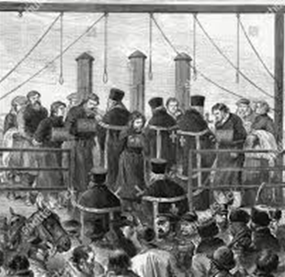
The Execution
The assassination of the Tsar was the groups high point, BUT……
A Bomber was captured and gave the details of the group and its members, consequently the Executive Committee was captured tried and hanged within 8 days.
Notes:
The members of the Narodnaya Volya who were involved in the assassination of Tsar Alexander II were subjected to a range of punitive measures by the Russian government.
After the assassination, the government launched a crackdown on revolutionary and terrorist activities, and those associated with the group faced arrest, trials, and various forms of punishment. Here's how some members of the group were executed, and the reasons behind it:
1. Arrests and Trials:
Many members of the Narodnaya Volya, including those directly involved in the assassination, were arrested in the aftermath of the attack. This led to a series of trials.
2. Death Sentences:
Several members of the Narodnaya Volya, including those who had thrown the bombs that killed the Tsar, were sentenced to death by hanging. The death penalty was a common punishment for political crimes in Russia at the time.
3. Public Executions:
The executions of the condemned members of the Narodnaya Volya were carried out in public, as was the practice for executions in Russia during that era. Public executions were intended to serve as a deterrent and to send a message of the government's resolve to suppress revolutionary activities.
4. Deterrence and Repression:
The Russian government's decision to execute the members of the Narodnaya Volya can be understood as part of its broader strategy of repression and deterrence. The government sought to demonstrate the consequences of engaging in terrorism and revolutionary actions against the state.
5. Symbolic Significance:
The execution of those involved in the assassination of the Tsar had a symbolic significance. It marked the government's response to what was considered a grave and direct threat to the monarchy.
6. The Fear of Uprisings:
The government was also concerned about the possibility of further uprisings and terrorist actions. The executions were meant to discourage other revolutionaries from taking similar actions and to maintain control over the population.
It's important to note that the response to the assassination varied for different individuals involved in the Narodnaya Volya and depended on their roles and levels of responsibility. Some received death sentences, while others faced imprisonment or exile.
The execution of the members of the Narodnaya Volya was part of a broader pattern of repression and crackdown against revolutionary movements in Russia during that period. While it may have temporarily suppressed some revolutionary activities, it did not eliminate the underlying causes of discontent and dissent that ultimately led to the Russian Revolution in 1917.

Slide 19
Historical Examples of Terror
Both the Sicarii and Narodnaya Volya provide classic examples of terrorist groups:
The Sicarii were motivated by ethnic, religious and nationalist agendas, whilst
Narodnaya Volya were motivated by bringing reform of the Government and replacing it with apolitical ideology of their own.
Almost all terrorist groups fall into one or more than one of these motivators (e.g. Al Qaeda, PIRA)

Slide 20


Today – Actions would be classed as Terrorist's
Notes:
Guy Fawkes – attempted to blow up HoP
Violent actions of Suffragettes – activists

Slide 21
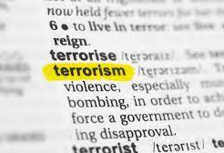
Terrorism

Slide 22
May Bulman 2018
UK more concerned about terror than any other country
Study surveyed 21,548 adults around the world revealed that four in ten British people think a war between North Korea and USA was likely.
British people are more concerned about terror attacks
  six in 10 people were concerned that a major incident would take place in 2018/2019

Slide 23

Defining Terrorism
Why should there be a definition for ‘terrorism’?
  Can you think of a definition of terrorism?
  What should we use a definition of terrorism for?

Slide 24
Defining Terrorism
Why do you think defining terrorism is so difficult?
Discuss

Slide 25
Threat Level - UK
Threat levels are designed to give a broad indication of the likelihood of a terrorist attack.
LOW means an attack is highly unlikely
MODERATE means an attack is possible, but not likely
SUBSTANTIAL means an attack is likely
SEVERE means an attack is highly likely
CRITICAL means an attack is highly likely in the near future
Where is the UK today?
Notes:
https://www.mi5.gov.uk/threat-levels

Slide 26

Defining Terrorism
An unending task…
Study: Schmidt and Jongman (1988)
109 Definitions of ‘Terrorism’ Analysed:
83.5% contained the term ‘Violence’
65% said it was ‘Political’
51% said it created ‘Fear’ or ‘Terror’
47% identified ‘threats’
41.5% psychological effects

Slide 27

Overview of Terrorism
https://www.youtube.com/watch?v=-9mMZOfN0a8

Slide 28

Terrorism and its different forms
Common elements that many definitions share:
Use of Violence or Threats
Political, Religious, or Ideological Motivation
Intention to Spread Fear
Targets and Victims
Non-State Actors
Notes:
Definition of Terrorism:
Terrorism is a complex and multifaceted concept that lacks a universally agreed-upon definition due to its political, ideological, and subjective nature. However, there are common elements that many definitions share:
Use of Violence or Threats: Terrorism involves the use of violence, threats, or intimidation to create fear and coerce individuals, groups, or governments into taking certain actions or adhering to specific ideologies.
Political, Religious, or Ideological Motivation: Terrorist acts are often driven by political, religious, or ideological motivations. These motivations can range from separatism and nationalism to religious extremism and revolutionary ideologies.
Intention to Spread Fear: One of the main goals of terrorism is to spread fear and panic within a population or a specific target group. This fear is intended to influence behaviour or policies.
Targets and Victims: Terrorist acts typically target civilians, non-combatants, and symbols of authority to maximize psychological impact. However, they can also target government facilities, infrastructure, or military personnel.
Non-State Actors: While states can engage in acts of violence, terrorism is primarily associated with non-state actors, such as extremist groups or individuals.

Slide 29

Terrorism Act 2000
“Terrorism”
The use or threat of “action” where -
involves serious violence against a person,
(b) involves serious damage to property,
(c) endangers a person's life, other than that of the person committing the action,
(d) creates a serious risk to the health or safety of the public or a section of the public, or
(e) is designed seriously to interfere with or seriously to disrupt an electronic system,
to influence the government, or an international governmental organisation,
Or to intimidate the public, or a section of the public,
Or the purpose of advancing
A Political, Racial, Religious or Ideological (PRRI) Cause.
Notes:
The Terrorism Act 2000 is a piece of legislation in the United Kingdom that was enacted to address the growing threat of terrorism and to provide law enforcement agencies with enhanced powers to combat terrorism. It was introduced in response to several factors and events that highlighted the need for updated and comprehensive counterterrorism legislation:
Rising Global Terrorism: In the late 20th century and early 21st century, terrorism became a significant global concern. High-profile attacks such as the 1998 U.S. embassy bombings in Kenya and Tanzania and the 9/11 attacks in the United States underscored the need for countries to strengthen their legal frameworks to counter terrorism.
International Obligations: The United Kingdom, like many other countries, is a signatory to various international conventions and agreements aimed at combating terrorism. These agreements, including United Nations Security Council resolutions, required member states to take specific measures to combat terrorism and its financing.
Domestic Threats: The UK faced its own challenges with terrorism. The Irish Republican Army (IRA) had been involved in a long-running conflict in Northern Ireland, and there were concerns about the potential for international terrorist groups to operate within the country.
Legal Gaps: Prior to the Terrorism Act 2000, the UK had several counterterrorism laws, but they were seen as fragmented and inadequate to address the evolving nature of terrorism. The new legislation aimed to consolidate and modernize these laws.
Key provisions and objectives of the Terrorism Act 2000 include:
Defining Terrorism: The act provided a legal definition of terrorism, which was essential for law enforcement to identify and prosecute terrorists effectively.
Preventative Detention: It granted law enforcement agencies the authority to detain suspects without charge for up to seven days, subject to judicial oversight, in cases involving national security concerns.
Stop and Search Powers: The act expanded stop and search powers for the police in designated areas, allowing them to search individuals and vehicles without requiring reasonable suspicion in certain circumstances.
Criminalization of Terrorism-Related Activities: The legislation made it an offense to be a member of a terrorist organization, engage in fundraising for terrorist purposes, and possess materials useful for terrorism.
Financial Measures: The act included measures to freeze assets and restrict the financial resources of individuals and organizations involved in terrorism.
Expulsion of Foreign Terrorist Suspects: It enabled the deportation of foreign nationals involved in terrorism.
The Terrorism Act 2000 has been subsequently amended and supplemented by other counterterrorism legislation in the UK to address emerging threats and challenges. It reflects the UK government's commitment to combating terrorism while safeguarding national security and human rights, although some of its provisions have been subject to criticism and legal challenges related to civil liberties and due process.

Slide 30
The Counter-Terrorism and Border Security Act 2019
Updates existing counter-terrorism legislation to ensure that it is fit for the digital age and reflect contemporary patterns of radicalisation. Some of the main provisions:
Section 1 extends the offence of inviting support for a organisation in section 12 of the Terrorism Act 2000;
Section 2 clarifies that the existing offence in section 13 of the Terrorism Act 2000 of displaying in a public place an image which arouses reasonable suspicion that the person is a member or supporter of a proscribed organisation;
Section 3 updates the offence in section 58 of the Terrorism Act 2000 of obtaining information likely to be useful to a terrorist to cover terrorist material
Section 4 provides for a new offence of entering or remaining in an area outside the United Kingdom that has been designated in regulations by the Secretary of State in order to protect the public from a risk of terrorism;
Section 6 offences to ensure that individuals abroad can be prosecuted for having encouraged or carried out acts of terror overseas;
Section 7 increases to 15 years’ imprisonment the maximum penalty for certain preparatory terrorism offences; and
Section 18 amends the Terrorism Act 2000 so that the pre-charge detention clock can be paused when a detained person is transferred from police custody to hospital.
Notes:
https://www.cps.gov.uk/crime-info/terrorism

Slide 31
The Counter-Terrorism and Sentencing Act (2021)
ends early release for anyone convicted of a serious terror offence and forces them to spend their whole term in jail. The most dangerous offenders – such as those found guilty of preparing or carrying out acts of terrorism where lives were lost or at risk – now face a minimum of 14 years in prison and up to 25 years on licence, with stricter supervision. Key measures include:
a new ‘Serious Terrorism Sentence’ for dangerous offenders with a 14-year minimum jail term and up to 25 years spent on licence;
increasing the maximum penalty from 10 to 14 years for a number of terror offences, including membership of a proscribed organisation;
widening the offences that can be classed as terror-connected to ensure they carry tougher sentences and offenders are subject to the Registered Terrorist Offender notification requirements post-release; and
boosting the disruption and risk management tools available to Counter-Terrorism Policing and the Security Service, by strengthening Terrorism Prevention and Investigation Measures

