Slide 2
What is affordance?
Concept from ecological psychology, work on visual perception: Gibson 1977, 1979
Considers the ‘animal’ in its ‘environment’:
  ‘The environment provides opportunities and resources for action, and information for what is to be perceived so as to guide action. Action has consequences that provide more information for the perceiver. The animal and environment are dynamic players in the systemic whole’ (Gibson and Pick 2000 p.14).
Notes:
Agent – eg. child
System - eg. natural space

Slide 3
Affordance
Gibson introduced the word ‘affordance’:
  ‘I have made it up. I mean by it something that refers to both the environment and the animal in a way that no existing term does. It implies the complementarity of the animal and the environment’ (Gibson 1979 p.127).

Slide 4
Affordance
The location of the affordance lies neither with the animal nor within the environment but between them within the perception by the animal of its environment.
‘The affordances of the environment are what it offers the animal, what it provides or furnishes, either for good or ill’ (Gibson 1979 p.127).
It is therefore not possible to measure affordance ‘as we measure [physical properties] in physics’ (Gibson 1979 p.128).

Slide 5
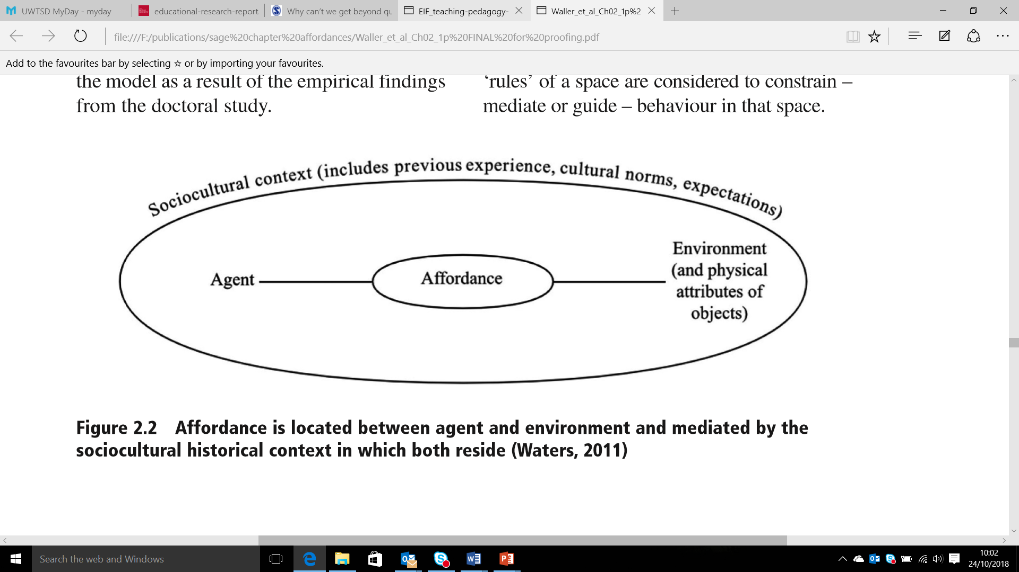
Affordance is located between agent and environment and mediated by the sociocultural historical context in which both
[Fig 2.2 Waters 2017]

Slide 6
Affordance and outdoor play
The term has been adopted by academics writing about young children in their outdoor spaces
Here the ‘animal’ is the human being, specifically the child
The ‘environment’ is the space in which the child finds herself

Slide 7
Perception of affordances 1
‘If a rock is big enough to fit the hand, it might be perceived as an object to grasp or throw; it affords grasping or throwing. A tree that is appropriately branched and stemmed, will likewise be perceived as climb-on-able; in affords climbing on.’ (Fjortoft and Sageie 2000 p.111)
Notes:
The perceptual aspect of affordance is essential to understand it

Slide 8
Perception of affordances 2
We need to ensure we do not, as adults, decide that certain features afford certain activities in certain circumstances as this is omitting the perceptual nature of affordance
The space can only afford an activity if the activity is perceived as do-able in the space by the do-er

Slide 9
Fjortoft and Sageie (2000) clearly state: ‘as adults we perceive the landscape as forms, whereas children will interpret the landscape and terrain as functions’ (p.85)

Slide 10
Perception of affordances 3
The description of an environment using the concept of affordance then must be based on children’s activity within the environment, rather than on an adult’s ideas about what children can do in a space.
We cannot judge the affordances of an environment before or without such activity taking place.

Slide 11
Locating affordance
Kytta (2004) described affordances as being ‘located at the interface between the setting and the person’ (p.181)
Kytta suggests we can consider potential affordances
  those affordances of an environment that are specified relative to an individual and ‘are available to be perceived’ (ibid.)
A subset of these are the actualised affordances
  revealed through actions of the individual, or through self report.
Notes:
Kytta’s work offers a solution to the problem of pre-judging a space and its affordances

Slide 12
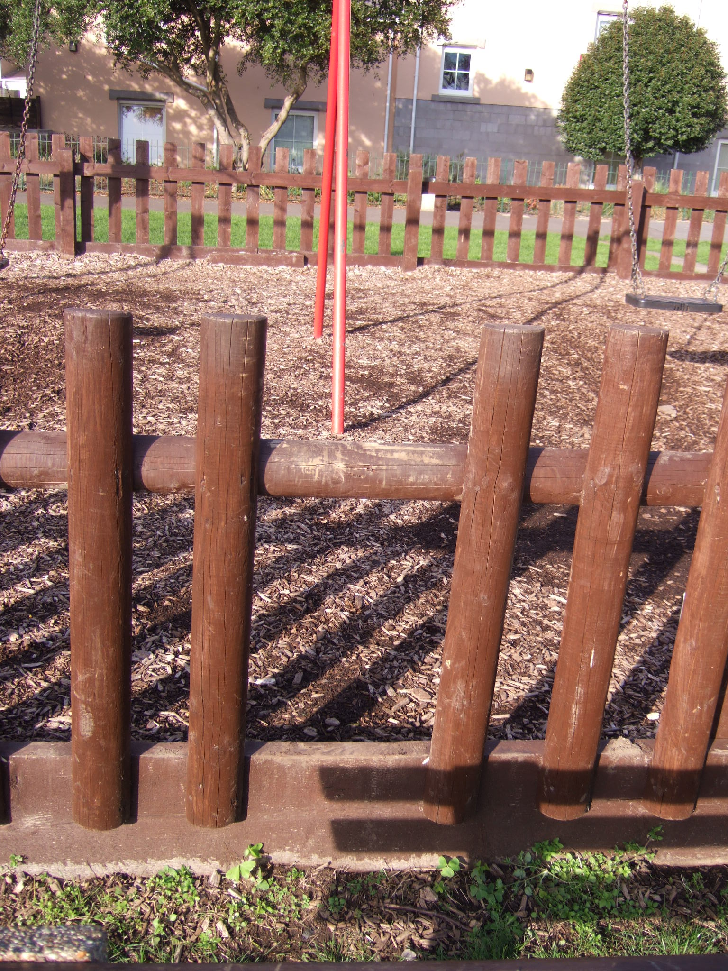
Notes:
What may this afford – what is the potential affordance? (What might a child do here?)

Slide 13
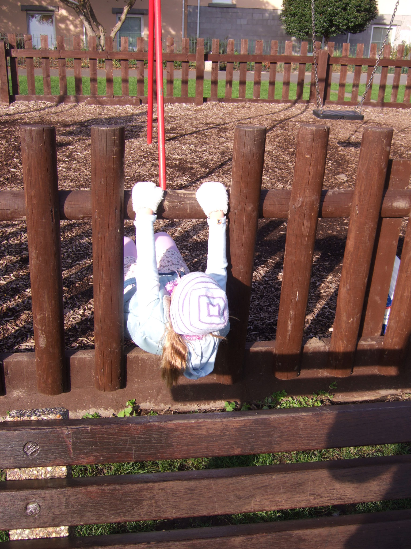

Slide 14
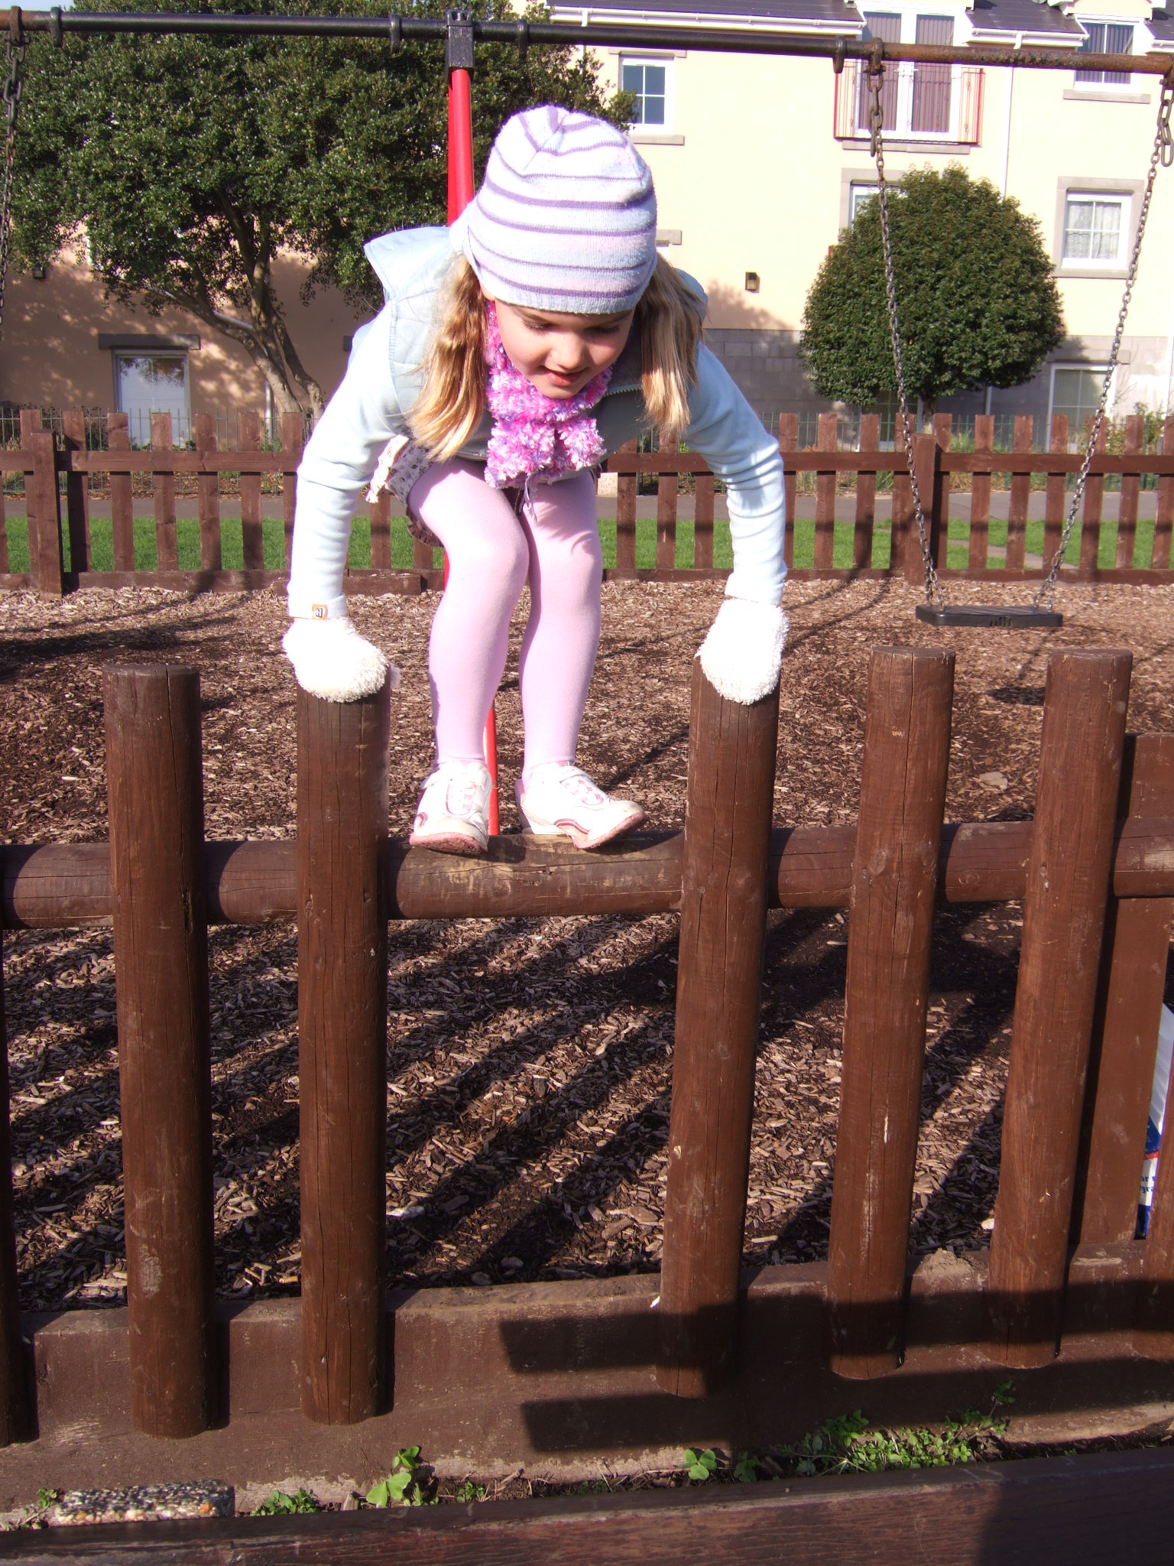

Slide 15
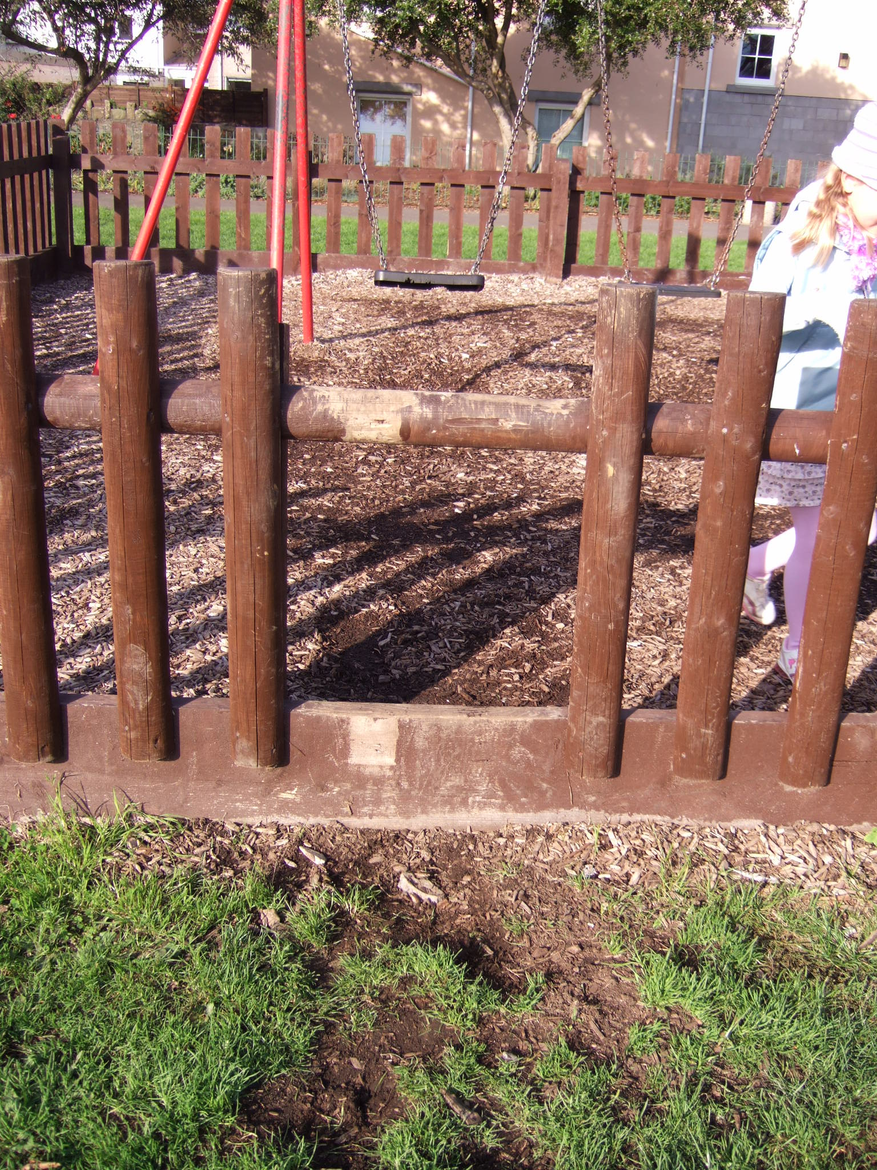

Slide 16
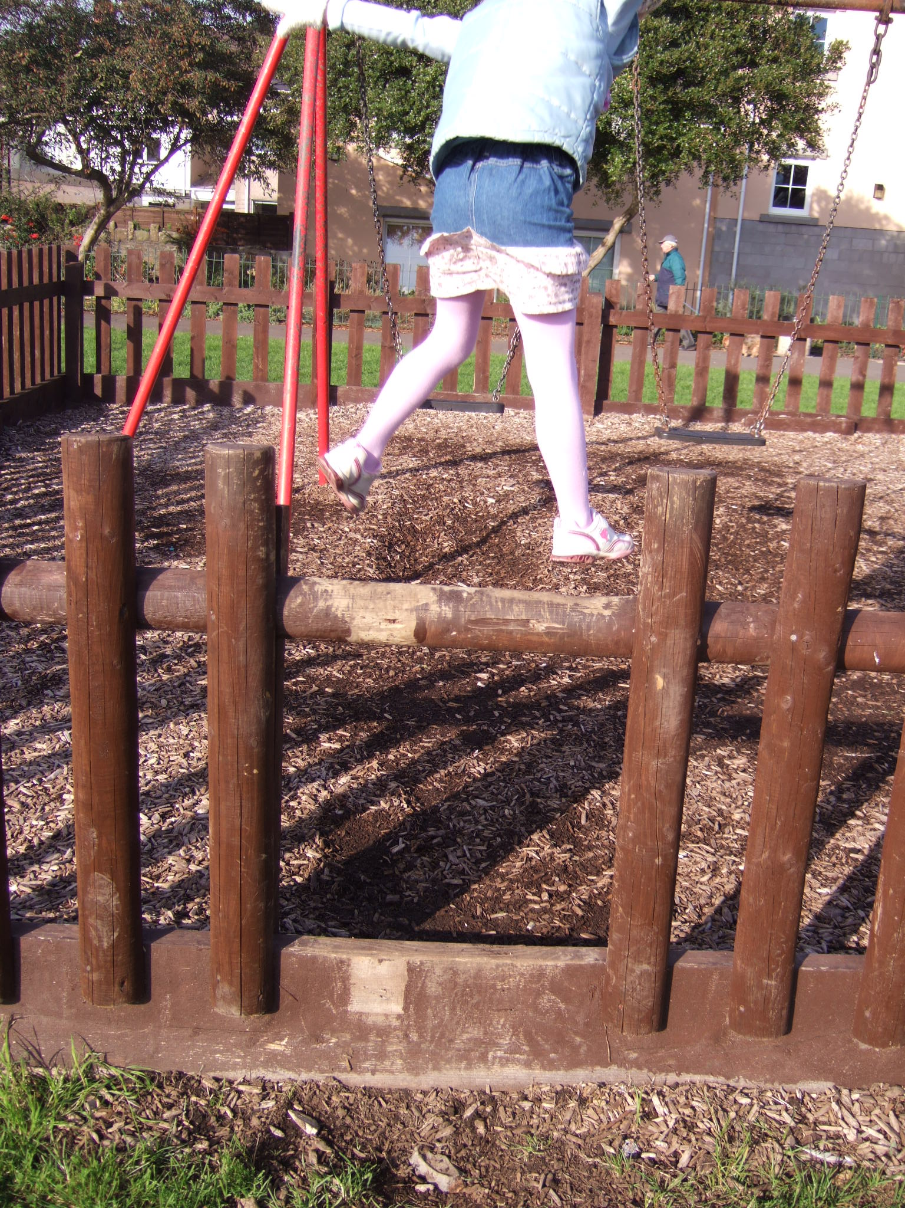

Slide 17
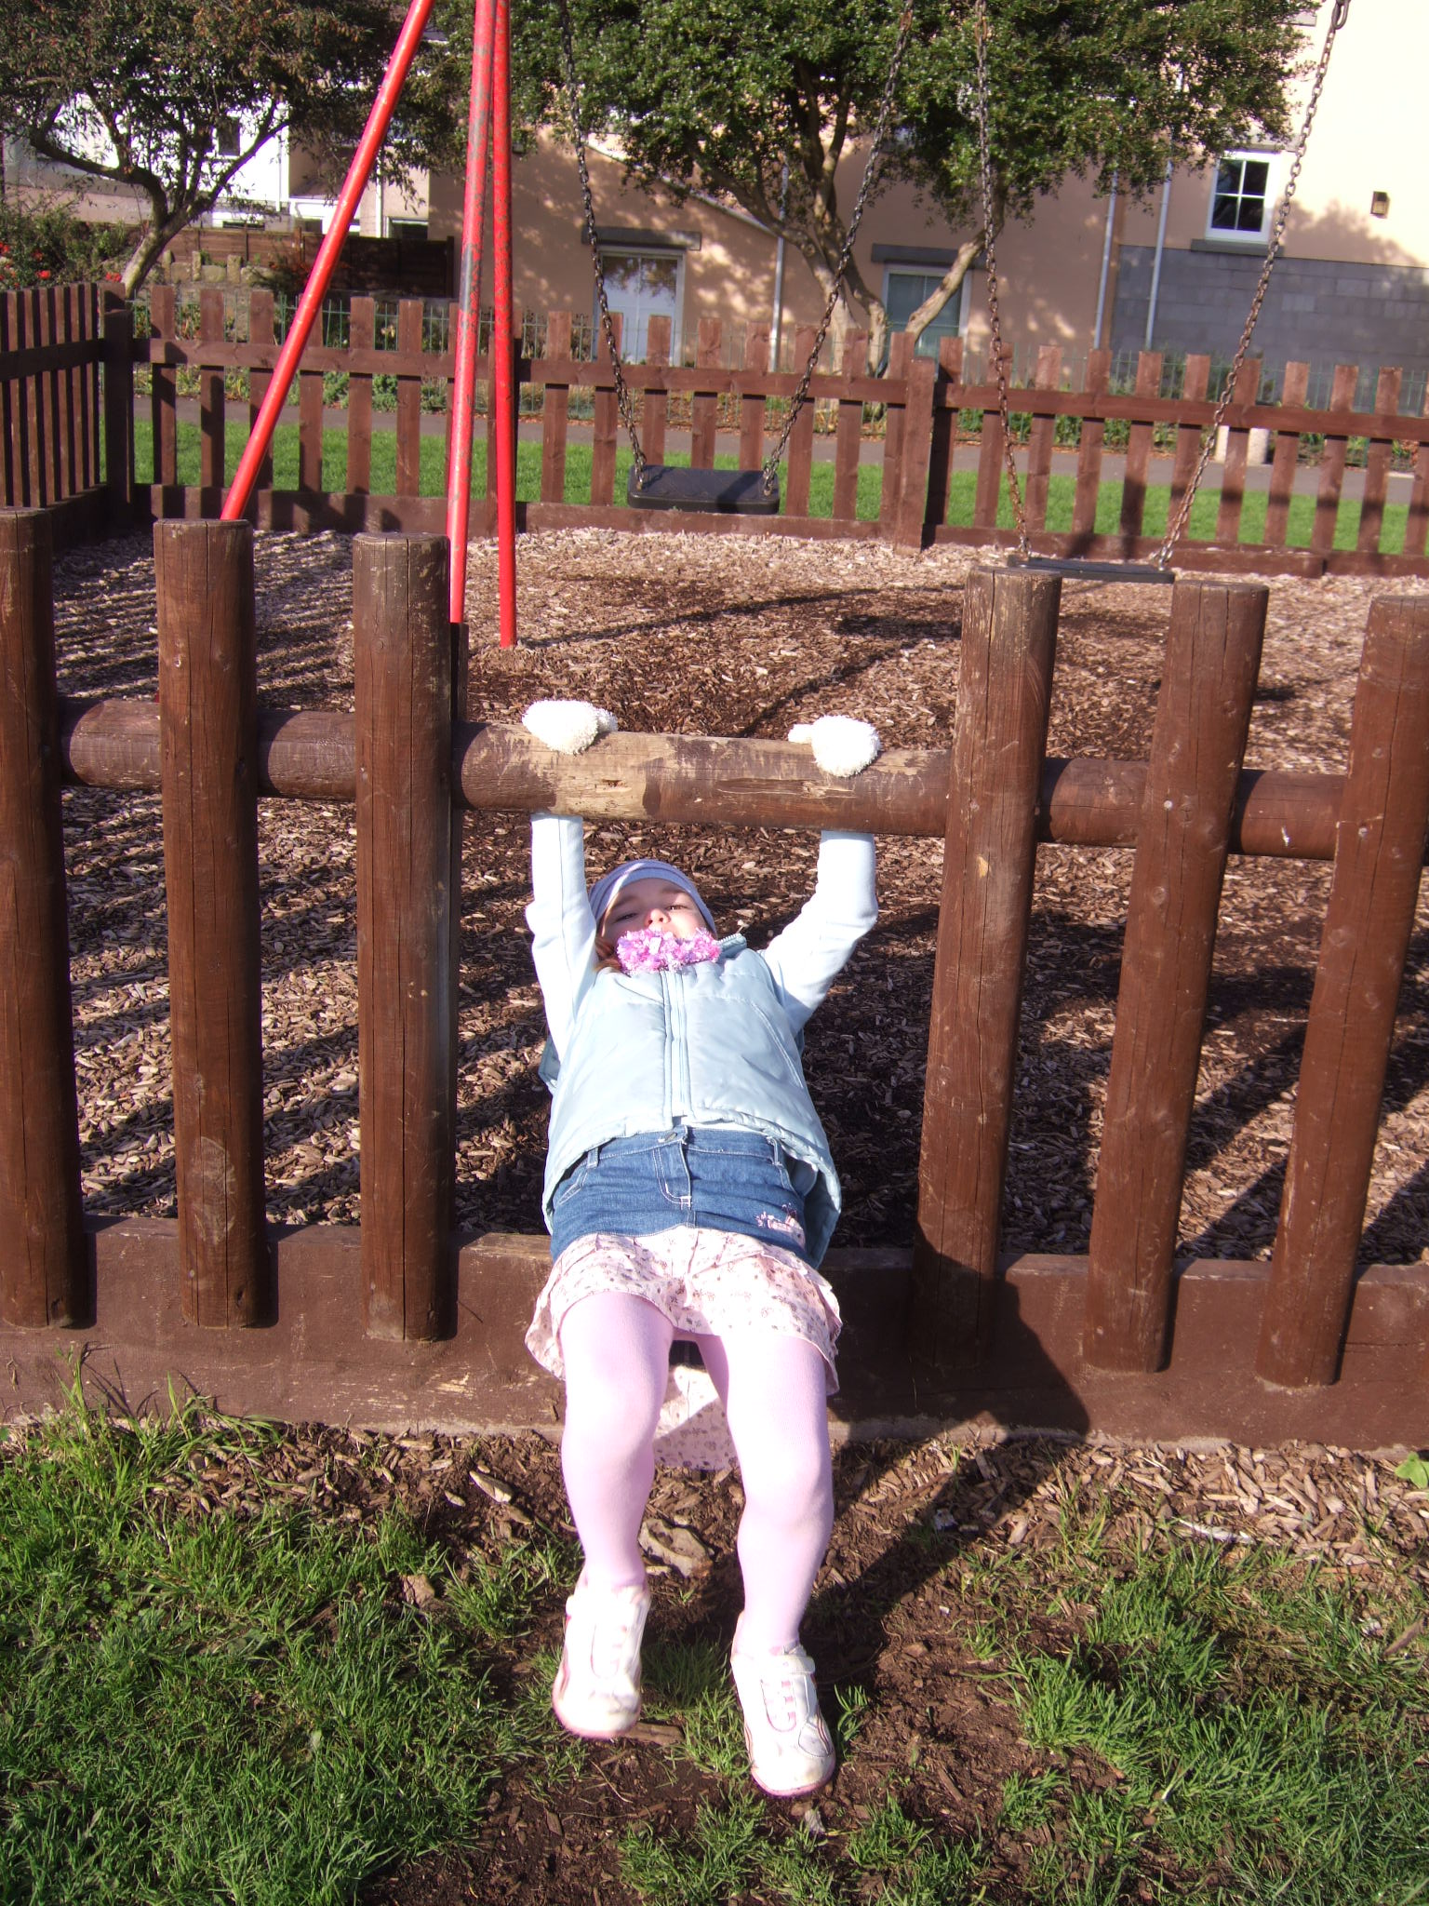

Slide 18
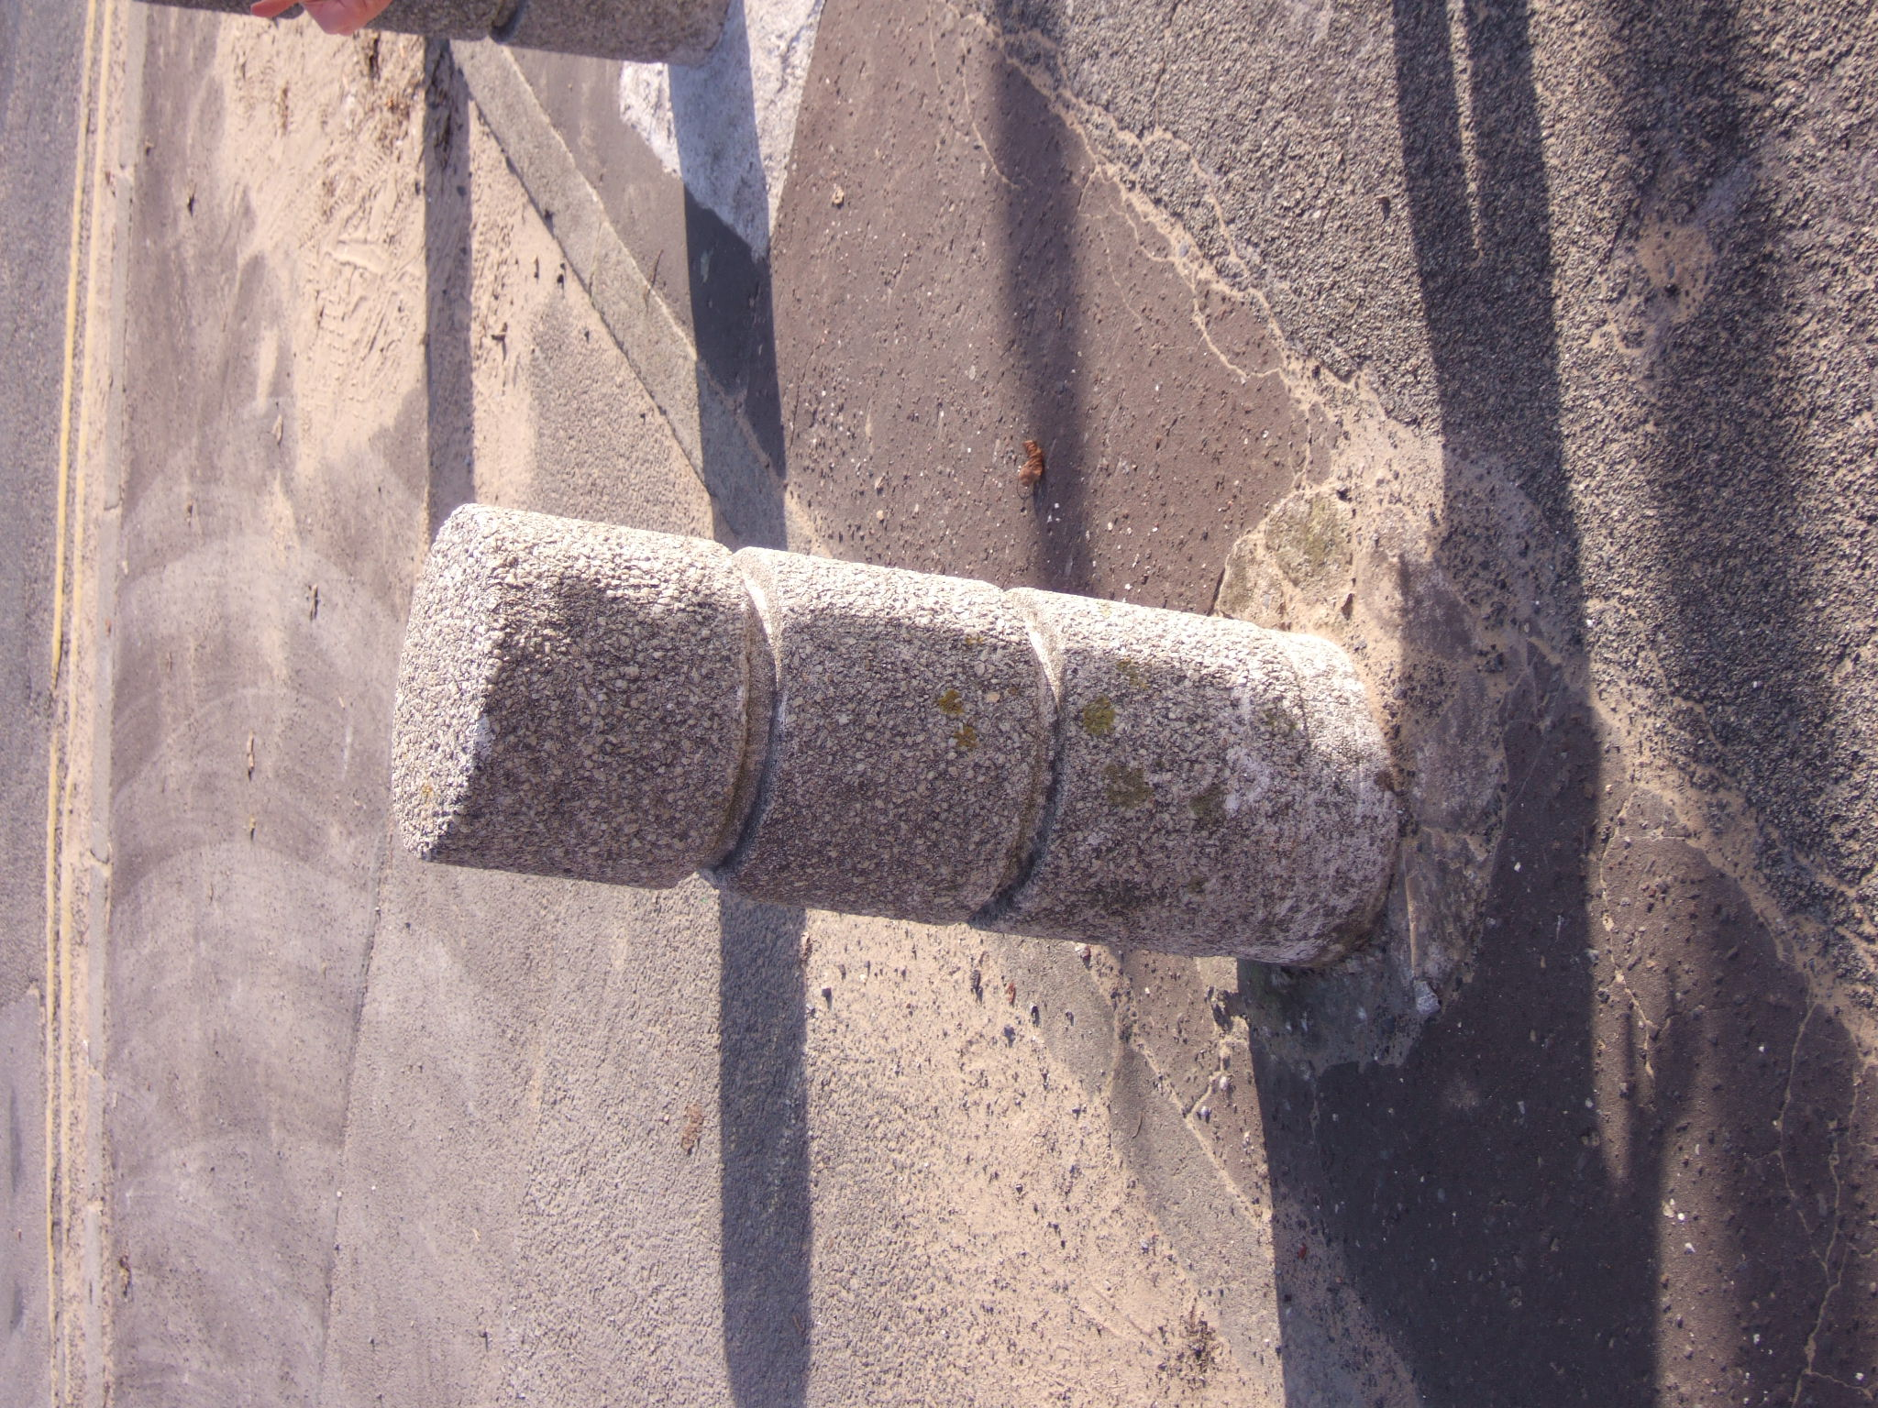

Slide 19
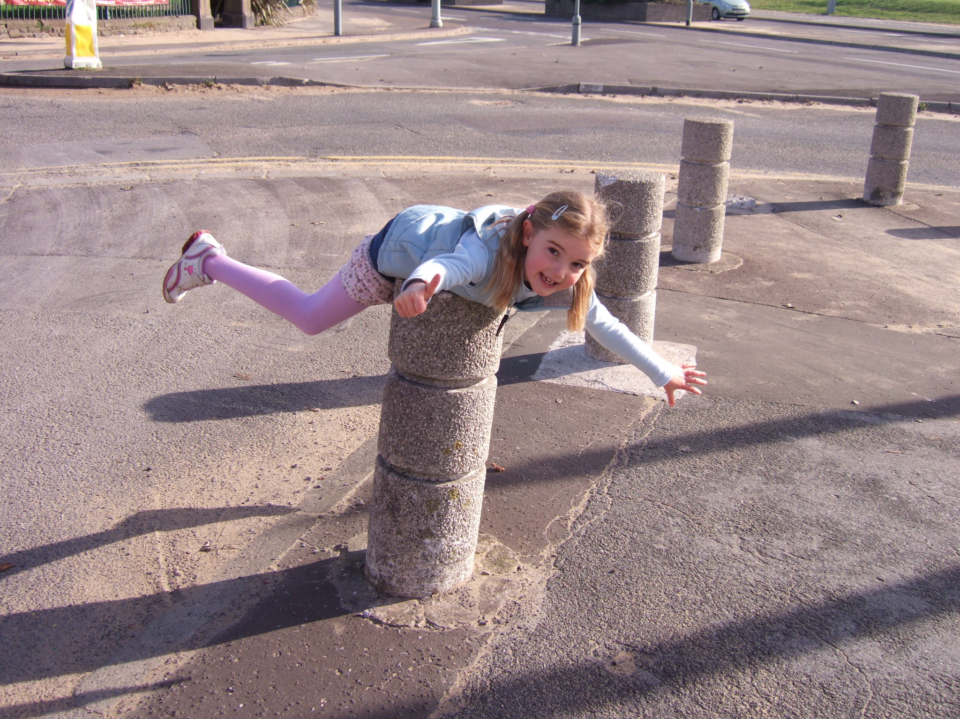
Notes:
Note what we considered initially – we CANNOT as adults anticipate what children will do in their environment - to begin to do so limits the potential of the space.

Slide 20
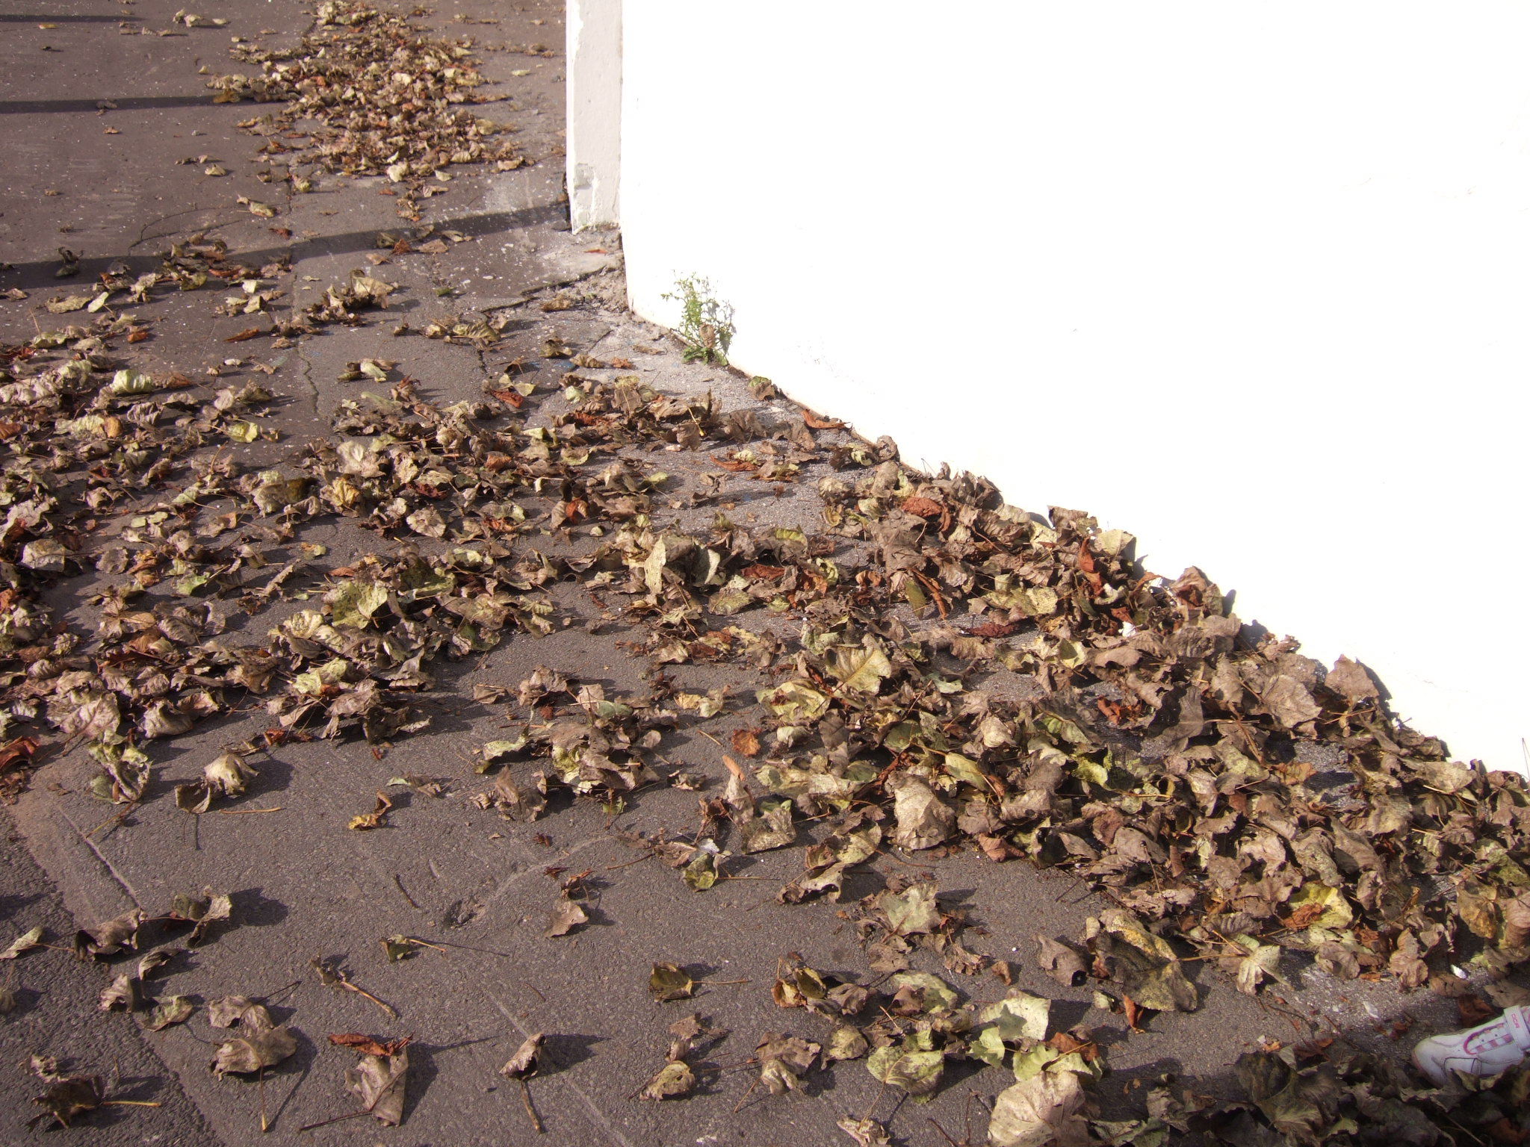

Slide 21
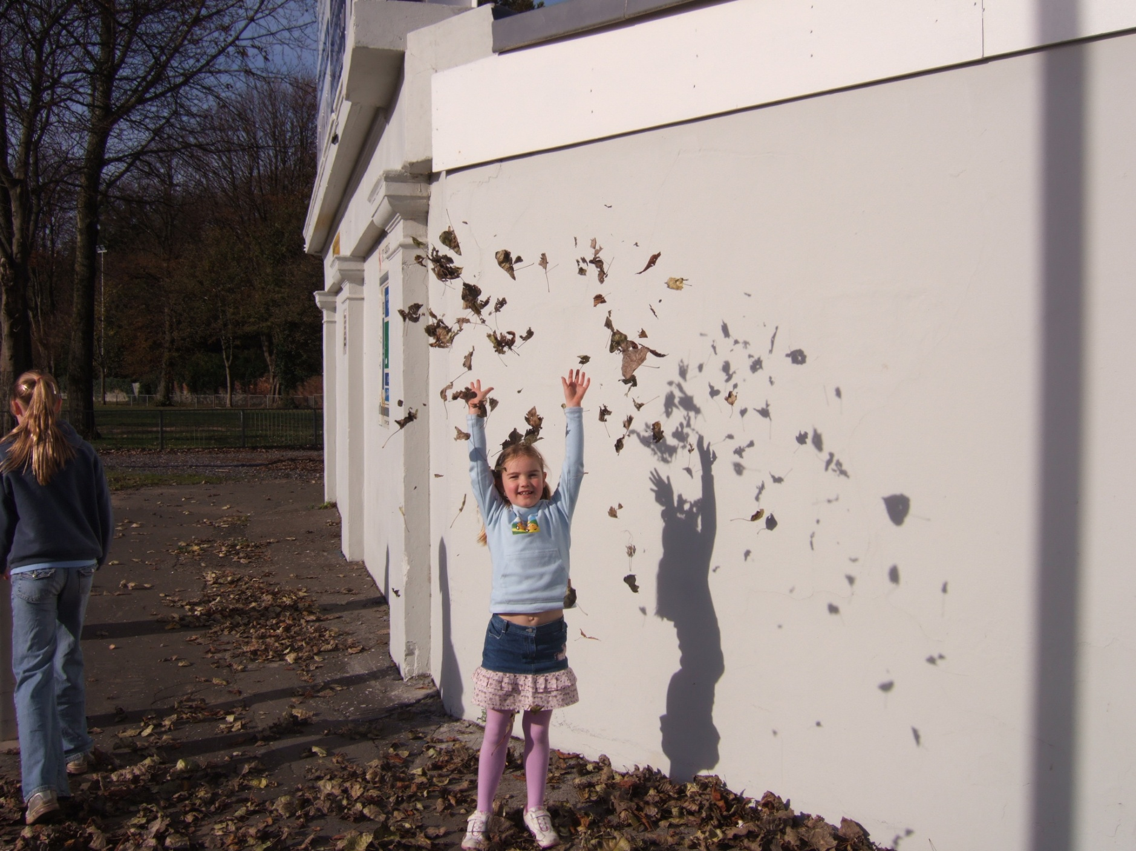

Slide 22
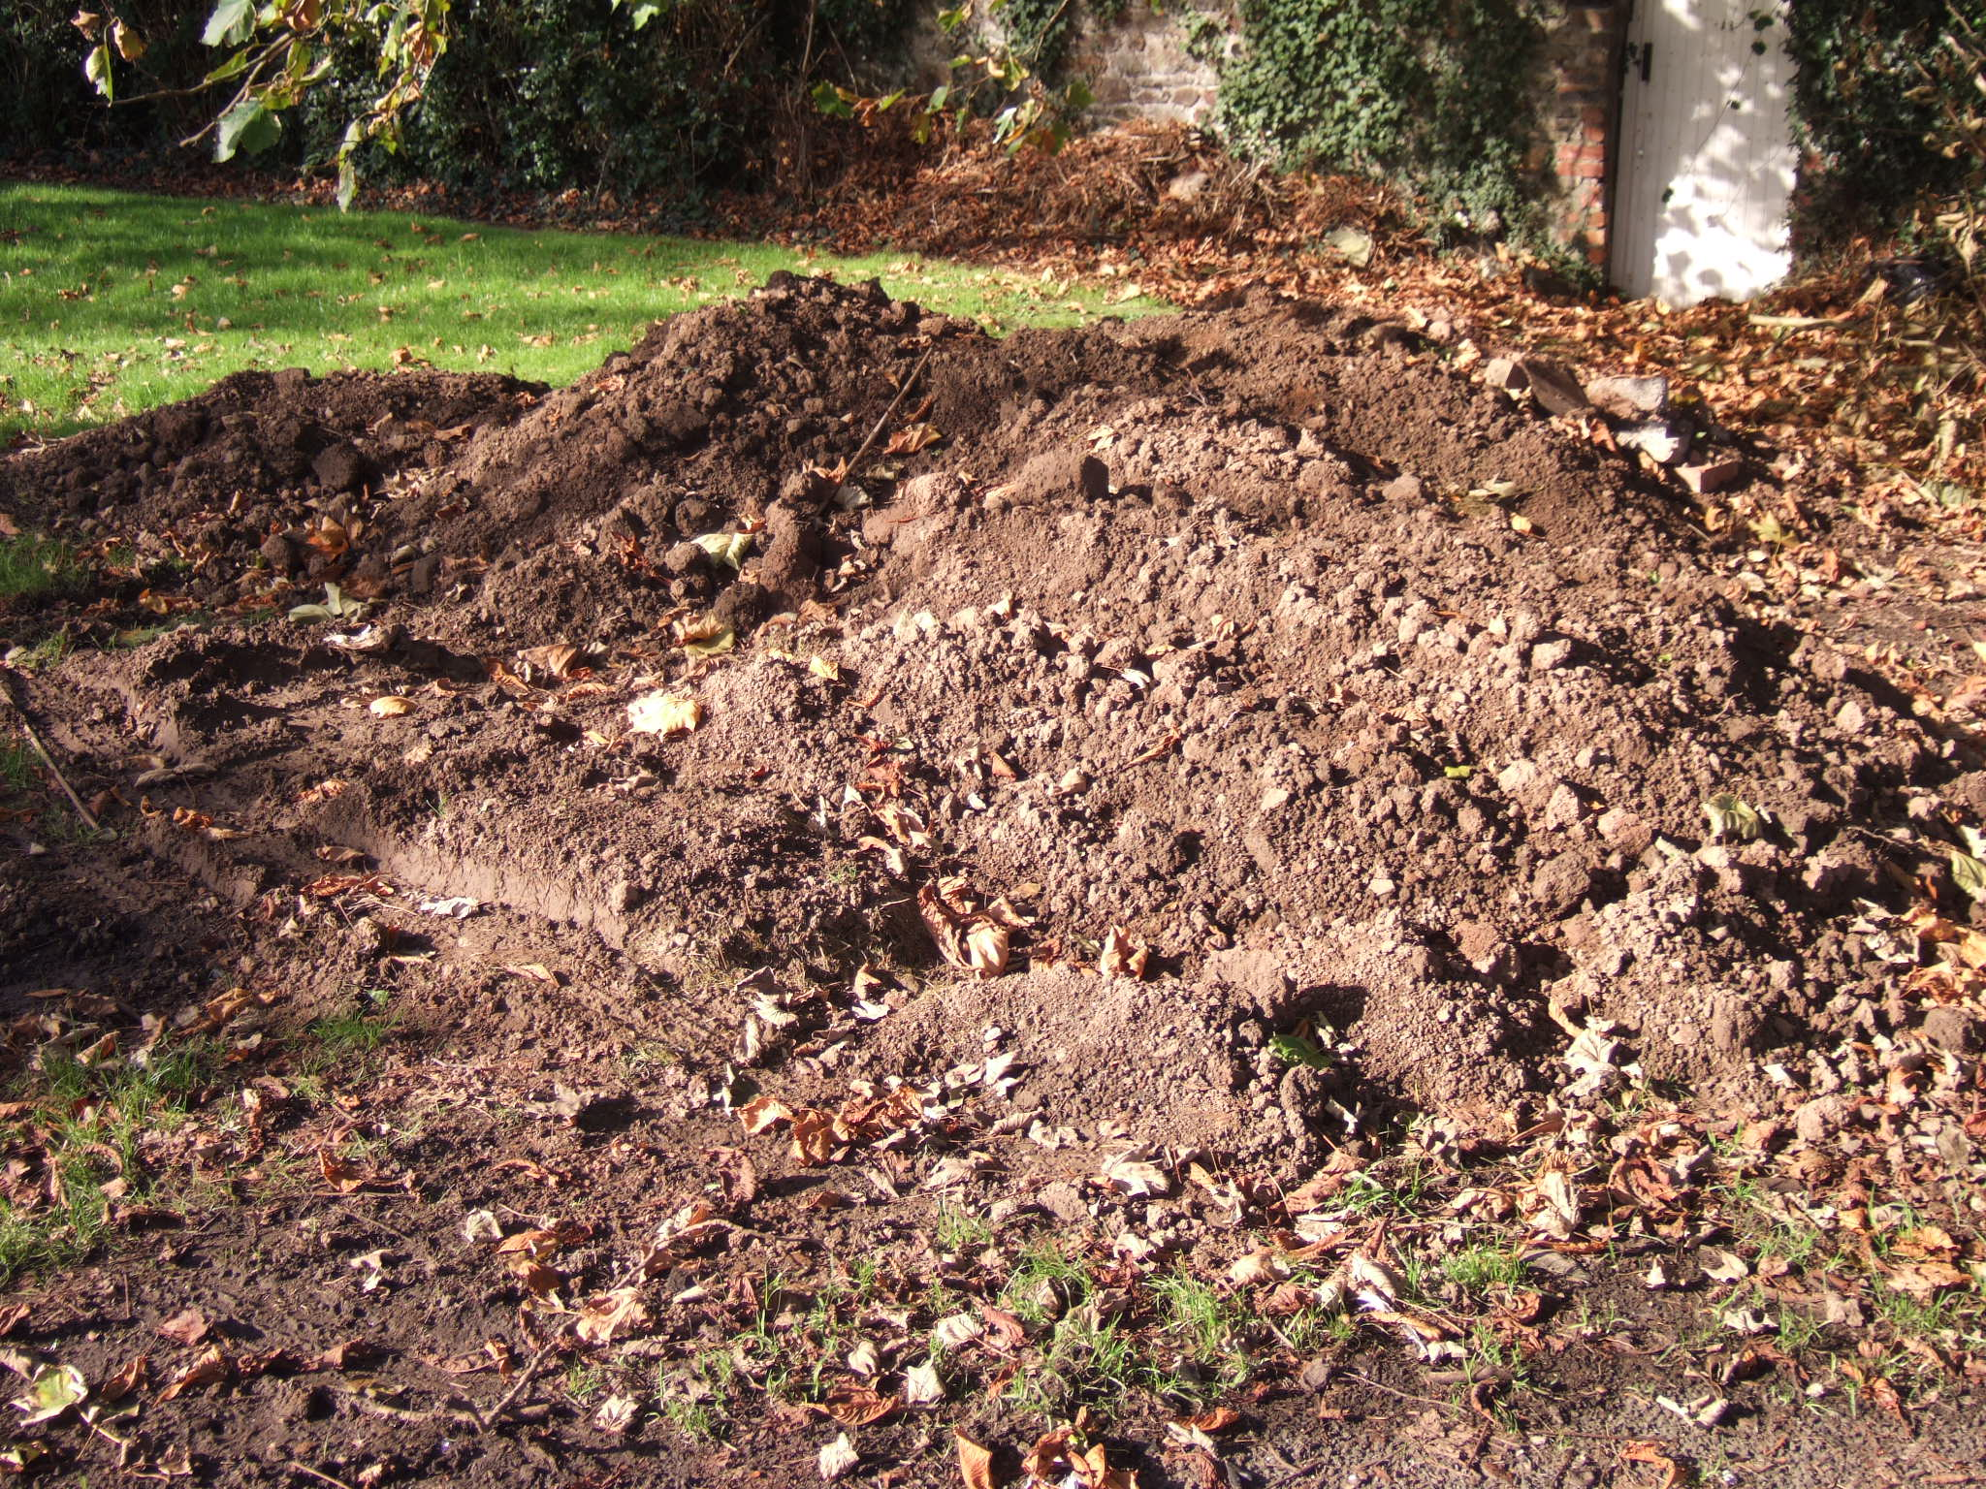

Slide 23
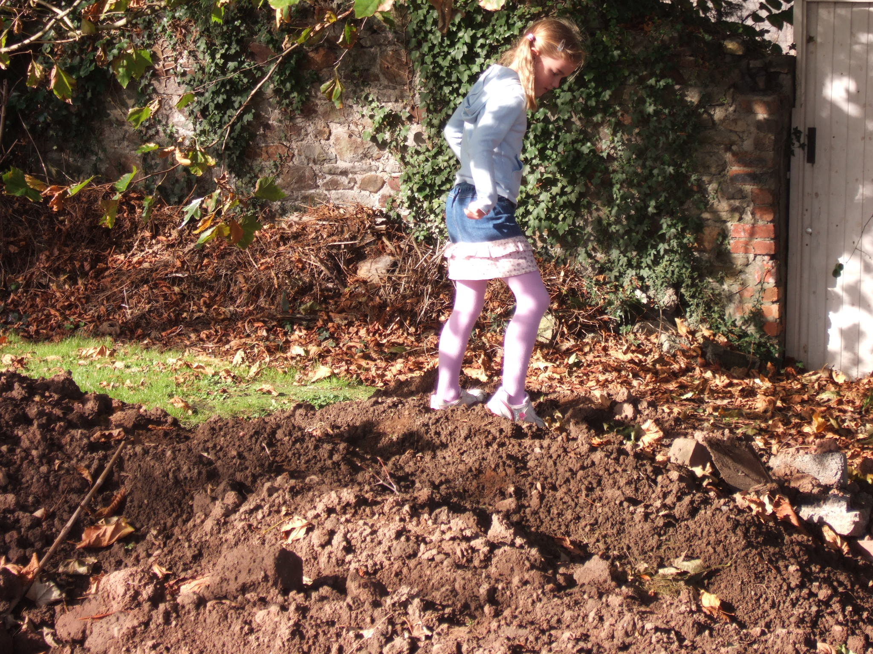

Slide 24
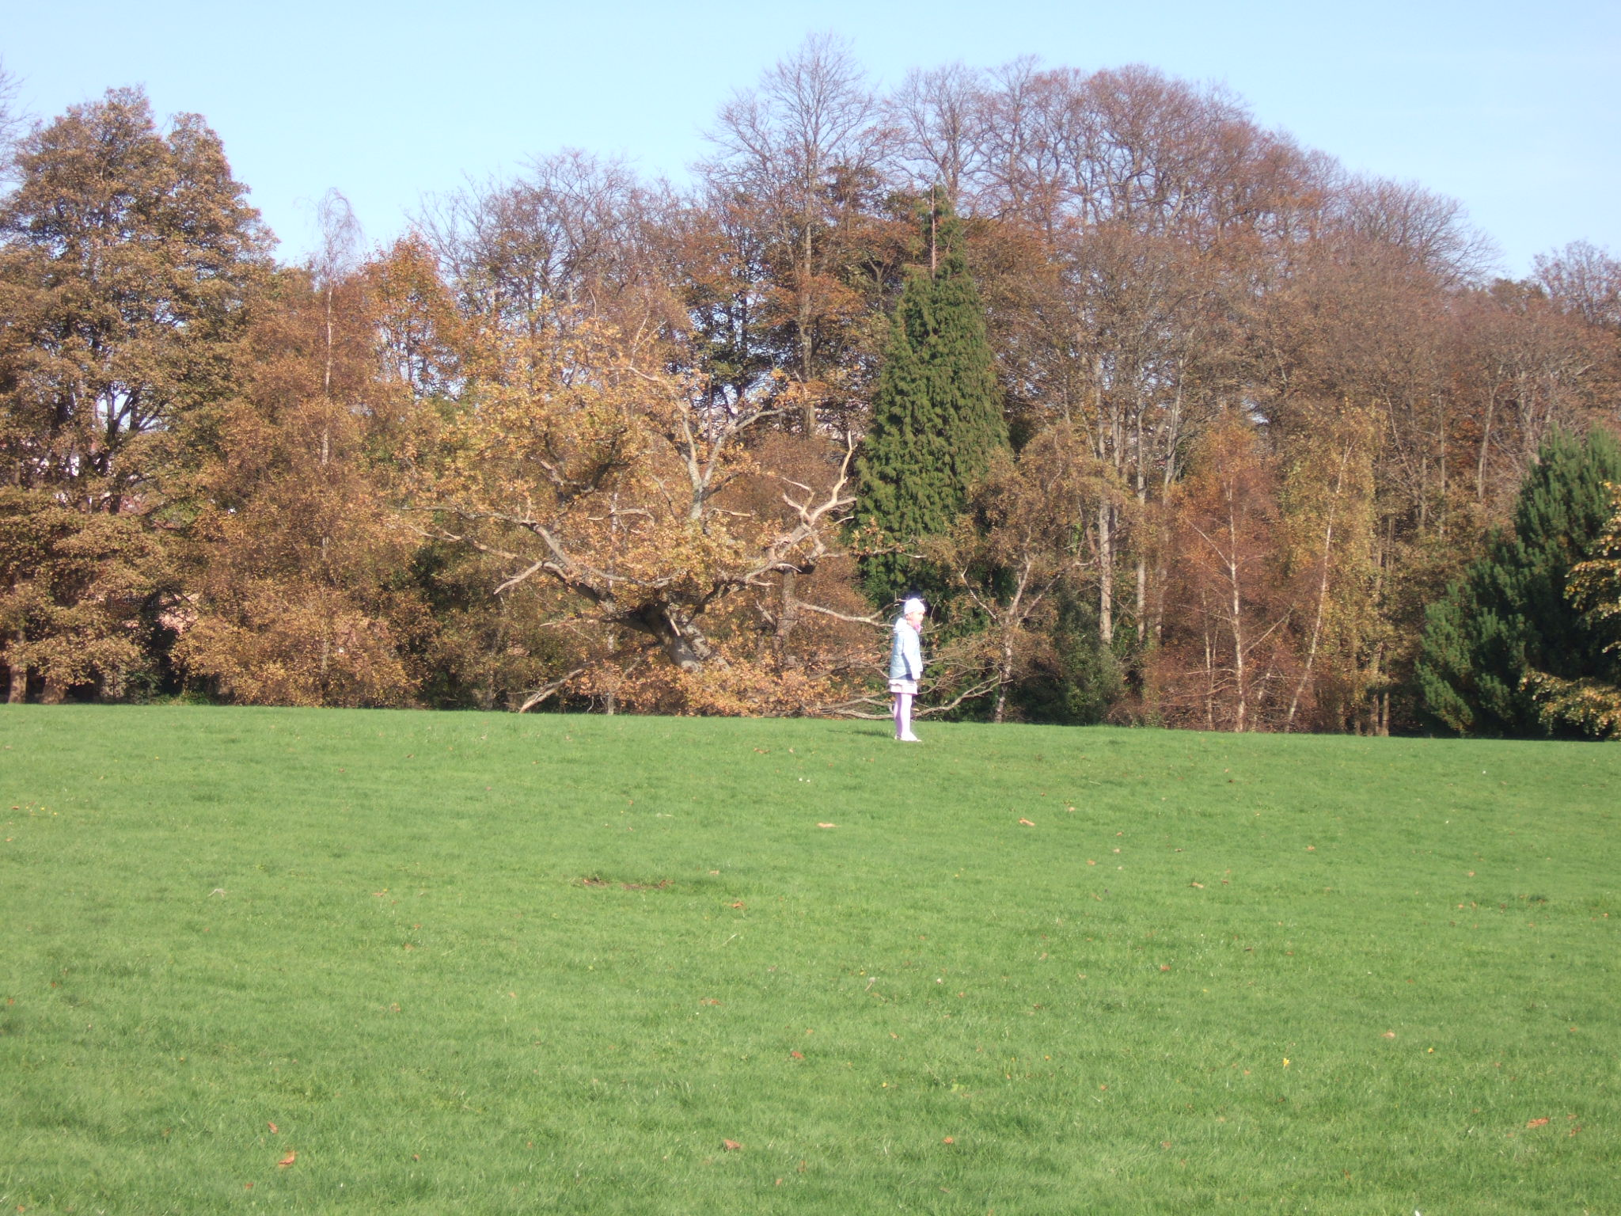
Notes:
Potential affordance of this tree?

Slide 25
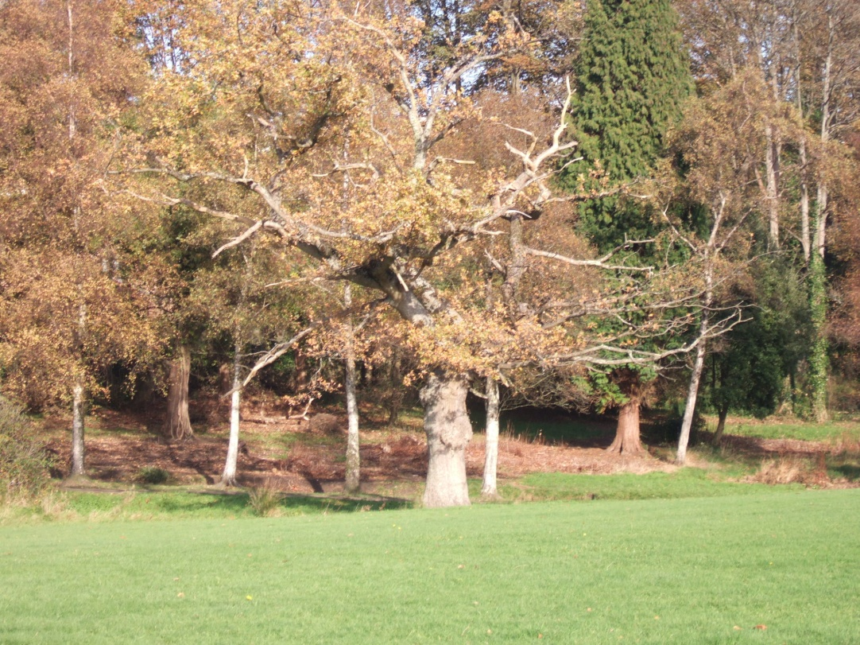
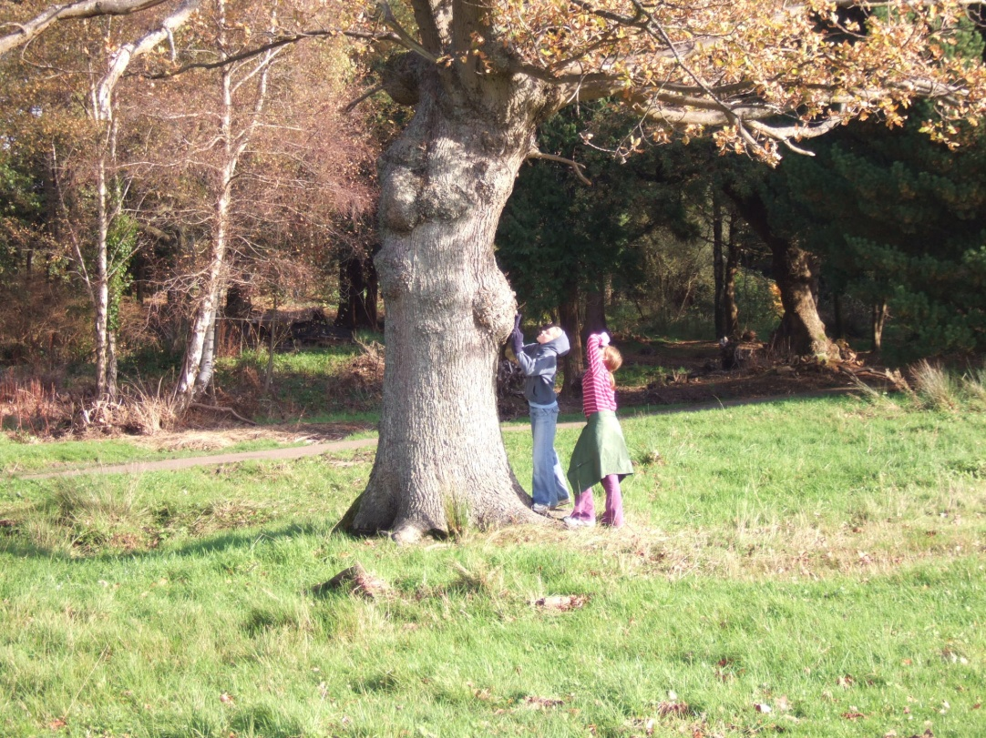
Notes:
‘Climbable’ - not an affordance for these children

Slide 26
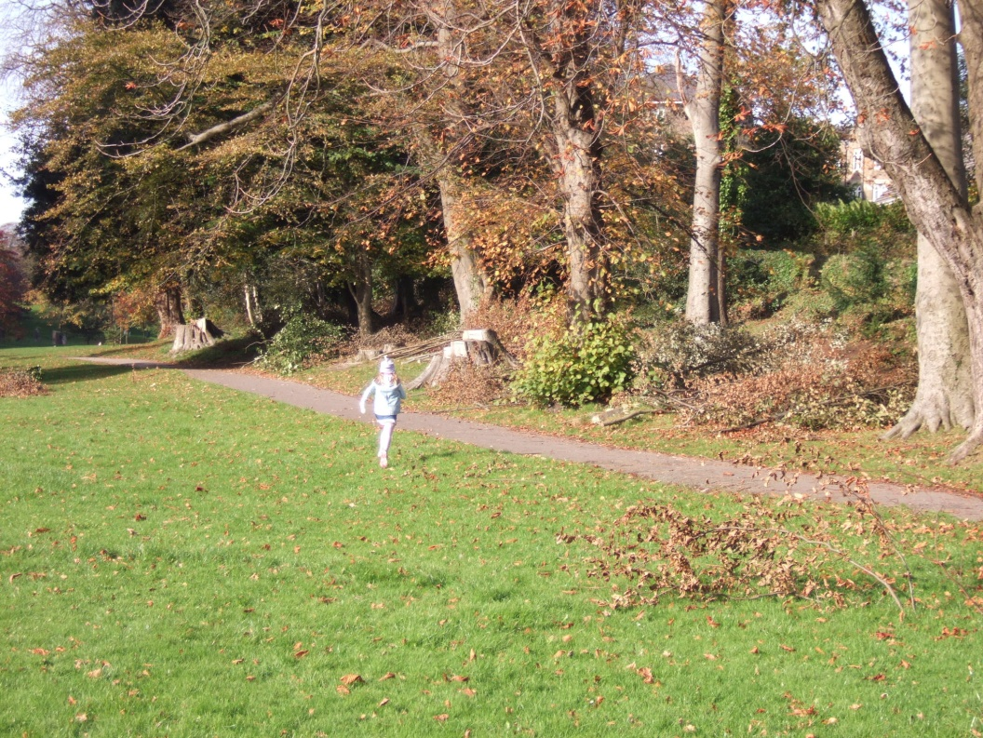
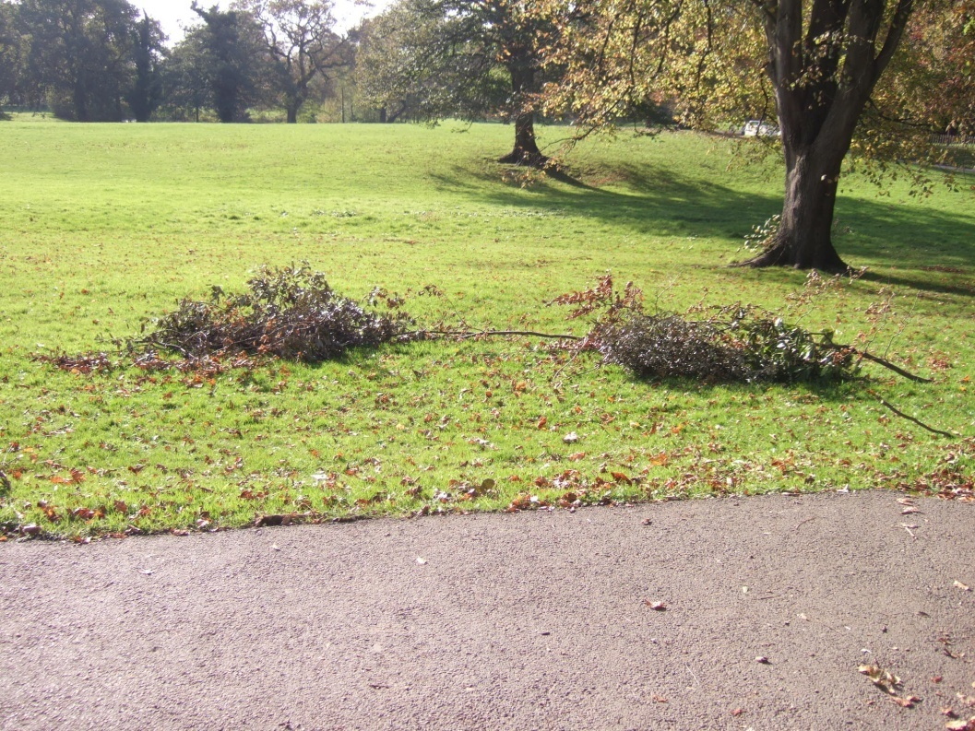

Slide 27
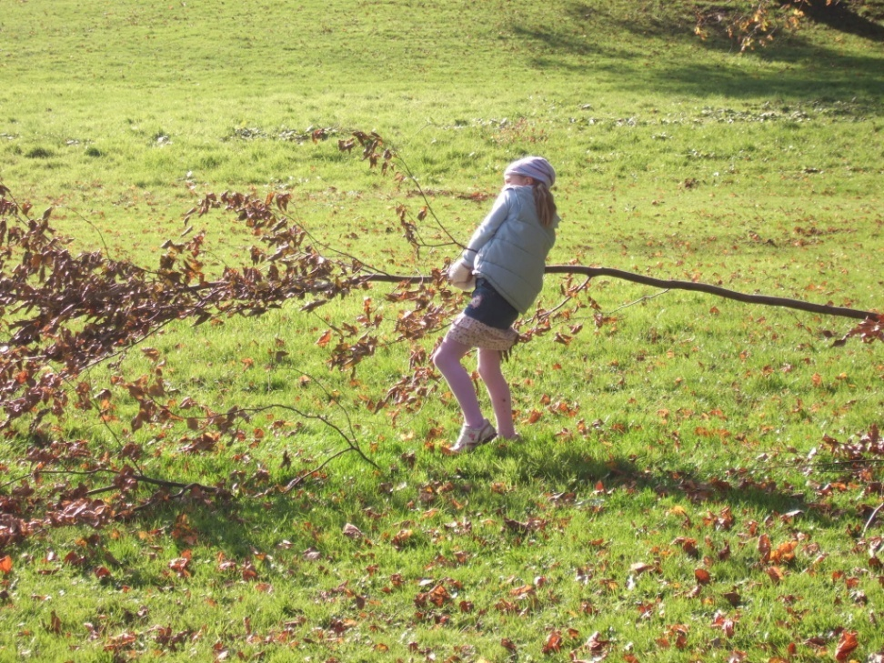
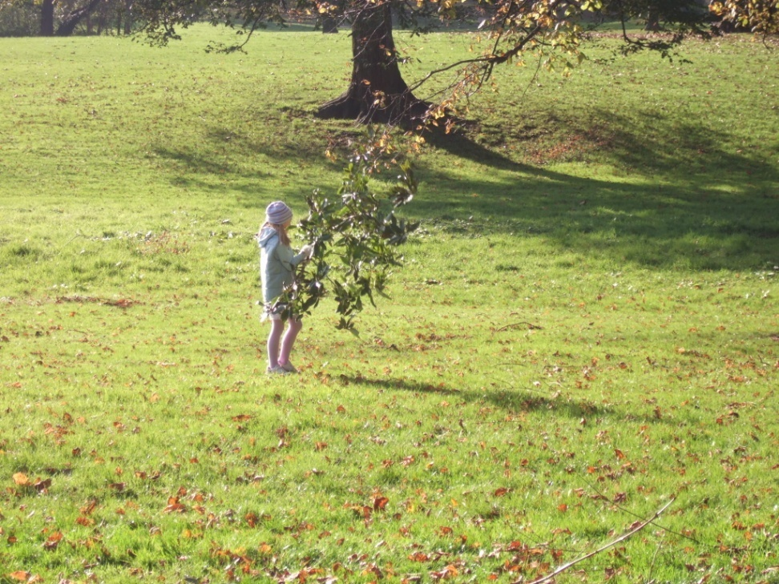

Slide 28
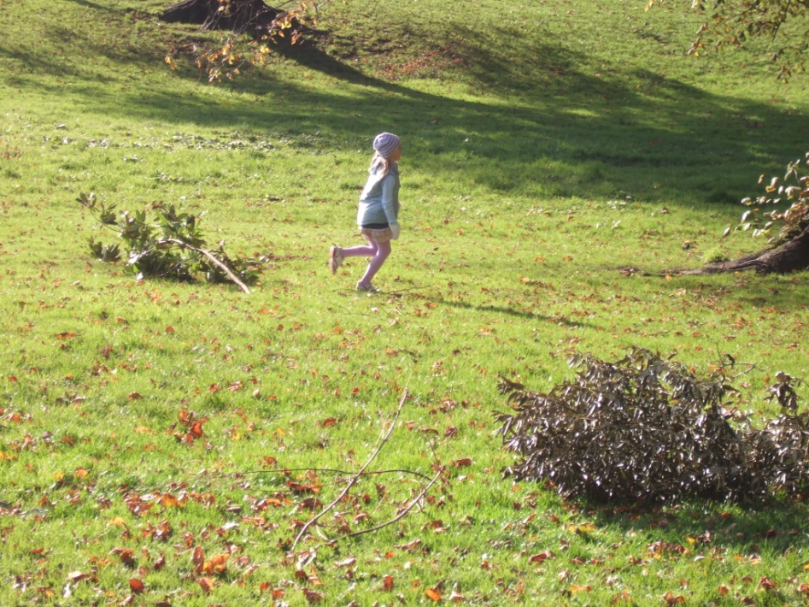
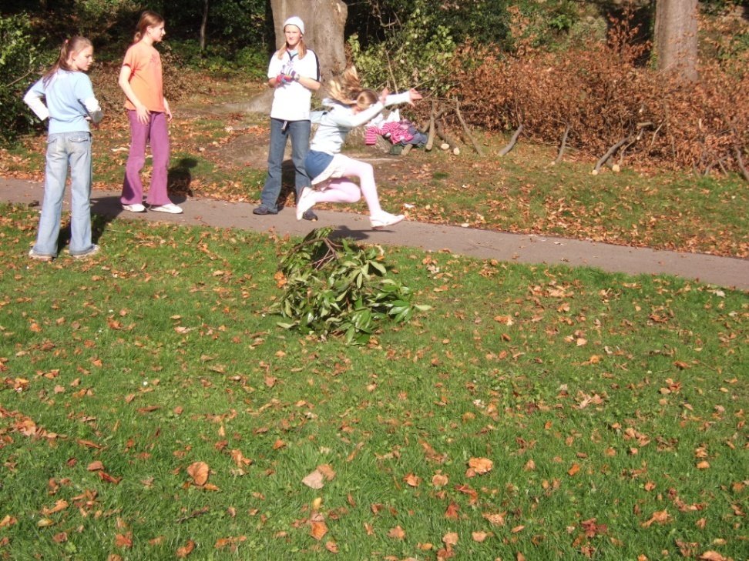
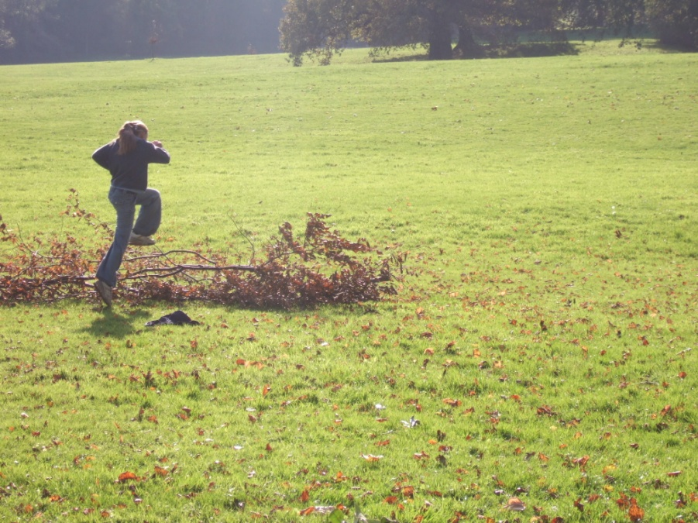

Slide 29
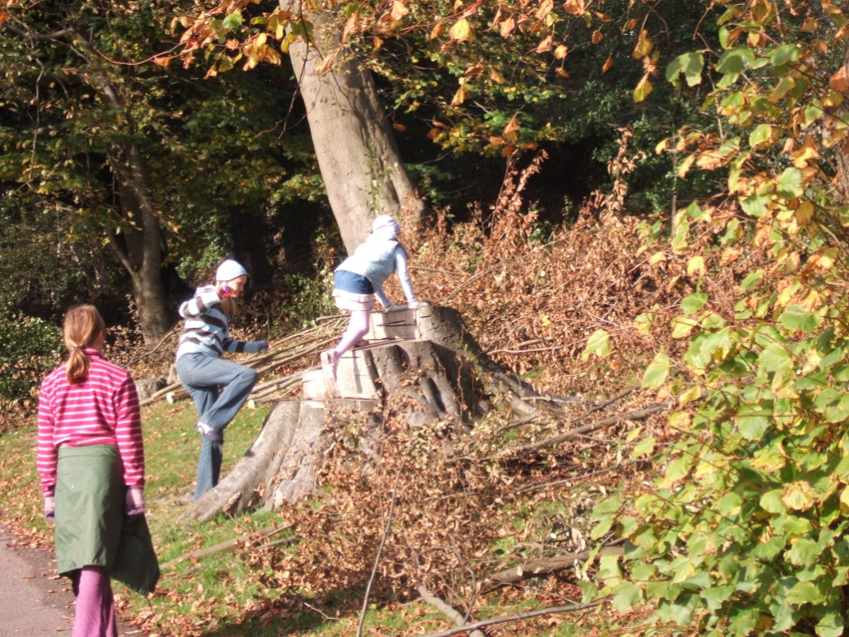
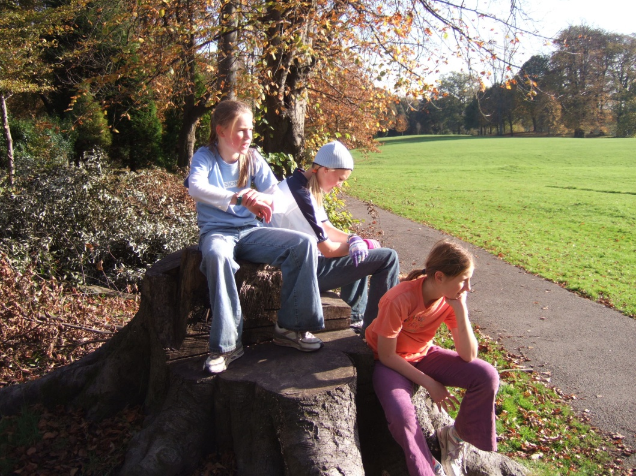

Slide 30
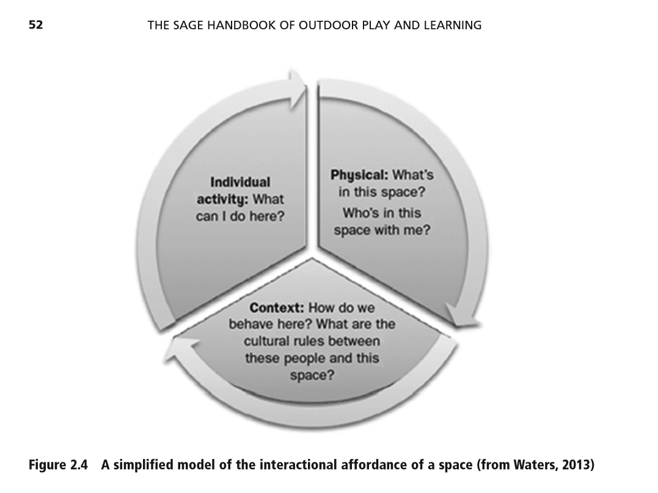

Slide 31
Key messages:
As adults we cannot assume to know, in advance, how a child (or group of children) will use a space.
We can use our knowledge of the child/ren, and the space, to identify what they may do (potential affordances)
We can observe to see what they actually do (actualised affordances)
This can be a useful way of considering how effective outdoor and indoor spaces are for providing for children’s activity
We might also ask why they do not fulfil some potential affordances….
Notes:
We might also ask why they do not fulfil some potential affordances….
This will be further considered next week.
The mapping task of potential and actualised aff’s might usefully be carried out for the OLP spaces.

Slide 32
References
Armitage, M. (2001) The ins and outs of school playground play: children’s use of ‘play places’ In Bishop, J.C. and Curtis, M. [Eds] (2001) Play today in the primary school playground Buckingham, OUP
Fjortoft I. (2001) The Natural Environment as a Playground for Children: the impact of outdoor play activities in pre-primary school children Early Childhood Education Journal v.29.n.2 pp.111-117 [available online]
Fjortoft I. & Sageie J. (2000) The natural environment as a playground for children: Landscape description and analyses of a natural playscape. Landscape and Urban Planning v.48 pp. 83 – 97 [available online]
Gibson, J. J. (1979/1986) The ecological approach to visual perception. Hillsdale, New Jersey: Lawrence Erlbaum. (Original work published in 1979).
Gibson, E.J. and Pick, A.D. (2000) An ecological approach to perceptual learning and development. Oxford: OUP
Kytta, M. (2004) The extent of children's independent mobility and the number of actualized affordances as criteria for child-friendly environments Journal of Environmental Psychology 24: 179 - 198.
Waters, J. (2017) ‘Affordance Theory’, in The SAGE Handbook of Outdoor Play and Learning, eds Tim Waller, Eva Ärlemalm-Hagsér, Ellen Beate Hansen Sandseter, Libby Lee-Hammond, Kristi Lekies and Shirley Wyver. London: SAGE.

