Slide 1
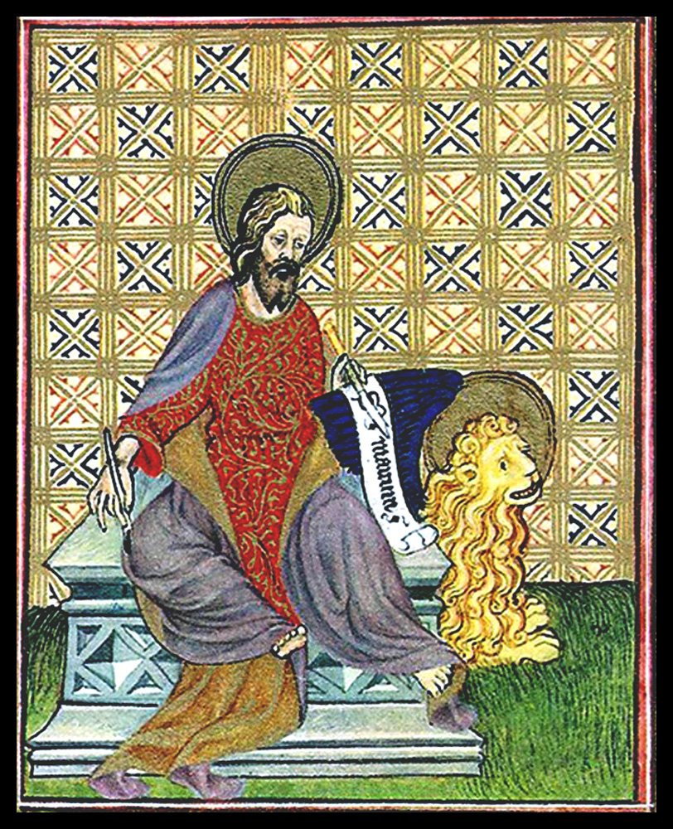
Jesus through Faith and Culture
The Gospel of Mark

Slide 2
Origins and Background
Probable date of composition is around 70 CE (shortly before or after the destruction of the Jerusalem Temple).
Paul’s last known letters pre-dated the Gospel of Mark by around 15 years.
The earliest – and shortest - of the four canonical Gospels, the main source for the other Synoptic Gospels (Matthew and Luke; what about John?).
Markan priority: closer links with oral traditions?

Slide 3
Synoptic Gospels: Literary Relationship
Mark
Logia ‘Q’
M
L
Matthew
Luke

Slide 4
Mark’s Interest in Christology
Not simply a random collection of units (‘string of pearls’), but a carefully woven account.
Distinctiveness of his interpretations of Jesus in the shaping and structuring of his material.
Recurrent themes and motifs.
Declarations and events of christological significance are placed at key points in the narrative.

Slide 5
The Shape of Mark
Prologue (1:1-13)
The kingdom proclaimed (1:14-8:26)
Turning-point (8:27-30)
The road to Jerusalem (8:31-15:39)
Epilogue (15:40-16:8)
Later ending? Oldest manuscripts end abruptly at 16:8; later copyists added a shorter and longer ending.

Slide 6
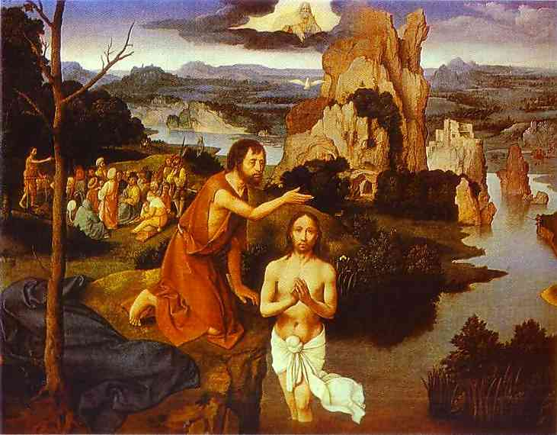
The Prologue (1:1-13)
Vital clues about the gospel and about Jesus’ identity.
Sets Jesus in relation to John the Baptist

Slide 7
Jesus as Messiah, Son of God
‘The beginning of the good news (gospel) of Jesus Christ, the Son of God’ (Mark 1:1).
‘Jesus Christ’ or ‘Jesus the Messiah’?
Some textual witnesses omit ‘Son of God’.
The meaning of this heading and its designations is unfolded at key points in the narrative:
Beginning: ‘You are my Son, the Beloved; with you I am well pleased’ (1:11).
Middle: ‘You are the Messiah’ (8:29; cf. 9:7).
End: ‘Truly this man was God’s Son’ (15:39; cf. 14:61-62).

Slide 8
Jesus as Messiah, Son of God
Note that the Markan Jesus never refers to himself as Son of God.
Mark always puts this title on the lips of others:
- narrator (1:1)
- God (1:11; 9:7)
- demons (3:11; 5:7)
- centurion (15:39)
Key titles (Messiah and Son of God) brought into conversation with each other in unprecedented ways.
Emphasis on the unfolding of Jesus’ identity through the flow of the narrative = narrative christology.

Slide 9
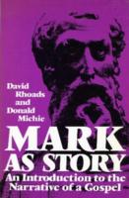
Mark as Narrative Christology
How is the story (narrative) told?
How does the narrative shape the ‘knowledge’ of the reader?
Importance of
  Plot
  Characters
  Setting

Slide 10
Mark as Narrative Christology
Point of view (norms, values and worldview assumed in/by the text).
Narration – how are characters or events presented and perceived.
Symbolism and irony: a text of many levels, and one which uses irony as a device pointing to the real meaning as opposite to the apparent meaning (e.g. crowning of Jesus with thorns).
Narrative patterns to guide how the text is to be read and understood – repetition, contrasts, comparisons (‘intercalation’).

Slide 11
The kingdom proclaimed (1:14-8:26)
Mission statement: ‘The time is fulfilled, and the kingdom of God has come near; repent, and believe in the good news’ (1:15).
Style: continuous flow of action and repeated use of euthus (at once, immediately).
Much more emphasis on activity than on teaching.
This is confirmed in Jesus’ activity as authoritative healer (5:25-43; 7:31-37) and exorcist (1:23-27; 5:1-20).

Slide 12
The kingdom proclaimed (1:14-8:26)
Paradoxical message: Jesus proclaims the kingdom, but is not recognized by his people.
They marvel at his authority but only gain a partial understanding of his identity and mission.
Even the disciples do not grasp his significance: ‘Who then is this, that even the wind and the sea obey him?’ (4:41). And they are rebuked for their lack of faith (6:52; 8:17-21).

Slide 13
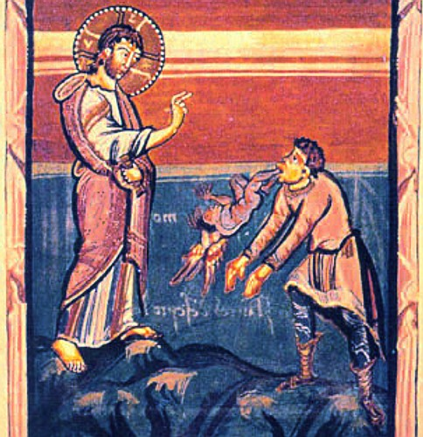
The kingdom proclaimed (1:14-8:26)
Preaching ‘the gospel’ and performing miracles leads to immediate attention (demons) and opposition.
Jesus’ unique status is recognized by demons.
They acclaim him as ‘the Son of God’ (3:11; cf. 1:24; 5:7), echoing the words of the divine voice at Jesus’ baptism (1:11; cf. Ps. 2:7; Isa. 42:1).

Slide 14
Secrecy Motif
Jesus’ open acknowledgement of his divine sonship is followed by his command for the demons to be silent.
This is a key component of the Markan secrecy motif – ‘the messianic secret’.
Wilhelm Wrede (1901) suggested that the command to silence (1:34, 44; 5:43; 7:36; 9:9, 30) was the creation of the Early Church.
Wrede: Jesus made no claim to be the Messiah, but the Church sought to justify its claim that he did.
The secret is not consistent in Mark (e.g. Jesus does not prevent Bartimaeus in 10:46-50).
Whatever the origin of this motif, it is a key theme for interpreting Mark’s presentation of Jesus.

Slide 15
Turning-point (8:27-30)
Jesus went on with his disciples to the villages of Caesarea Philippi; and on the way he asked his disciples, ‘Who do people say that I am?’ And they answered him, ‘John the Baptist; and others, Elijah; and still others, one of the prophets.’ He asked them, ‘But who do you say that I am?’ Peter answered him, ‘You are the Messiah.’ And he sternly ordered them not to tell anyone about him.
(Mark 8:27-30; par. Matt. 16:13-20; Luke 9:18-21).
Second time for Jesus’ messiahship to be mentioned since the title or introduction (1:1).
Jesus’ response is that they should not ‘tell anyone about him (8:30).

Slide 16
Turning-point (8:27-30)
No denial follows but a qualification (with a distinctive shift): he is the Son of Man who must suffer, be rejected by the authorities, killed and then rise again (8:31; cf. 9:31; 10:32-34).
Then he began to teach them that the Son of Man must undergo great suffering, and be rejected by the elders, the chief priests, and the scribes, and be killed, and after three days rise again. He said all this quite openly. And Peter took him aside and began to rebuke him. But turning and looking at his disciples, he rebuked Peter and said, ‘Get behind me, Satan! For you are setting your mind not on divine things but on human things’. (8:31-33)

Slide 17
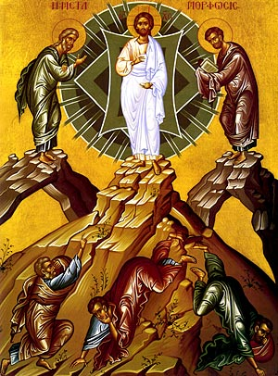
The Suffering and Crucified Messiah
Jesus’ messianic identity cannot be understood in isolation from his suffering, death and resurrection.
There is no ‘gospel’ without the cross.
Note also the transfiguration: after the divine voice declares, ‘This is my Son, the Beloved’ (9:7), the disciples are commanded to say nothing of Jesus’ glory until after Jesus’ resurrection (9:9).

Slide 18
Jesus as Son of Man
Jesus often uses the term ‘Son of Man’ but not consistently.
In Aramaic it could be simply a form of reference (‘one such as I’).
It could also function as a designation or title.
It is used in some places in Mark’s Gospel (13:26; 14:62) with echoes of Daniel 7, where it possesses a titular significance.
Scholarly consensus that Son of Man was not understood as a messianic reference in Judaism.

Slide 19
The road to Jerusalem (8:31-15:39)
The journey to Jerusalem is marked by Jesus’ teaching of his disciples (e.g. about divorce, wealth, power).
Arrival in Jerusalem is a mix of messianic expectation and enthusiasm for a popular uprising.
Period of mounting opposition from the Jewish religious authorities, leading to a demand for the Romans to execute Jesus.
Fulfilment of earlier predictions through Jesus’ arrival in Jerusalem.

Slide 20
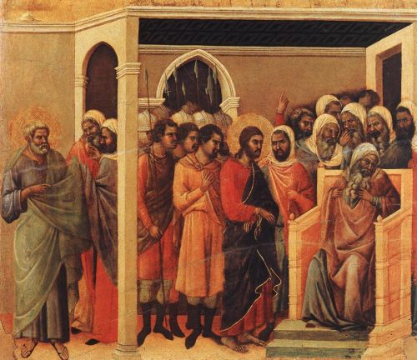
From Concealment to Disclosure
The high priest asked him, ‘Are you the Messiah, the Son of the Blessed One?’ Jesus said, ‘I am; and you will see the Son of Man seated at the right hand of the Power, and coming with the clouds of heaven’. Then the high priest tore his clothes and said, ‘Why do we still need witnesses? You have have heard his blasphemy’. (Mark 14:61-64; cf. Psalm 110:1; Dan. 7:13-14).

Slide 21
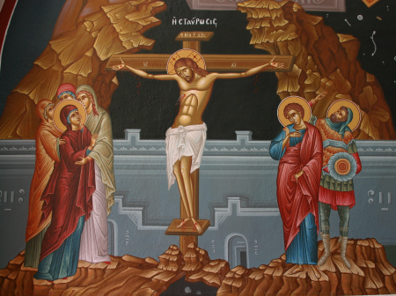
The ‘End’ of Mark’s Christology
His divine sonship is acclaimed at the moment of his death on the cross by a Roman centurion: ‘Truly this man was God’s Son’ (15:39).
This marks the climax of Mark’s narrative christology.

Slide 22
Epilogue (15:40-16:8)
The women come to prepare Jesus’ tomb, but it is empty.
They are directed to tell the disciples to meet Jesus in Galilee.
Ending of Mark
  historical approaches: evidence of an unfinished work (torn scroll?)
  Narrative approaches: puzzling end fits with Mark’s style and purpose – the women did not allow fear to over them otherwise the story would never have been told.

