Slide 1
Spark-based heatmap visualization
Dongsheng Cao
1805155@student.uwtsd.ac.uk

Slide 2
Content
Background of the subject
The aims of this project
How my study fits into the project
The research and development method
The issues maybe encounter and the solution of these issues
Final objectives

Slide 3
Background of the subject
In this Big Data era, facing the increasing data, it is becoming more difficult to the data visualization displaying whole data information of the large dataset. There are some major issues for the current data visualization.
Data is becoming complicated and scattered – missing data, incorrect data values, low level of structure…
Iterative analysis of data is costly.
The size of data points exceeds the effective pixel points of the ordinary electronic screen.
Difficult to build complex workflows – getting raw data with various attributes from multiple data sources…

Slide 4
Background of the subject
With the increasing requirements for web visualization, there are some web visualization tools like D3, heatmap.js, the Matplotlib and Boken based on Python and so on, which almost does not perform well facing the large volume of data set for displaying whole data simultaneously on the web
For example, D3 manipulates the documents of data, which is a JavaScript library to help people to make data to life by CSS, HTML and SVG (Scalable Vector Graphics). D3 actually has a variety of advantages but it is not suitable facing the data above 1 billion points. The Echart from Baidu is also with this problem.

Slide 5
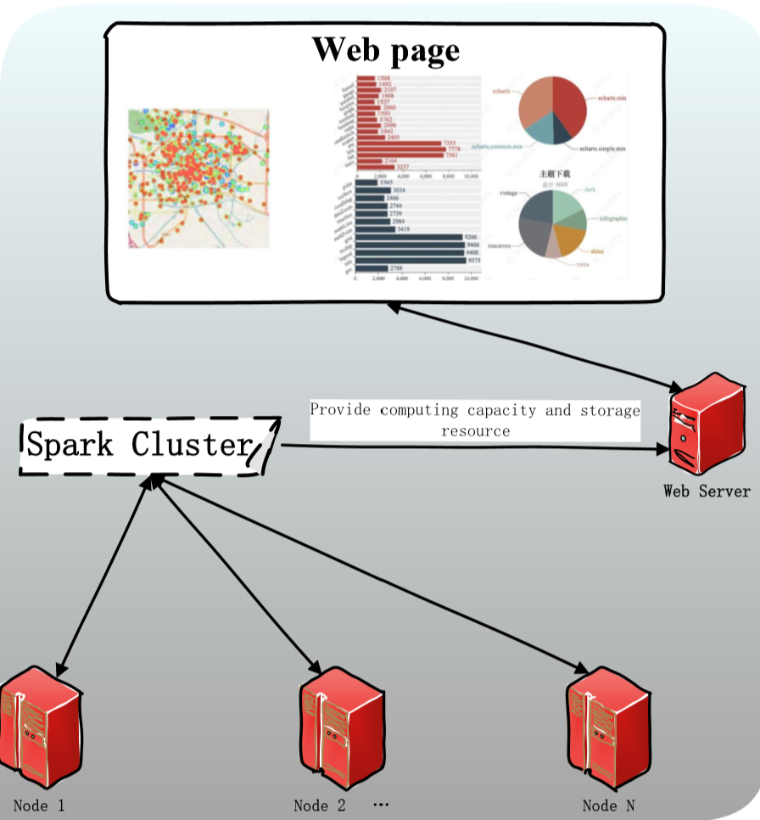
The aims of this project
Make web visualization faster
More capable with the whole dataset using the spark cluster to improve the computing speed of a series of complex algorithm for the large size of dataset

Slide 6
How my study fits into the project
Have learnt Web Technologies for eCommerce by Gaynor Thomas.
Have learnt Distributed Web Application by Tim.
Have learnt some knowledge of data analysis by Mabrouka.
Have learnt some Knowledge of data visualization by Nik.
Have been learning the knowledge of development of big data.

Slide 7
The research and development method
Research method: In the project, I decide to find some data with geographic coordinates to construct heatmap on the web. For example, accident data, telephone communication data.
Development method：the waterfall model, a kind of lifecycle model including 5 steps:
  Problem definition and planning
  Requirement analysis
  Designing functions of software
  Developing software
  Software test

Slide 8
The issues maybe encounter and the solution of these issues
Cannot complete the work on time – strictly set up and carry out the review meeting weekly with my mates to review our works respectively and report works weekly to supervisor.
Struggle to realize some functions – ask my supervisor, other teachers and mates for help and check some relating forums.
Don not have enough data to test – make some more complex iterative process to increase the amount of calculation and in the meanwhile to find some relating data to mix properly.

Slide 9
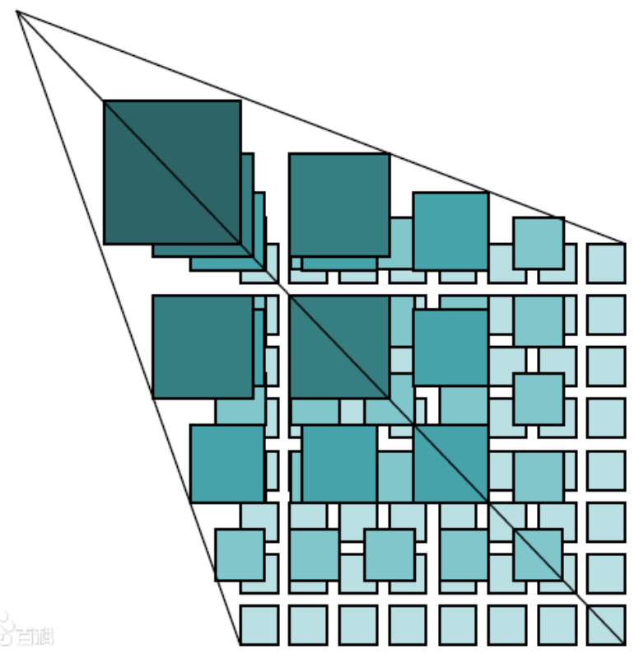
Final objectives
Some development tools will be uesd Such as Spark cluster, GeoServer, Openlayer, Echart, Hbase and so on.
Objectives:
  The heatmap visualization on the web to display 5 layers of tile map –
  overlaying the transparent image painted with data on the map of each layer.
  To do a series of data analysis for the dataset displaying on the web page.
  To realize the function in terms of real-time aspect.
  To Realize some optimized functions such as using distributed database (Hbase), Ajax to dynamically transfer data of map and so on.

Slide 10
Thank you for watching
Dongsheng Cao

