Slide 1
BA International Hotel Management
Marketing Essentials
Session 7
M4X01916

Slide 2
Session 7
Marketing Information System (MIS)

Slide 3
Learning Outcomes
At the end of this session students should be able to:
Define the marketing information system and be able to discuss its components;
Understand the significance of information to the company;
Know the steps in the marketing research process;
Understand how companies analyze and distribute marketing information

Slide 4
Marketing Information System
It is a system that consists people, equipment, and procedures that gather, sort, analyze, evaluate, and distribute needed, timely, and accurate information to marketing decision makers.
It involves various means and methods of gathering and assessing various company’s marketing information needs.

Slide 5
Marketing Information System
In sum, MIS refers to people and procedures dedicated to assessing information needs, developing the needed information, and helping decision makers to use the information to generate and validate actionable customer and market insights.

Slide 6
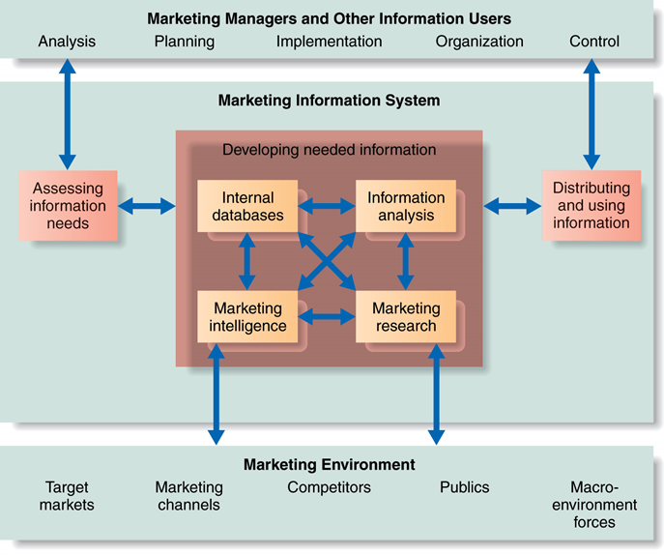
Marketing Information System

Slide 7
Marketing Information System (MIS)
Characteristics of MIS:
It is planned system developed to facilitate smooth and continuous flow of information.
It provides pertinent information (both internal and external) for making marketing decisions.
It provides right information at right time to the right person.

Slide 8
Types of Marketing Information
MI provides three types of information
1. Recurrent Information
This is the periodic data supplied by MIS on weekly, monthly, quarterly or annual intervals
This includes data pertaining to sales, market share, sales call reports, inventory levels, payables, receivables, customer awareness of company’s brands, ad campaigns, data relates to competitors etc

Slide 9
Types of Marketing Information
2. Monitoring Information
This pertains to data obtained from regular scanning of certain sources such as trade journals and other publications.
The data relates to the changing trends, competitors activities etc.
Some of these data is purchased by companies from Market Research agencies, govt. sources etc.

Slide 10
Types of Marketing Information
3. Problem Related or Customized Information
This information is developed in response to some specific requirements related to a marketing problem or any particular data requested by a manager
It consists of both primary data as well as secondary data
This data is collected by conducting market research study with adequate sample size

Slide 11
Marketing Information System (MIS)
The MIS is of importance to the company managers and also to external partners.
The MIS must balance needs against feasibility:
    Not all information can be obtained.
    Obtaining, processing, sorting, and delivering
    information is not cheap.

Slide 12
Marketing Information System
Information needed could be obtained through:
(Company’s) Internal data;
Competitive Marketing Intelligence;
Marketing Research.

Slide 13
Marketing Information System
Internal Data Gathering:
Internal Data is gathered through customer databases, financial records, and operations reports.
Advantages of internal data include prompt/easy access to information.
Disadvantages arise from incompleteness or unsuitability of data to a particular situation.
Data ages quickly, keeping the database current requires a major effort.
Managing vast information that a large company produces requires sophisticated equipment and techniques

Slide 14
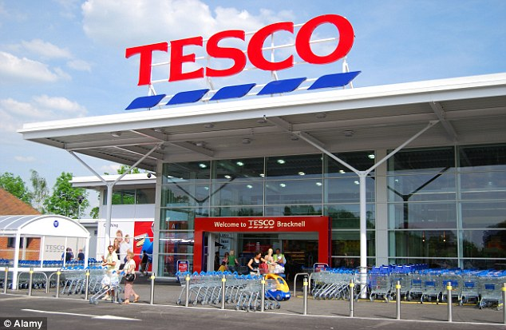
Marketing Information System
Internal data gathering:
Tesco through its Clubcard database collects data from its customers, stores the data in a database, and uses the data to tailor vouchers, ads and marketing offers to its customers.

Slide 15

Marketing Information System
Through its Nectar loyalty card, Sainsbury found out that a cereal brand called Grape-Nuts was worth stocking even with weak sales – because the shoppers who bought it were extremely loyal to Sainsbury's and often big spenders.

Slide 16
Marketing Information System
Competitive Marketing Intelligence:
Refers to the systematic monitoring, collection and analysis of publicly available information about consumers, competitors and developments in the marketing environment.

Slide 17
Marketing Information System
Competitive Marketing Intelligence:
Competitive intelligence gathering activities have grown.
Many companies send out teams of trained observers to mix and mingle personally with customers as they use and talk about the company’s products.

Slide 18
Marketing Information System
Competitive Marketing Intelligence:
Reputable brands such as PepsiCo, Dell and MasterCard have set up sophisticated digital command centres that routinely monitor brand – related online consumer and market-place activity.
There are many sources of competitive information.

Slide 19
Marketing Information System
Sources of Competitive Intelligence:
Company employees;
Internet;
Published information;
Competitor’s employees;
Trade shows;
Benchmarking;
Channel members and key customers.

Slide 20
Marketing Information System
Marketing research is the systematic design, collection, analysis, and reporting of data relevant to a specific marketing situation facing an organization.
Several steps are involved in the marketing research process.

Slide 21

Marketing Information System
Marketing research allows companies to customize their marketing mix to meet consumer needs.

Slide 22

Marketing Information System
The Marketing Research Process

Slide 23

Marketing Information System
Step 1: Defining the problem and research objectives
Don’t confuse the symptoms of the problem with its cause when defining the problem.
Exploratory, descriptive, and causal research each fulfil different objectives.

Slide 24

Marketing Information System
Exploratory Research:
Marketing research to gather preliminary information that will help define problems and suggest hypothesis.

Slide 25

Marketing Information System
Descriptive Research:
Marketing research to better describe marketing problems, situations or markets, such as the market potential for a product or the demographics and attitudes of consumers.

Slide 26

Marketing Information System
Causal Research:
Marketing research to test hypothesis about cause-and-effect relationships.

Slide 27

Marketing Information System
Step 2: Developing the Research Plan
Research objectives guide the determination of specific information needs.

Slide 28
Marketing Information System
Step 2: Developing the Research Plan
  Research proposals outline the
  type of data needed and the
  research plan.
    Secondary data: Information collected for another purpose which already exists.
    Primary data: Information collected for the specific purpose at hand.

Slide 29
Marketing Information System
Secondary data:
Secondary data sources:
  Government information
  Internal, commercial, and online databases
  Publications
Advantages:
  Obtained quickly
  Less expensive than primary data
Disadvantages:
  Information may not exist or may not be usable.

Slide 30
Marketing Information System
Primary data:
Company gathers primary data by asking people questions about their knowledge, attitudes, preferences and buying behaviour.
Primary data sources:
Personal interviewing
Telephone surveys
- Online via internet surveys, online focus groups,
Web-based experiments, or,
Tracking of consumers’ online behaviour

Slide 31
Marketing Information System
Advantages:
  Companies control the design and the questions, so they get exactly the information they want;
  Sometimes the information company need cannot be obtained in any other way
  Companies see themselves as ‘reliable sources’
Disadvantages:
  It is time consuming and can be expensive
  If the data are available elsewhere, primary data collection is a poor use of resources

Slide 32
Marketing Information System
Evaluate the following when judging data quality:
Relevance
Accuracy
Currency
Impartiality

Slide 33
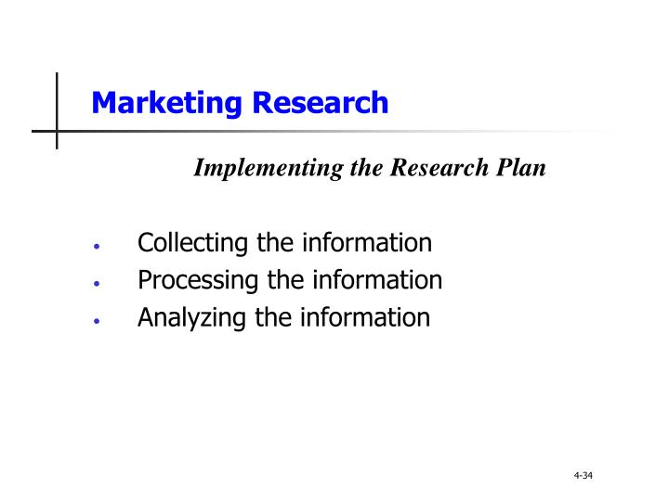
Marketing Information System
Step 3 of the Research Process:
Implementing the Research Plan
  Involves collecting, processing, and analyzing information.

Slide 34
Marketing Information System
Step 4 of the Research Process:
Interpreting and reporting the findings

Slide 35
Next Session….
We will examine…..
Analysing Marketing Information
(Customer Relationship Management - CRM)

