Slide 1



Digital Skills and Research Method BMSW4003
Title: Need to provide training on how to use technology to collaborate at uwtsd.
Date : 3rd March 2022
Time: 11:45am
Tutor’s Name: Seyed Nasirpourosgoei
Student full name & Student’s ID number | Picture
Mohammad Ilyas 2029045
Zafrin akther 2107425
Shabeena akther 1920973

Slide 2
1st presenter:
Mohammad Ilyas
2029045

Slide 3
Introduction
Tools that use to collaborate at UWTSD.
Giving training to adults.
Older adults need more training. Hickman(2007)
Technology makes learning more exciting and easy.

Slide 4
How to provide training to use technology?
Task instruction should printed in a paper if task requires technology. A.D. (2007)
Be patient-even if lessons are repeated. Hickman(2007)
Design tutorials on how to use technology. C. and Coughlin(2015)
Should design a courses on how to use word or Power Point before giving assignments. M. (2010)
Should told to complete training trials at the end to see what they had learned. J.F. (2015)

Slide 5
REFERENCES
Hickman, J.M., Rogers, W.A. and Fisk, A.D. (2007) ‘Training older adults to use new technology’, The journals of gerontology. Series B, Psychological sciences and social sciences, 62 Spec No 1(Special_Issue_1), pp. 77–84. doi:10.1093/geronb/62.special_issue_1.77.
Lee, C. and Coughlin, J.F. (2015) ‘PERSPECTIVE: Older Adults’ Adoption of Technology: An Integrated Approach to Identifying Determinants and Barriers’, The Journal of product innovation management, 32(5), pp. 747–759. doi:10.1111/jpim.12176.
Warschauer, M. (2010). Invited commentary: New tools for teaching writing. Language, Learning & Technology, 14(1), 3–8.

Slide 6
2nd Presenter:
Zafrin Akhter
2107425

Slide 7
Is there a need to provide training on how to use technology to collaborate at UWTSD.
By Zafrin, Mohammed and Shabina.

Slide 8
BENEFITS: (Zaf)
Allows students to participate simultaneously, also allows flexible learning.
Collaborative learning environment (keeps user engaged).
Effective for people with children, or with a disability if taught how to use correctly.
Makes tasks/work easier and quicker to do.
Large variety of new methods of learning. E.g., educational apps.
Journal of science education and technology; studies found that training and development are very essential as to whether the adoption of technology is successful or not (Keenge, J, Kidd, T, Kyei-Blankson, L 2009).
Notes:
There are many benefits as a result of why training on how to use new technology should be given. It allows students to participate simultaneously as well as allowing flexible learning. It is effective for people with children and/or with a disability, if they are taught on how to use it correctly. It also makes tasks and work easier to do. In the journal of science education and technology, Keenge, Kidd and Kyei-Blankson (2009) found that training and development are essential as to whether the adoption of technology is successful or not. They also came to the conclusion that if training is not given on how to use and put new technology into effect, then users will be uncertain and not confident in using it. So, for new technology to be used effectively, users need to be familiar with it and how to use it. This can only be done through training which the user is to receive. Which is why it is important for training to be given for the adoption of new technology. However, users should not only be taught how to use it but should also be trained on how to implement the knowledge to others. Foe example, In higher education, teachers/ lecturers should receive training on how to use the technology but should also be trained on how to reciprocate the training to students, so they are then able to adopt the usage of the new technology.

Slide 9
References
Keengewe, J., Kidd, T. & Kyei-Blankson, L. Faculty and Technology: Implications for Faculty Training and Technology Leadership. J Sci Educ Technol 18, 23-28 (2009).
https://doi.org/10.1007/s10956-008-9126-2
Boothby, D., Dufour, A., Tang, J. _Technology adoption, training and productivity performance _ 2010. https://www.sciencedirect.com/science/article/pii/S0048733310000594

Slide 10
3rd Presenter:
Shabeena akther
1920973

Slide 11
How do we use technology to collaborate at UWTSD?
Group presentation as1 – Shabeena Akhtar -1920973
Digital Skills and Research Method BMSW4003
-
Date: 23/02/22
Time:
Tutor’s Name: Dr Syede

Slide 12
Assignment 1 - Is there a need to provide training on how to use technology to collaborate at UWTSD?
Training to use technology at UWTSD should be required for those in need with disabilities. For example, a student with a disability will find it is a lot more complicated working with technology and completing tasks as theirs a lot of things involved in working with technology and software's. Where as for others it may be easy using remote learning as its simple but for those who can’t complete these tasks they should be required training to use technology.

Slide 13
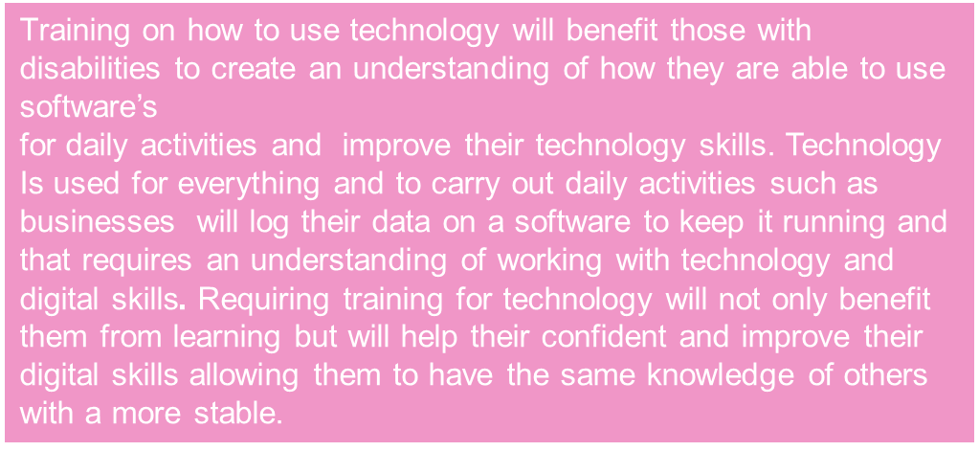
Assignment 1 - Is there a need to provide training on how to use technology to collaborate at UWTSD?
Why is training required for those with disabilities and can’t use technology?
Technology is used for everything, to work you need to have some knowledge towards using a software to keep the business going.
We have to understand having a disability will effect the way you do and see things in life so having training in place will help and improve learning for those who are singled out for their disabilities.

Slide 14
Assignment 1 - Is there a need to provide training on how to use technology to collaborate at UWTSD?
Information technology has improved in advanced countries covering all sectors of life such as the following: global economy, business, and technology. On the other hand we have Developing countries that haven’t committed to an agreement in this global revolution. The challenges AND DIFFICULTIES THAT DONOUR COUNTIRES AND DEVELOPING COUNTIRES experience such as the following: government policies, training and culture of the beneficiary countries. TO IMPROVE THE SITUATION OF DEVELOPING COUNTIRES WE WILL NEED INVOLVEMENT OF THE GOVERNMENT, PEOPLE OF THE BENEFICARY NATIONS AND the global community.

Slide 15
References:
Ejiaku, Samuel A. (2014) "Technology Adoption: Issues and Challenges in Information Technology Adoption in Emerging Economies," Journal of International Technology and Information Management: Vol. 23 : Iss. 2 , Article 5.
Available at: https://scholarworks.lib.csusb.edu/jitim/vol23/iss2/5

Slide 16
HYPOTHESIS
Because we observed there’s a need to provide training on technology, we believe that making change for adult people will make them able to use technology easily and become familiarised with the new technology or apps.
We’ll know this when we observe people are confident in using technology.

Slide 17
FINAL REFERENCES
Hickman, J.M., Rogers, W.A. and Fisk, A.D. (2007) ‘Training older adults to use new technology’, The journals of gerontology. Series B, Psychological sciences and social sciences, 62 Spec No 1(Special_Issue_1), pp. 77–84. doi:10.1093/geronb/62.special_issue_1.77.
Lee, C. and Coughlin, J.F. (2015) ‘PERSPECTIVE: Older Adults’ Adoption of Technology: An Integrated Approach to Identifying Determinants and Barriers’, The Journal of product innovation management, 32(5), pp. 747–759. doi:10.1111/jpim.12176.
Warschauer, M. (2010). Invited commentary: New tools for teaching writing. Language, Learning & Technology, 14(1), 3–8.
Keengewe, J., Kidd, T. & Kyei-Blankson, L. Faculty and Technology: Implications for Faculty Training and Technology Leadership. J Sci Educ Technol 18, 23-28 (2009).
https://doi.org/10.1007/s10956-008-9126-2
Boothby, D., Dufour, A., Tang, J. _Technology adoption, training and productivity performance _ 2010. https://www.sciencedirect.com/science/article/pii/S0048733310000594
Ejiaku, Samuel A. (2014) "Technology Adoption: Issues and Challenges in Information Technology Adoption in Emerging Economies," Journal of International Technology and Information Management: Vol. 23 : Iss. 2 , Article 5.
Available at: https://scholarworks.lib.csusb.edu/jitim/vol23/iss2/5

