Slide 1
BMSK5101 Developing workplace critical thinking
Week 10
Workshop

Slide 2
Task 2
Critical evaluation of a management theory

Slide 3
Theorists – Collate the following…
Your report should include, but not limited to the following:
Name of theorist
Brief background of the theorist
Discuss the main assumptions of the management theory
Other views, critiques etc
How useful in the workplace
Give a practical example of how its been applied (positive or negative)
Your opinion

Slide 4
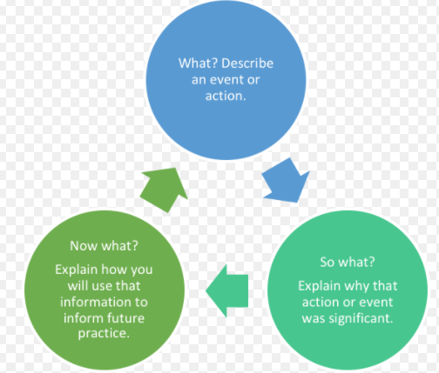
Reflection
Driscoll model of reflection (2007)

