Slide 1

Group Presentation – Research
Student name: Daniela Cimpoaca
Student Number: 2131329
Module Code: LCHS4002_BIRM
Module Title: Digital Skills and Research Methods
Lecturer Name: Julius Azasoo

Slide 2

Introduction
Educational technology is changing the way students learn right in front of our eyes. Long before COVID-19, technology played a growing role in education, even if not all students are comfortable utilising it both inside and outside of educational buildings.
Among the several benefits of using technology in teaching are:
Specialized learning
Communication and collaboration
Increased productivity and efficiency
Research Question:
Are students confident in using technology to collaborate ?
Daniela Cimpoaca

Slide 3

Rationale
Teachers may eliminate the students' barriers in the classroom by utilising the modern technology, and they can give their students a way to connect their educational interests with the real world.
''However, by incorporating technology into the classroom, students can begin to learn how to be responsible in the digital world and with their digital actions. The class becomes a microcosm of the broader digital landscape where students can practice how to communicate, search, and engage with other digital citizens'' (7 Reasons Why Students Need Technology in the Classroom” (no date) Explorance. Available at: https://explorance.com/blog/7-reasons-students-need-technology-classroom/#:~:text=However%2C%20by%20incorporating%20technology%20into,engage%20with%20other%20digital%20citizens ) .
''Students use technology in natural ways that allow them to do what they want: communicate with anyone they want, in the time and space that suits them best. Easily accessible and user-friendly, collaboration tools allow students to explore, share, engage, and connect with people and content in meaningful ways that help them learn.'' ( Collaboration tools - ccti.colfinder.org (no date). Available at: http://ccti.colfinder.org/sites/default/files/PreService_International/resources/KD/M4/U4/Collaboration%20Tools.pdf (Accessed: November 19, 2022). )
Daniela Cimpoaca​

Slide 4
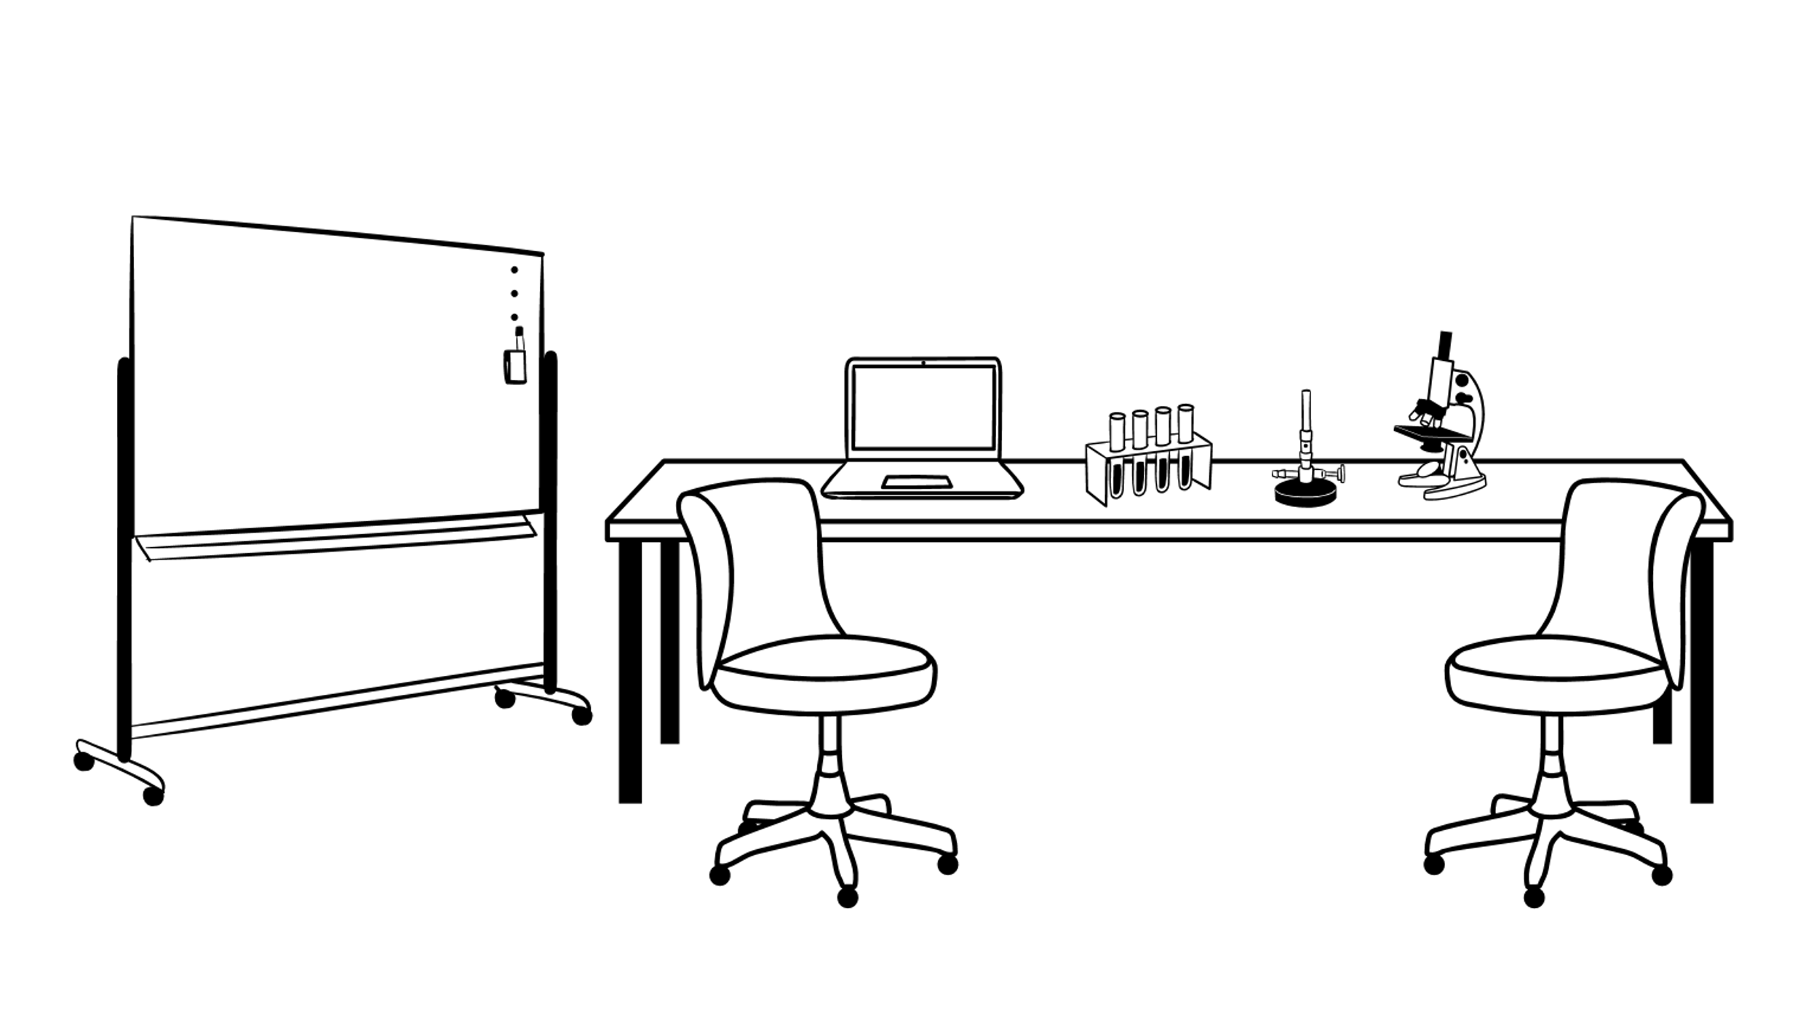
Researchers are discovering that majority of young adults have a limited set of digital skills. They might be skilled at using social media and corresponding via text, chat, and email. Because they participate in digital projects that fulfil their demands, which are considerably more constrained than those they would encounter during their education, they may not have much experience conducting effective online research.
''It pays to be sceptical about students' technical skills. To build technical skills, students need to be using in a variety of ways. I observed many classrooms where students' only experiences were word processing, website games and (ineffective) web searches. Asking those students to plan and execute a video would require a lot of scaffolding. ''
( HAMILTON, B.O.N.I. (2022) “ Chapter 4 Assumptions about Technology Skills,” in Integrating Technology in the Classroom: Tools to Meet the Needs of Every Student. Second Edition, p. 72).
Daniela Cimpoaca

Slide 5

Methods
What digital tool do you utilise the most to communicate with your peers?
What, in your opinion, will increase your comfort level when utilising current technology?
How frequently do you intend to collaborate using technology?
How do you feel when you have to collaborate with others online?
Daniela Cimpoaca

Slide 6

Ethical Consideration
Ethical considerations in research are a set of principles that guide your research designs and practices. Scientists and researchers must always adhere to a certain code of conduct when collecting data from people.
We are only able to ensure anonymity if we refrain from gathering any data that might be used to identify a specific individual, we also agree to respect each other's privacy and keep your data private.
Daniela Cimpoaca

Slide 7
Research Timeline
Week 7 | Week 8 | Week 9 | Week 10 | Week 11
Data collecting | Research Report writing | Analysis | Final Report Workshop | Submitting the Final Report
Daniela Cimpoaca

Slide 8

Hypothesis
My hypothesis is that if we are going to use technology more often for education besides our own needs, we will find ourselves way more confident and ready to work in a team on online platforms.
The activities we do on a daily basis have a strong impact on our confidence. So, the only way to boost our confidence is to alter the routine activities we do.
Daniela Cimpoaca

Slide 9

Reference List
7 Reasons Why Students Need Technology in the Classroom” (no date) Explorance. Available at: https://explorance.com/blog/7-reasons-students-need-technology-classroom/#:~:text=However%2C%20by%20incorporating%20technology%20into,engage%20with%20other%20digital%20citizens .
Collaboration tools - ccti.colfinder.org (no date). Available at: http://ccti.colfinder.org/sites/default/files/PreService_International/resources/KD/M4/U4/Collaboration%20Tools.pdf (Accessed: November 19, 2022).
HAMILTON, B.O.N.I. (2022) “ Chapter 4 Assumptions about Technology Skills,” in Integrating Technology in the Classroom: Tools to Meet the Needs of Every Student. Second Edition, p. 72.
Daniela Cimpoaca

