Slide 1

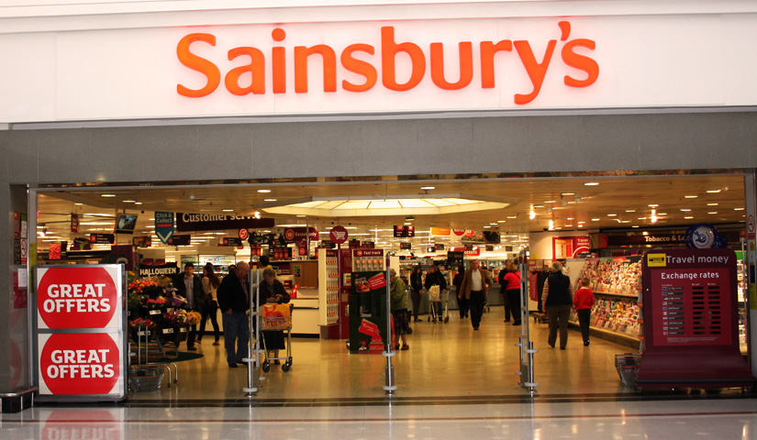
LCBB4009 Understanding Organisational Structure and Culture
Component 1: Practical: Individual presentation
Chosen Company: Sainsbury's
Name: Andreea Sibel Ismail
Student Number: 2516748

Slide 2
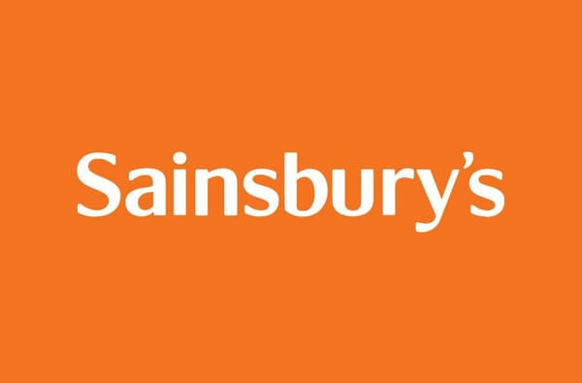
Outline
Defines organisational structure and charts, plus their strategic value
Explores hierarchical, flat, and matrix models via Sainsbury's PLC
Concludes on how large organisations blend structural forms
Notes:
The presentation will begin with the explanation of the understanding of what we are talking about by the organisational structure and organisational charts, and the strategic significance of the two. It therefore runs through three structural models, which are hierarchical, flat and matrix, by using Sainsbury PLC as a living case study. It concludes by discussing a summary of how large organisations have a tendency to confuse their structural forms with adherence.

Slide 3
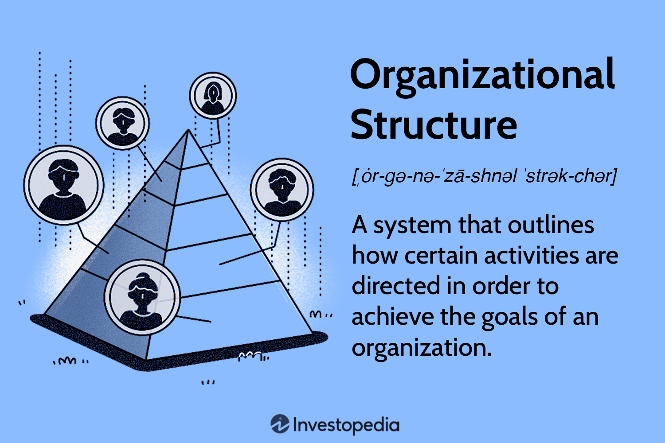
What is Organisational Structure?
Formal system dividing, combining, and coordinating work (Weth, 2025)
Defines responsibility allocation, authority, and communication patterns
Includes chain of command and informal day-to-day practices
Notes:
Organisational structure is the formal way in which work is divided, combined, and coordinated. It is placed in the framework of the mechanism that determines the allocation of responsibilities, power, and communication patterns (Weth, 2025). The structure also encompasses the recurring policies and procedures that are employed to inform the everyday behaviour, such as a chain of command, and it is a series of informal practices.

Slide 4
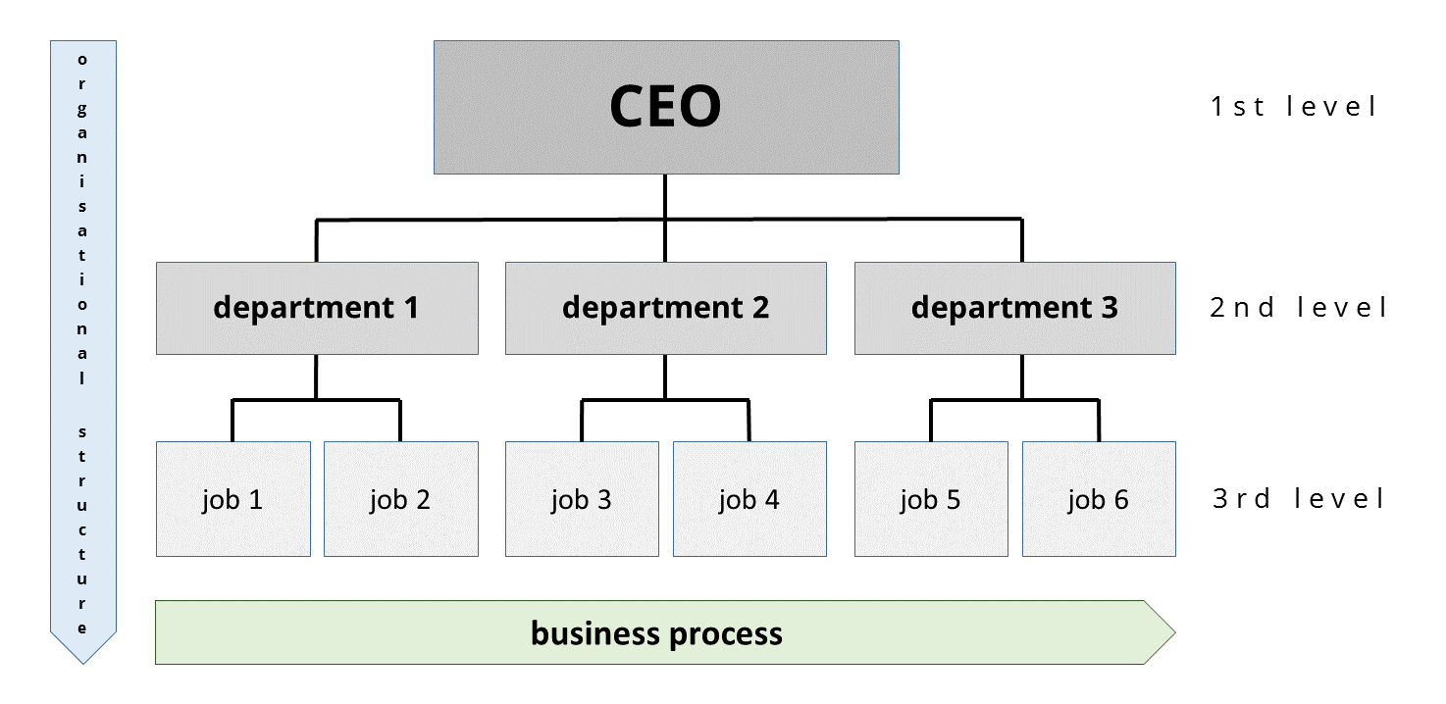
What is an Organisational Chart and Why Does Structure Matter?
A diagram showing reporting lines and departmental boundaries
Structure shapes strategy execution and handling of complexity (Savage, Brannock and Arnold, 2024)
Critical for large firms like Sainsbury's with 148,000+ employees (Sainsbury’s, 2025)
Notes:
A photographic view of this arrangement in the form of a diagram is an organisational chart and shows the reporting relations and departmental responsibilities limits. However, what it brings is a more significant interpretation of structure. The structure is one of the factors in terms of the capability to adopt a strategy and respond to complexity in an organisation (Savage, Brannock and Arnold, 2024). The concept of coherent structure is not an administrative matter in the context of a company with at least 148,000 employees, including at least one operating in hundreds of retail stores and based in London, like Sainsbury (Sainsbury’s, 2025).

Slide 5
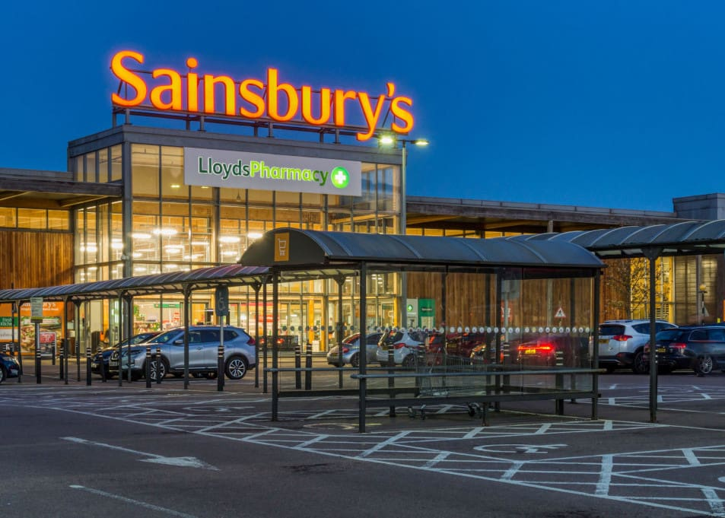
Overview of Sainsbury's PLC
Founded 1869; now operates 1,400+ outlets across multiple formats (Statista Research Department, 2025)
Portfolio includes Argos and Tu Clothing alongside core grocery
Scale and diversity make it ideal for studying real-world structure
Notes:
Founded in 1869, Sainsbury's has grown to be one of the most prosperous retail businesses in the UK with over 1400 outlets, including supermarkets, convenience formats, and a thriving online business (Statista Research Department, 2025). Its other portfolio includes Argos and Tu Clothing, which have their own collection of operational pressure. Of such magnitude and diversification, the case of Sainsbury is an excellent prism through which to see how the structural principles were developed up to the complexity of the real-world organisation.

Slide 6

Way 1: Hierarchical Structure
Traditional tall structure with clear chain of command (Danilishyn and Danilishyn, 2024)
Multiple management layers with decisions made at the top
Enables transparency and managerial responsiveness
Notes:
The hierarchical structure, also referred to as the tall structure, is the most traditional structure of organisation. It is a management system with many management layers, a clearly established chain of control, and decisions that are made at the top (Danilishyn and Danilishyn, 2024). These arrangements make transparency over progress and the responsiveness of the manager possible.

Slide 7

Way 1: Hierarchical Structure
Sainsbury's runs CEO to directors to regional managers to store teams to colleagues
Pyramid design maintains strategic control across dispersed locations (Adom et al., 2023)
Top management retains authority over a geographically spread retail chain
Notes:
Sainsbury is highly hierarchical in its organisational structure on a corporate level. The most junior is the Group Chief Executive Officer, who is supported by functional directors, regional levels of management, store management, the departmental supervisors, and finally, the customer-facing colleagues. Its structure, which is a pyramidal form up to the bottom, allows the top management to have strategic control of a geographically dispersed retail chain (Adom et al., 2023).

Slide 8
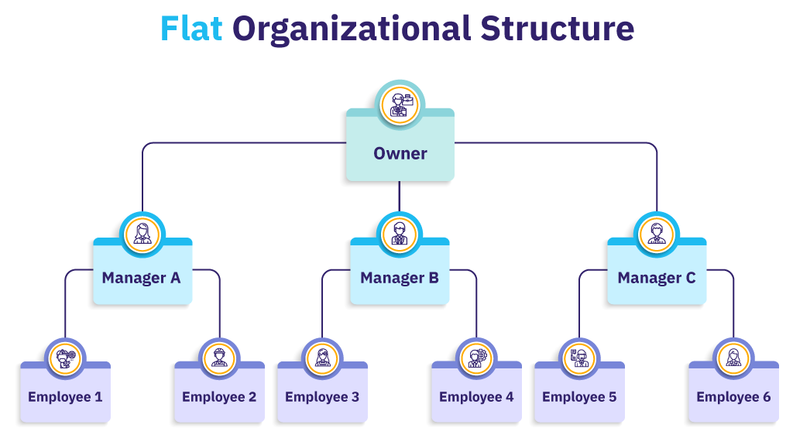
Way 2: Flat Structure
Fewer Management Layers; Broader Spans Of Control (Bhattacharyya, 2024)
Boosts Employee Autonomy And Speeds Up Decision-making
Visible In Sainsbury's Stores: Supervisors Report Directly To Store Manager
Notes:
On the other hand, a flat organisation minimises the levels of management and expands the spans of control all the way to the lowest level of the organisation, resulting in the decision-making process being deeper in the organisation (Bhattacharyya, 2024). The plan will probably result in increased independence of the employees and help the process of decision-making be faster. This is explicable through applying this argument to Sainsbury's individual department stores, where departmental supervisors report to a store manager.

Slide 9
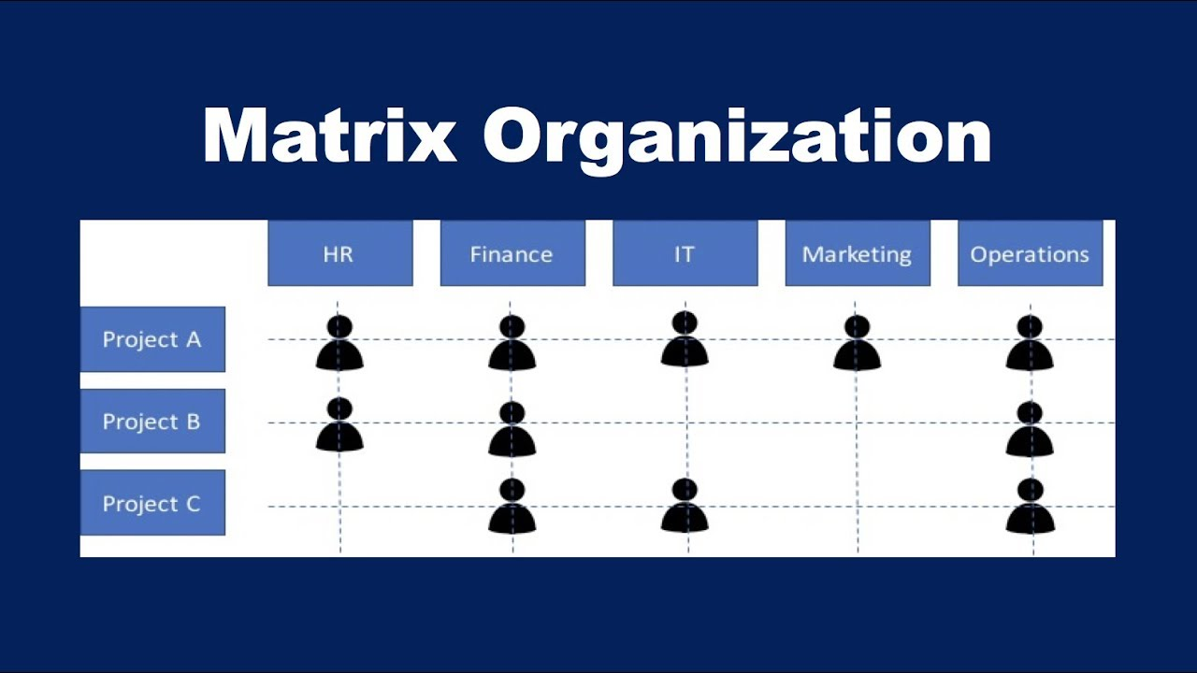
Way 3: Matrix Structure
Breaks single-line authority with dual reporting structure (Janes and Sutton, 2017)
Employees report to both a functional and a project manager
Key advantages are flexibility and effective use of specialist knowledge
Notes:
The unified line authority is subdivided into the matrix organisation. It is an integration of a functional dimension and a project-based dimension to create a dual reporting environment where employees report to a functional manager and a project or product manager (Janes and Sutton, 2017). The key advantages of flexibility and effective use of specialist knowledge are identified.

Slide 10
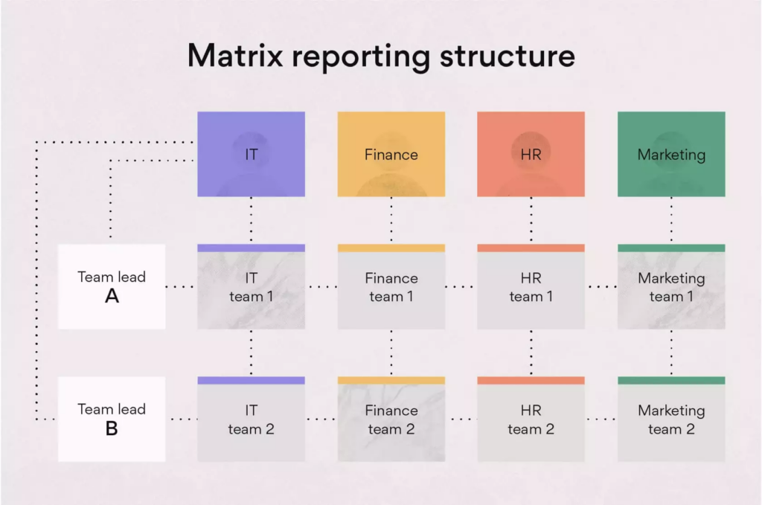
Way 3: Matrix Structure
Used in Sainsbury's cross-functional projects like Nectar and sustainability (Prior, Buttle and Maklan, 2024)
Teams draw staff from IT, finance, marketing, and operations
Charts show individuals at the intersection of functional columns and project rows
Notes:
The matrix style is visible in the working of the corporate sections of Sainsbury, particularly in the cross-functional projects such as the Nectar loyalty scheme and the sustainability plan of this company (Prior, Buttle and Maklan, 2024). The teams of projects consist of IT, finance, marketing and operations recruited employees, but remain functional line reporting. The structure chart of this structure is an indicator of the dual reporting relationship since individuals are located in a cross of a functional column and a project row-design.

Slide 11
Conclusion
Hierarchical structure ensures clear authority and accountability
Flat structure supports operational agility and empowerment
Matrix enables specialist collaboration on complex, time-bound initiatives
Notes:
In conclusion, this presentation has addressed three approaches to organisational design as applied to Sainsbury PLC as the framework of practice. The hierarchical structure defines the authority and accountability clearly and clearly. It has a flat hierarchy that enables operations to be agile and empowered. The matrix organisation gives an opportunity to mobilise the specialisation in complex initiatives that are time-bound.

Slide 12
References
Adom, K., Hinson, R.E., Mintah, E.O. and Obuobisa-Darko, T. (2023) Business administration: an introduction for managers and business professionals. CRC Press. Available at: https://books.google.com/books?id=zSTcEAAAQBAJ&pg=PA71&dq=pyramid+structure+business&hl=en&newbks=1&newbks_redir=1&sa=X&ved=2ahUKEwj_0ZvA5biTAxUiWHADHUMeIDYQ6AF6BAgMEAM.
Bhattacharyya, D.K. (2024) Organizational structure and design: text and cases. Taylor & Francis. Available at: https://books.google.com/books?id=UsIuEQAAQBAJ&pg=PT20&dq=Flat+Structure++business&hl=en&newbks=1&newbks_redir=1&sa=X&ved=2ahUKEwj0kaLP5biTAxWVaHADHW-BMnIQ6AF6BAgHEAM.
Danilishyn, I. and Danilishyn, O. (2024) Hierarchical dynamic mathematical structures (Models) theory. Primedia eLaunch LLC. Available at: https://books.google.com/books?id=KmUdEQAAQBAJ&pg=PA202&dq=hierarchical+structure&hl=en&newbks=1&newbks_redir=1&sa=X&ved=2ahUKEwi05Lik5biTAxUpTmwGHfn_BC4Q6AF6BAgLEAM.
Janes, A. and Sutton, C. (2017) Crafting and executing strategy: the quest for competitive advantage. McGraw Hill. Available at: https://books.google.com/books?id=PssvEAAAQBAJ&pg=PA387&dq=Matrix+Structure+business&hl=en&newbks=1&newbks_redir=1&sa=X&ved=2ahUKEwjR5PKm5riTAxU-yDgGHSVbFMcQ6AF6BAgIEAM.
Prior, D.D., Buttle, F. and Maklan, S. (2024) Customer relationship management: concepts, applications and technologies. Taylor & Francis. Available at: https://books.google.com/books?id=sATmEAAAQBAJ&pg=PT145&dq=Nectar+loyalty+scheme&hl=en&newbks=1&newbks_redir=1&sa=X&ved=2ahUKEwi68qXA5riTAxXPaHADHWF5B5UQ6AF6BAgIEAM.
Sainsbury’s (2025) Sainsbury’s PLC, Sainsburys.co.uk. Available at: https://corporate.sainsburys.co.uk/media/tyxkubai/j-sainsbury-plc-preliminary-results-2324-factsheet.pdf (Accessed: March 20, 2026).
Sandermoen, K. (2017) Organisational structure: Making strategy happen. Adizes methodology in action. Sandermoen Publishing. Available at: https://books.google.com/books?id=SgW1DwAAQBAJ&pg=PT29&dq=organisational+chart&hl=en&newbks=1&newbks_redir=1&sa=X&ved=2ahUKEwjhm5bw5LiTAxUcSmwGHWKxJhMQ6AF6BAgHEAM.
Savage, A.A., Brannock, D. and Arnold, A. (2024) Accounting information systems: connecting careers, systems, and analytics, international adaptation. John Wiley & Sons. Available at: https://books.google.com/books?id=FXr3EAAAQBAJ&pg=SA8-PA7&dq=organizational+chart+business&hl=en&newbks=1&newbks_redir=1&sa=X&ved=2ahUKEwiWs5r65riTAxVxTWwGHYECF-QQ6AF6BAgKEAM.
Statista Research Department (2025) Sainsbury group in the united kingdom(Uk), Statista. Available at: https://www.statista.com/topics/8773/sainsbury-group-in-the-united-kingdom-uk/?srsltid=AfmBOoqj5mYGzziJ5cq4uPAs7bIdjcKJ_FwrkNDfTzQ0_owUyySdO0OA (Accessed: March 24, 2026).
Weth, M. (2025) Why is the multidivisional organisational form (M-form) preferable to the functional organisational form (U-form) ? GRIN Verlag. Available at: https://books.google.com/books?id=oZZlEQAAQBAJ&pg=PA4&dq=Organisational+structure&hl=en&newbks=1&newbks_redir=1&sa=X&ved=2ahUKEwiruerD5LiTAxWubmwGHczdGWIQ6AF6BAgHEAM.

