Slide 1


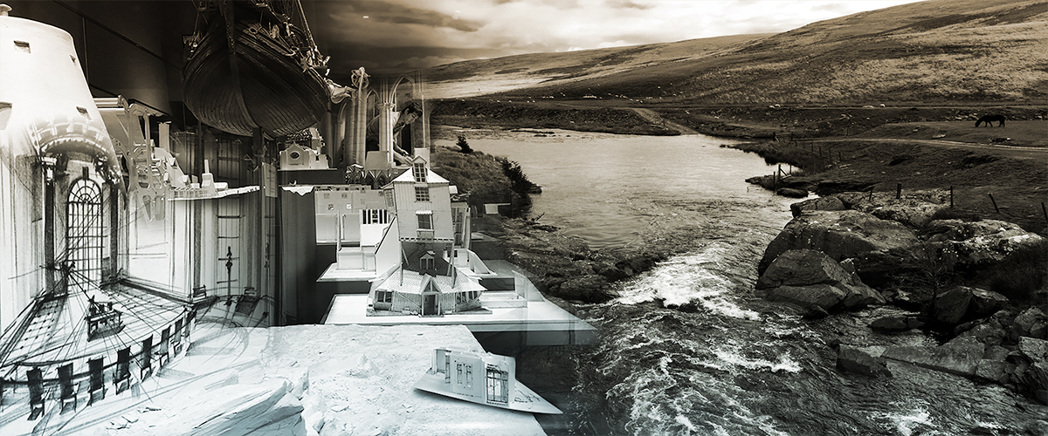
Asking the right questions in the right way.
University of Wales Trinity St David | GAM L5

Slide 2
GAM L5 | Creativity & Value Creation
“Surveys show that surveys never lie.” Natalie Angier.

Slide 3
GAM L5 | Creativity & Value Creation
The most important part of the survey process is the creation of questions that accurately measure the opinions, experiences and behaviours of your target audience.

Slide 4
GAM L5 | Creativity & Value Creation
Creating productive surveys involves both writing good questions and organising them to form the questionnaire.

Slide 5
GAM L5 | Creativity & Value Creation
Good News.

Slide 6
GAM L5 | Creativity & Value Creation
Your questionnaires are pilot surveys and as such, don’t need to measure change over time - something that often considers how opinions or behaviours have been measured in prior surveys.

Slide 7
GAM L5 | Creativity & Value Creation
Pretesting a survey - a pilot survey - is an essential step in the questionnaire design process to evaluate how people might respond to the main questionnaire and specific questions therein.

Slide 8
GAM L5 | Creativity & Value Creation
Similar to any design process, questionnaire development is iterative. The development of questions are tested ahead of their release by qualitative methods i.e focus groups, tutorials, pre-testing.

Slide 9
GAM L5 | Creativity & Value Creation
Similar to.

Slide 10
GAM L5 | Creativity & Value Creation
A comedian testing out new material to a smaller audience prior to a bigger tour.

Slide 11
GAM L5 | Creativity & Value Creation
“Open & Closed”

Slide 12
GAM L5 | Creativity & Value Creation
Are the questions posed in your pilot survey open-ended, where your target audience provides a response in their own words ?

Slide 13
GAM L5 | Creativity & Value Creation
Or.

Slide 14
GAM L5 | Creativity & Value Creation
Are the questions posed closed-ended, where they are asked to choose from a list of response choices?

Slide 15
GAM L5 | Creativity & Value Creation
“Let Us Explore”

Slide 16
GAM L5 | Creativity & Value Creation
It’s fine to conduct a pilot survey using only open-ended questions to discover which responses are most common. These responses can then develop closed-ended questions that include the most common responses as answer choices.

Slide 17
GAM L5 | Creativity & Value Creation
However.

Slide 18
GAM L5 | Creativity & Value Creation
Too many open-ended questions will alienate your target audience; you’re asking too much of them. It all about,

Slide 19
GAM L5 | Creativity & Value Creation
“Balance”

Slide 20
GAM L5 | Creativity & Value Creation
Closed Questions in their most basic form only require a yes or no answer but they do have their uses in a survey.

Slide 21
GAM L5 | Creativity & Value Creation
Can you think of two instances where closed questions might be useful?

Slide 22
GAM L5 | Creativity & Value Creation
Explain to me how a closed question might find its way into your survey.

Slide 23
GAM L5 | Creativity & Value Creation
Closed.

Slide 24
GAM L5 | Creativity & Value Creation
Are you feeling better today ?
Are you equipped for an attempt at human flight ?
Will you please stop pointing at me ?

Slide 25
GAM L5 | Creativity & Value Creation
“The Classic”

Slide 26
GAM L5 | Creativity & Value Creation
Does anyone have any questions ?

Slide 27
GAM L5 | Creativity & Value Creation
However, not all closed-ended questions have to be answered with a yes or no. Any question that is worded such that it can be answered with a simple, direct response of one word or just a few words is also closed-ended.

Slide 28
GAM L5 | Creativity & Value Creation
These next three partially closed questions have direct responses that don't require elaboration in order to fully answer what was asked.

Slide 29
GAM L5 | Creativity & Value Creation
Who made this delicious gâteau ?
Do you want to stay at home or go out ?
Would you rather have an electric bike or scooter ?

Slide 30
GAM L5 | Creativity & Value Creation
“Would you like to buy the first Xmas tree in that line or leave empty handed ?”

Slide 31
GAM L5 | Creativity & Value Creation
This is actually called Hobson’s Choice, where you appear to have free choice but only one thing you want is actually offered.

Slide 32
GAM L5 | Creativity & Value Creation
“Shall I make you cry by using a range of stuffed, toy hedgehogs or with shards of glass from a disused Victorian warehouse ? ”

Slide 33
GAM L5 | Creativity & Value Creation
This is called Morton’s Fork, a seemingly logical dilemma that upon inspection sees you presented with equally bad choices. Often phrased as between a rock and an hard place.

Slide 34
GAM L5 | Creativity & Value Creation
Open.

Slide 35
GAM L5 | Creativity & Value Creation
Open-ended questions are ones that require more than one-word answers or that the respondent chooses from a few options.

Slide 36
GAM L5 | Creativity & Value Creation
These questions require longer responses, with answers often coming in the form of a list or a few sentences from the respondent.

Slide 37
GAM L5 | Creativity & Value Creation
What led you to make such a delicious gâteau ?
What do you look for when choosing a set of wings ?
How can I know it's the right time to point at someone until they cry ?

Slide 38
GAM L5 | Creativity & Value Creation
What suggestions can you share to help me bring the substance of this lecture to a close ?

Slide 39
GAM L5 | Creativity & Value Creation
https://youtu.be/LpV3tMy_WZ0

