Slide 1
Developing Leadership and Management Skills
Seminar

Slide 2
Learning Objectives
By the end of the session you should be able to:
Recognise the impact of management & leadership development.
Understand key areas for development
Evaluate development tools and techniques

Slide 3
What is leadership/management development?
“describes all developmental activities, whether formal or informal, that help managers and leaders enhance their skills, competencies and knowledge to the benefit of the individual, the employees they manage and the organisation” (CIPD 2021)

Slide 4
Challenges
Individual - Identifying and developing capabilities of individuals to lead others effectively (leader development).
Organisational - Creating organisational structures and cultures that encourage and enable leadership.

Slide 5
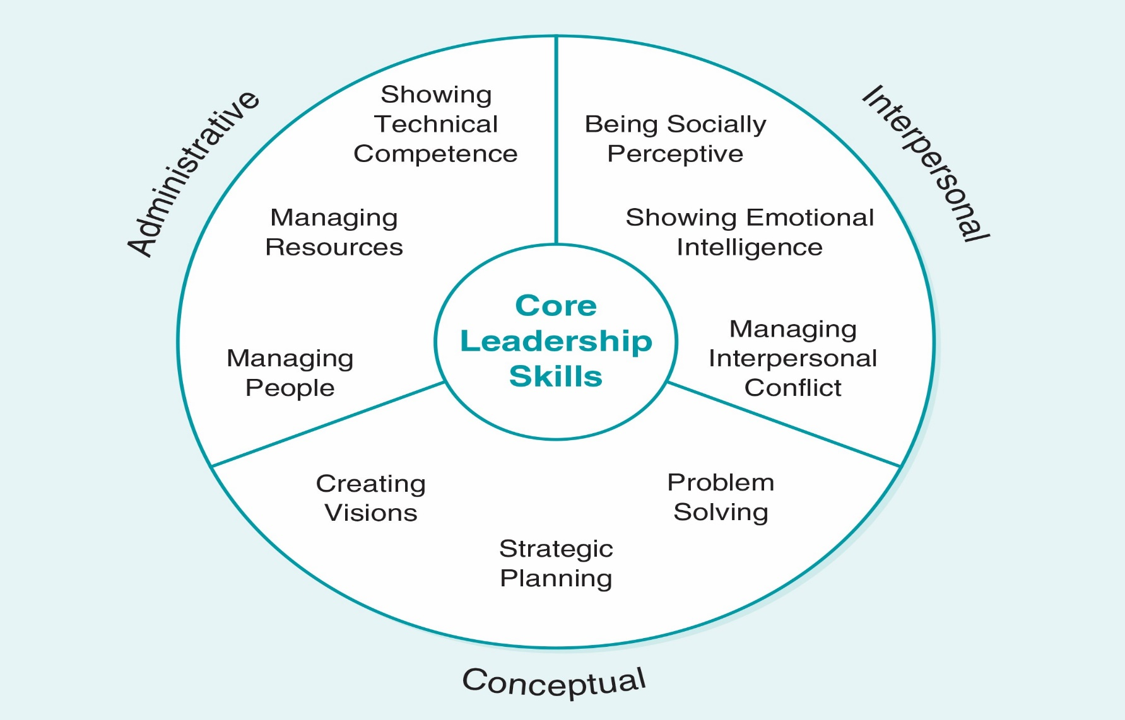
Primary Leadership Skills

Slide 6
What to Develop?
Leadership development approaches focus on identifying and developing individuals that display honesty, integrity and strongly-held moral principles, and translate them into behaviours of leading others

Slide 7
Developing individual leaders
Many organisations provide activities to develop leadership capabilities of individuals through training, development and experience.
Despite the clear business case for line managers also to be leaders, many organisations promote people in managerial roles based on their technical competence, rather than leadership skills.
These individuals are likely to need more formal and/or informal support to be effective leaders

Slide 8
Methods
Coaching & Mentoring
Team Development
Formal training programmes
Shadowing senior managers/leaders
Secondments/ Exposure to new experiences
Job Rotation
Networking

Slide 9
Leadership Process Cycle (Smith & Cockburn 2013)
Face reality
• Continuously reflect alone and with others
• Recognize the strengths you have and build on them
• Start from where you are
• Learn by leading in your particular context
• Learn from successes and failures
• Continue to incrementally improve at your best pace
• Organize in a people-centric way
• Motivate stakeholder participation
• Leverage the wisdom of your learning partners

Slide 10
Organisational Factors
Even where individuals have leadership skills, their ability to lead in practice is affected by organisational factors, including hierarchical structures, performance management systems and other people management policies and practices

Slide 11
Organisational Factors
Hierarchy and bureaucracy undermine devolved, front-line leadership.
Short-term, bottom-line focus overshadows priorities of delivering quality.
Individualism in reward and accountability hinders collaborative working and creates inertia.
‘Us’ and ‘them’ mentality obstructs the potential benefits of workforce diversity (CIPD 2014)

Slide 12
The Future: “VUCA” Environment
Acronym used to describe the
volatility,
uncertainty,
complexity
ambiguity of general conditions and situations.

Slide 13
VUCA Environment
“It is taxing even the most able of leaders who may find their skills growing obsolete as quickly as their organizations change in this volatile, unpredictable landscape. Leadership agility and adaptability are now required skills if organizations are to succeed in this VUCA world.” Lawrence (2013)
Leaders must develop new capabilities and resilient systems if they are to successfully steer their communities through the newly emerging era of social change as well as social digital connectivity and global dynamic complexity

Slide 14
Review
Michael Marquardt (2000) foresaw: “Our new century demands new kinds of leadership with new skills. Leadership styles and skills that may have worked in a more stable, predictable environment of the 20th Century will be inadequate in this new era of uncertainty and rapid change, where we can hardly define the problem, much less engineer possible solutions”.
The widespread push for staff to work from home and self-isolate to avoid spreading the highly contagious Covid-19 infection has given extra impetus to the use of such technology.

Slide 15
Class discussion
How will the VUCA Environment affect
1- methods used to develop leadership
2- the organisational factors that influencing leadership skills

