Slide 1
Why Society deems it Necessary to use the following Labels for Social Class
By Katie John

Slide 2
Labelling theory
‘Sociological approach to the study of deviance, which emphasises the ways in which rule breaking and role failure are maintained by the reactions of others.’ (Pilgram, 2014. P.160)
Labels that we give to people determine how we interact with them.
Homeless people are likely to be labelled drug users, offenders and stigmatised behind negative words despite this isn’t always the case.
(Becker, 1963)

Slide 3
The Othering Process
Created by society where we ‘other’ a particular group or person and spot the things that aren’t the same as us.
e.g. the higher class looking at the lower class and treating them differently because they don’t have the same social activities, financial balance
We can’t assume that because his clothes are dirty he’s poor or because she has no qualifications she’s too poor to be educated.
Society is measured by what it’s not

Slide 4
Stereotyping
A view or representation of someone or something based on purely yours or societies opinion on them
Looking at someone in tracksuit who smokes cigarettes and assuming they are a chav
Can be stereotyped in a job, in school, in a social group
e.g. naughty ex-pupil at school may have got excluded, younger brother comes into school and the known family name is remembered through teachers therefore gets treated differently
Self-fulfilling prophecy
Karl Jung
(Stangor, 2000)

Slide 5
Positive impacts
Makes you feel safer
A sense of belonging
You may be labelled for a good thing
May help you get a job (linking, bridging, bonding)
Social inclusion
Access to social groups
More opportunities

Slide 6
Negative Impacts
Hard to remove yourself from that group/stereotype
Judged and labelled despite you may not want that label
Affect you from getting a job
Generalised
No real identity
Lack of opportunities
Can encourage social deviance
Underestimates ones ability
Social exclusion
Less valued

Slide 7
Key influences of Social Class:
Oppression – (Paulo Friere)
Power (Carl Jung)
Capitalism – (Marxism)
Wealth – (Kahl’s model)
Social Reproduction of Inequalities (Bourdieu)
Distribution of Power
Inequalities of resources (The scale of Economic Inequality)

Slide 8
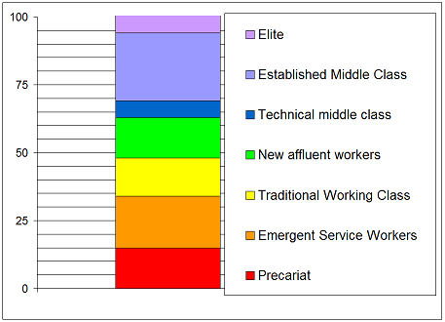
The British Class Survey
In 2013 there were changes to the original three social classes: lower class, working class and upper class.
According to BBC British Class Survey there are now seven social classes.
Working class is now considered good compared to before where it was considered lower class.
Although working class people are still struggling with the cost of living increasing however wages aren’t, therefore it’s easy to get into a cycle of benefits and poverty.
Follows the hierarchy of Kahl’s model where Elite represent Executives and Precariat as the under class.
(BBC, 2013)
The ‘New’ 7 Fold class breakdown, % of people in Britain by label, 2013

Slide 9
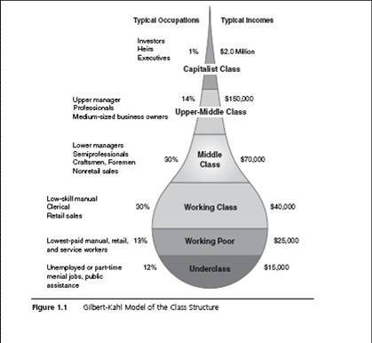
Kahl’s model
1% executives are manipulating and shaping us.
We are controlled by those at the top
Reinforces Marx’s theory
Forced into education which benefits the 1% at the top who we work for

Slide 10
Capital Theory
‘The more you have the more you get, the less you have the less you get’ reinforces those who are at the lower end of the hierarchy who are on benefits or minimum wage are likely to spend the rest of their lives in that sector. In comparison to those who are rich and at the higher end of the model will maintain their capital if not get richer.
Social Capital – Who you know
Financial Capital – How much money you have
Human Capital – Your background
These all play a part in defining where people are on the social class system.

Slide 11
Cohen’s Sub-culture theory
Follows the work of Merton
Researched why delinquency occurs more in working class young males
‘Middle Class Measuring Rod’
When middle class boys don’t fit into the category and positioning that upper class fit into with them having the advantage of better opportunities, their frustration can lead to crime.

Slide 12
How the media portrays social class
Upper Class
Rich
Posh
Independent
Hardworking
Business people
Powerful
Resourceful
Top of the hierarchy
Working/ Lower Class
Poor
On the Dole
Underprivileged
Poverty
Uneducated
Unemployed
Single mothers

Slide 13
Politics
‘Two child policy’
Tax credits and housing benefits cut for families who have more than 2 children
Affects social class
Lower class unable to afford to have more children
(Department for Work and Pensions, 2017)

Slide 14
Scotland’s trial scheme
Universal benefit income trials
Fixed income regardless of earnings
Aims to get rid of poverty
Remove the social class system
Everyone gets treated fairly and equally
If our society was equal and fair, everyone would be able to accumulate capitalism.
(Brooks, 2017)

Slide 15
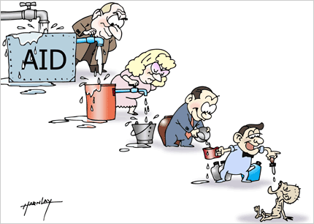
Trickle down theory
Supported by conservatives
Supports the idea of Marxism
The upper class feed off the
lower class to survive and stay rich
(Welton,2017)

Slide 16
Theorists of Social Stratification
Max Weber
Karl Marx
‘A person’s status, or position within a stratified social system, is determined by their relative power, prestige and wealth.’
(Sills, 2017)
These four are combined to make ones social class:
Power
Wealth
Prestige
Property
Means of production
Bourgeoise
Proletariat
Power + inequality = Societal change
Exploited by business owners

Slide 17
Bourdieu, P & Passeron, J,C. (2013) Social Reproduction of Inequality in Education, Society 7 Culture. UK: Sage
Bourdieu, P (1990) The Logic of Practice, Stanford, CA: Blackwell Publishers.
Ball, S,J. (2004) Routledge Falmer Reader in Sociology of Education, London.
BBC Science. (2013). The Great British Class Survey – Results. [online] Available at: http://www.bbc.co.uk/science/0/21970879 [Accessed 3 Apr. 2013].
Brooks, L. (2017). Universal basic income trials being considered in Scotland. The Guardian. [online] Available at: https://www.theguardian.com/politics/2017/jan/01/universal-basic-income-trials-being-considered-in-scotland [Accessed 1 Jan. 2017].
Dillon M (2010) Introduction to Sociological Theory. Theorists, concepts and their Applicability in the Twenty-First Century, Chichester, West Sussex, Blackwell Publishing.
Dorling, D (2018). The ‘New’ 7 Fold class breakdown, % of people in Britain by label, 2013. [image] Available at: http://blogs.lse.ac.uk/politicsandpolicy/what-class-are-you/ [Accessed 30 Apr. 2013].
Giddens, A. (2006) Sociology. Cambridge, Polity Press.
Pilgram, D (2014). Key Concepts in Mental Health, SAGE, London
Stangor, C (2000) Stereotypes and and prejudice: Essential Readings. UK, Psychology press
Welton, K. (2017). Trickle Down Economics. [image] Available at: http://www.spaulforrest.com/2011/04/trickle-down-economics-its-kinda-like.html [Accessed 13 Apr. 2017].

