Slide 1
Mindfulness
Julie Thomas

Slide 2
Definitions
According to Professor Mark Williams (2011), Oxford University "Mindfulness is a translation of a word that simply means awareness. It's a direct, intuitive knowing of what you are doing while you are doing it. It's knowing what's going on inside your mind and body, and what's going on in the outside world as well.”
‘Mindfulness is a type of meditation in which you focus on being intensely aware of what you're sensing and feeling in the moment, without interpretation or judgement.
Practicing mindfulness involves breathing methods, guided imagery, and other practices to relax the body and mind and help reduce stress.’ (Mayo Clinic, 2018)
Notes:
Key word is ‘awareness’ – being aware of what’s going on in your body, mind and all around you. It’s about being present and not worrying about the past and future.
Spending too much time planning, problem-solving, daydreaming, or thinking negative or random thoughts can be draining. It can also make you more likely to experience stress, anxiety and symptoms of depression. Practising mindfulness exercises can help you direct your attention away from this kind of thinking and engage with the world around you.

Slide 3
Why practise mindfulness?
The basis of emotional intelligence is the capacity to be aware of what we are doing and how we are doing, in order to correct this if need be.
i.e. Mindfulness increases self-awareness
‘ . . when it comes to managing your distressing emotions, you’ve got to know you’re having them, otherwise they will hijack you before you know it’ (Goleman, 2012).

Slide 4
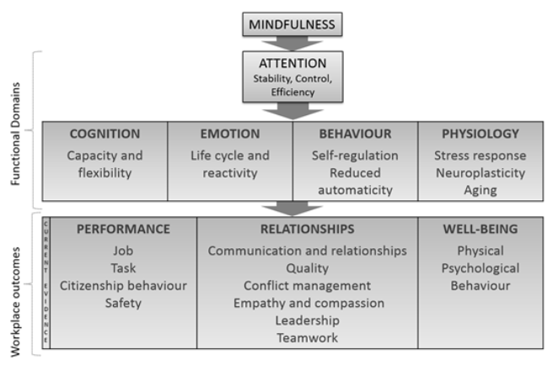
Link between Mindfulness and Positive Outcomes (Good et al., 2016 cited in Mindfulnet, 2016)
Notes:
The framework identifies how mindfulness influences attention, with downstream effects on functional domains of cognition, emotion, behaviour, and physiology. Ultimately, these domains impact key workplace outcomes, including performance, relationships, and well-being.
Attention – reduced mind wandering, getting less distracted, as less distanced, attention is more efficient.
Cognition – as better attention, memory and ability to problem-solve/creativity improve.
Emotions – mindfulness reduces the life-cycle of emotions (the time it takes to return to normal after an emotional reaction), less likely to respond badly to negative stimuli, more psychologically distanced, less regret about past and less anxiety about future. Mindfulness creates less negative and more positive tone.
Behaviour - increased self-regulation and less emotional, automatic responses. You choose how to respond. For example, if you crave a cigarette, you can choose to go for a walk instead. If a manager rejects your idea you can choose to see this as simply a rejection of your idea, not a rejection of you.
Physiology – Improved reaction to stress, better sleep. Neuroplasticity – there’s a change in brain structure related to memory, attention, self and emotional regulation. Ageing – brain and body, disease-resistance.
Performance – all round benefits – more job satisfaction, attention to tasks, compassion and empathy for others, less conflict and better relationships, less dips in performance, focus on goals, less critical and feel less guilt and embarrassment. People are more attentive and make less errors, so safety is improved.
Relationships – better communication, less conflict, greater empathy and compassion. A result of more stable attention, reduced emotional reactivity, more positive emotional tone. Results in better leadership, teamwork. If leaders are less judgemental, this breeds trust, which results in psychological safety and increased employee voice, more error correction and a learning environment.
Well-being – Less burnout, stress, work/family conflict, negative moods. Better sleep quality, job satisfaction, self-compassion and resilience (less emotionally involved).

Slide 5
Simple ways to practise mindfulness
Pay attention
Live in the moment
Accept yourself
Focus on your breathing
Notes:
Pay attention. It's hard to slow down and notice things in a busy world. Try to take the time to experience your environment with all of your senses — touch, sound, sight, smell and taste. For example, when you eat a favourite food, take the time to smell, taste and truly enjoy it.
Live in the moment. Try to intentionally bring an open, accepting and discerning attention to everything you do. Find joy in simple pleasures.
Accept yourself. Treat yourself the way you would treat a good friend.
Focus on your breathing. When you have negative thoughts, try to sit down, take a deep breath and close your eyes. Focus on your breath as it moves in and out of your body. Sitting and breathing for even just a minute can help.

Slide 6
More structured ways to practise mindfulness
Body scan meditation
Sitting meditation
Walking meditation
Notes:
Body scan meditation. Lie on your back with your legs extended and arms at your sides, palms facing up. Focus your attention slowly and deliberately on each part of your body, in order, from toe to head or head to toe. Be aware of any sensations, emotions or thoughts associated with each part of your body.
Sitting meditation. Sit comfortably with your back straight, feet flat on the floor and hands in your lap. Breathing through your nose, focus on your breath moving in and out of your body. If physical sensations or thoughts interrupt your meditation, note the experience and then return your focus to your breath.
Walking meditation. Find a quiet place 10 to 20 feet in length, and begin to walk slowly. Focus on the experience of walking, being aware of the sensations of standing and the subtle movements that keep your balance. When you reach the end of your path, turn and continue walking, maintaining awareness of your sensations.

Slide 7
Mind (2020) – Mindful Exercises
Mindful eating
Mindful moving, walking or running
Body scan
Mindful colouring and drawing
Mindful meditation
Notes:
From MIND (2020):
Mindfulness exercises to try
Here are a few exercises you could try. You don't need any special equipment:
Mindful eating. This involves paying attention to the taste, sight and textures of what you eat. For example, when drinking a cup of tea or coffee you could focus on how hot and liquid it feels on your tongue, how sweet it tastes or watch the steam that it gives off.
Mindful moving, walking or running. Notice the feeling of your body moving. You might notice the breeze against your skin, the feeling of your feet or hands against different textures on the ground or nearby surfaces, and the different smells that are around you.
Body scan. This is where you move your attention slowly through different parts of the body, starting from the top of your head moving all the way down to the end of your toes. You could focus on feelings of warmth, tension, tingling or relaxation of different parts of your body.
Mindful colouring and drawing. Focus on the colours and the sensation of your pencil against the paper, rather than trying to draw something in particular. You could use a mindfulness colouring book or download mindfulness colouring images.
Mindful meditation. This involves sitting quietly and focusing on your breathing, your thoughts, sensations in your body and the things you can hear around you. Try to bring you focus back to the present if your mind starts to wander. Many people also find that yoga helps them to concentrate on their breathing and focus on the present moment.
Different things work for different people, so if you don’t find one exercise useful, try another. You can also try adapting them so that they suit you and are easier to fit in with your daily life.
Tips on getting the most from mindfulness exercises
When you do any mindfulness exercise, the key steps are:
Pay attention – for example, when you shower in the morning, make a special effort to really pay attention to the feel of the water on your skin.
Notice – when your mind wanders, which is just what minds do, simply notice where your thoughts have drifted to.
Choose and return – choose to bring your attention back to the present moment, usually by focusing on your breathing or another sensation in your body.

Slide 8
What to do now
Following this lecture, please read the article by Good et al. (2016), or one of the other peer reviewed articles that are on Moodle
Try out some mindfulness!

