Slide 1

PCET Session
Action Research as a concept

Slide 2
Action Research
Emerged in the 20th century as a philosophical approach to discovering information about practice within an increasingly complex world.
Its origins in the work of Kurt Lewin and Stenhouse

Slide 3

The contemporary educational context
means that it is not enough for the teacher to study their work
they also need to study themselves within the context of teaching.

Slide 4
Action Research
Carr and Kemmis (1986) describe Action Research as a form of self-reflective inquiry.
They suggest that outcomes of action research are focused upon the following;
  Improving practice
  Gaining a new understanding of practice
  And improving the situation where practice takes place

Slide 5

Reflection or Reflexive
There are parallels between reflective practice (Schon) and Action Research.
However, the focus of Action Research is to inform personal development.
A key concept within Action Research is self- reflexivity.

Slide 6
Self -reflexivity
Asks that the Teacher (or Researcher) reflects on and evaluates their own experience
the impact of those values, past experiences, attitudes and assumptions may have upon their teaching

Slide 7
Teaching and Action Research
It is likely that Teachers are already involved in some aspect of Action Research
In addition to the action (i.e. teaching), there is a need to draw on the body of literature to interpret and evaluate the action.
It is this integration of theory, concepts and action that differentiates the approach from case study and is a key element of action research

Slide 8
Action Research and Social Justice
It is useful to note values are abstract and that as teaching practitioners the approach is best typified as forming critical pedagogy and collaboration (Freire,....).
Indeed, the approach is advocated by Griffiths (….) who argues that Action Research is an enabler of social justice.

Slide 9

In summary
Action Research is about Teachers trying to improve practice on a day-to-day basis
Teacher is the main ‘actor’ within the teaching practice
Aims to create positive change through reflexivity

Slide 10
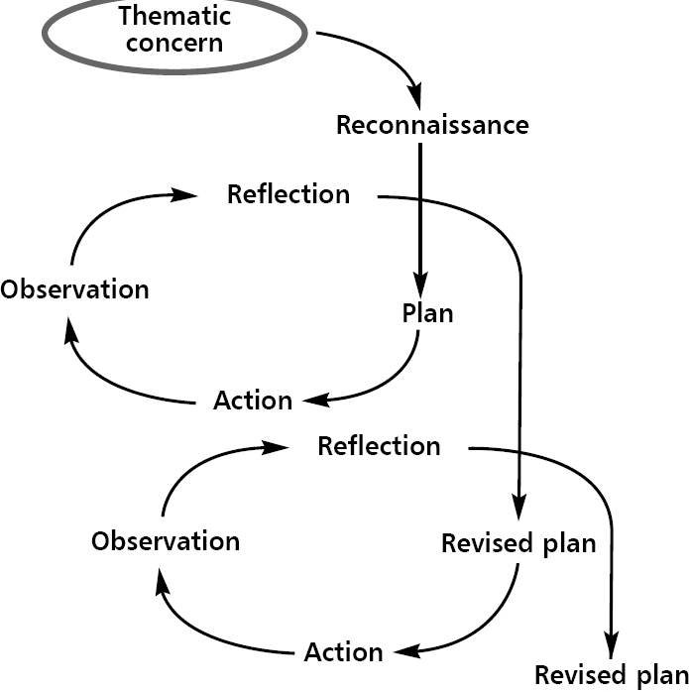
Figure 1.1 The Action Research Spiral

Slide 11
PCET Session
Starting an Action Research project

Slide 12
Starting point of Action Research
Ask the following questions
How do I improve my practice?
How do I focus on small aspect my teaching practise?

Slide 13
Starting questions
Whitehead (2002) proposes a set of framing questions.
What is my concern?
Why am I concerned?
What do I think I can do about it?
What will I do about
What does the evidence to show?
What is my influence in the situation?
How will ensure that the judgements that I make a fair and accurate ?
What will I do then?
Whitehead (2002) pp136 in Atkins and Wallace, (2012)

Slide 14
PCET
Session
Action Research evidence

Slide 15
Action Research evidence
Data sources
Observation
Recordings of performance
Product
Diaries
Institutional data
Policies
Reports

Slide 16
Typical report structure
Abstract
Introduction
Literature review
Methodology
Data
Discussion
Conclusion
Recommendations

Slide 17
More reading
http://insight.cumbria.ac.uk/id/eprint/4045/1/Whitehead_AllYouNeedTo.pdf

Slide 18
References.
Atkinson L and Wallace S (2012) ‘Qualitative action research’ BERA

