Slide 1
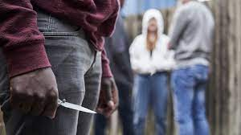
Gang violence and knife crime
Notes:
Quick intro

Slide 2

Recap of last week
What did we learn last week:
The definition of kidnap and extortion

Slide 3

Learning objectives
By the end of this session, you should be able to ……
- Identify the prevalence of gang violence and knife crime in the UK.
- Explore the causation between gangs and knife crime
- Evaluate strategies being used to address these crimes
Notes:
Read the learning objectives

Slide 4
WHAT IS A ‘GANG’?
Section 34(5) of the Policing and Crime Act 2009, as amended by the Serious Crime Act 2015, provides that something is ‘gang related’ if it occurs in the course of, or is otherwise related to, the activities of a group that:​
Consists of at least three people; and
Has one or more characteristics that enable its members to be identified by others as a group.​​
Notes:
Read section 34 (5)
A gang could consist of at least 3 people
One or more characteristics

Slide 5

Peer group
A relatively small and transient social grouping which may or may not describe themselves as a gang depending on the context.
Street gang
“Groups of young people who see themselves (and are seen by others) as a discernible group for whom crime and violence is integral to the group's identity.”
Organised criminal gangs
“A group of individuals for whom involvement in crime is for personal gain (financial or otherwise). For most crime is their 'occupation.”
Notes:
3 different types of gangs
Peer group
Small and transient social grouping which may or may not
Example school friends
Street gang
Groups of young people who see themselves and seen by others as a group for whom crime and violence is integral to the group's identity
Local gang of youths

Slide 6
TASK
CAN YOU FIND AN EXAMPLE OF A ‘STREET GANG’ AND AN ‘ORGANISED CRIMINAL GANG’.
WHAT ARE THE KEY DIFFERENCES BETWEEN THESE TWO TYPES OF GANGS?

Slide 7

Why do young people join gangs?
recognition
excitement
friends
acceptance
a sense of belonging
power over other people
money from crime
protection
territory
respect
Notes:
Recognition
Excitement
Friends
Acceptance
Sense of belonging
Power over other people
Money from crime
Protection
Territory
respect

Slide 8

Gang culture
Serious and widespread criminal offending
Strong ties with affiliated serious organised crime offenders based on a shared acquisitive interest.
Gangs often prey on young and other vulnerable people, coercing them to become involved with crime.
Notes:
​Serious and widespread criminal offending
Strong ties with affiliated serious organised crime offenders
Who remembers what acquisitive means?
Gangs often pray on young and other vulnerable people, coercing them to become involved with crime

Slide 9
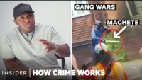
Street gangs
Notes:
https://www.youtube.com/watch?v=HvWavE-yeGE

Slide 10
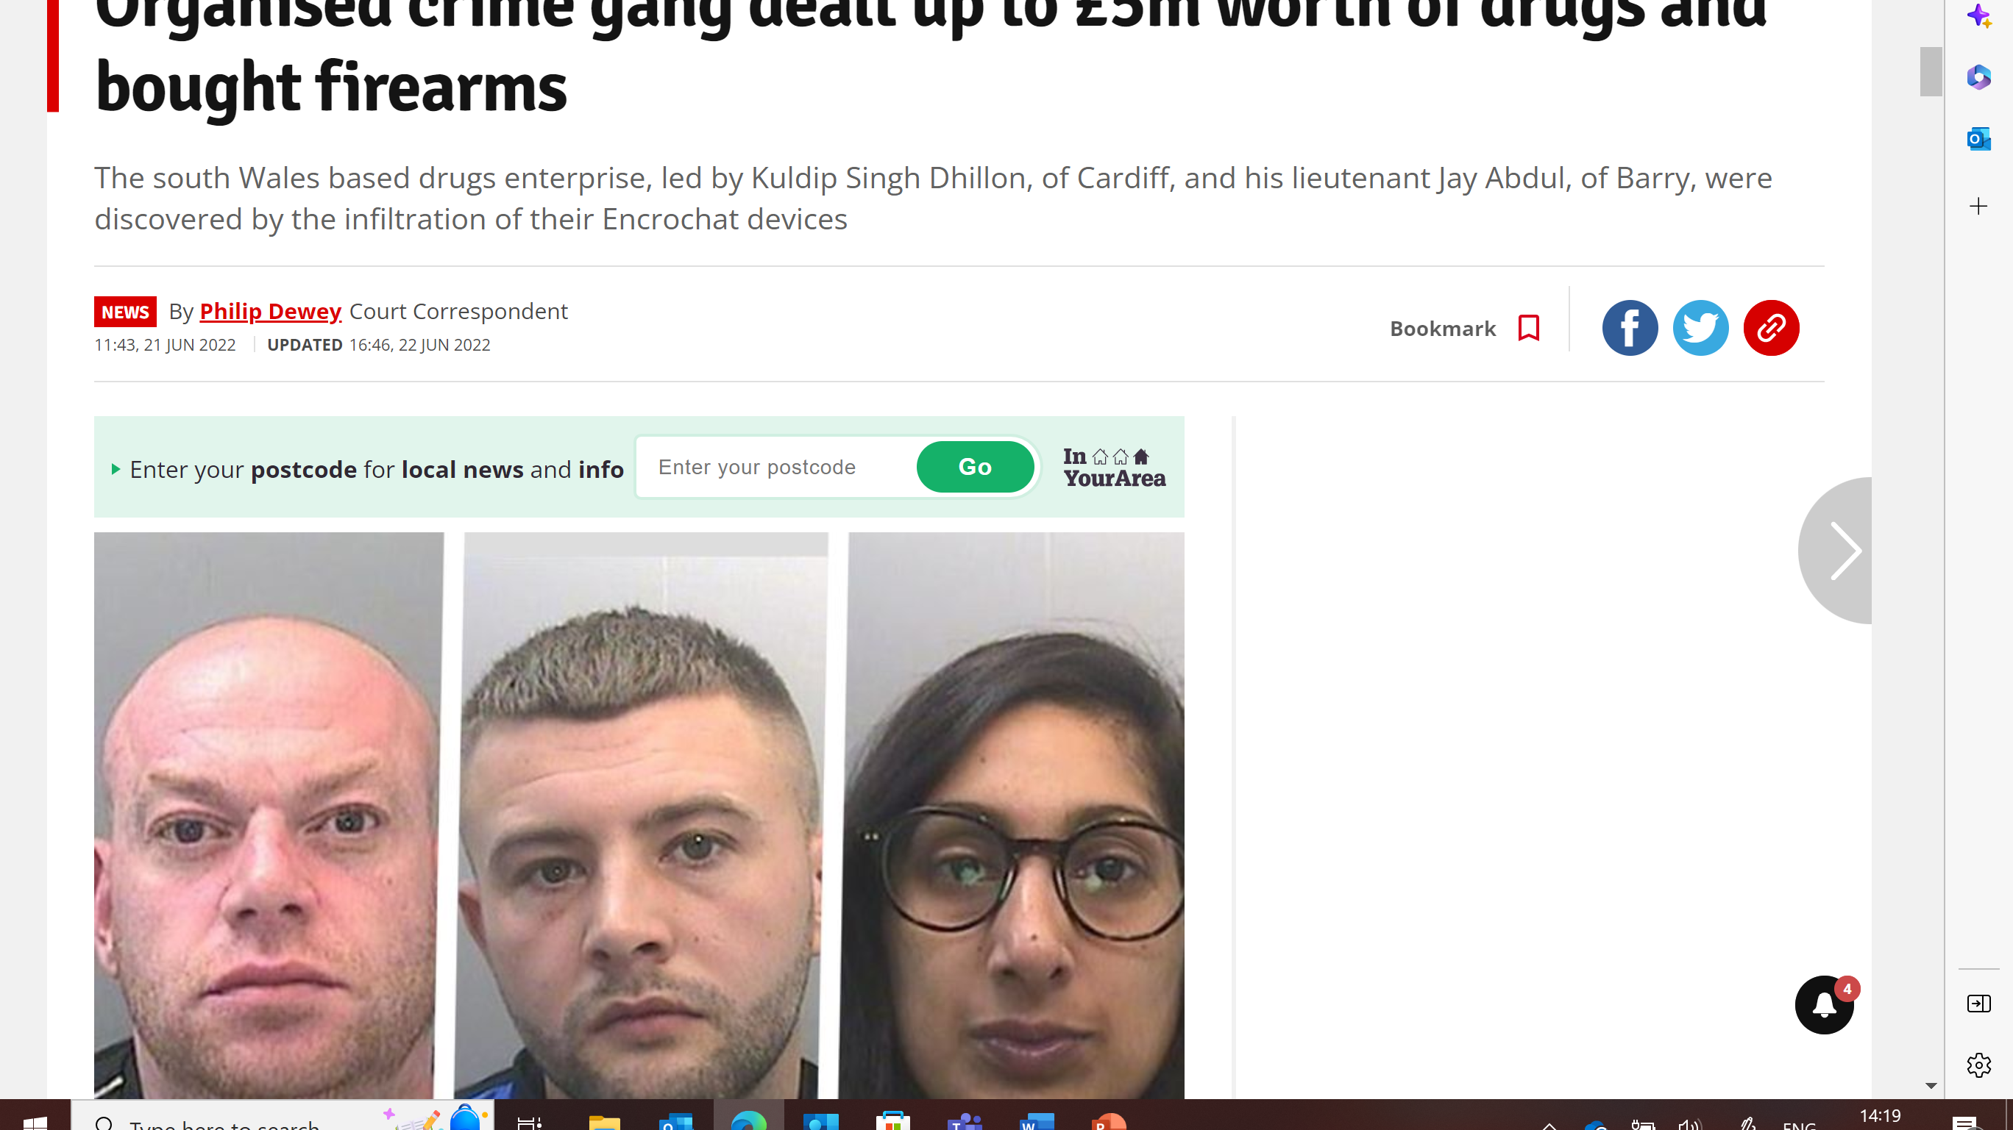
ORGANISED CRIME GANGS
Notes:
It's not illegal for a young person to be in a gang – there are different types of ‘gang’ and not every ‘gang’ is criminal or dangerous. However, gang membership can be linked to illegal activity, particularly organised criminal gangs involved in trafficking, drug dealing and violent crime.
Organised crime gang dealt up to £5m worth of drugs and bought firearms - Wales Online
A gang which dealt up to £5m worth of drugs in a substantial commercial operation were discovered after their encrypted chats were cracked by police. The group also bought firearms as part of the enterprise which saw them trafficking class A drugs into south Wales.
The group was led by Kuldip Singh Dhillon, of Cardiff, and his lieutenant Jay Abdul, of Barry, who enlisted other members including romantic partners to facilitate the purchase and supply of drugs including cocaine, heroin, amphetamine and cannabis. A sentencing hearing at Cardiff Crown Court heard the authorities accessed Encrochat devices used by the dealers and revealed conversations between June 6 and 12, 2020, relating to the conspiracy which lasted 13 months.
While Dhillon and Abdul, 39, led the group, Ryan Hales, 28, played a senior organisational role and was entrusted with the Enchrochat device. Marc Harris, 31, was not a member of the group but was a regular customer and sold cocaine by the kilo with the assistance of his partner Naisha Hembury, 35.
Abdul got 19 years 6 months
Hales was sentenced to 11 years and three months imprisonment.
Harris was sentenced to seven years and four months imprisonment
Smith was sentenced to five years and three months imprisonment
Aysha Ali was sentenced to three years and nine months imprisonment
Neesha Ali was sentenced to four years and six months imprisonment
Hembury was sentenced to 22 months' imprisonment suspended for 18 months and was ordered to carry out 100 hours unpaid work and a 15-day rehabilitation activity requirement

Slide 11
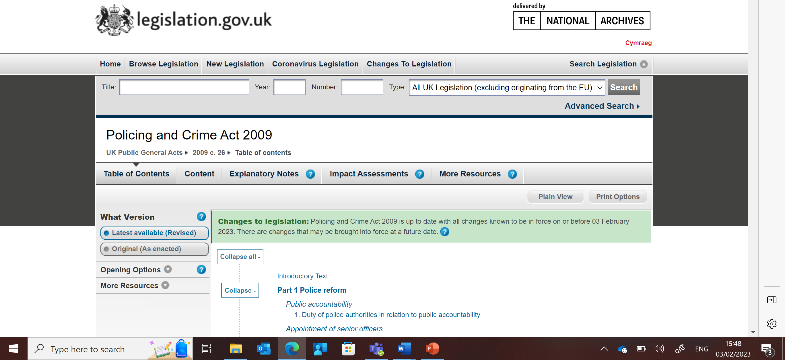
Orders:
Gang related injunctions; Part IV Policing and Crime Act 2009
Allows the Police and local authorities to apply for injunctions to prevent gang related violence and gang-related drug dealing activity.
Anti-social Behaviour, Crime and Policing Act 2014​
Modern Slavery Act 2015: Slavery and Trafficking Risk Order
Notes:
Orders that the police can use

Slide 12

Orders on conviction
TASK: WHAT CONDITIONS CAN BE IMPOSED UNDER THESE ORDERS?
Serious Crime Prevention Order
Criminal Behaviour Order
Slavery and Trafficking Prevention Order
Forfeiture and destruction
Notes:
​​

Slide 13
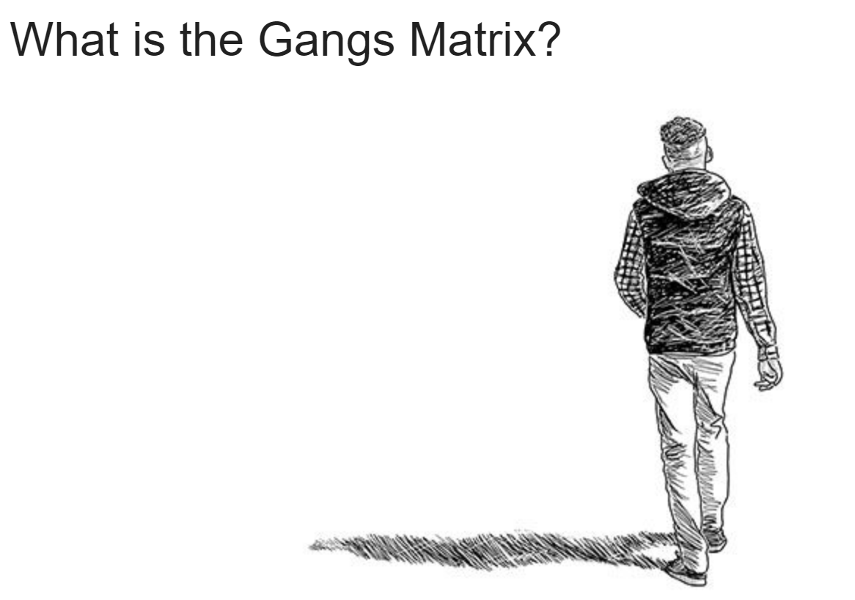
Trapped in the Matrix Amnesty report.pdf
IS IT FIT FOR PURPOSE?
Notes:
How many potential gang members are in the red category?
How many people from BAME background are on the matrix?
How many females are on the matrix?
Do you think the matrix is fit for purpose?
What are the issues with the matrix?
72% of those identified as responsible for gang flagged violence are black
27% of those responsible for serious youth violence are black

Slide 14
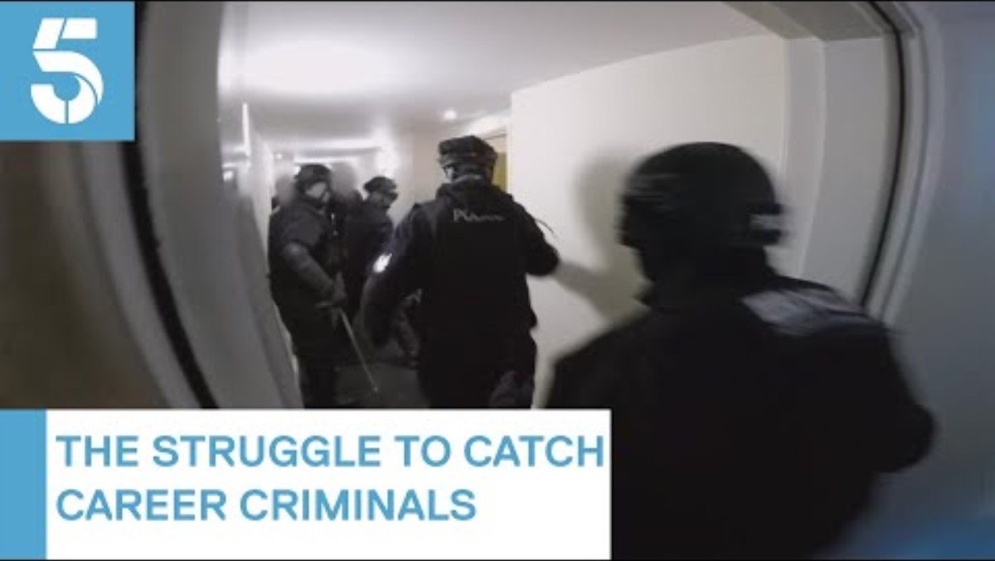
Notes:
https://www.youtube.com/watch?v=TCSA8ds_j5w

Slide 15
Ending gang violence
County lines – This is to stop the exploitation of vulnerable people by a hard core of gang members to sell drugs
Protect vulnerable locations – these are places where young people are vulnerable such as pupil referral units and residential children’s care home
Reduce violence and knife crime – improving the way national and local partners use tools and powers
Safeguard gang-associated women and girls – this includes strengthen local practices
Promote early intervention – identify and support vulnerable children and young people (including identifying mental health problems
Promote meaningful alternatives to gangs – education, training and employment
Notes:
County lines
This will be touched upon more next week
Here they want to stop the exploitation of vulnerable people to be coerced by hard core gang members to transport/ sell drugs
Protect vulnerable
Children in either social care or in youth offending teams are more at risk to be exploited by gangs
However, children not known to services are also vulnerable due to evade detection
Cases where gang members have waited outside schools to meet children, take them do criminal activities and then return them so they aren’t reported missing
Reduce violence and knife crime
Ending knife crimes and violence using local programmes
We will look at these more later in the session
Safeguard gang associated women and girls
This is to help vulnerable females to be leave gangs
This will be achieved again through local programmes
Promote early intervention
Intervening early so that young people do not become involved in gangs and then eventually youth violence
Promote meaningful alternatives to gangs
Give them meaningful alternative such as education, training and employment
Especially those who are leaving care

Slide 16
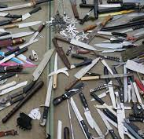
KNIFE CRIME

Slide 17
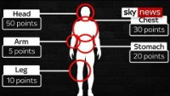
Notes:
https://www.youtube.com/watch?v=z_e4RaSe_J0

Slide 18
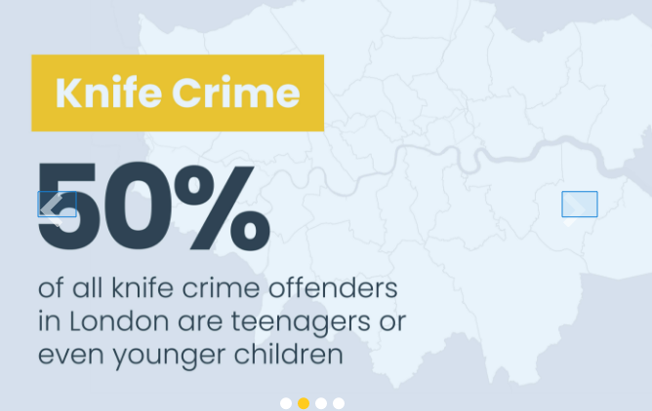
Prevalence of gang violence and knife crime
Knife-enabled crime recorded by the police saw a 10% increase to 49,027 offences in the year ending March 2022, from 44,642 in the year ending March 2021.
It is hard to estimate the number of people in gangs.
60,000 children may self-identify as a gang member or know a gang member who is a sibling
300,000 children may know a gang member
34,000 children may know a gang member and have been a victim of violence in the previous 12 months.
Notes:
10% increase to 49,027 offences in 2022 from 44,642 in the year ending March 2021
60,000 may self-identify as a gang member or know a sibling that is
300,000 children may know a gang member
34,000 children may know a gang member and have been a victim in the last 12 months

Slide 19
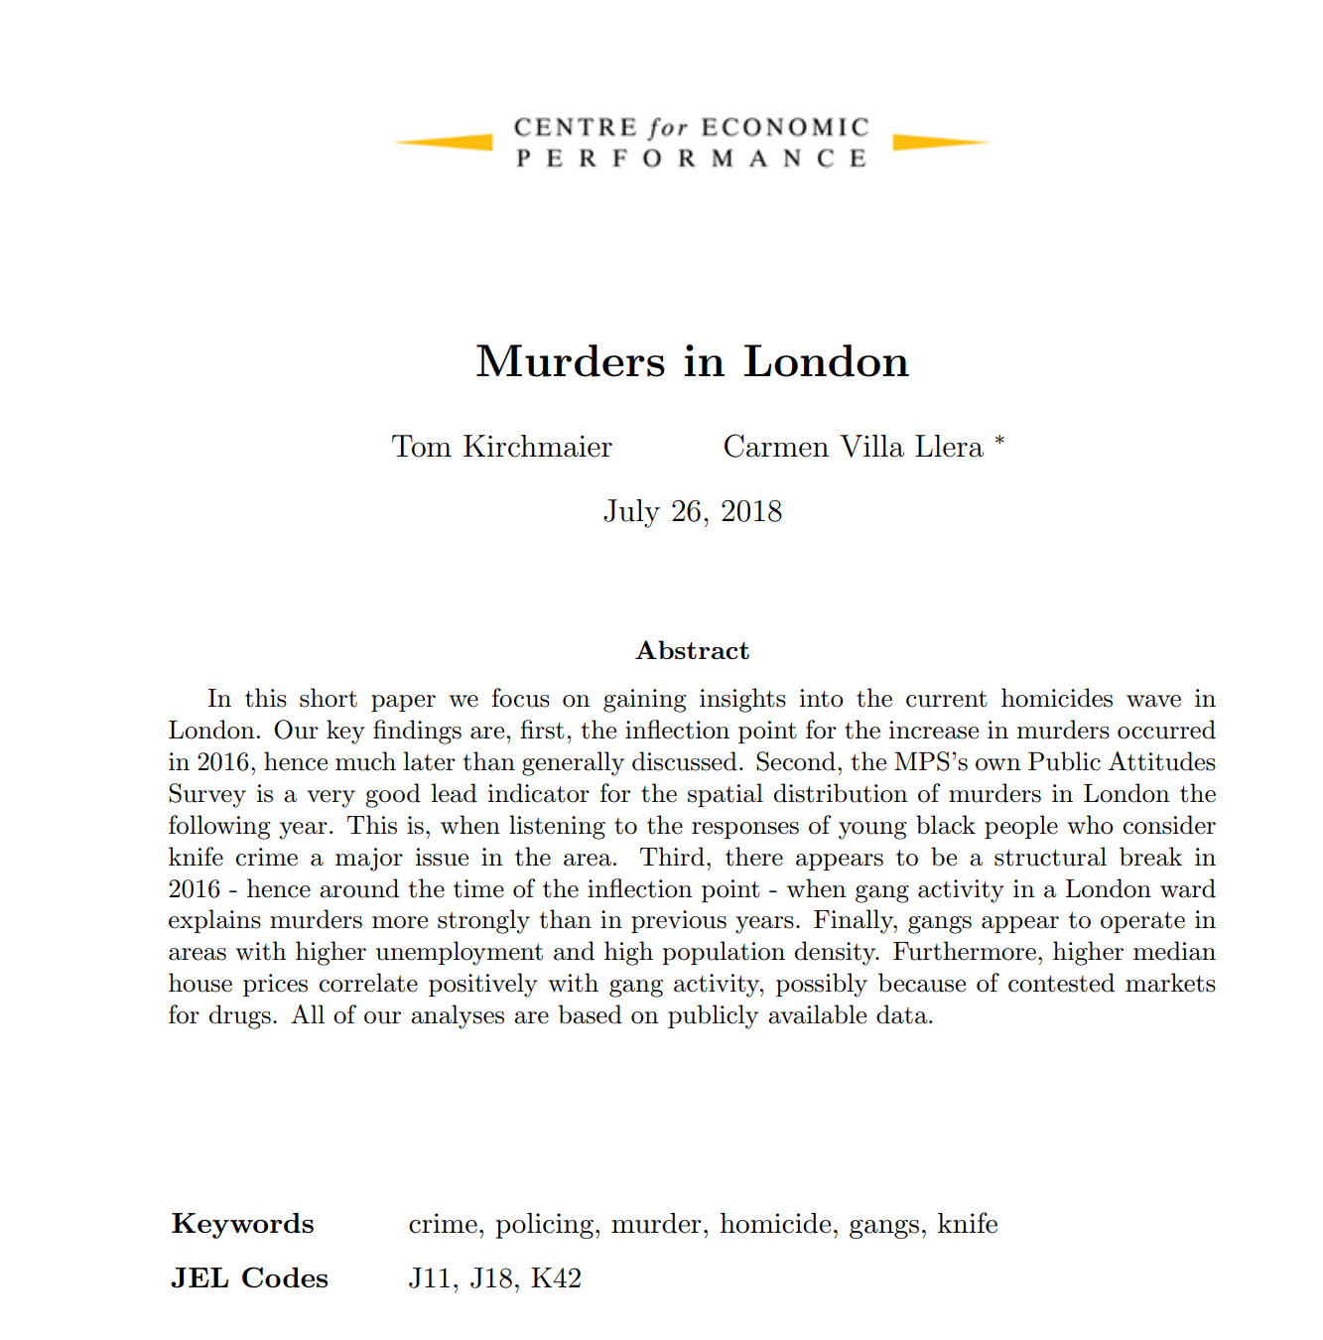
Understanding patterns of knife crime
Murder locations were positively correlated with the percentage of the previous years’ young black respondents (aged 24-35) who believed knife crime was a major concern in that area.
Analysis suggests a stronger link in London between gangs and knife crime since 2016.
Notes:
Kirchmaier, T. and Villa Llera, C. (2018). Murders in London. Centre for Economic Performance, LSE: London.
Black respondents believe knife crime was a major concern in that area
Analysis suggests a stronger link in London between gangs and knife crime since 2016

Slide 20
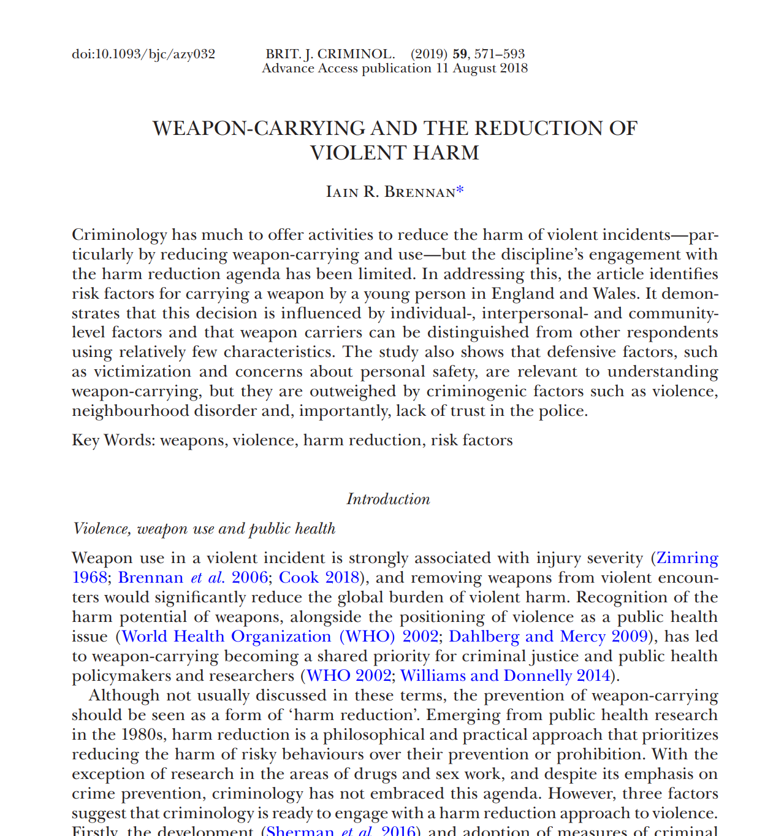
Risk factors associated with knife crime
Gender
Age
Adverse childhood experiences
Educational attainment
Ethnicity
WHAT DO YOU THINK THE RESEARCH SAYS?
Brennan (2018)
Notes:
Gender
Age
Adverse childhood experiences (ACE'S)
Educational attainment
ethnicity
Brennan, I.R. (2018). Weapon-Carrying and the Reduction of Violent Harm. British Journal of Criminology. Online access: https://doi.org/10.1093/bjc/azy032.

Slide 21
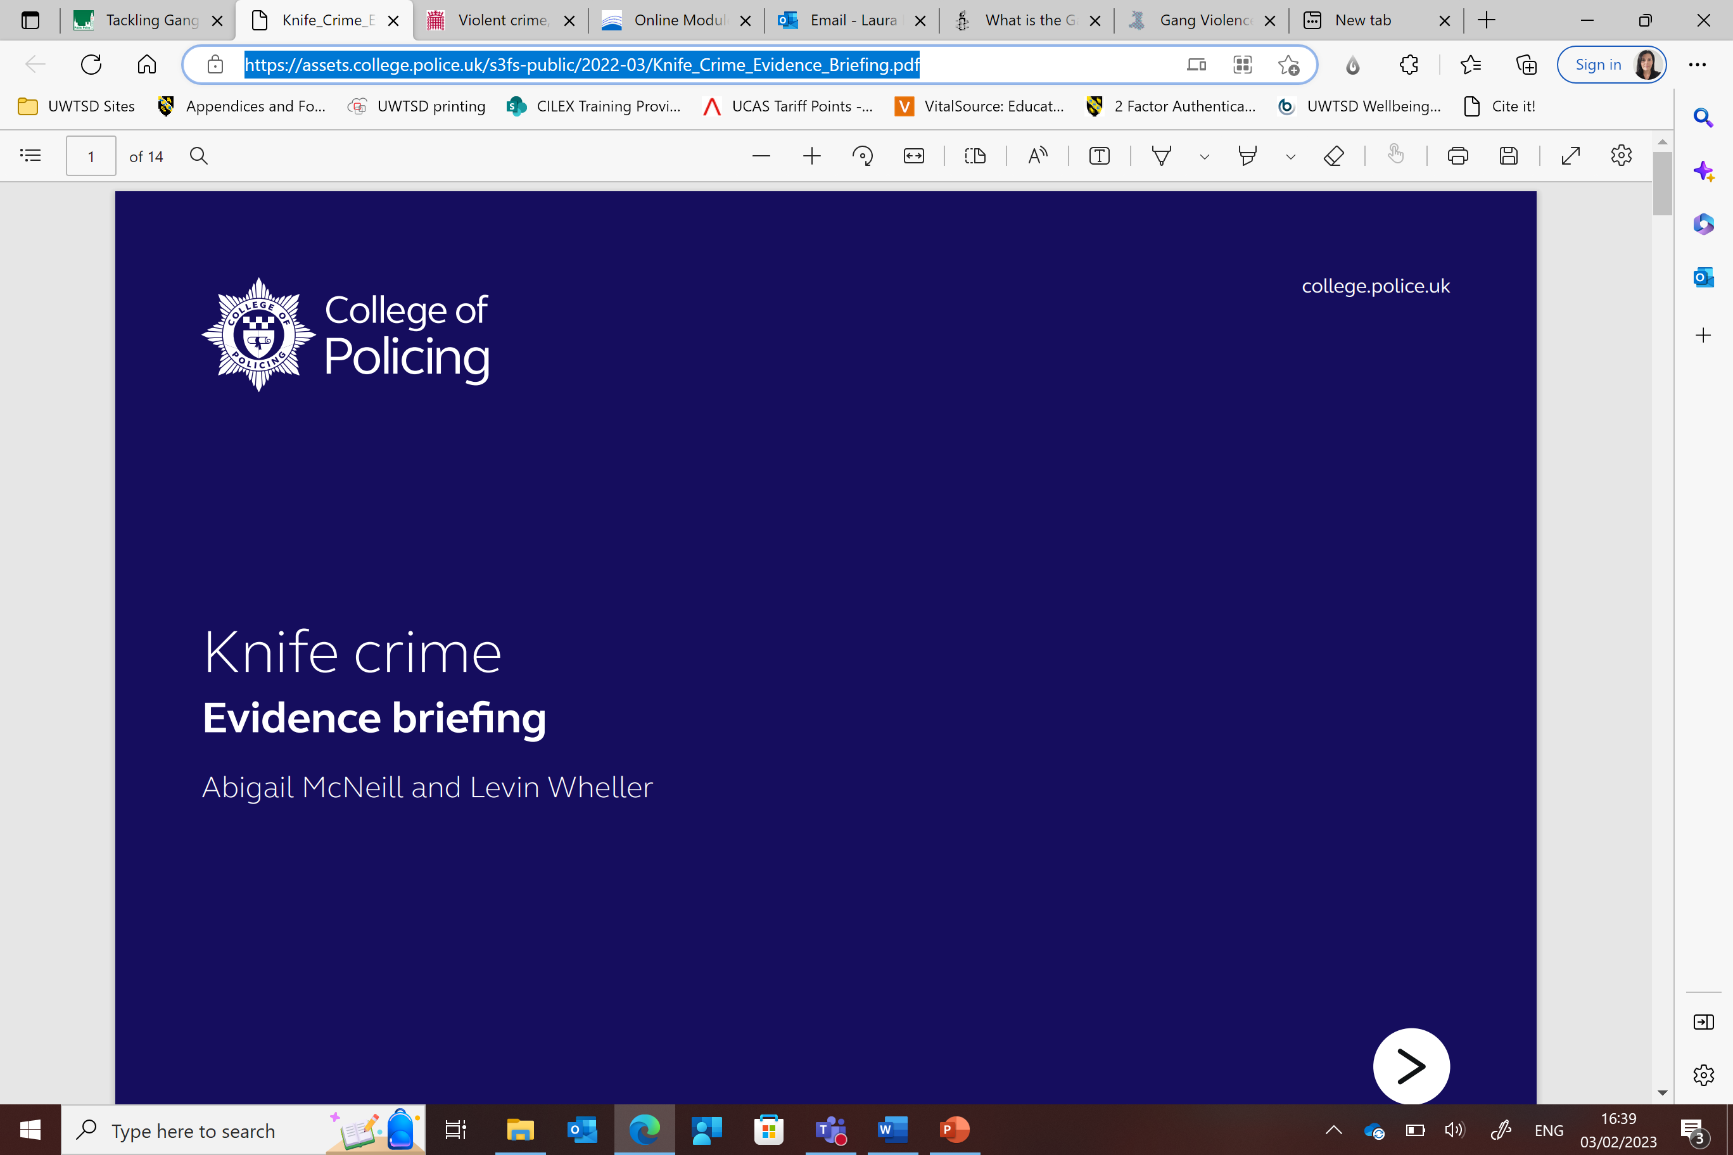
Motivations for carrying weapons
Self protection and fear
Self-presentation
Utility
Thinkpoint:
How can a lack of trust in the police affect the levels of knife crime?
Notes:
Self-protection and fear
Self-presentation
Utility
Do not feel safe
Knife_Crime_Evidence_Briefing.pdf (college.police.uk)

Slide 22
Local statistics for knife crime
Knife Crime in South Wales rose by 20%
885 offences involving a knife or sharp weapon
This up from 735 the year prior
In Dyfed-Powys Police Force in 2023, they recorded 204 reports of knife crime. However, they have only charged 22 people with knife crime offences
This in contrast than the 113 that was reported in 2018 for the no. of people charged with knife crime offences
Highest no. of recorded knife crimes was in 2022 with 482
In the year 2023, 30 children between the ages of 11 and 16 were arrested for possession of knife or sharp weapon
Notes:
Knife crime in South Wales has risen by 20%
885 offences involving a knife or sharp weapon
This is up from 735 the year prior
2023, Dyfed-Powys Police recorded 204 reports of knife crime
However, they only charged 22 people with knife crime offences
These figures contrast with the 113 that were charged with knife crime offences
And the 482 reported knife crimes in 2022
Also in the 2023, 30 children between the ages of 11 and 16 were arrested for possession of knife or sharp weapon
The no. of 11-year-olds was 3.
The most was 16-year-olds with 10

Slide 23
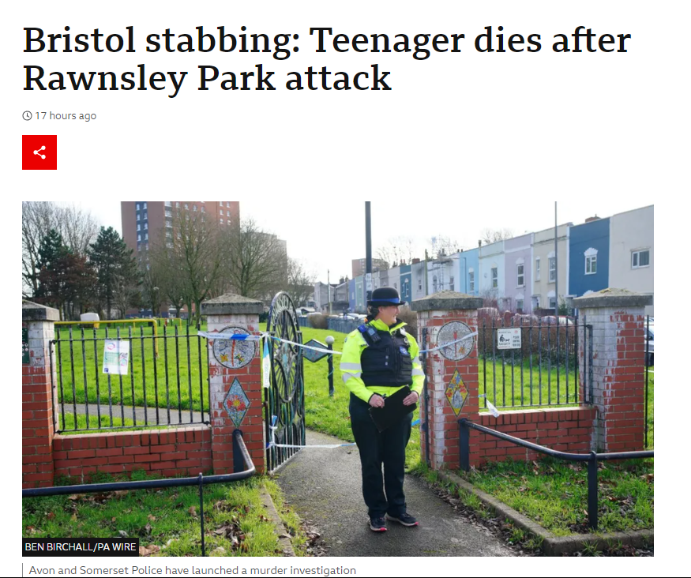
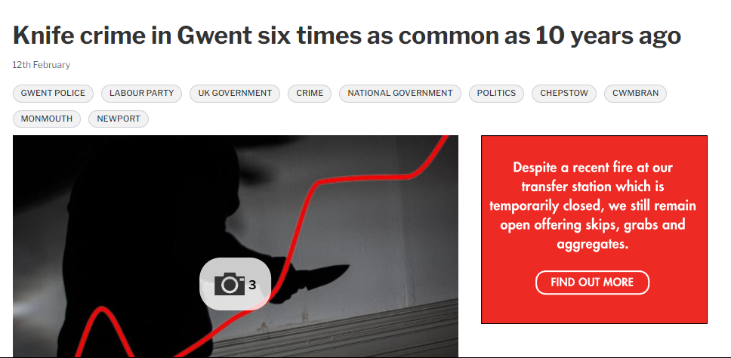
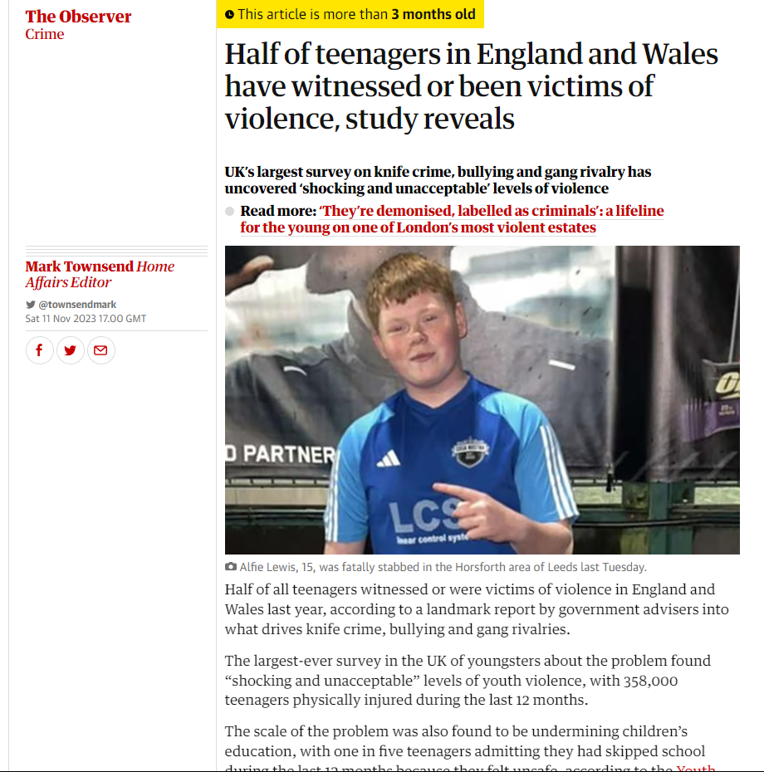
Notes:
Gwent
Knife crime in Gwent 6 times more common than 10 years ago
Bristol Stabbing
Recent
16-year-old stabbed by two people wearing masks
Police given enhanced Stop & Search powers, allows them to search people for weapons without needing reasonable suspicion
Guardian newspaper
358,000 were physical injured during the last 12 months
(Pic) Alfie Lewis 15 killed in Leeds by a 14-year-old
47% of teenagers say a fear of violence affects their daily lives
In comparison 7% said that worse relationships with parents affected their daily lives

Slide 24
Tackling gang violence and knife crime

Slide 25
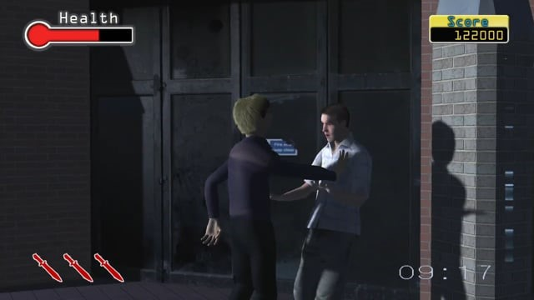

Slide 26

Developing interventions to reduce knife crime
Pulling levers
Early intervention and prevention programmes
Restorative Justice
Knife Amnesties
Community and educational interventions
Notes:
Pulling levers
Early intervention and prevention programmes
Restorative justice
Knife amnesties
Community and educational interventions
Knife_Crime_Evidence_Briefing.pdf (college.police.uk)

Slide 27
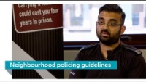
Neighbourhood – Tackling knife crime in Leicestershire
Notes:
https://www.youtube.com/watch?v=ySNWUbBe-B0&t=1s

Slide 28

No More Red Campaign
Notes:
Since 2022, Arsenal and Adidas have run the No More Red campaign
Typical the club wear red, but wear all white
Kit will never be sold (do sell community t-shirt where all proceeds being donated)
To help tackle knife crime and youth violence
Work in conjunction with major charities such as (Stephen Lawrence day foundation and Ben Kinsella Trust)
Investing in safe spaces to play football
Given 83 young people an opportunity to gain experience in creative industries

Slide 29
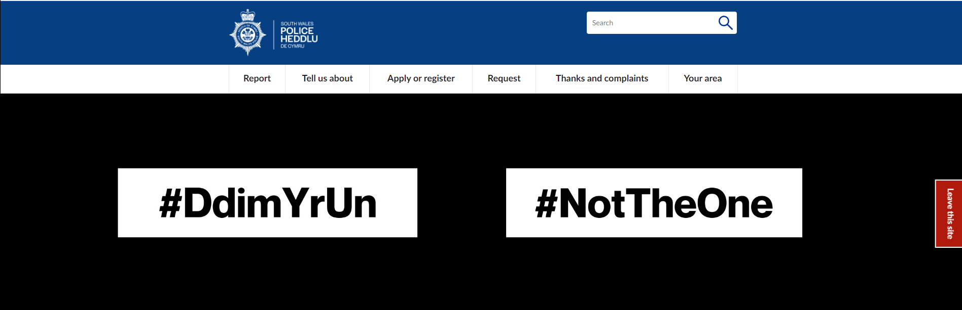
Notes:
A campaign by SW Police force to educate young people on the consequences of carrying a knife
Early intervention approach
Aimed at 11–16-year-old males
Also aimed at teachers, family and friends

Slide 30
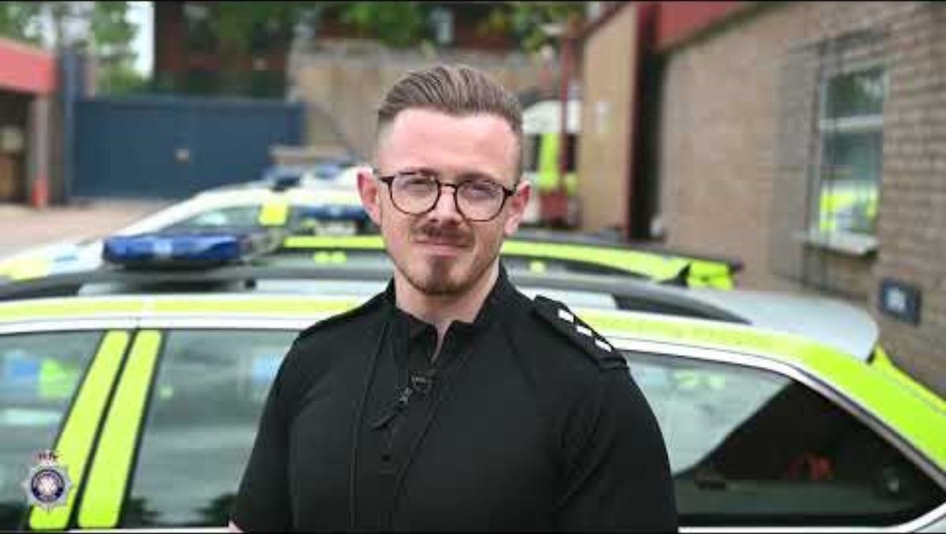
Operation Sceptre
Notes:
https://www.youtube.com/watch?v=LYe5F44-iK0
Op Sceptre is a national programme done by police forces to get knives of the streets

Slide 31
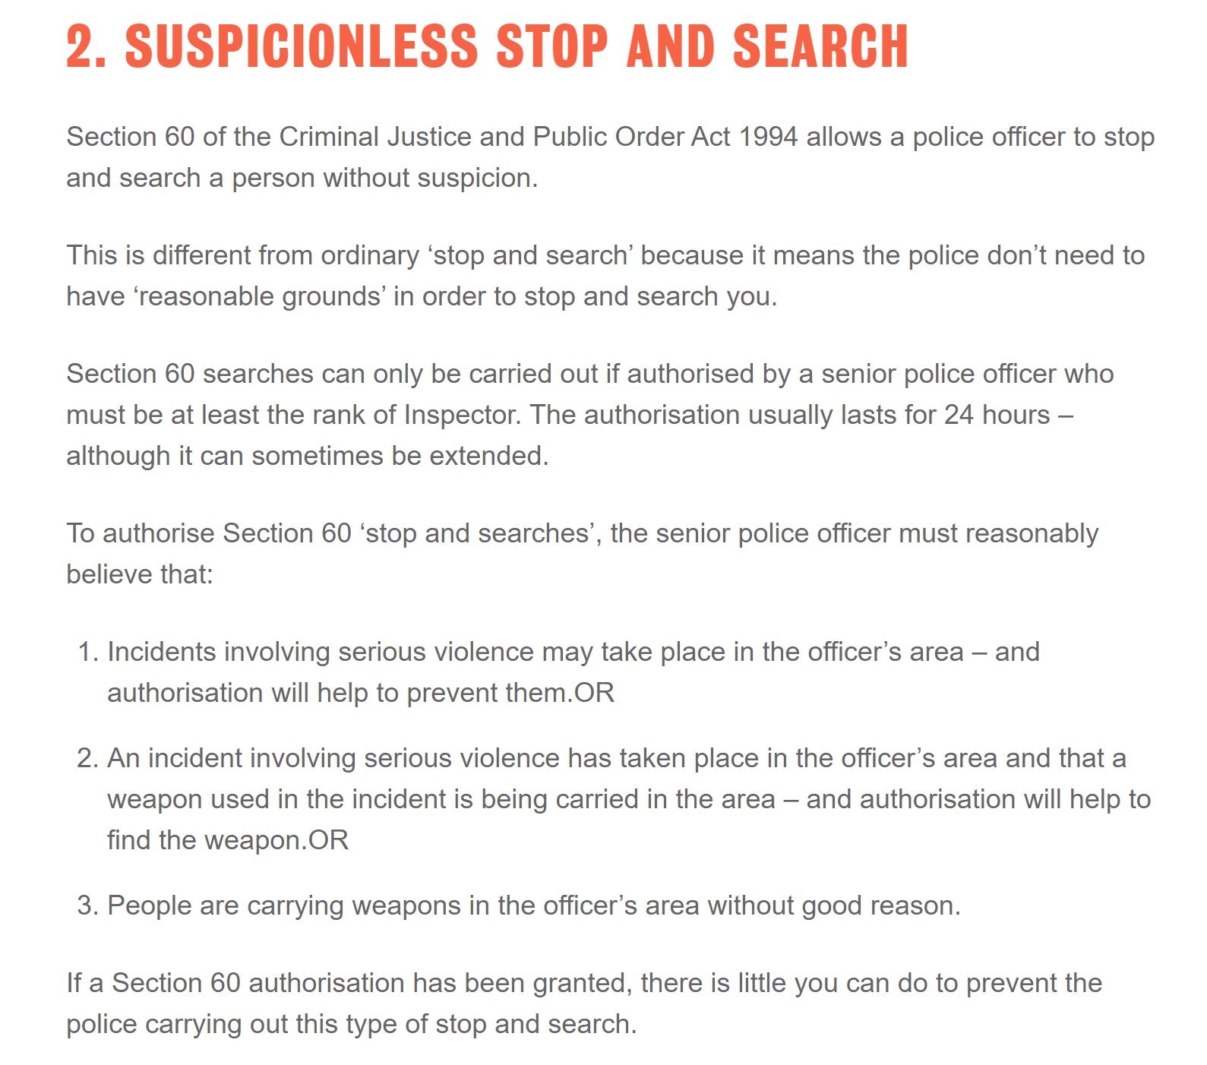
HOW EFFECTIVE ARE STOP AND SEARCH POWERS AT COMBATTING KNIFE CRIME?
Notes:
Do believe stop and search powers are effective?

Slide 32

JOINT ENTERPRISE
You were part of a group and someone in that group kills someone with a knife. This is the same for any other weapon or physical attack.
You were supporting the attacker’s actions in some way. This could be verbally by encouraging them or physically if you acted as a supportive presence.
You knew that the person who made the attack was going to start violence against the victim, and you did nothing to stop it
Notes:
Showcases the reality of knife crime
Programme done by west midlands police
They believe it is a choice

Slide 33
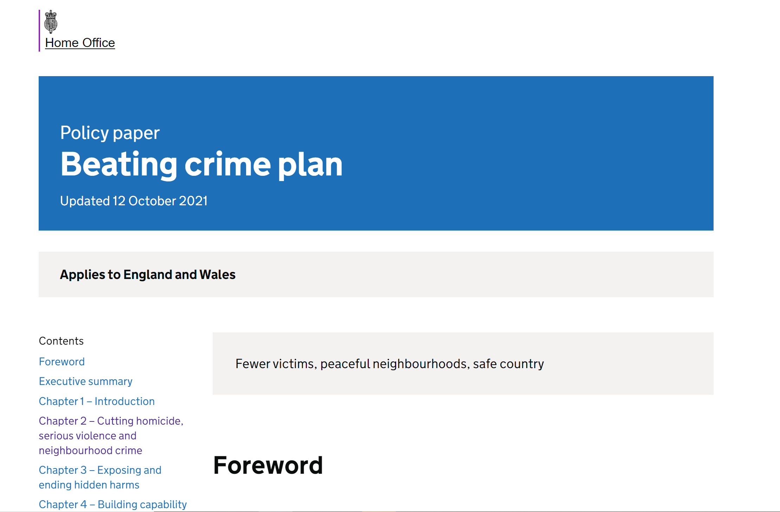
Government strategy to tackle crime and gang activity
recruit 20,000 extra police officers by March 2023
reconnecting the police with the public;
targeted interventions and investments to support young people at risk of serious violence
expanding the use of electronic monitoring for “serious acquisitive offenders”
empowering the police to take more knives off the streets by increasing their stop and search powers
investing to expand Project Adder,
legislating for the new serious violence duty (now contained in the Police, Crime, Sentencing and Courts Act 2022), requiring local bodies (for example police, local authorities and health authorities) to work together on analysing and implementing strategies to reduce serious violence in a certain area
Notes:
Recruit 20,000 extra police officers
Reconnecting the police with the public
Targeted interventions and investments to support young people at risk
Expanding the use of electronic monitoring for serious acquisitive offenders
Empowering the police to take more knives off the streets by increasing their stop and search powers
Investing to expand project adder
Beating Crime Plan (2021)

Slide 34
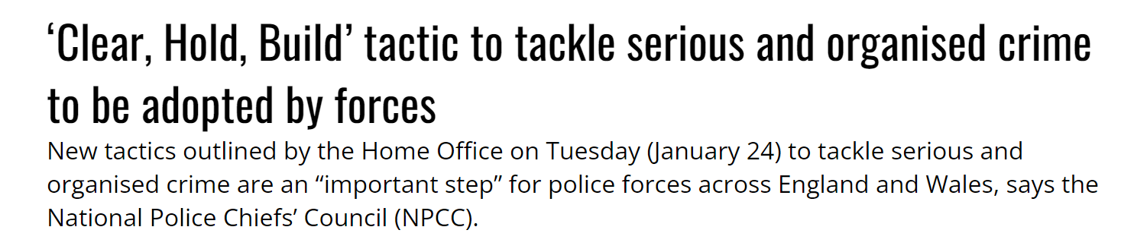
Clear, Hold, Build strategy
New strategy introduced by the Home Office.
Aims – to build community resilience and make areas affected by Organised Crime safer place to live.
The purpose is to:
  Clear – Arrest and disrupt Organised Crime Groups members and networks.
  Hold – This phase involves consolidating and stabilising the area in attempt to stop remaining or other Organised Crime Groups on capitalising from the power vacuum.
  Build – Deliver community empowered interventions that tackle the drivers of crime and exploitation of vulnerable people.
Notes:
This is a new strategy that has been introduced by the Home Office last year
The aim of the strategy is to build community resilience and make areas affected by Organised Crime safer place to live
The Purpose is to:
Clear – is to arrest members and disrupt OCG network, targets business interests and spheres of influence
The police are able to use all powers and levers available to them, so that create safer spaces to begin restoring community confidence
Hold – This phase involves and consolidating the area so that remaining members and other OCG groups do not capitalise on the power vacuum that would be created
In this phase the police hope io improve community confidence by ensuring spaces remain safe, this will be achieved by having visible neighbourhood policing in hot spot areas to provide assurance
Build – deliver community empowered interventions that tackles the reasons for crime, exploitation of people's vulnerabilities
Aims to build – improved engagement with services, increased confidence with the community, greater reporting with continued neighbourhood policing
Government announces crackdown against organised criminal gangs - GOV.UK (www.gov.uk)

Slide 35

Recap of the session
In today's session we have learnt about:
We have identified the prevalence of gang violence and knife crime in the UK.
We have looked at the correlation between gangs and knife crime
We have evaluated the strategies being used to address these crimes

Slide 36

Any Questions?

Slide 37

Next Week
We will look at County lines, Violence and Drug supply
We will have a Guest Speaker – Carole Hopkins

