Slide 1
Student name: Viral Jivani
Student number : 2242374
Lecturer Name : Efua Adams
Module name : Marketing Management (LCMB7001)
PRESENTATION - A Critical Analysis of the Global Business Environment - Post Pandemic

Slide 2

Marketing Management
A Critical Analysis of the Global Business Environment - Post-Pandemic: Tesla

Slide 3
Table of contents
Introduction
Market Analysis of Tesla - Internal Factors
Market Analysis of Tesla - External Factors
Resource Allocation to Meet Current Challenges
Competitive Strategy for Tesla
Green Marketing and Corporate Social Responsibility Strategies
Recommendation
Conclusion
Notes:
Tesla's internal characteristics are paramount in determining its market performance in the post-pandemic age. Elon Musk's charismatic leadership, the company's unique electric vehicle technology, and its strong brand image are its competitive advantages. Tesla has established itself as a global leader in the sector because of its capacity to create cutting-edge electric vehicles with exceptional range and performance. Additionally, Tesla has a competitive advantage due to its vertically integrated business strategy, which includes everything from battery manufacturing to charging infrastructure. Its Gigafactories provide cost savings and economies of scale in manufacturing. Tesla does, however, have some internal issues. Its ability to satisfy consumer demand has occasionally been hampered by restrictions on production capacity, supply chain problems, and quality control problems (Adams et al., 2019).

Slide 4
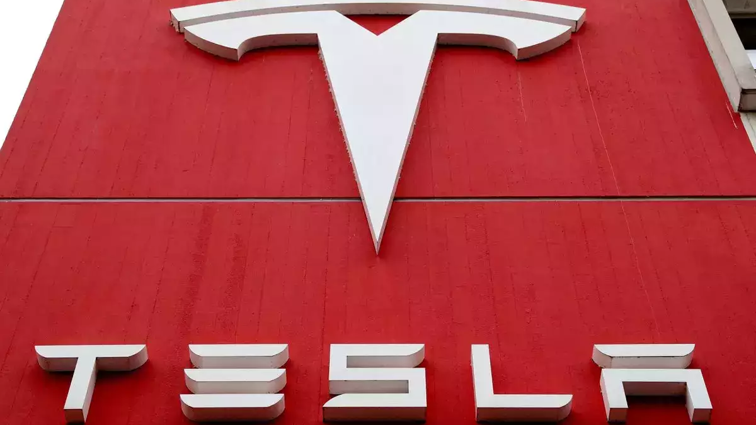
Introduction
The rise of digitalization, rising brand awareness and competitiveness, changes in consumer purchasing behavior, and the necessity for businesses to adopt "green" practices and exhibit corporate social responsibility are just a few of the significant challenges the post-pandemic business environment has faced (Eltarabily and Elghezanwy, 2020).
This presentation's critical analysis will delve into the global business climate of Tesla, a known international company.
Examining the internal and external factors that affect Tesla's market performance, identifying potential market failure factors, exploring how the company allocates resources to deal with current issues, developing a competitive strategy for gaining a sustainable competitive advantage and assessing Tesla's green marketing and CSR strategies are all topics covered in this presentation.
Finally, it will offer Tesla advice on strengthening its competitive position in the post-pandemic economic climate (Atik et al., 2023).
Notes:
The rise of digitalization, rising brand awareness and competitiveness, changes in consumer purchasing behavior, and the necessity for businesses to adopt "green" practices and exhibit corporate social responsibility are just a few of the significant challenges the post-pandemic business environment has faced (Eltarabily and Elghezanwy, 2020). This presentation's critical analysis will delve into the global business climate of Tesla, a known international company. Examining the internal and external factors that affect Tesla's market performance, identifying potential market failure factors, exploring how the company allocates resources to deal with current issues, developing a competitive strategy for gaining a sustainable competitive advantage and assessing Tesla's green marketing and CSR strategies are all topics covered in this presentation. Finally, it will offer Tesla advice on strengthening its competitive position in the post-pandemic economic climate (Atik et al., 2023).

Slide 5
Market Analysis of Tesla
a) Internal Factors
Tesla's internal characteristics are paramount in determining its market performance in the post-pandemic age. Elon Musk's charismatic leadership, the company's unique electric vehicle technology, and its strong brand image are its competitive advantages.
Tesla has established itself as a global leader in the sector because of its capacity to create cutting-edge electric vehicles with exceptional range and performance.
Additionally, Tesla has a competitive advantage thanks to its vertically integrated business strategy, which includes everything from battery manufacturing to charging infrastructure. Its Gigafactories provide cost savings and economies of scale in manufacturing.
Tesla does, however, have some internal issues. Its ability to satisfy consumer demand has occasionally been hampered by restrictions on production capacity, supply chain problems, and quality control problems (Adams et al., 2019).
Notes:
Tesla's internal characteristics are paramount in determining its market performance in the post-pandemic age. Elon Musk's charismatic leadership, the company's unique electric vehicle technology, and its strong brand image are its competitive advantages. Tesla has established itself as a global leader in the sector because of its capacity to create cutting-edge electric vehicles with exceptional range and performance. Additionally, Tesla has a competitive advantage due to its vertically integrated business strategy, which includes everything from battery manufacturing to charging infrastructure. Its Gigafactories provide cost savings and economies of scale in manufacturing. Tesla does, however, have some internal issues. Its ability to satisfy consumer demand has occasionally been hampered by restrictions on production capacity, supply chain problems, and quality control problems (Adams et al., 2019).

Slide 6
b) External Factors
For Tesla, the post-pandemic global business landscape offers opportunities and difficulties.
Besides, the market for Tesla's environmentally friendly transportation options is favorable because of rising environmental awareness and government support for electric vehicles.
The push for decarbonization and the rising demand for clean energy aligns with Tesla's purpose and potentially expand the market.
Tesla competes against established manufacturers and newcomers to the electric vehicle market, among other external variables, in a highly competitive business.
The demand for electric vehicles may also be impacted by shifting laws, rules, and incentives governing emissions requirements and incentives.
In addition, economic factors like variations in energy prices, consumer purchasing power, and the stability of the global economy might affect how well Tesla does on the market (Chehertma, 2022).
Notes:
b) External Factors
For Tesla, the post-pandemic global business landscape offers opportunities and difficulties. Besides, the market for Tesla's environmentally friendly transportation options is favorable because of rising environmental awareness and government support for electric vehicles. The push for decarbonization and the rising demand for clean energy aligns with Tesla's purpose and potentially expand the market. Tesla competes against established manufacturers and newcomers to the electric vehicle market, among other external variables, in a highly competitive business. The demand for electric vehicles may also be impacted by shifting laws, rules, and incentives governing emissions requirements and incentives. In addition, economic factors like variations in energy prices, consumer purchasing power, and the stability of the global economy might affect how well Tesla does on the market (Chehertma, 2022).

Slide 7
Resource Allocation to Meet Current Challenges
Tesla's strategy to address current challenges in the post-pandemic global business environment includes resource allocation as a critical component. The company must carefully manage its resources to ensure successful operations and long-term growth.
Research and development (R&D) funding is one area where Tesla receives assistance. Tesla devotes a significant portion of its assets to R&D efforts to maintain its position at the forefront of innovation. In doing so, the organization can enhance its vehicles' self-sustaining riding abilities, battery efficiency, and electric vehicle technology. Tesla can maintain its competitive edge and fulfill changing customer expectations by allocating resources to R&D (Park, 2020).
Production and manufacturing are two additional essential factors in the allocation of resources for Tesla. Through the continued operation of Gigafactories around the world, the firm has been able to increase its manufacturing capacity. Allocating funds to improve manufacturing capabilities enables Tesla to increase car production, reduce costs through economies of scale, and satisfy the rising demand for its electric vehicles.
Notes:
Tesla's strategy to address current challenges in the post-pandemic global business environment includes resource allocation as a critical component. The company must carefully manage its resources to ensure successful operations and long-term growth.
Research and development (R&D) funding is one area where Tesla receives assistance. Tesla devotes a significant portion of its assets to R&D efforts to maintain its position at the forefront of innovation. In doing so, the organization can enhance its vehicles' self-sustaining riding abilities, battery efficiency, and electric vehicle technology. Tesla can maintain its competitive edge and fulfill changing customer expectations by allocating resources to R&D (Park, 2020).
Production and manufacturing are two additional essential factors in the allocation of resources for Tesla. Through the continued operation of Gigafactories around the world, the firm has been able to increase its manufacturing capacity. Allocating funds to improve manufacturing capabilities enables Tesla to increase car production, reduce costs through economies of scale, and satisfy the rising demand for its electric vehicles.

Slide 8
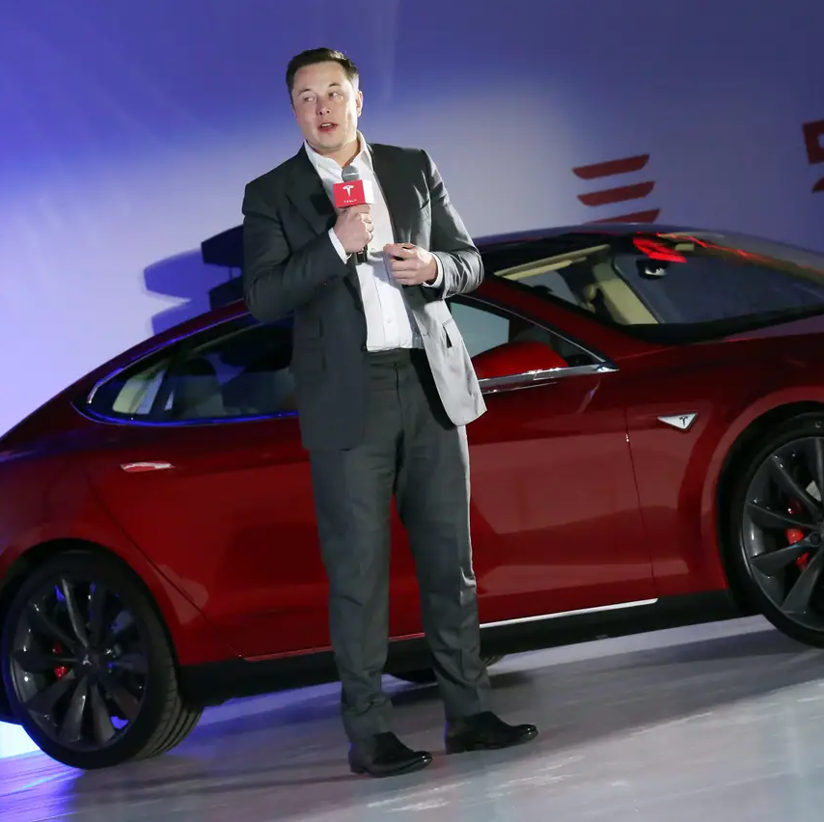
Continues
Tesla invests resources in brand awareness, advertising, marketing, research, development, and production.
The company invests in social media, public relations, and advertising to enhance its brand visibility and connect with a larger target market.
By allocating funds to marketing initiatives, Tesla can stand out in a crowded market and draw in a sufficient number of customers (Deepak and Jeyakumar, 2019).
Furthermore, Tesla has committed funds to expand and build its Supercharger network, crucial for providing easy and convenient charging infrastructure for its electric vehicles.
By providing this assistance, Tesla customers are guaranteed a dependable and environmentally friendly charging experience, increasing overall customer happiness and promoting the adoption of electric cars.
Notes:
Tesla invests resources in brand awareness, advertising, marketing, research, development, and production. The company invests in social media, public relations, and advertising to enhance its brand visibility and connect with a larger target market. By allocating funds to marketing initiatives, Tesla can stand out in a crowded market and draw in a sufficient number of customers (Deepak and Jeyakumar, 2019).
Furthermore, Tesla has committed funds to expand and build its Supercharger network, crucial for providing easy and convenient charging infrastructure for its electric vehicles. By providing this assistance, Tesla customers are guaranteed a dependable and environmentally friendly charging experience, increasing overall customer happiness and promoting the adoption of electric cars.

Slide 9
Competitive Strategy for Tesla
Tesla's competitive strategy is crucial for securing a long-lasting competitive edge in the post-pandemic global economic landscape. Understanding the opportunities and problems that exist in the industry will help Tesla create a thorough plan for separating from the crowd and maintaining an edge over rivals.
Product differentiation is one of the central tenets of Tesla's competitive strategy. The company has established itself as a pioneer in the electric vehicle age by producing high-overall performance vehicles with long-range and cutting-edge technologies.
In addition, a further factor in Tesla's competitive advantage is its dedication to vertical integration. Due to the company's control over the entire value chain, cost savings, quality control, and shorter innovation cycles are possible from battery manufacture through infrastructure for charging.
Tesla's aggressive strategy also heavily emphasizes developing a powerful logo. The business has positioned itself as an aspirational and ecologically conscious brand, luring customers who share its goals and ideals.
Furthermore, Tesla's investment in creating a global charging network, the Supercharger network, helps reduce range anxiety and gives the company a competitive edge over other manufacturers of electric vehicles.
Notes:
Tesla's competitive strategy is crucial for securing a long-lasting competitive edge in the post-pandemic global economic landscape. Understanding the opportunities and problems that exist in the industry will help Tesla create a thorough plan for separating from the crowd and maintaining an edge over rivals.
Product differentiation is one of the central tenets of Tesla's competitive strategy. The company has established itself as a pioneer in the electric vehicle age by producing high-overall performance vehicles with long-range and cutting-edge technologies. Concerning traditional automakers, Tesla stands apart because it acknowledges ongoing innovation and technological developments. By highlighting its distinctive price proposition, Tesla attracts clients who value sustainability, cutting-edge technology, and a superior riding experience (Leach et al., 2021).
In addition, a further factor in Tesla's competitive advantage is its dedication to vertical integration. Due to the company's control over the entire value chain, cost savings, quality control, and shorter innovation cycles are possible from battery manufacture through infrastructure for charging. With more control over its goods, Tesla can better provide a streamlined and integrated customer experience due to this connection.
Tesla's aggressive strategy also heavily emphasizes developing a powerful logo. The business has positioned itself as an aspirational and ecologically conscious brand, luring customers who share its goals and ideals. Tesla has a competitive edge due to its substantial brand equity and tremendous popularity, which customers associate with modern technology, innovation, and sustainability (Kotabe and Helsen, 2022).
Furthermore, Tesla's investment in creating a global charging network, the Supercharger network, helps reduce range anxiety and gives the company a competitive edge over other manufacturers of electric vehicles. Tesla owners can profit from long-distance travel due to the extensive charging infrastructure, which also widely promotes electric vehicle use.

Slide 10
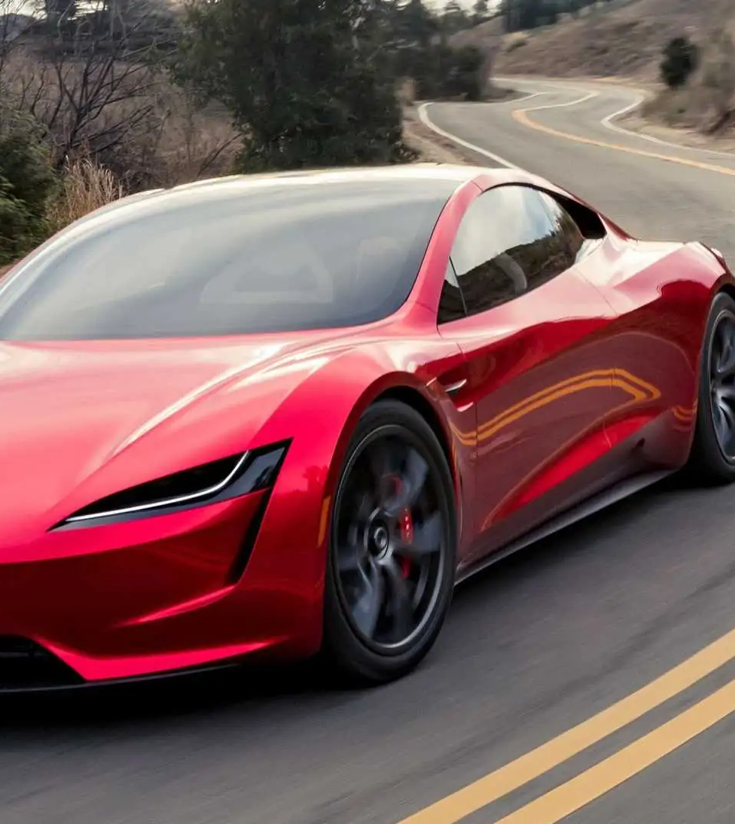
Green Marketing and Corporate Social Responsibility Strategies
Tesla's green marketing and corporate social responsibility (CSR) initiatives significantly contribute to the company's ability to weather the challenges of the post-pandemic global business environment.
These tactics support Tesla's mission of providing sustainable transportation while enhancing its competitive advantage and brand recognition.
Tesla promotes its electric vehicles as a way to cut carbon emissions and fight climate change, which is one of the company's most ineffective marketing strategies. The company highlights the advantages of electric automobiles for the environment by emphasizing zero emissions and reduced reliance on fossil fuels.
The influential environmental impact that consumers may have by choosing electric vehicles is noted in Tesla's marketing campaigns (Hao et al., 2020).
Tesla's commitment to CSR is also evident in its sustainability-focused initiatives. The company invests in renewable energy projects through its subsidiary SolarCity, such as solar energy generation and energy storage solutions.
Tesla demonstrates its commitment to reducing the carbon footprint associated with its operations and goods by actively advocating and imposing simple electrical solutions.
Notes:
Tesla's green marketing and corporate social responsibility (CSR) initiatives significantly contribute to the company's ability to weather the challenges of the post-pandemic global business environment. These tactics support Tesla's mission of providing sustainable transportation while enhancing its competitive advantage and brand recognition.
Tesla promotes its electric vehicles as a way to cut carbon emissions and fight climate change, which is one of the company's most ineffective marketing strategies. The company highlights the advantages of electric automobiles for the environment by emphasizing zero emissions and reduced reliance on fossil fuels. The influential environmental impact that consumers may have by choosing electric vehicles is noted in Tesla's marketing campaigns (Hao et al., 2020).
Tesla's commitment to CSR is also evident in its sustainability-focused initiatives. The company invests in renewable energy projects through its subsidiary SolarCity, such as solar energy generation and energy storage solutions. Tesla demonstrates its commitment to reducing the carbon footprint associated with its operations and goods by actively advocating and imposing simple electrical solutions.

Slide 11
Continues
Tesla also pays close attention to resource conservation and recycling. The group aggressively promotes battery recycling and looks into cutting-edge methods of repurposing and reusing materials.
Tesla is committed to recycling to create a closed-loop battery system to reduce waste and improve resource efficiency.
In terms of CSR, Tesla is interested in networking and charitable endeavors. The company has launched initiatives like the Tesla Impact Fund, which supports businesses promoting environmental sustainability, renewable energy, and education.
Tesla is committed to having a significant impact beyond its products, as evidenced by its involvement in charitable and community projects (Ladson-Billings, 2021).
By implementing these inexperienced CSR and advertising techniques, Tesla increases consumer familiarity with its logo, and fosters trust among those who care about the environment.
It sets itself apart from rivals by displaying a comprehensive approach to sustainability that includes the products it sells and its operations, network participation, and environmental programs.
Notes:
Tesla also pays close attention to resource conservation and recycling. The group aggressively promotes battery recycling and looks into cutting-edge methods of repurposing and reusing materials. Tesla is committed to recycling to create a closed-loop battery system to reduce waste and improve resource efficiency.
In terms of CSR, Tesla is interested in networking and charitable endeavors. The company has launched initiatives like the Tesla Impact Fund, which supports businesses promoting environmental sustainability, renewable energy, and education. Tesla is committed to having a significant impact beyond its products, as evidenced by its involvement in charitable and community projects (Ladson-Billings, 2021).
By implementing these inexperienced CSR and advertising techniques, Tesla increases consumer familiarity with its logo, and fosters trust among those who care about the environment. It sets itself apart from rivals by displaying a comprehensive approach to sustainability that includes the products it sells and its operations, network participation, and environmental programs.

Slide 12
Recommendations for Gaining a Competitive Advantage
Expand Global Market Presence: Tesla has to continue to extend its marketplace attain by entering new markets and focusing on regions with excessive boom potential for electric motors. By information neighborhood purchaser alternatives and adapting its advertising techniques, Tesla can fortify its aggressive position and growth market proportion (Eltarabily and Elghezanwy, 2020).
Enhance Affordability and Accessibility: While Tesla vehicles have won recognition in most of the top rate sections, there is an opportunity to make electric-powered vehicles extra accessible to a much broader range of consumers. Tesla must explore options to broaden more low-priced models without compromising on exceptional and overall performance.
Invest in Advanced Battery Technology: As the core aspect of electric automobiles, the battery era is essential in performance and range. Tesla must continue to spend money on research and improvement to improve battery performance, reduce fees, and make a more extensive vehicle range.
Strengthen Charging Infrastructure: Tesla should similarly enlarge its Supercharger community and invest in fast-charging technology. This will address range tension concerns and offer a seamless charging experience for clients.
Foster Customer Engagement and Loyalty: Tesla must be mindful of improving consumer enjoyment and building long-term relationships. This can be achieved thru personalized services, assertive communication, and modern possession packages. Engaging with clients and listening to their comments will help Tesla recognize their evolving wishes and choices, allowing the business enterprise to enhance its products and services continuously
Notes:
Tesla may want to take into account the following advice to acquire a competitive edge in the post-pandemic business environment:
Expand Global Market Presence: Tesla has to continue to extend its marketplace attain by entering new markets and focusing on regions with excessive boom potential for electric motors. By information neighborhood purchaser alternatives and adapting its advertising techniques, Tesla can fortify its aggressive position and growth market proportion (Eltarabily and Elghezanwy, 2020).
Enhance Affordability and Accessibility: While Tesla vehicles have won recognition in most of the top rate sections, there is an opportunity to make electric-powered vehicles extra accessible to a much broader range of consumers. Tesla must explore options to broaden more low-priced models without compromising on exceptional and overall performance. This can assist in capturing a more considerable marketplace percentage and faucet into new customer segments.
Invest in Advanced Battery Technology: As the core aspect of electric automobiles, the battery era is essential in performance and range. Tesla must continue to spend money on research and improvement to improve battery performance, reduce fees, and make a more extensive vehicle range. Advancements in battery generation can give Tesla a competitive gain in phrases of longer-lasting and extra value-effective electric-powered motors (Benjamin et al., 2020).
Strengthen Charging Infrastructure: Tesla should similarly enlarge its Supercharger community and invest in fast-charging technology. This will address range tension concerns and offer a seamless charging experience for clients. A robust charging infrastructure supports Tesla's very own cars and contributes to the broader adoption of electric motors, solidifying Tesla's function as a marketplace chief.
Foster Customer Engagement and Loyalty: Tesla must be mindful of improving consumer enjoyment and building long-term relationships. This can be achieved thru personalized services, assertive communication, and modern possession packages. Engaging with clients and listening to their comments will help Tesla recognize their evolving wishes and choices, allowing the business enterprise to enhance its products and services continuously.
By putting the recommendations into practice, Tesla will stand out from the competition, maintain its competitive advantage, and continue to dominate the world of electric vehicles in the post-pandemic economy (Deepak and Jeyakumar, 2019).

Slide 13
Conclusion
In conclusion, Tesla's success in the post-pandemic global business environment depends on its ability to handle challenging circumstances and take advantage of possibilities.
Tesla can achieve a durable competitive advantage through a thorough market study, resource allocation, developing a competitive strategy, and deploying unproven advertising and CSR efforts.
Tesla can maintain its position as a market leader and continue influencing the development of sustainable transportation by increasing its market presence and affordability, investing in improved battery technology, bolstering the infrastructure for charging and encouraging customer participation.
Notes:
In conclusion, Tesla's success in the post-pandemic global business environment depends on its ability to handle challenging circumstances and take advantage of possibilities. Tesla can achieve a durable competitive advantage through a thorough market study, resource allocation, developing a competitive strategy, and deploying unproven advertising and CSR efforts. Tesla can maintain its position as a market leader and continue influencing the development of sustainable transportation by increasing its market presence and affordability, investing in improved battery technology, bolstering the infrastructure for charging and encouraging customer participation.

Slide 14
References
Atik, D., Dholakia, N. and Ozgun, A., 2023. Post-Pandemic Futures: Balancing Technological Optimism with Sociocultural Fairness. Global Business Review, p.09721509221142110.
Chehertma, B., 2022. International competitiveness management of Tesla, Inc. during the COVID-19 pandemic (Doctoral dissertation, Private Higher Educational Establishment-Institute “Ukrainian-American Concordia University”).
Adams, P., Freitas, I.M.B. and Fontana, R., 2019. Strategic orientation, innovation performance and the moderating influence of marketing management. Journal of Business Research, 97, pp.129-140.
Deepak, R.K.A. and Jeyakumar, S., 2019. Marketing management. Educreation Publishing.
Kotabe, M.M. and Helsen, K., 2022. Global marketing management. John Wiley & Sons.
Park, S., 2020. Marketing management (Vol. 3). Seohee Academy.
Leach, M., MacGregor, H., Scoones, I. and Wilkinson, A., 2021. Post-pandemic transformations: How and why COVID-19 requires us to rethink development. World Development, 138, p.105233.
Ladson-Billings, G., 2021. I'm here for the hard re-set: Post-pandemic pedagogy to preserve our culture. Equity & Excellence in Education, 54(1), pp.68-78.
Benjamin, S., Dillette, A. and Alderman, D.H., 2020. “We can’t return to normal”: committing to tourism equity in the post-pandemic age. Tourism Geographies, 22(3), pp.476-483.
Eltarabily, S. and Elghezanwy, D., 2020. Post-pandemic cities-the impact of COVID-19 on cities and urban design. Architecture Research, 10(3), pp.75-84.
Hao, F., Xiao, Q. and Chon, K., 2020. COVID-19 and China’s hotel industry: Impacts, a disaster management framework, and post-pandemic agenda. International journal of hospitality management, 90, p.102636.
Notes:
Atik, D., Dholakia, N. and Ozgun, A., 2023. Post-Pandemic Futures: Balancing Technological Optimism with Sociocultural Fairness. Global Business Review, p.09721509221142110.
Chehertma, B., 2022. International competitiveness management of Tesla, Inc. during the COVID-19 pandemic (Doctoral dissertation, Private Higher Educational Establishment-Institute “Ukrainian-American Concordia University”).
Adams, P., Freitas, I.M.B. and Fontana, R., 2019. Strategic orientation, innovation performance and the moderating influence of marketing management. Journal of Business Research, 97, pp.129-140.
Deepak, R.K.A. and Jeyakumar, S., 2019. Marketing management. Educreation Publishing.
Kotabe, M.M. and Helsen, K., 2022. Global marketing management. John Wiley & Sons.
Park, S., 2020. Marketing management (Vol. 3). Seohee Academy.
Leach, M., MacGregor, H., Scoones, I. and Wilkinson, A., 2021. Post-pandemic transformations: How and why COVID-19 requires us to rethink development. World Development, 138, p.105233.
Ladson-Billings, G., 2021. I'm here for the hard re-set: Post-pandemic pedagogy to preserve our culture. Equity & Excellence in Education, 54(1), pp.68-78.
Benjamin, S., Dillette, A. and Alderman, D.H., 2020. “We can’t return to normal”: committing to tourism equity in the post-pandemic age. Tourism Geographies, 22(3), pp.476-483.
Eltarabily, S. and Elghezanwy, D., 2020. Post-pandemic cities-the impact of COVID-19 on cities and urban design. Architecture Research, 10(3), pp.75-84.
Hao, F., Xiao, Q. and Chon, K., 2020. COVID-19 and China’s hotel industry: Impacts, a disaster management framework, and post-pandemic agenda. International journal of hospitality management, 90, p.102636.

Slide 15


