Slide 1
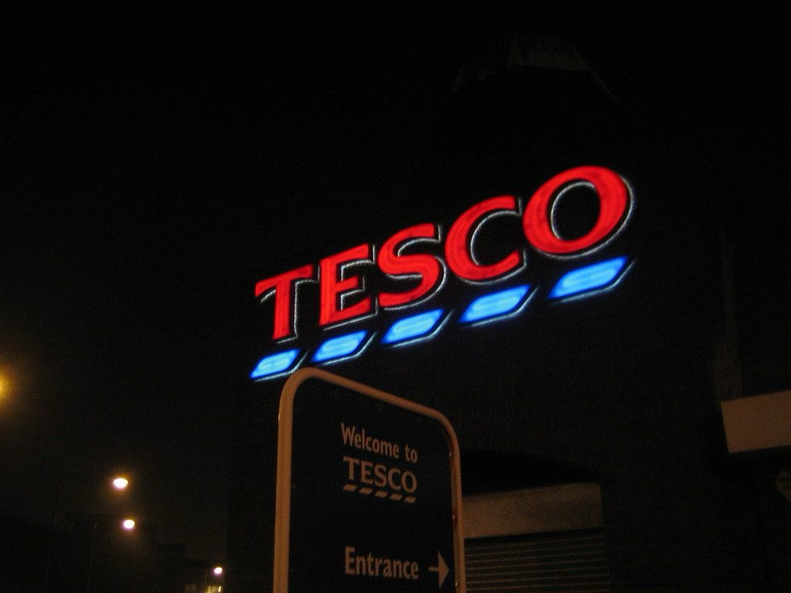

TESCO
Henri Fayol’s Five Management Functions
Component 1: Group presentation
Module: LCBB4015
Lecturer: Mohammad Rahman
Presented by
Team Leader:
Carmen Ancuta Sigartau – 2425074
Team Members:
Mario Roberto Mădălin Rugină – 2425073
Florentina Daniela Licsandru – 2527752
Cristian Boerescu - 2515712

Slide 2
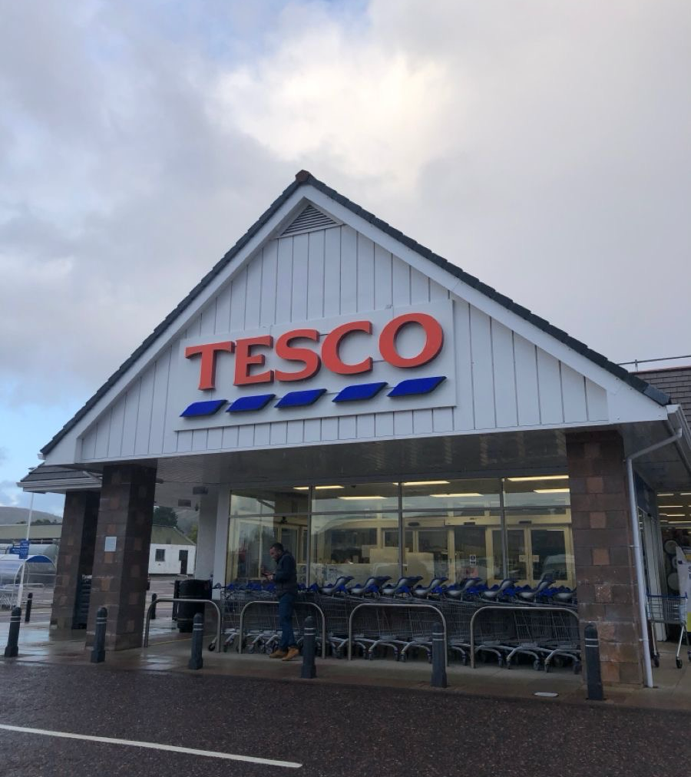
Table of contents:
Introduction
About Tesco
Henri Fayol’s Theory
Planning
Organising
Commanding
Coordinating
Controlling
Essential skills
Conclusion
References

Slide 3

Introduction
Management helps organisations achieve goals efficiently.
Henri Fayol developed 5 key management functions.
These functions are still used modern businesses
This presentation applies Fayol’s theory to Tesco.

Slide 4
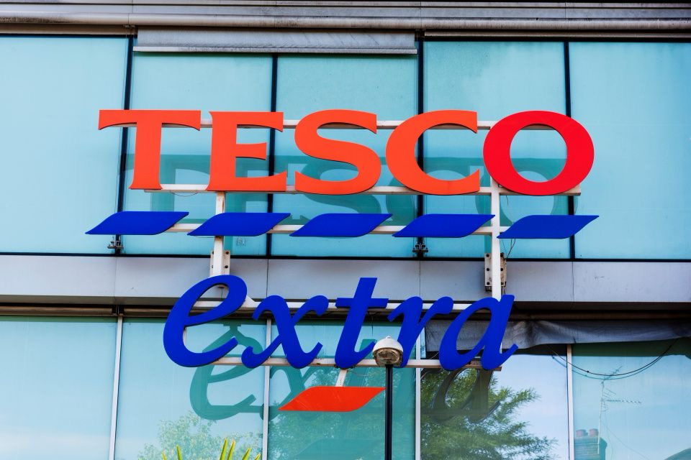
About Tesco:
Uk’s largest supermarket retailer
Founded in 1919 by Jack Cohen
Headquarters: Welwyn Garden City, UK
Operates supermarkets, online shopping, banking and services
Employs over 300000 people worldwide
Tesco Annual Report (latest edition)

Slide 5
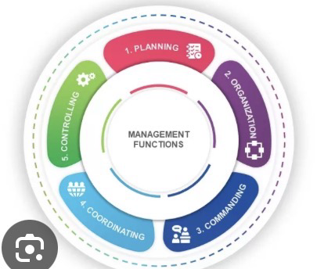
Henri Fayol’s Five Functions
https://slidebazaar.com/templates/fayols-five-functions-management-powerpoint-google-slides/

Slide 6

Planning
Setting goals and deciding how to achieve them
Tesco examples:
Demand forecasting
Budget planning
Seasonal promotions
Online expansion
Benefits: improves efficiency and increases profit

Slide 7


Organising
Arranging resources and staff effectively
Tesco examples:
Staff scheduling
Warehouse operations
Inventory systems
Benefits: improves productivity and reduces costs

Slide 8

Commanding
Leading and motivating employees
Tesco examples:
Staff training
Performance management
Communication of goals
Benefits: improves motivation and service quality

Slide 9

Coordinating
Ensuring departments work together
Tesco examples:
Supply chain coordination
Marketing and sales alignment
Online delivery systems
Benefits: smoother operations and better customer experience

Slide 10

Controlling
Monitoring performance and correcting issues
Tesco examples:
Sales tracking
Quality control
Customer feedback analysis
Benefits: ensures targets are met and reduces errors

Slide 11

Essential managerial skills:
Leadership
Communication
Decision-making
Problem-solving
Digital skills
Time management
Teamwork

Slide 12
Conclusion
Fayol’s theory is still relevant today
Tesco uses all five functions in daily operations
Effective management improves efficiency and customer satisfaction
Strong managerial skills support business success

Slide 13
References:
Fayol, H. (1949) General and Industrial Management
Robbins, S.P. & Coulter, M. (2022) Management
Tesco Annual Report (latest edition)
Fayol, H. (1949) General and Industrial Management. London: Pitman Publishing.
Daft, R.L. (2021) Management. 14th edn. Boston: Cengage Learning.
Tesco PLC (2025) Annual Report and Financial Statements 2025. Welwyn Garden City: Tesco PLC.

Slide 14

Thank you!

