Slide 1

Student name: MARIA-GABRIELA ION
Student number: 2509672
Lecturer’s name: Christiana Melam
LCHS4010
Psychology in Health and Social Care
Acknowledgement of the use of AI tools
I confirm that I have not used AI tools to research, structure, or write this assignment.
I have only used AI tools for proofreading and creating images (Microsoft Copilot), in line with the permitted uses stated in the module assessment guidelines.

Slide 2
Introduction and Presentation Aim
Introduces Piaget’s cognitive development theory.
Applies the theory to Isaac, a 4‑year‑old attending a London children’s centre.
Isaac shows limited language, reduced peer interaction, and separation distress (Shabnam, Lone and Sidiq, 2025).
Aim: explain Piaget’s theory and relate it to Isaac’s developmental needs.
Examines biological and environmental influences on Isaac’s learning.
Presents evidence‑based strategies to support cognitive, language, and social development.

Slide 3
Outline of Piaget's Cognitive Development Theory
Piaget believed children actively construct knowledge through exploration and experience.
Four developmental stages include sensorimotor, pre-operational, concrete operational, and formal operational thinking.
Isaac is in the pre-operational stage, characterised by symbolic play, developing language, and egocentric thinking (Qu et al., 2026).
Learning develops through assimilation, accommodation, and equilibration using play-based, developmentally appropriate experiences.

Slide 4

Early Years Relevance: The Pre‑operational Stage
Symbolic representation and imaginative thinking increase.
Children express ideas through language, drawings, and pretend play.
Egocentrism limits perspective‑taking (Rochat, 2024).
Isaac’s reduced language and withdrawal may restrict symbolic play.
Guided interactions and adult modelling support cognitive growth.

Slide 5
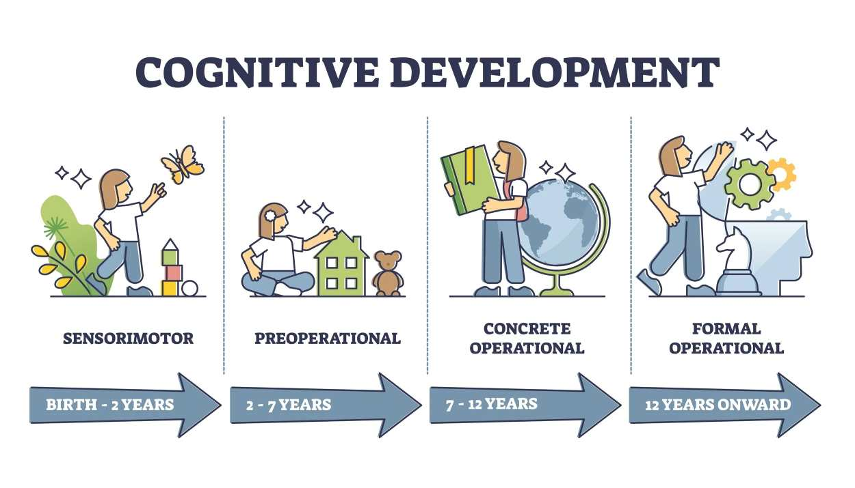
Applying Piaget’s Theory to Isaac’s Situation
Disrupted childcare and separation anxiety reduce exploration.
Limited peer interaction affects symbolic communication.
Piaget emphasises learning through active engagement and adaptation (Shabnam, Lone and Sidiq, 2025).
Support should include predictable routines and emotionally secure relationships.
Provide meaningful play experiences to strengthen confidence and communication.

Slide 6

Biological and Environmental Influences
Development shaped by interactions between biology and environment.
Temperament and separation sensitivity influence learning.
Maternal postnatal depression may reduce language‑rich interactions (Malik and Marwaha, 2023).
Childcare disruption limits opportunities for exploration and play.
Collaboration between family, practitioners, and specialists is essential.

Slide 7

Theory‑Informed Strategies and Interventions
Play‑based activities (sorting, block play, pretend play) support problem‑solving (Whitebread, 2012).
Adults should model simple language and use visual supports.
Encourage small‑group interactions to build confidence.
Consistent routines and a key‑worker reduce separation anxiety (Bowlby, 1988).
Multi‑agency support (e.g., speech and language therapy) promotes progress.

Slide 8
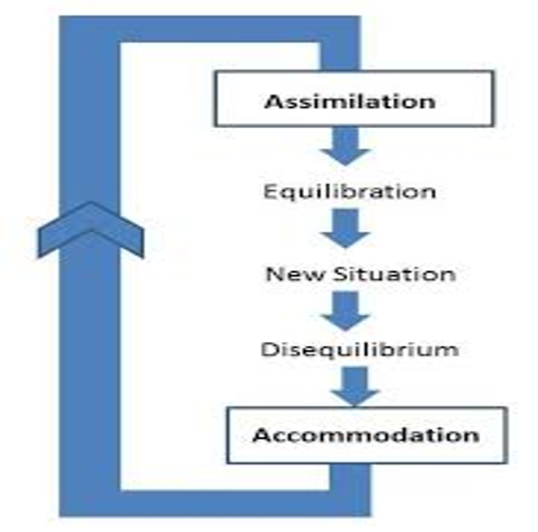
Strengths of Piaget’s Theory for Practice
Promotes child‑centred, active learning.
Helps plan developmentally appropriate activities.
Observing symbolic play and reasoning guides practice (Rochat, 2024).
Supports meaningful learning experiences tailored to Isaac.
Encourages hands‑on exploration and discovery.

Slide 9
Weaknesses and Contextual Considerations
Piaget may underestimate children’s abilities in familiar settings.
Limited focus on emotions, attachment, culture, and social inequality.
Isaac’s distress cannot be explained by cognition alone.
Attachment and sociocultural theories offer additional insight (Bowlby, 1988; Hoff, 2013).
Practitioners should combine Piaget with broader developmental approaches.

Slide 10
Conclusion
Piaget’s theory explains Isaac’s cognitive needs in the pre‑operational stage.
Separation anxiety, disrupted caregiving, and language delay affect learning.
Practitioners should use structured routines, guided play, and language‑rich experiences (Shabnam, Lone and Sidiq, 2025).
Multi‑agency interventions promote confidence, communication, and independence.
Support should be consistent, collaborative, and developmentally appropriate.

Slide 11
References
Bowlby, J. (1988) A secure base: Parent‑child attachment and healthy human development. New York: Basic Books.
Available at: https://openlibrary.org/books/OL17776198M/A_secure_base
(Accessed: 10 July 2026).
Hoff, E. (2013) ‘Language development’, Annual Review of Psychology, 64, pp. 87–113.
Available at: https://openlibrary.org/books/OL3313879M/Language_development
(Accessed: 10 July 2026).
Malik, F. and Marwaha, R. (2023) ‘Cognitive development’, in StatPearls.
Available at: https://www.ncbi.nlm.nih.gov/books/NBK537095/?report=reader/
(Accessed: 10 July 2026).
Piaget, J. (1952) The origins of intelligence in children. New York: International Universities Press.
Available at: https://archive.org/details/originsofintelli00piag
(Accessed: 10 July 2026).
Rochat, P. (2024) ‘The evolution of developmental theories since Piaget: A metaview’, Perspectives on Psychological Science, 19(6), pp. 921–930.
Available at: https://journals.sagepub.com/doi/10.1177/17456916231186611
(Accessed: 10 July 2026).
Shabnam, M., Lone, N. and Sidiq, M. (2025) ‘Revisiting Piaget’s cognitive principles among 4–7‑year‑old children’, International Journal of Clinical Pediatric Dentistry, 18(7), pp. 766–771.
Available at: https://www.ijcpd.com/doi/pdf/10.5005/jp-journals-10005-3177
(Accessed: 10 July 2026).
Whitebread, D. (2012) ‘The importance of play’, Tactyc Journal, pp. 3–15.
Available at: https://tiestorage.b-cdn.net/resources/Dr-David-Whitebread-The-importance-of-play-final.pdf
(Accessed: 10 July 2026).

