Slide 1
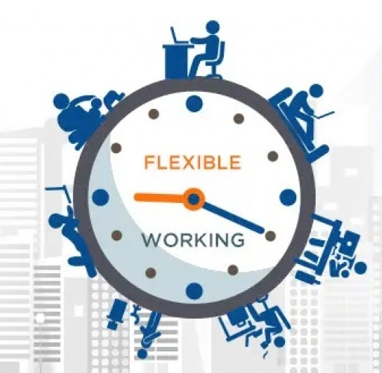
Individual Presentation
Student name: Vlada Basiul (2028043)
Programme: BA Business Management
Module name: Managing People
Course code: LCBB5004
Lecturer: Doctor Terry Walcott
Topic : Make a case against flexible working in relation to inequality at work and analyse the role of HR in addressing the concerns of inequality that may arise from flexible working.

Slide 2
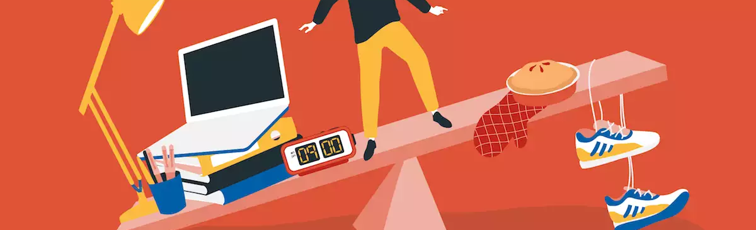
Introduction
Any employment structure involving telecommuting and remote work, is referred to as flexible working or flex work.
Flexible working also involves part-time employment, freelancing, and other flexible hours.
As the name suggests, this category includes any kind of flexible and adjustable employment arrangement between employers and employees.
Notes:
Flexibility in work hours has gained enormous popularity recently both domestically and overseas. These demonstrate how flexible employment is becoming more and more popular considering the fact that the US labor market is now thriving and that a record number of individuals are changing jobs.

Slide 3

Overview Of The Flexible Hour
Employers at a retail firm with 1,000 employees spread across many sites may have a dilemma.
It might be challenging for employees to keep a distinct separation between work and home.
Employers also stress about decreased productivity.
Workplace flexibility refers to altering work schedules to better match life outside of work (Wiatr, 2021).
Notes:
Imagining that there are no drawbacks to employing flexible working arrangements will not be advantageous to the team or the company. After all, certain personalities flourish in various environments. While some individuals could perform better in a flexible environment, some people require the rigidity of defined working hours to perform at their best. Employers also worry about losing sight of what people are producing, and team chemistry deteriorating.

Slide 4
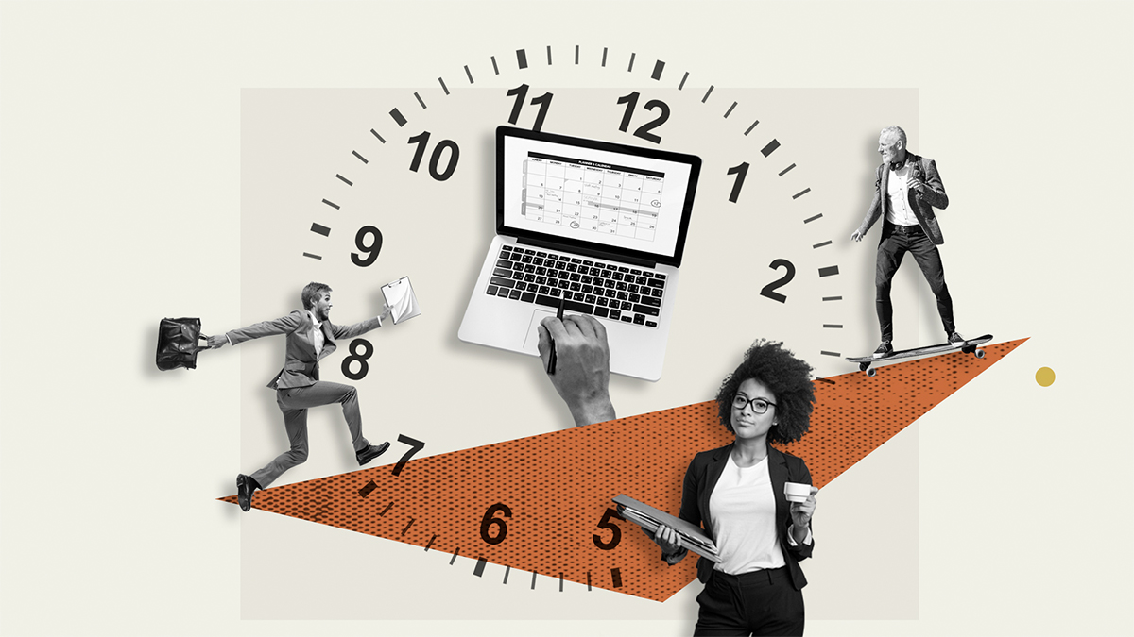
The Basic Disadvantages Arise From The Flexible Working Hour
Flexible work schedules can reduce productivity.
Workers may be able to delay their working hours as a result of procrastination.
Flexible working hours might irritate managers and companies.
It might be concentrating on the particular requirements of employees without engaging in discrimination (Shrm, 2022).
Notes:
In order for flexible work schedules to be successful, there must be a give-and-take attitude between companies and workers. Flexible working arrangements can cause inefficiencies, a decline in quality, and poor communication if they are not well managed. One of the topics that are frequently discussed in the modern business world and among business stakeholders is a work-life balance or work-family conflict (Beo, 2021). When everyone on the team works different shifts or locations, it is much more difficult to keep track of what they are up to. Flexible work schedules typically refer to working remotely, which can be challenging for employees.

Slide 5
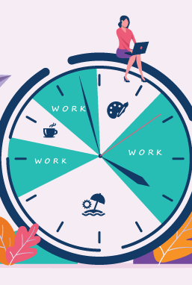
Inequality Due To Flexible Hour
Flexible working can worsen the impact on a person's career.
In this sense, flexible working has the capacity to widen gender disparities.
Inequality due to flexible working make people doubt about women's work flexibility.
The state of women's employment has been more severely impacted by flexible working (Demir, 2021).
Notes:
It is a reform that has been long-requested by groups including women, individuals who are responsible for caring for others, and persons with disabilities. However, economists and employment specialists are cautioning that it could result in greater inequality in the workplace, especially for working mothers. It causes employees to stray from the perfect worker image in a retail firm with 1,000 employees spread across multiple sites.

Slide 6
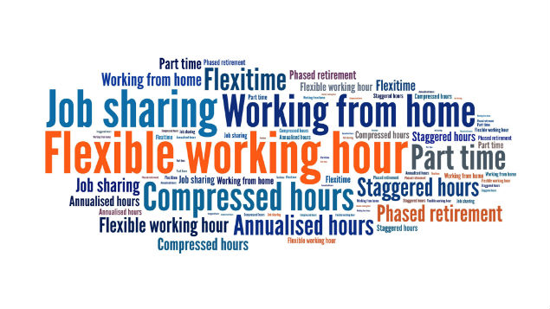
Inequality Due To Flexible Hour
A male employee who successfully applies for flexible working might find himself excluded.
This exclusion feeling comes from decision-making and professional advancement.
Women may experience special difficulties when working remotely due to their isolation from the office (Lancaster, 2022).
Notes:
Flexible work arrangements could result in workers being marginalized in a retail firm. Inequalities that arise due to flexible working hours must be handled carefully by the human resource management of the company for the retention of employees as well as for organizational development. It is even less acceptable when a male employee makes the request.

Slide 7

Inequality Due To Flexible Hour
Being vulnerable during a recession may result from flexible working.
Flexible working arrangements may not always translate to high-paying jobs in a retail firm (Beno,2021).
In some organizations, vulnerability might increase a worker's risk of being laid off.
Women bear a disproportionate amount of unpaid caregiving and work affecting their employment (Sullivan, 2019).
Notes:
Flexible working arrangements will depend as much on organizational requirements as on individual worker requirements. Instead of being a perk for valuable employees, offering flexible work arrangements may be a viable technique for boosting workplace efficiency. It is a widespread misperception that someone with a flexible schedule must also be making six figures.

Slide 8
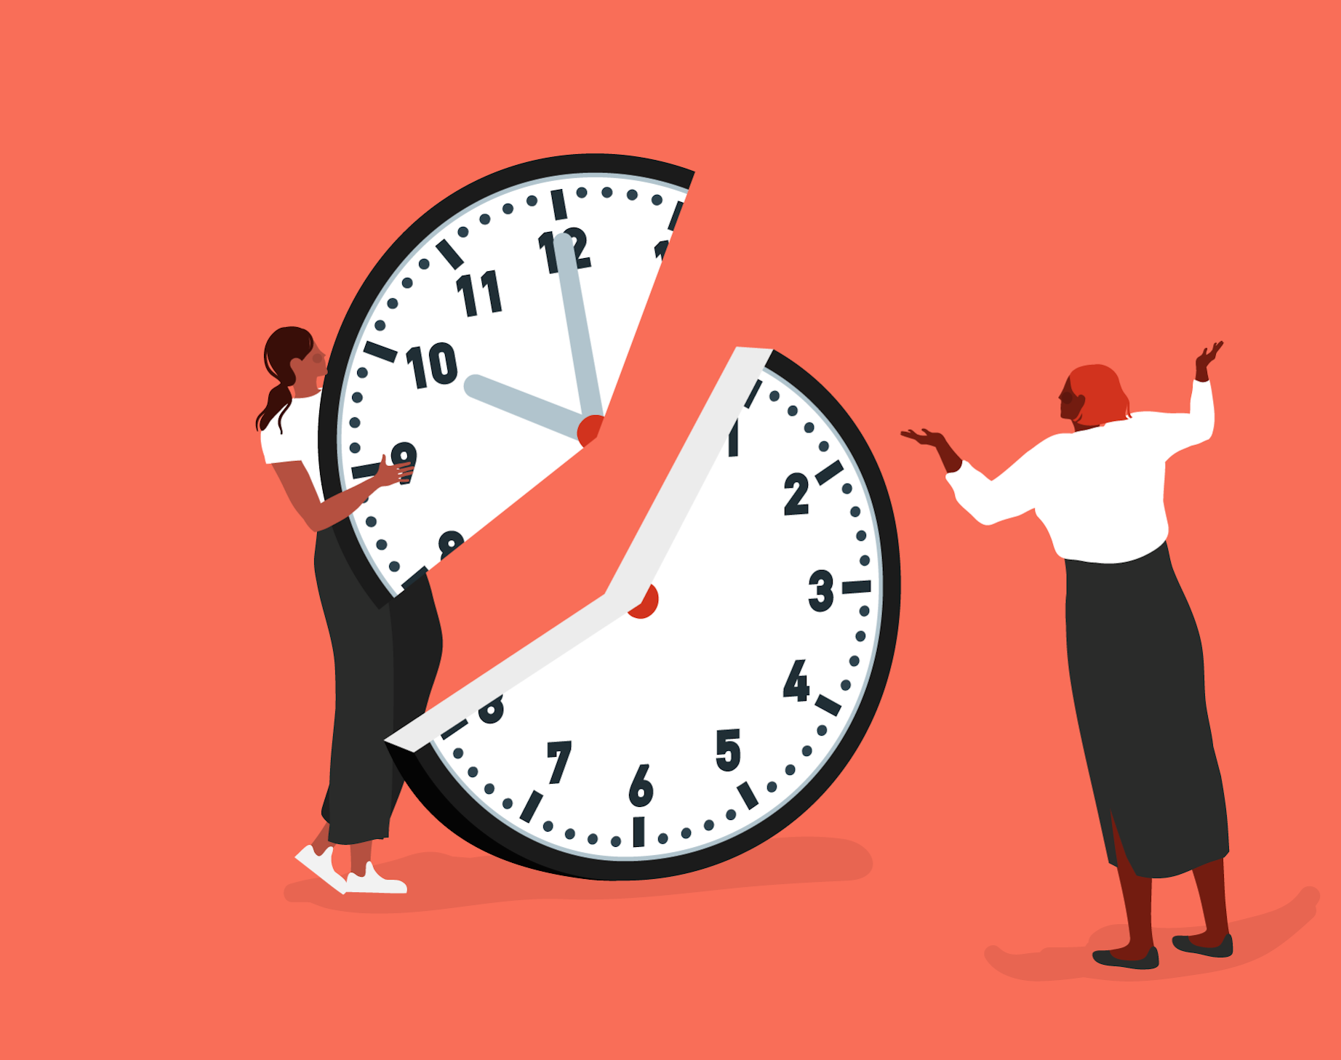
The Role Of HR In Addressing The Issues Of Flexible Working Hours
HR can keep an eye on a person's authorization.
HR must understand what constitutes a violation.
The term "flexible work arrangement" refers to changing hours of work (Wadhawan, 2019).
Notes:
By frequently assessing the company's flexible working policies, the employer may ensure that they are equitable to all employees, regardless of their circumstances, such as those who have longer commutes or caring duties. HR should concentrate on what procedures are in place if one occurs, and how to resolve any difficulties in that situation.

Slide 9
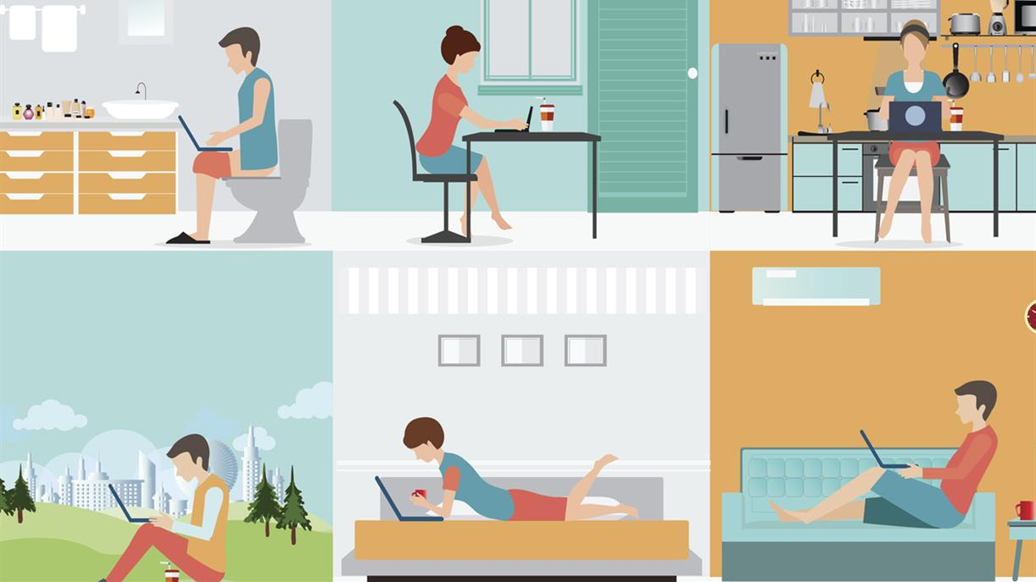
The Role Of HR In Addressing The Issues Of Flexible Working Hours
HR must ensure that any requests for flexible working are compliant with employment laws and regulations (Citation, 2022).
HR may assist workers who work flexible hours by advising them to call them if they need assistance.
HR can monitor their general wellness, identifying any specific training needs.
Notes:
Flexible work arrangements (FWAs) are used by businesses to attract, retain, and satisfy human resource capital, while employees utilise them to balance work and personal obligations, as well as to relieve stress and conflict (Smith et al., 2019). HR is crucial to both employee happiness and dispute resolution. When workers are working remotely or at various hours, it is harder to detect any signs of stress, conflict, or poor mental health than when they are in a shared workspace. The UK has employment regulations in place to protect both employers and employees.

Slide 10

Recommendation For HR
Lower-level employees rarely have the flexibility to choose their workplace (Kossek , 2018).
HR can persuade the employer to pay for connections for the employees
This will enable employees to access the applications from anywhere.
Notes:
In a retail company with 1,000 employees spread across various locations, HR should make sure to support each employee by keeping in touch with them on a frequent basis. As HR specialists, their knowledge is crucial to achieving successful business outcomes. Furthermore, there is no excuse for HR executives to forgo using video conferencing solutions like Skype, Google Hangouts, and others to improve communication with staff members given the expanding sophistication of these platforms.

Slide 11

Conclusion
In conclusion, there is no reason why corporations should not accept newer forms of working arrangements.
Flexible Working is increasing thanks to accelerating technological advancements.
In fact, HR Managers must create flexible work practices for this reason.
Notes:
In addition, governmental incentives for flexible work are growing. As a result, given its many advantages and promising future, it is thought that flexible work will persist.

Slide 12
References
Beno, M., (2021). The advantages and disadvantages of E-working: An examination using an ALDINE analysis. Emerging Science Journal, 5, pp.11-20.
Citation. (2022). UK Employment Laws. Available at. https://www.citation.co.uk/news/hr-and-employment-laws-explained/ (Assessed on 12 July 2022).
Demir, O., (2021). Gender inequality in the labour market: comparison of Turkey and OECD countries by multidimensional scaling method. Yonetim ve Ekonomi Dergisi, 28(2), pp.377-397.
Kossek, E.E. and Lautsch, B.A., (2018). Work-life flexibility for whom? Occupational status and work-life inequality in upper, middle, and lower level jobs. Academy on Management Annals, 12(1), pp.5-36.
Lancaster. (2022). Inequalities due to Flexible Working Hours. Available at: https://www.Lancaster.ac.uk/news/outdated-attitudes-risk-widening-inequalities-in-hybrid-workplace-think-tank-warns (Assessed on 12 July 2022).
Shrm., (2022). Basic Disadvantages of Flexible Working Hours. Available at: https://www.shrm.org/resourceandtools/tools-and-samples/toolkits/pages/managingflexibleworkarrangements.aspx (Assessed on 12 July 2022).
Sullivan, O., (2019). Gender inequality in work-family balance. Nature Human Behaviour, 3(3), pp.201-203.
Wadhawan, S., (2019). Impact of flexible working arrangements on employee satisfaction in IT sector. BVIMSR Journal of Management Research, 11(1), p.59.
Wiatr, A., (2021). Flexible Working Arrangements-Current Conditions and Research Directions. (1), pp.67-78.

Slide 13

Thank You

