Slide 1
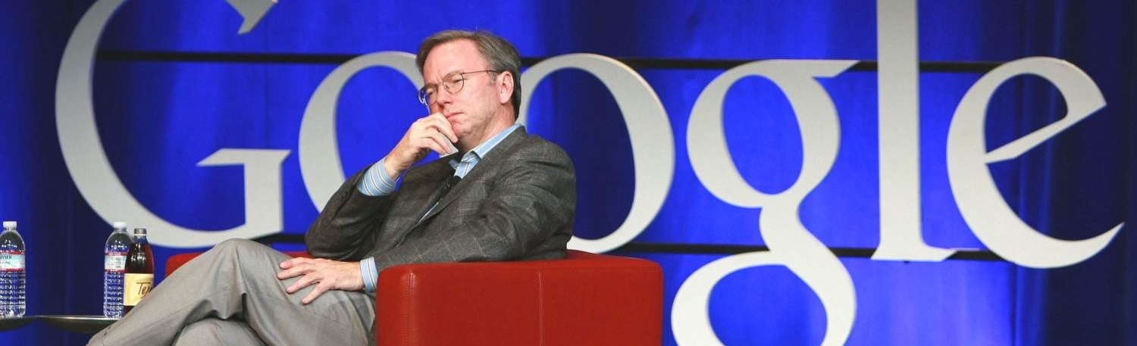

University of Wales Trinity Saint David
Introducing the Modern Workplace LCBB4003
Lecturer : Uju Ugochuku
Anca –Diana Gog (1918426)
Diegis Florea (1919249)
Ioana Ienea (1918148)
Zlatina Kircheva (1918147)
Eric Schmidt –CEO of Google

Slide 2
Table of contents
In the next few slides you will be able to follow how the successful leadership' strategy and methods improve the company Google.
How innovative thinking and freedom of staff create and develop Google like one of the best company in our times, but also expansion to whole culture.
We will take a deep look at the structure of management style of Google's leader-Eric Schmidt.
Examples and lessons for improvement in management in our time
Conclusion
Questions
References

Slide 3

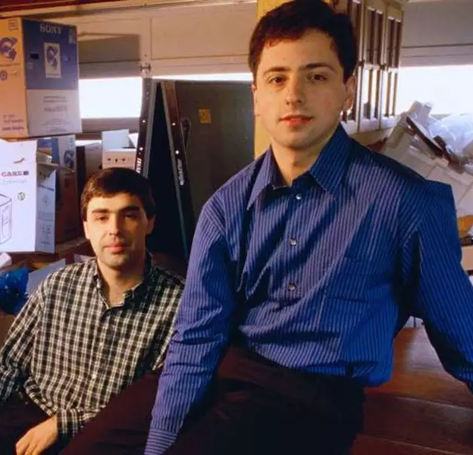
Google was launched in 1998 by Larry Page and Sergey Brin.
Google started as a web search engine.
Now they are one of the largest media companies.
They crated - Google Maps, Gmail, Google news, Google Chrome, etc.

Slide 4
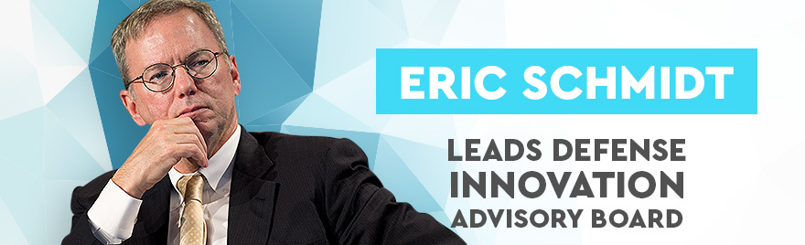
Eric Schmidt
Born on 27th April 1955.
Businessman and software engineer.
Google CEO 2001-2011.
Executive Chairman of Google 2011-2015.
Executive Chairman of Alphabet Inc. 2015-2017.
Technical advisor of Alphabet Inc. 2017-2020.

Slide 5
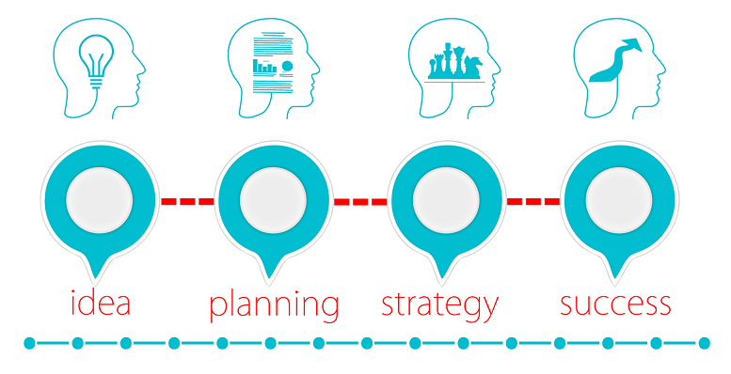
Eric Schmidt's rise to success
Led Google's transformation into a global titan
During Schmidt's tenure, Google expanded beyond its roots as a search engine to tackle other technologies, including mobile phones and online video.

Slide 6
Schmidt's own inclinations for independent thinking and research has a powerful impact on his leaderhip style
“I would suggest that persistence is the single biggest predictor of future success,”Schmidt says . “And so we would look for persistence.”

Slide 7

Eric Schmidt leading Google
Focused on steady growth and expansion.
His main goal at Google was to make Google
"A systematic innovator at scale"
Introduced Gmail and Chrome
Eric Schmidt a Laissez-Faire leader.
Empowering employees.

Slide 8

Eric Schmidt innovation focused
Gave staff time to work on their own projects.
Organised Google into small undirected teams.
Acquired small companies with innovative ideas.

Slide 9

Lessons to learn from Eric Schmidt
The importance of diversity at work
Groups make better decisions than individuals (Manyika, 2008)
Need for well-rounded leaders
Leaders can start over and win again

Slide 10
Conclusions
Your title makes you a manager, your people make you a leader
Leadership plays a vital role within an organzation
Eric Schmidt's leadership provided the innovative outcomes of the company
Google is the best example of network-based organization.

Slide 11


Slide 12
References
Alastair R Agutter,Getting Inside Google's Head Book:The 13 Key Elements to Successful to Web Side Optimization Success(2014)
Ferguson, C.H., 2005. What’s next for Google. Technology Review, 108(1), pp.38-46.
Herman, J.L., McCausland, T.C. and Bliton, D., 2020. Making a difference in the digital age: global leadership and multiteam systems. In Research Handbook of Global Leadership. Edward Elgar Publishing.
Landeweerd , M., Spil, T. and Klein, R., 2013, June. The success of Google search, the failure of Google health and the future of Google plus. In International Working Conference on Transfer and Diffusion of IT (pp. 221-239). Springer, Berlin, Heidelberg.
Lewis R. ,Eric Schmidt American engineer and executive, available at :https://www.britannica.com/biography/Eric-Schmidt

Slide 13
Manyika , J., 2008. Google’s view on the future of business: An interview with CEO Eric Schmidt. McKinsey Quarterly.
Oke, Adegoke, Natasha Munshi, and Fred O. Walumbwa. "The influence of leadership on innovation processes and activities." Organizational Dynamics 38.1 (2009): 64-72.
Schermerhorn, J.,Introduction to Management(2011),student version, 11 edition, John Wiley and Sons(Asia)
Schmidt, E. and Rosenberg, J., 2014. How google works. Hachette UK.
Trippe, S.,An analysis of Big Companies and their Menagement Styles(20.10.2015), Anchor Academic Publishing,Hamburg
Walter, F., Humphrey, R.H. and Cole, M.S., 2012. Unleashing leadership potential:: Toward an evidence-based management of emotional intelligence. Organizational Dynamics, 41(3), pp.212-219.

