Slide 1


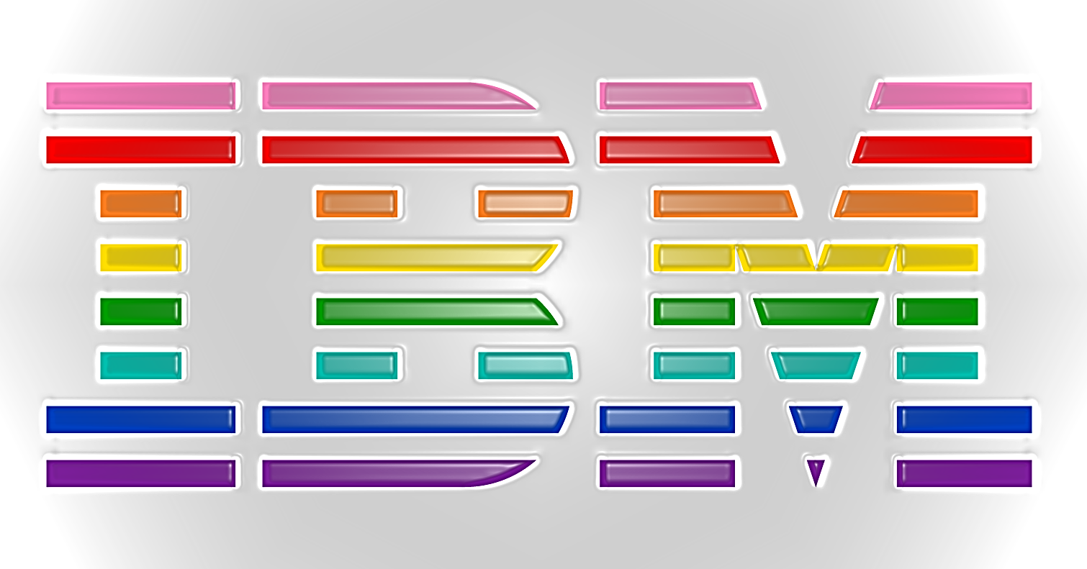
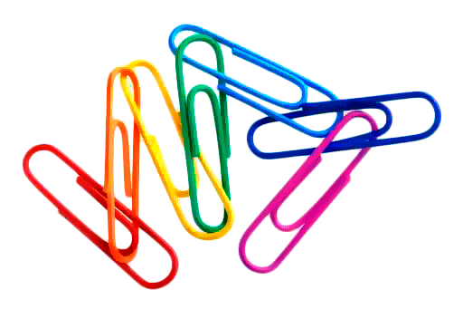
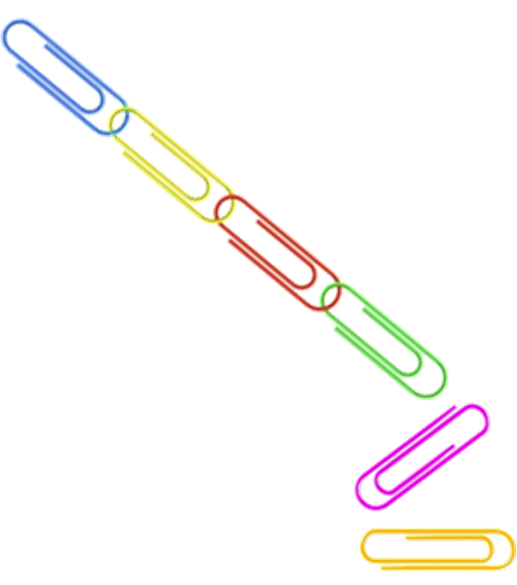
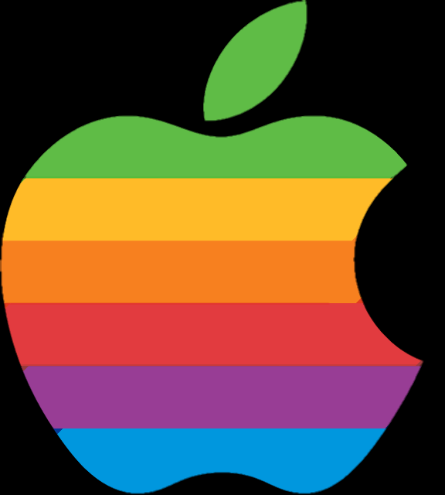

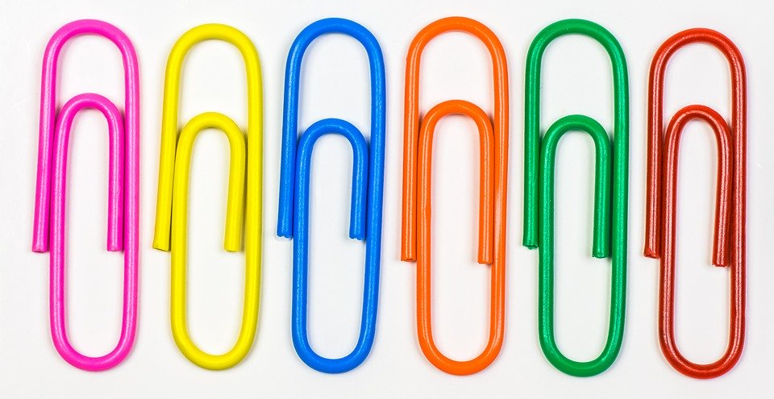
Can Apple make you “Think Different”?
Does exposure to a brand change your behaviour?
The Method
341 participants.
Either shown Apple or IBM logo.
Each logo shown for 13 milliseconds 12 times.
Mindless task – Cross out all of the “e”s in a textbook for 5 minutes.
Creativity test – How many unusual uses can you think of for a paperclip or brick?
Participants completed both tasks, but half doing the mindless task BEFORE the creativity test.
Pilot test found that Apple was ranked higher for creativity than IBM.
https://www.ibm.com/blogs/policy/wp-content/uploads/2017/01/IBM_LGBT_Logo_RGB.jpg
Those exposed to the Apple logo resulted as more creative than those exposed to the IBM logo or control tests.
Participants who performed the mindless task before the creativity task, tested higher in creativity.
http://1.bp.blogspot.com/-ppT3QD3BNZE/UM4I0O0cNWI/AAAAAAAABlw/7TUyyAgsCYo/s640/apple+logo.png

Slide 2
Reference
Fitzsimons, G., Chartrand, T. & Fitzsimmons, G., 2008. Automatic Effects of Brand Exposure on Motivated Behavior: How Apple Makes You “Think Different”. Journal of Consumer Research, 35(1), pp. 21-35.

