Slide 1
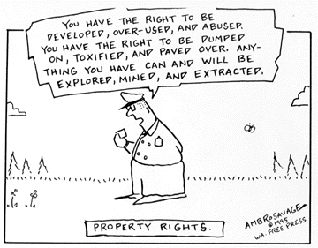
Property (Rights and Relations)

Slide 2


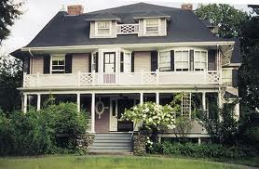
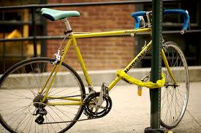
So what is property?

Slide 3
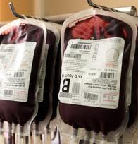
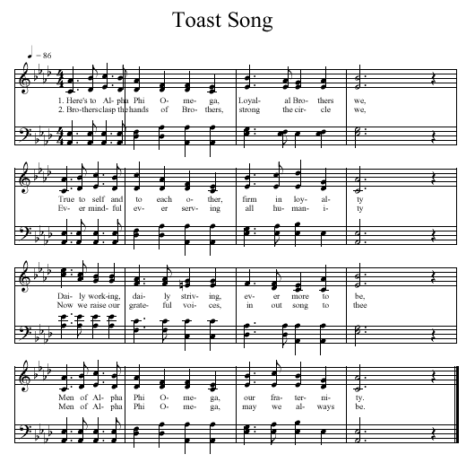
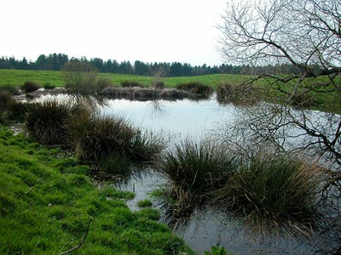
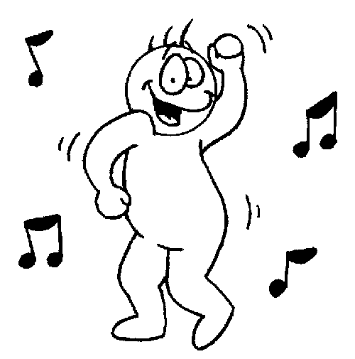

Slide 4
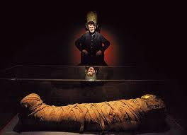
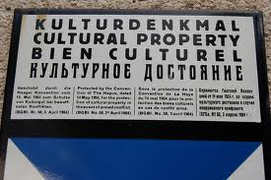
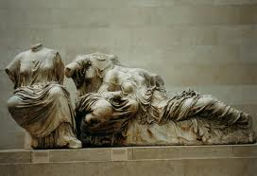
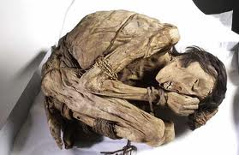

Slide 5



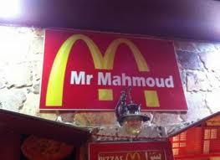

Slide 6



It’s not a thing
It’s an idea about a thing (who can use it, how it can be used …)
Property relations are between people about the use of things

Slide 7
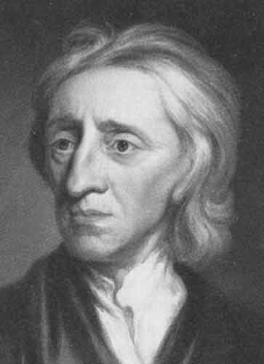
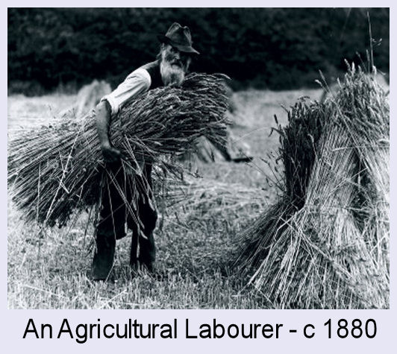
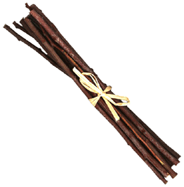
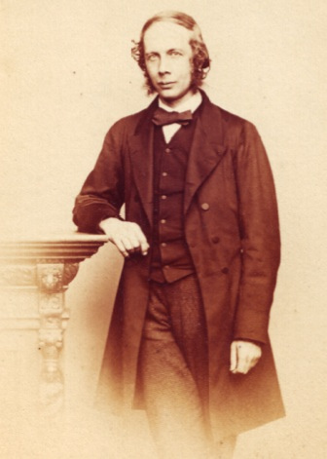
Locke
Moral justification for rights to the products of labour. Labour + Nature = Transformed Nature / Product
Property is a bundle of rights
Maine

Slide 8
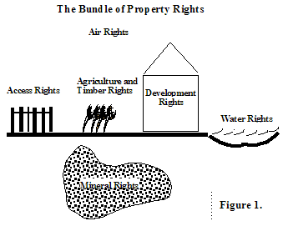

Slide 9
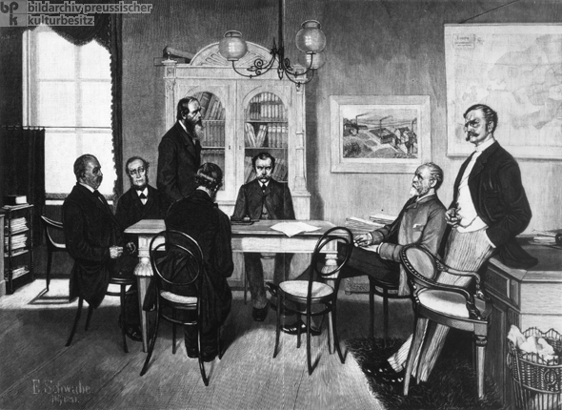
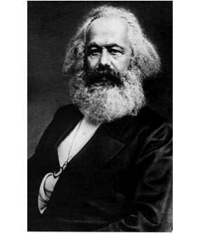
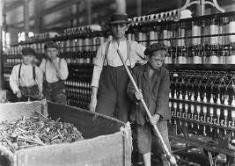
Property relations are another way of talking about the social relations of production

Slide 10
Property is a Total Social Fact
Having the rights to access, use or dispose of things is linked to power and systems of relatedness:
  Economics
  Politics
  Ideology
  Kinship
Private property is only one kind of property
  Exclusive rights to something that are enforced by the state.

Slide 11
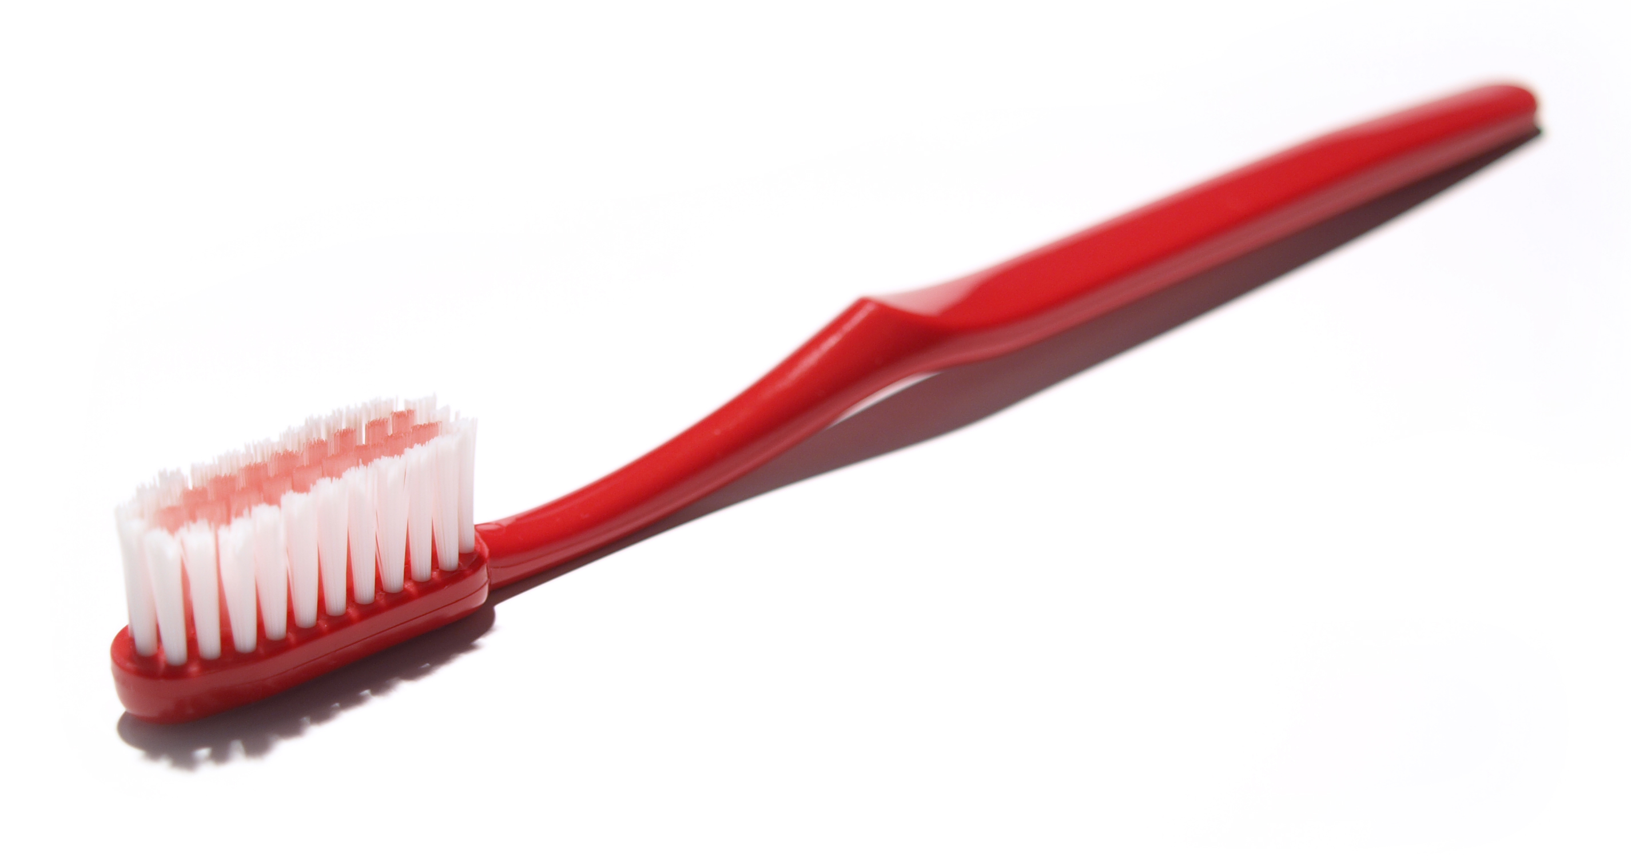
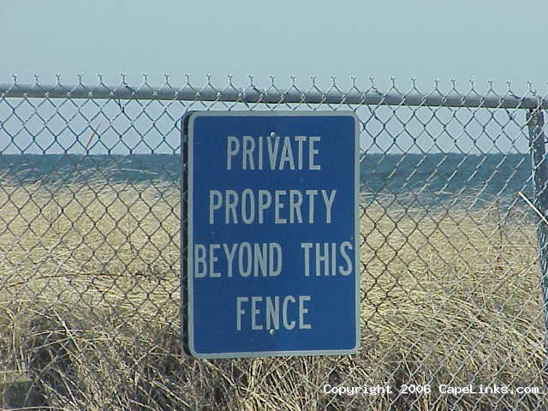
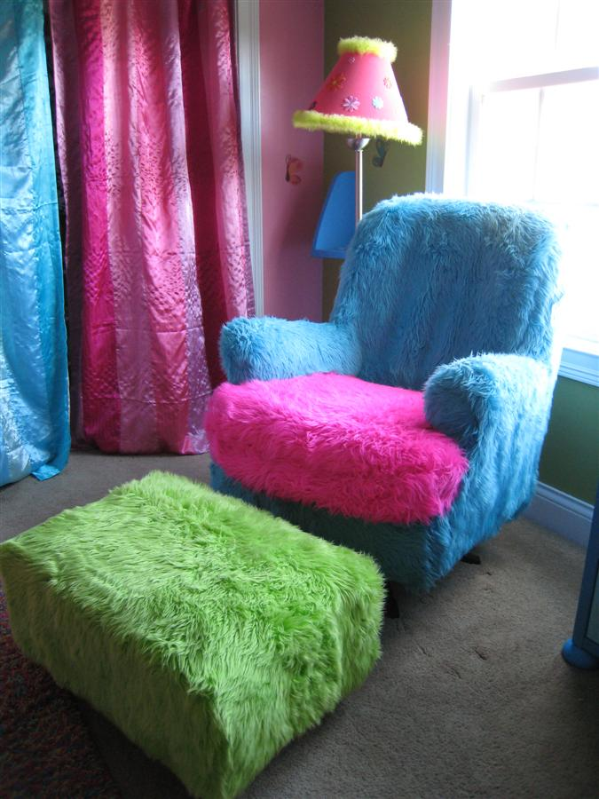
Private property
Personal property

Slide 12
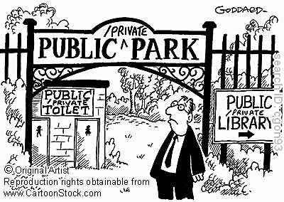
Public (common) Property
Who does the state recognise as citizens with rights?
Owning, being and belonging closely connected
Who is the public?

Slide 13
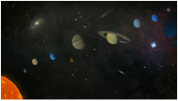
Open Access
Increasingly regulations are being put in place
  e.g. 1979 Agreement Governing the Activities of States on the Moon and Other Celestial Bodies,
    aka the Moon Treaty
Outer space = ‘common heritage of mankind’

Slide 14
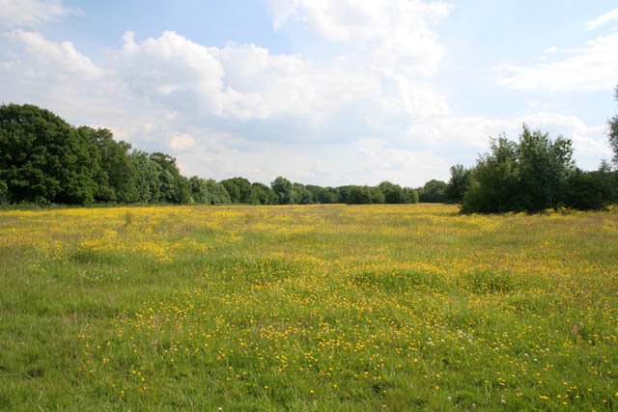
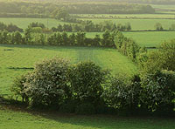
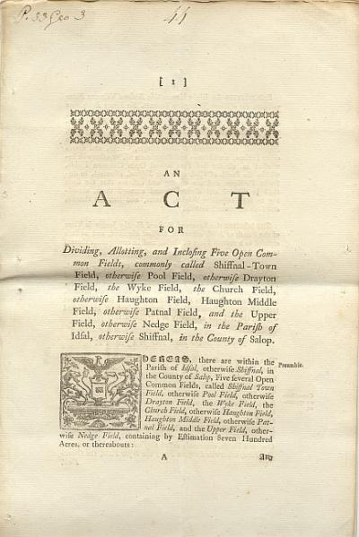
Enclosure Acts from 13thC … 1801 Inclosure Consolidation Act
‘class robbery’ E.P.Thompson

Slide 15
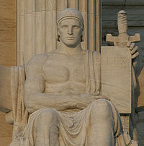
Ius in personam – rights to a thing through the person
  i.e. someone can use or access something because they belong to the group who have those collective rights
  I belong to this group / family and therefore have the rights to use x or y through that connection
    but as collective rights, I cannot dispose of or alienate x or y
Ius in rem – rights in/to the thing itself
  the thing can be alienated.

Slide 16
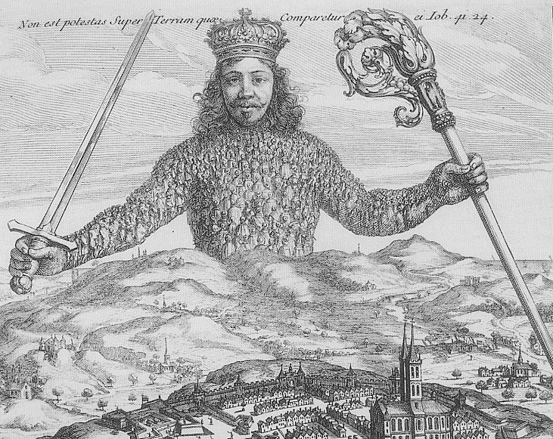
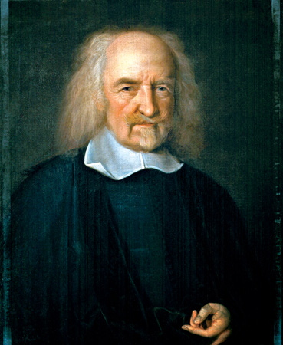
Who enforces claim to private property?
Thomas Hobbes,
Leviathan: (1651)

Slide 17
John Locke, Two Treatises of Government
Though the earth, and all inferior creatures, be common to all men, yet every man has a property in his own person: this no body has any right to but himself. The labour of his body, and the work of his hands, we may say, are properly his. Whatsoever then he removes out of the state that nature hath provided, and left it in, he hath mixed his labour with, and joined to it something that is his own, and thereby makes it his property. It being by him removed from the common state nature hath placed it in, it hath by this labour something annexed to it, that excludes the common right of other men: for this labour being the unquestionable property of the labourer, no man but he can have a right to what that is once joined to, at least where there is enough, and as good, left in common for others.

Slide 18
Labour theory of ownership
2 fundamental rights
  to self and fruits of the labour of my body:
    labour + nature = transformed world.
  "Every man has a property in his own person. This nobody has a right to, but himself.”
Fundamental moral rights: fruits of individual labour
Property rights precede political society
  Therefore political society is based on the moral principles relating of rights of individual
Legitimate political power = trust / contract
  State upholds property

Slide 19
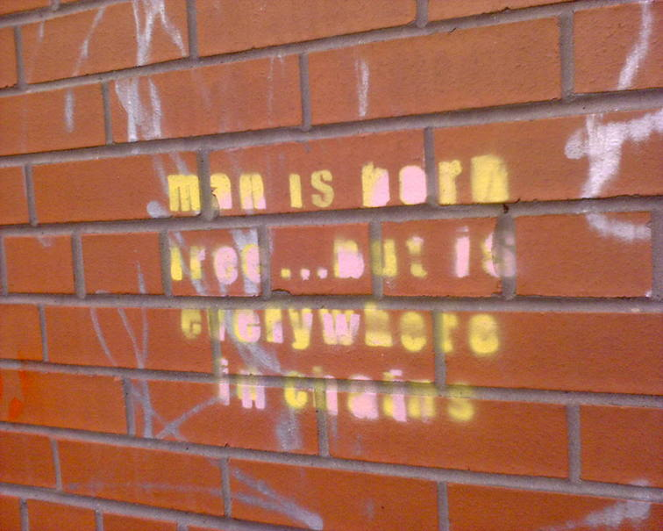

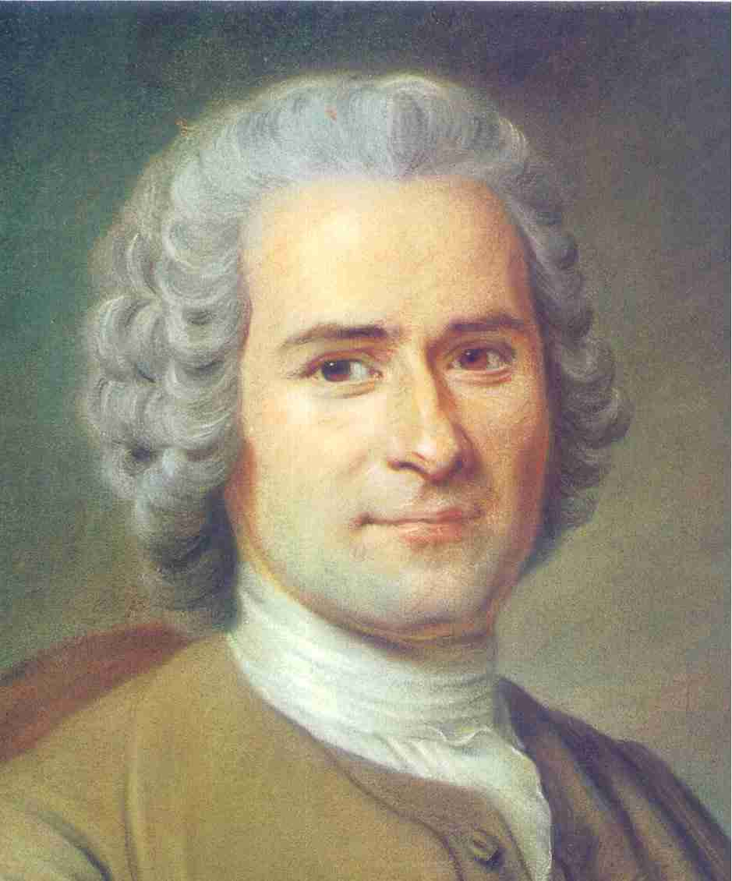
John Jacques Rousseau

Slide 20
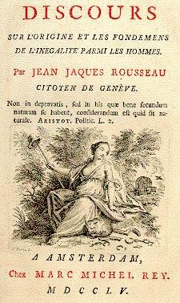
The first man, who, having enclosed a piece of ground, bethought himself of saying ‘This is mine’, and found people simple enough to believe him, was the real founder of civil society. From how many crimes, wars and murders, from how many horrors and misfortunes might not anyone have saved mankind, by pulling up the stakes, or filling up the ditch, and crying to his fellows: ‘Beware of listening to this impostor; you are undone if you once forget that the fruits of the earth belong to us all, and the earth itself to nobody’. (DOI, 1993:84)

Slide 21
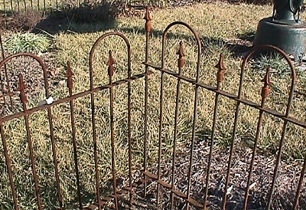
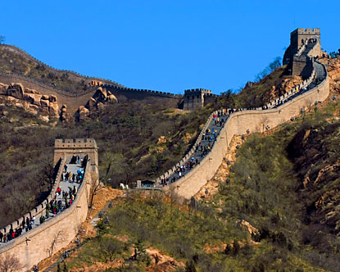
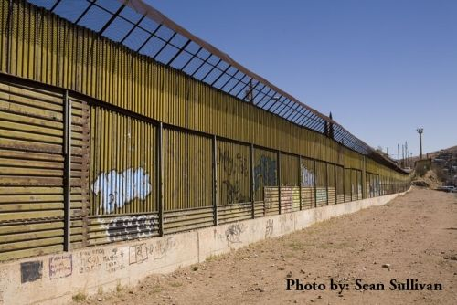


Slide 22
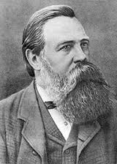
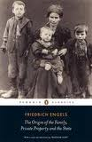
Friedrich Engels
The Origin of the Family, Private Property & The State (1884)

Slide 23
Evolutionary Approach
Prehistoric sexual division of labour, but men lived in women’s households and society was matrilineal and matriarchal
With a shift to agriculture, men controlled domestic animals and tools
Men became more mobile and society became patriarchal
Men wanted to ensure paternity for the transmission of their property, hence the oppression of women and their sexuality

Slide 24
The Reproduction of Capitalism
Led to monogamous relations (at least for women!), and the creation of the nuclear family
Reproduced the structures of capitalism
Women were a source of unpaid labour, and produced new labour
Family unit upheld the idea of the ‘natural’ transmission of property
Women’s subordinate position reproduces key aspects of capitalism
  Exploitation of labour, private property and class
  The home as a microcosm of capitalist society

Slide 25
Sahlins: Original Affluent Society
Not all societies are economically maximising
Questioned notions of ‘economic man’ (or woman!)
Hunter Gatherer groups have hours of leisure time once their needs are met
Hoarding is not compatible with their lifestyle
Sharing mechanisms and collective ownership
What does ‘affluence’ mean in this context?

Slide 26
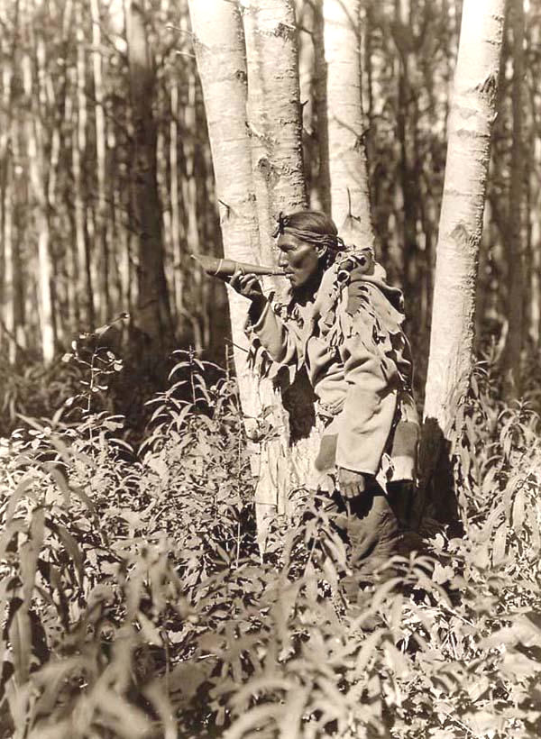
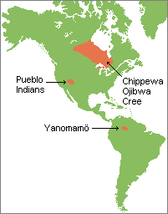
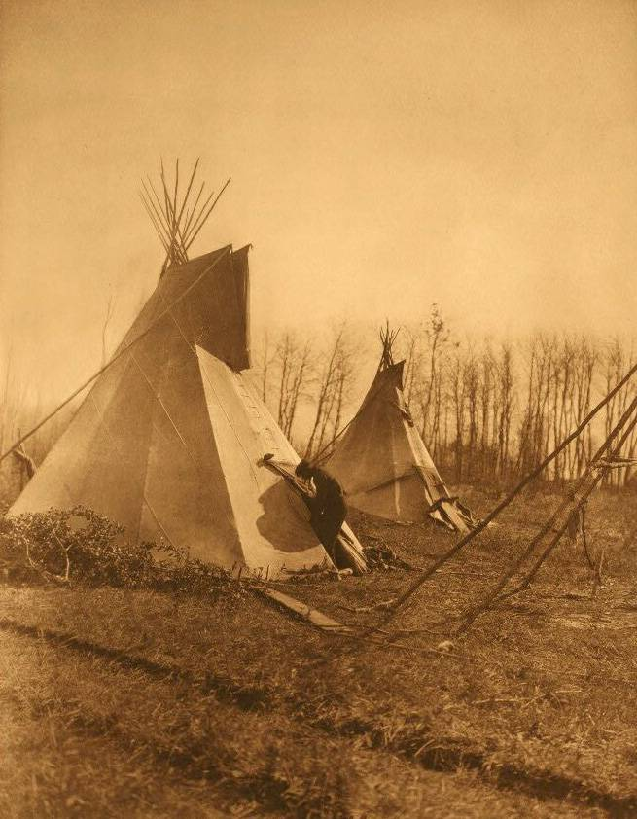
The Cree

Slide 27
C. Scott (1991 [1988])
  No words for property / ‘to own’.
  Layered system of property right
  Household rights to its labour, collective obligations –
  Rights to hunting grounds through group membership/ belonging (sharing with non-human)
  No exclusive rights to resources but stewardship
    The import of this now in environmental discourse

Slide 28
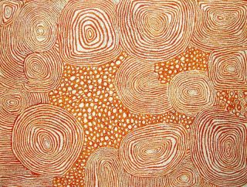
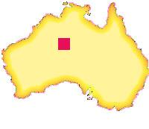
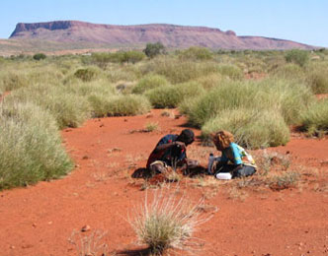
Pintupi country

Slide 29
Myers (1991 [1988])
Property rights are negotiable and are shifting
Indicator of social relationships and a basis for Pintupi identity
Property relations – and identity – is based on ‘giving away’ rather than accumulation
Shared relations to property creates identity
Property should be viewed as a sign (p.54)
Objects move through social networks rapidly and with ease
Willingness to include others as a ‘co-owner’

Slide 30
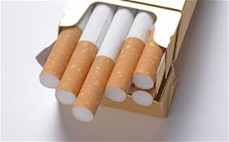
Cigarettes
Sharing, owning and asking
It is acceptable to hide objects
  But why would you want to?
  You are denying the opportunity to create a relationship
    and, in turn, your own identity
  You also build your own right to ask for objects by giving

Slide 31
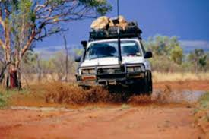
Trucks
Pintupi individuals buy or ‘look after’ community motor vehicles
Highly valued and useful
To ‘own’ a car is to be subject to constant requests
Creates conflict and constant pressure
Obligation

Slide 32
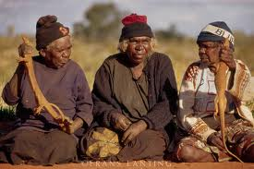
Opportunity
‘To give’,
  look after relations, and to be understood as generous
“The demands on a proprietor are not entirely a bad thing, since they provide the opportunity to ‘be someone’” (p. 61)

Slide 33
General attitude towards personal possessions
“There are plenty more motor cars: no worries” (p. 61)
Trucks are replaceable
Reflects the expectation of long-term reciprocity
Someone else will provide
  Reflects attitudes to land
“Prefer to invest in people rather than things” (p.62)
Aware of the distinction between themselves and ‘white man’

Slide 34
Identity
“The accumulation of private objects, while not entirely ignored, is not the means through which one’s identity is transmitted through time. It is secured, it would seem, in part, through giving things away” (pg. 62)

Slide 35
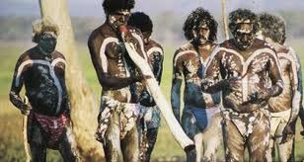
Sharing extends to land and knowledge
Male identity, particularly, is related to ‘named places’
Younger generation attend ceremonies, so country can be ‘passed on’
But they are not passing on personal property
Rather an identity that is objectified in the land

Slide 36
‘Inalienable Wealth’
One can ‘give’ one’s country without really losing it (p. 73)
The ease that Pintupi part with possessions is owed to this aspect of their identity
They have assured identity rooted in their country, and through exchange
Very different from the ways in which identity is created through personal objects

Slide 37
Conclusions…
Questions our assumptions about wealth, property and affluence
The ways that property , and property relations, relates to identity
Property relations structure, and are structured by, broader social relations
The relationship between freedom and property
  Obligation and opportunity

