Slide 1
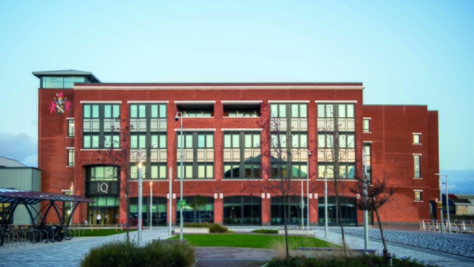
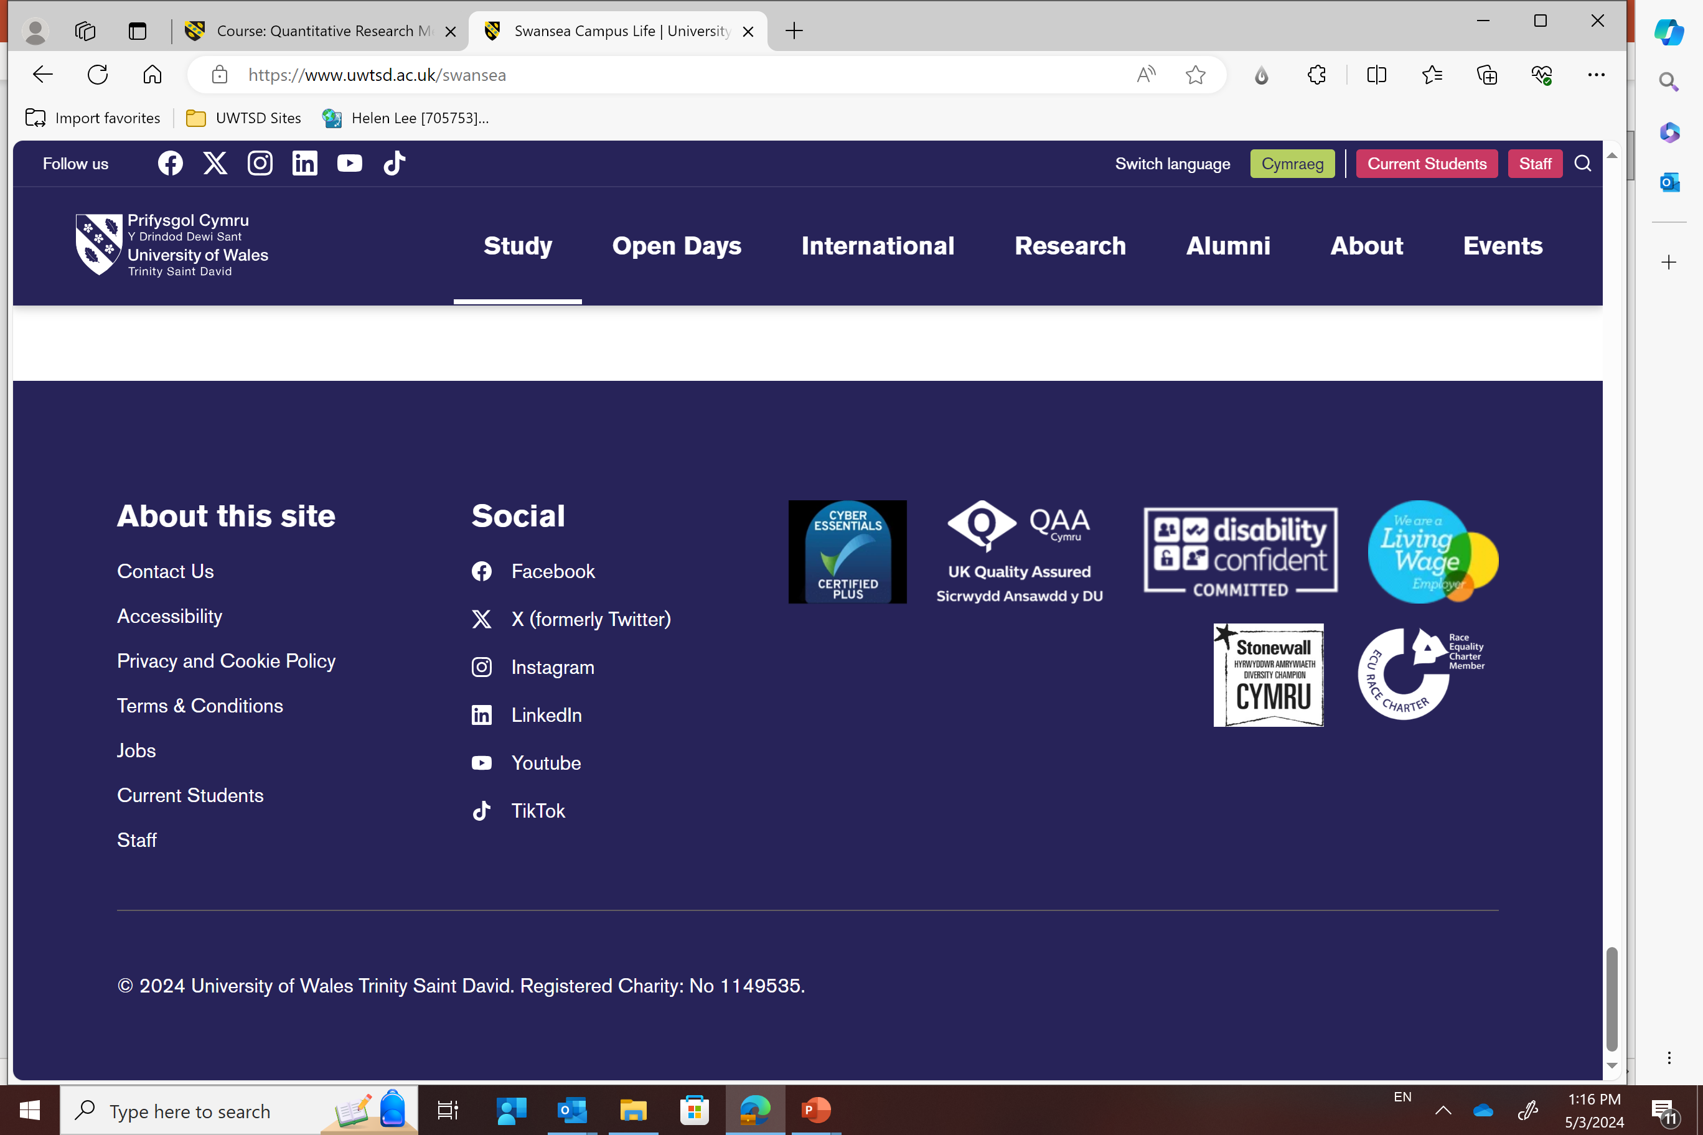
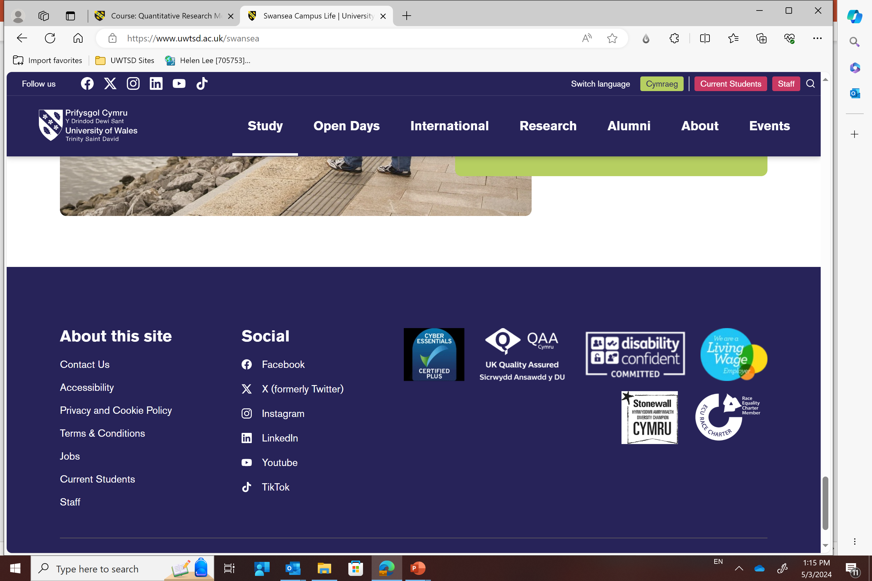

LCDB7012 - Advancing to the Doctoral Research Stage
Week 2
Assignment Brief
Dr. Helen Lee

Slide 2
LCDB7012 – Assignment Brief
Assessment components | Weighting | Submission Due
Assignment 1 – Written Report (4,500 words) | 60% | 3rd Oct 2025 (Fri)
Assignment 2 – Presentation (18 mins) * | 40% | In the following week after the report submission. 7th Oct 2025 (Tue)
* Sequence of the presentation will be confirmed via lucky draw in September 2025

Slide 3
LCDB7012 – Assignment Brief
D/L : 3rd Oct 2025 (Friday)
Source : Moodle Handbook

Slide 4
LCDB7012 – Assignment Brief

Slide 5
Use of Generative AI in Assessment

Slide 6
LCDB7012– Assignment Brief
Please refer to the Moodle Handbook for details

Slide 7
Q&A !

