Slide 1
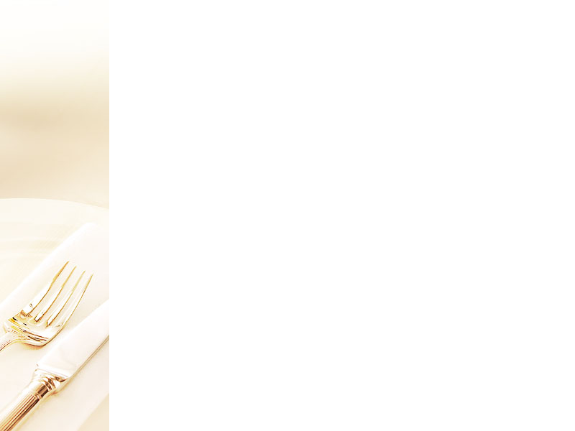

HOTEL TRINITY
Dining, takeaway, and delivery options are available. We recommend you to use our online delivery options as well due to the current scenario of Covid-19. Our restaurant's website offers online food delivery choices. We are rigorously adhering to all health guidelines and protocols due to the Covid-19 situation. We use one-time-use environmentally friendly serving plates, bowls, trays, and glasses and we are also following all the guidelines provided by the government.
Timings
11 am to 10 pm (Monday to Friday)
11 am to Midnight (Saturday and Sunday)
Please keep in mind that we accept cash and online payments.
Delivery charge- £3
Starters
Grilled Salmon with Tartar Sauce (£13)
Salmon marinated in herbs and grilled with smoked provolone sauce, served with spicy and chef's special tartar sauces; salmon and sparkling champagne are allergies.
Broccoli Quiche with Malvasia (£12)
On top of an oven-baked short crust pastry base, spring onion, butter tossed broccoli, pepper, salt, and double cream soft cheese. It is served with Malvasia to complement the sweetness of the wine; allergens include protein and carbohydrates.
Potato Churros with Vinegar Salt (£10)
Deep-fried potato flour in a stick shape, with egg, milk, and mixed herbs added to the potato flour. It comes with a vinegar salt and chocolate dipping sauce; allergens include milk, egg, and starch.
Mains
Lamb Chops with Rosemary and Garlic (£32)
Garlic, pepper, salt, rosemary, and lemon zest marinated meat. Garlic, red wine, and lamb protein are allergens in this dish, which is served with butter sautéed veggies.
Vegetable Sandwich with Zinfandel (£19)
Seasonal veggies in butter are served on toasted multigrain sandwiches with Zinfandel wine and spicy mayonnaise sauce; scratch and Zinfandel wine may cause an allergic reaction.
Oven-roasted Mackerel with Champagne (£28)
The entire mackerel is marinated in salt, pepper, lemon juice, olive oil, bay leaves, garlic, and rosemary. The mackerel is wrapped in foil to keep the infused flavor intact and comes in a tray. This dish is also accompanied by a glass of champagne.
Grilled Mushroom with Pinot Grigio (£22)
Chef's special caramelized honey and Pinot Grigio wine were served with the grilled button mushrooms; allergens include mushrooms and wine.
768 Seaside Walk
Swansea,
SA1 1AA
Contact Telephone Number: 07896523546

Slide 2

Deserts
Dark Chocolate and Red Wine Truffle (£8)
Red wine-infused chocolate truffles are served with whipped cream and ice cream of your choice as a topping; allergies include chocolate, red wine, and milk.
Poached Pear with Gingerbread Loaf (£7)
Three whole pears are poached in a wine-flavored gingerbread loaf and served with cinnamon tea; allergies include ginger roots, chocolate, pear, vanilla, and wine.
Cabernet Blueberry Cupcakes (£6)
Blackberry-flavored sponge cupcakes with blackberries on top. However, plums, blueberries, and raspberries are all options for topping; allergens include red wine, berries, and milk.
Wines
Sparkling Wine (£3)
Any white or red grape can be used to make sparkling wine, which is a carbonated wine. Although white sparkling wines are the most popular, sparkling rosé and, to a lesser extent, red sparkling wines are also available.
Medium Red Wine (£7)
The alcohol percentage of medium-bodied red wines is between 12.5 and 13.5 percent, with more tannins than light-bodied red wines but less than full-bodied red wines.
Moscato Wine (£6)
Dessert wines are often referred to as Moscato wines. They might be exceedingly sweet and have significantly less alcohol than a typical glass of wine. Because of this pairing, it's a great wine to sip after dinner when you want to wind down but still have a little something with your dessert.
Prosecco (£3)
Prosecco has a light flavor and the bubbles make it a versatile drink that can be used in a variety of delightful summer cocktails. It has fruity, floral smells, making it ideal for the summer season and as an aperitif drink.
Dairy, Nuts, Eggs, and other allergies are present in some of our recipes. Please be sure to let us know if you have any food sensitivities before placing your purchase. We will do our utmost to meet your requirements.
Thank You for Visiting Us
If you want more information about us, please visit our website at: https://www.thetrinityhotel.com/
Cold Drinks/Hot Beverages
Coca-Cola 300 ml (£2)/Diet Coke 300 ml (£2)
Schweppes 330 ml (£3)
Coffee (£2)
Tea (£1.50)
Sides
Green salad (£4)
Fried potatoes (£3)
Fried rice (£3)
Onion rings (£3)

