Slide 1
Material Properties

Slide 2
Slides based on Materials:Engineering Science, Processing and Design, Ashby, Shercliff and Cebon 2007

Slide 3
Material Properties

Slide 4
Mechanical Properties
Elasticity – Bend a steel ruler and it will spring back-its elastic. Its elastic stiffness (resistance to bending) (1.2b)
is dependent on shape ( thin strips are easier to bend) and elastic Modulus, E (high E, like steel, are intrinsically stiff, low E, like polyethylene, are not.
Permanent deformation has to do with strength, not stiffness. The ease with which a steel ruler can be bent depends on shape and its yield strength σ_{y}
Large σ_{y} like titanium alloys are hard to deform permanently even though their stiffness is high. Materials like lead with low σ_{y} are easily deformed. When metals deform they get stronger(called work-hardening) but there is an ultimate limit called tensile strength σ_{ts} beyond which the material fails. The amount it stretches before it breaks is called the ductility. Perspex or Plexiglas rulers are not able to be permanently bent as they will fracture first. They are brittle. The resistance to cracking and fracture is measured by the fracture toughness (or stress intensity factor when a thin crack begins to grow) K_{Ic} (MPa · m^{1/2})

Slide 5
Fracture Toughness
Material type | Material | K_{Ic} (MPa · m^{1/2})
Metal | Aluminum alloy (7075) | 24
 | Steel alloy (4340) | 50
 | Maraging Steel (200 Grade) | 175
 | Titanium alloy | 44–107^{[4]}
 | Aluminum | 14–28
Ceramic | Aluminum oxide | 3–5
 | Silicon carbide | 3–5
 | Soda-lime glass | 0.7–0.8
 | Concrete | 0.2–1.4
Polymer | Polymethyl methacrylate | 0.7–1.60
 | Polystyrene | 0.7–1.1
Composite | Mullite-fibre composite | 1.8–3.3^{[5]}
 | Silica aerogels | 0.0008–0.0048^{[6]}
Most steels are tough, they have high K_{ic.}
Glass is very brittle, it has low K_{Ic}

Slide 6
Density (mass per unit volume)
High density = high weight
Weight is an important property in anything that moves as it carries a fuel penalty.
Cars, trucks, trains, aircraft and space vehicles
Increasing fuel penalty

Slide 7
Thermal Properties
Properties of a material usually get worse with temperature, strength falls, it starts to ‘creep’ (sag slowly over time), it may oxidise, degrade, decompose. There is a limiting temperature called the maximum service temperature, T_{max}, above which its use is impractical. Stainless steel has a high T_{max}, up to 800°C. Most polymers have a low T_{max} and are rarely used above 150°C.
Most materials expand when heated, but by differing amounts depending on their thermal expansion coefficient. When a substance is heated, the kinetic energy of its molecules increases. Thus, the molecules begin vibrating/moving more and usually maintain a greater average separation. The relative expansion (also called strain) divided by the change in temperature is called the material's coefficient of thermal expansion, α and generally varies with temperature. The expansion is small but the consequences can be large. If a rod is constrained (eg a railroad track) then the expansion forces it against the constraints causing it to buckle.

Slide 8
Some materials (like metals) feel cold while others (like wood) feel warm. This has to do with two thermal properties of the material: thermal conductivity, λ and heat capacity C_{p} . Thermal conductivity measures the rate at which heat flows through a material when one side is hot and the other cold. High λ is good for conducting heat, eg cooking pots, radiators and heat exchangers. Low λ is good to insulate houses, reduce energy consumption of refrigerators and freezers and enable space rockets to re-enter the earth’s atmosphere. These applications have to do with long-time steady heat flow. When time is limited, heat capacity matters. It measures the amount of heat that it takes to make the temperature of material rise by a given amount. High heat capacity materials like copper, require a lot of heat to change their temperature, low heat capacity materials like polymer foams take much less. Heat capacity is proportional to size of the system.

Slide 9
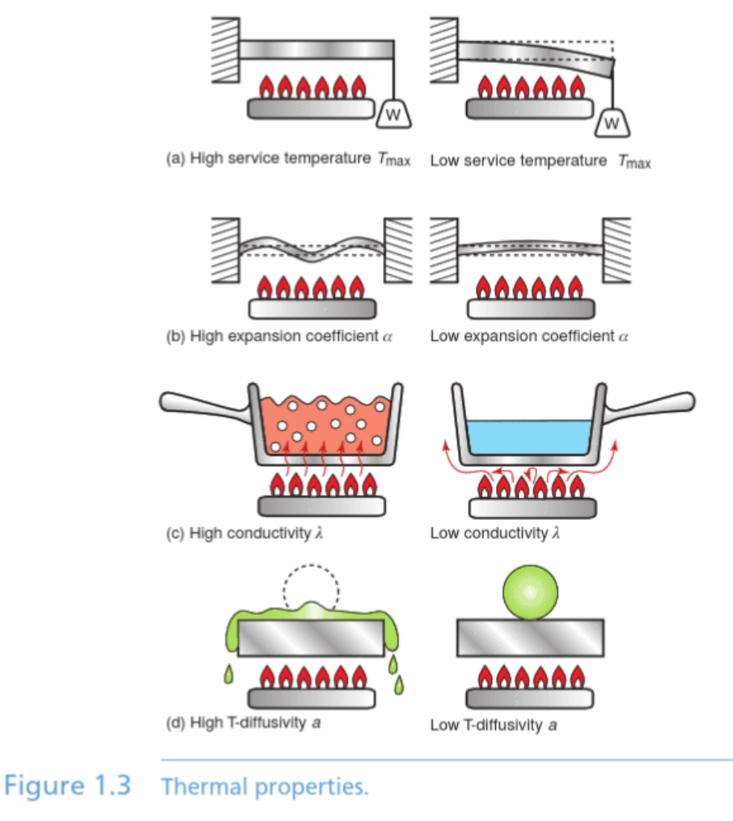
Thermal Properties
There is a subtler property that describes what happens when heat is first applied. Imagine lighting the gas under a cold slab of material with a ball of ice-cream on top. First the bottom of the slab gets hot but the rest is cold, then the middle gets hot and finally the top warms up and the ice-cream starts to melt. How long does this take?
For a given thickness of slab the time is inversely proportional to the thermal diffusivity of the material of the slab. It differs from conductivity because materials differ in their heat capacity, in fact it is proportional to λ/ C_{p}

Slide 10
Electrical, Magnetic and Optical Properties
Without electrical conduction, we would not have the light, heat, power, control and communication that we have today. Copper and Aluminium are the best affordable conductors. But fuse boxes, switch casings and the suspensions for transmission lines require insulators that can also carry some load, tolerate heat and survive a spark. What we need is high resistivity, ρ_{e}, the inverse of electrical conductivity, κ_{e}. Plastics and glass have high resistivity, and are used as insulators (but can be made to conduct). The ability to allow the passage of microwave radiation (like the radome) or reflect them (like the passive reflector of the boat has to do with dielectric properties, particularly the dielectric constant, ε_{D}. Materials with high ε_{D} respond to an electric field by shifting their electrons about, or even reorienting their molecules; those with low ε_{D} are immune to the field and do not respond.

Slide 11
The Dielectric Constant
The Dielectric Constant, or permittivity (the amount of charge needed to generate one unit of electric flux in a particular medium) - ε - is a dimensionless constant that indicates how easy a material can be polarized by imposition of an electric field on an insulating material. The constant is
the ratio between the actual material ability to carry an alternating current to the ability of vacuum to carry the current
The dielectric constant can be expressed as
ε = ε_{s} / ε₀ (1)
where
ε = the dielectric constant
ε_{s} = the static permittivity of the material
ε₀ = vacuum permittivity
The Dielectric Constant of common fluids are indicated in the table below. The Dielectric Constant is in general influenced by
temperature
moisture levels
electrical frequency
part thickness

Slide 12
Magnetism
Electricity and magnetism are closely linked. Electric currents induce magnetic fields; a moving magnet induces in any nearby conductor an electric current. The response of most materials to magnetic fields is too small to be of any practical value but a few called ferro magnets and ferrimagnets have the capacity to trap a magnetic field permanently. These are called hard magnetic materials because once magnetized they are hard to demagnetize. They are used as permanent magnets in headphones motors and dynamos. Here the key properties is the remanence, a measure of the intensity of the retained magnetism. A few others soft magnetic materials are easy to magnetize and demagnetize. They are the materials of transformer cores and the deflection coils of a TV tube. They have the capacity to conduct a magnetic field, but not retain it permanently. For these a key property is the saturation magnetization, which measures how large a field the material can conduct.
Materials respond to light as well as to electricity and magnetism, hardly surprising since light is an electromagnetic wave. Materials that are opaque reflect light those that are transparent refract it and some have the ability to absorb some wavelengths(colours) while allowing others to pass freely.

Slide 13
Chemical Properties
Products have to function in hostile environments, exposed to corrosive fluids, hot gases or radiation. Damp air is corrosive, so is water the sweat of your hand is particularly corrosive and there are more aggressive environments than these. If the product is to survive it must be made of or coated with materials that can tolerate the surroundings in which they operate, fresh and salt water, acids, alkalis, organic solvents, oxidizing flames and ultraviolet radiation.

Slide 14
Design Limiting Properties
The performance of a component is limited by certain of the properties of the materials of which it is made.
The values of design limiting properties must meet targets for performance. Eg for an aeroplane, stiffness, strength and toughness are design limiting, if any one of them are too low the plane won’t fly.
In the design of power transmission electrical resistivity is design limiting. In the design of a camera lens it is optical quality and refractive index.
Processes too have properties.
Engineering design depends on materials that are shaped joined and finished by processes. Design requirements define the performance required of the materials. A material is chosen because it has properties that meet the targets and is compatible with the processes.

Slide 15
Questions
What are the units for the properties listed?
What is a design-limiting property?
Research the history and uses of either tin, glass, cement, titanium or carbon fibre
There have been many attempts to manufacture a plastic bicycle. All have been too flexible. Which design-limiting property is insufficiently large?
What are the design limiting properties for the material for the blade of a knife that will be used to gut fish?
What are the design limiting properties for the material of an oven glove?
What are the design limiting properties for the material of an electric lamp filament?
A material is needed for a tube to carry fuel from the fuel tank to the carburettor of a motor mower. The design requires that the tube can bend

Slide 18
Materials : Engineering, Science, Processing and Design by Michael Ashby, , Hugh Shercliff, , and David Cebon
Publisher Elsevier Science & Technology
Date 2007-02-13

