Slide 1

Breakfast Clubs
Week 3 - Tuesday

Slide 2
Learning Outcomes:
Explain how breakfast-club models and policy arrangements differ.
Critically assess evidence about diet, attainment, attendance, behaviour, social experience and family support.
Compare perspectives from children, families, schools, policymakers and researchers.
Apply equity, implementation and evaluation concepts to a policy choice.
Make a reasoned recommendation while acknowledging uncertainty and trade-offs.

Slide 3
Decisions!! what counts as success?
Choose your top two. Which outcomes could conflict, and whose priorities should guide the answer?
Reduce hunger or improve diet quality.
Help children feel ready to learn; improve attainment or classroom experience.
Support family routines, work and childcare.
Improve social connection, wellbeing or belonging.
Reduce inequality and make access fairer.

Slide 4
What is a breakfast club?
Definition:
What are breakfast clubs?
Recent UK policy expansions (universal primary provision)
Aims today: Critically analyse benefits, challenges, and impact
Links:
DfE Guidance
https://www.gov.uk/government/publications/breakfast-clubs-early-adopter-guidance-for-schools-and-trusts-in-england/breakfast-clubs-early-adopter-guidance-for-schools-and-trusts-in-england
Children’s Wellbeing Bill
https://www.theyworkforyou.com/pbc/2024-25/Children’s_Wellbeing_and_Schools_Bill/07-0_2025-01-30b.249.2

Slide 5
What is a breakfast club?
Before-school club: supervised provision before the formal school day.
Classroom breakfast: food is served in classrooms, sometimes during registration.
Grab-and-go: food is available for pupils to take and eat flexibly.
Mixed model: more than one delivery format in a school or programme.
Food provision, childcare and a social start to the day overlap…but are not identical.

Slide 6
The UK is not one policy system - Devolution
England: phased free breakfast-club programme; government reported more than 2,700 schools from September 2026.
Wales: a separate Free Breakfast in Primary Schools scheme; guidance distinguishes breakfast provision from childcare.
Scotland: universal primary breakfast-club offer planned from August 2027.
Northern Ireland: different local and policy arrangements; do not assume England’s programme applies.

Slide 7
Task 1: One service, different meanings
DISCUSS
What might a breakfast club mean to a child, parent/carer, school staff member, policymaker and researcher?
Choose two stakeholder groups.
Name one priority and one concern for each.
Identify one tension between perspectives.
Notes:
A child may value friendship, choice or a calm start
A parent may value reliable morning support
Staff may focus on safe, manageable delivery
Policymakers may prioritise reach and cost
Researchers may ask whether outcomes can be attributed to the programme.
These are perspectives to investigate further…

Slide 8
Why has the issue become prominent?
Policy rationales include food access, readiness to learn, family morning routines and childcare support.
England’s programme is linked in government guidance to tackling child poverty and helping children achieve and thrive.
These are policy intentions, not proof that a particular scheme achieves them.
A strong evaluation begins by making programme aims explicit.
Key distinction: policy intention ≠ observed outcome ≠ causal impact.

Slide 9
Benefits of Breakfast Clubs – what does the research say???
Resources on Moodle…

Slide 10

Benefits of Breakfast Clubs
Improved attendance, punctuality, attainment, wellbeing
Nutritional support & social interaction
Evidence from case studies and government research
https://www.gov.uk/government/case-studies/benefits-of-breakfast-clubs
https://www.nutrition.org.uk/news/the-importance-of-breakfast-for-school-children/
https://pmc.ncbi.nlm.nih.gov/articles/PMC4457018/
'Life-changing' breakfast club could be extended
https://www.bbc.co.uk/news/articles/c9wr1dq7rwjo

Slide 11
Which outcomes have been studied?
Nutrition: food consumed, breakfast quality and breakfast skipping.
Education: attainment, readiness to learn, memory or concentration.
Participation: attendance, punctuality and engagement.
Wellbeing: behaviour, relationships, belonging and pupil experience.
Family outcomes: morning routines, costs, work and childcare.
Access: who is offered a place, who attends, and who is left out.
One programme may affect some outcomes and not others…measure what it actually aims to change.

Slide 12
Discuss the following statement…
‘Breakfast clubs improve attainment.’
Rewrite this as a claim that is defensible given the evidence.
Specify pupils, delivery model and attainment outcome.
Separate an individual study finding from a general claim.

Slide 13
What evidence would make you more confident (or more cautious) about using public funds to support breakfast clubs?

Slide 14
Issues…
Some evaluations report positive attainment findings for particular models or age groups, but results are not uniform and should not be generalised to every programme.
The revised Magic Breakfast evaluation reported a Year 2 finding but no Year 6 attainment impact.
A 2026 English analysis of earlier schemes reported modest average attainment effects.
These are different evaluations, not interchangeable estimates.

Slide 15
https://www.gov.wales/healthy-eating-schools-regulations-2025-statutory-guidance-local-authorities-and-governing-bodies
Welsh Government (2025)
Wales has had a Free Breakfast in Primary Schools scheme for years; it is different from England’s newer national breakfast-club rollout.
In Wales, maintained primary schools can provide a free breakfast before the school day, and the legal framework requires the local authority to arrange provision if a school requests it, subject to the statutory conditions.
The scheme is not childcare: children are supervised while eating, but any earlier wraparound-care session is separate and may be chargeable.
A significant current change is about what schools serve, rather than a new breakfast-club rollout.
New Welsh nutritional regulations for maintained nursery and primary schools come into force on 31 October 2026.
For school breakfast, they require options from four categories: plain milk or plant-based drinks, cereals, fruit and vegetables, and breads with reduced-fat spreads. They also restrict foods such as confectionery and savoury snacks

Slide 16
Wales: What is going on in terms of breakfast club provision?
Murphy et al. (2010)
The study evaluated the impact of a national school programme of universal free healthy breakfast provision in Wales, UK.
A cluster randomised controlled trial with repeated cross-sectional design and a 12-month follow-up. Primary outcomes were breakfast skipping, breakfast diet and episodic memory. Secondary outcomes were frequency of eating breakfast at home and at school, breakfast attitudes, rest-of-day diet and class behaviour.
Setting: Primary schools in nine local education authority areas.
A total of 4350 students (aged 9–11 years) at baseline and 4472 at follow-up in 111 schools.
Results: Students in intervention schools reported significantly higher numbers of healthy food items consumed at breakfast and more positive attitudes towards breakfast eating at 12 months.
Parents in intervention schools reported significantly higher rates of consumption of breakfast at school and correspondingly lower rates of breakfast consumption at home. No other significant differences were found.
The intervention did not reduce breakfast skipping; rather, pupils substituted breakfast at home for breakfast at school.
However, there were improvements in children’s nutritional intake at breakfast time, if not the rest of the day, and more positive attitudes to breakfast, which may have implications for life-course dietary behaviours.
There was no impact on episodic memory or classroom behaviour, which may require targeting breakfast skippers.

Slide 17
Identify the strengths and limitations of the current situation in Wales…

Slide 18
Key Issues and Challenges
Financial viability: funding gaps, cost concerns, staff workload
Access and equity: stigma, dietary/SEND needs, operational barriers
Impact uncertainty: mixed research outcomes
Links:
Schools Withdraw https://schoolsweek.co.uk/79-schools-withdraw-from-breakfast-clubs-trial/
TES Teacher’s Concerns https://www.tes.com/magazine/news/primary/schools-worries-about-free-breakfast-clubs-lack-of-funding
SEND Inclusion https://www.schoolfoodmatters.org/news-views/blog/how-ensure-breakfast-clubs-meet-needs-send-children

Slide 19
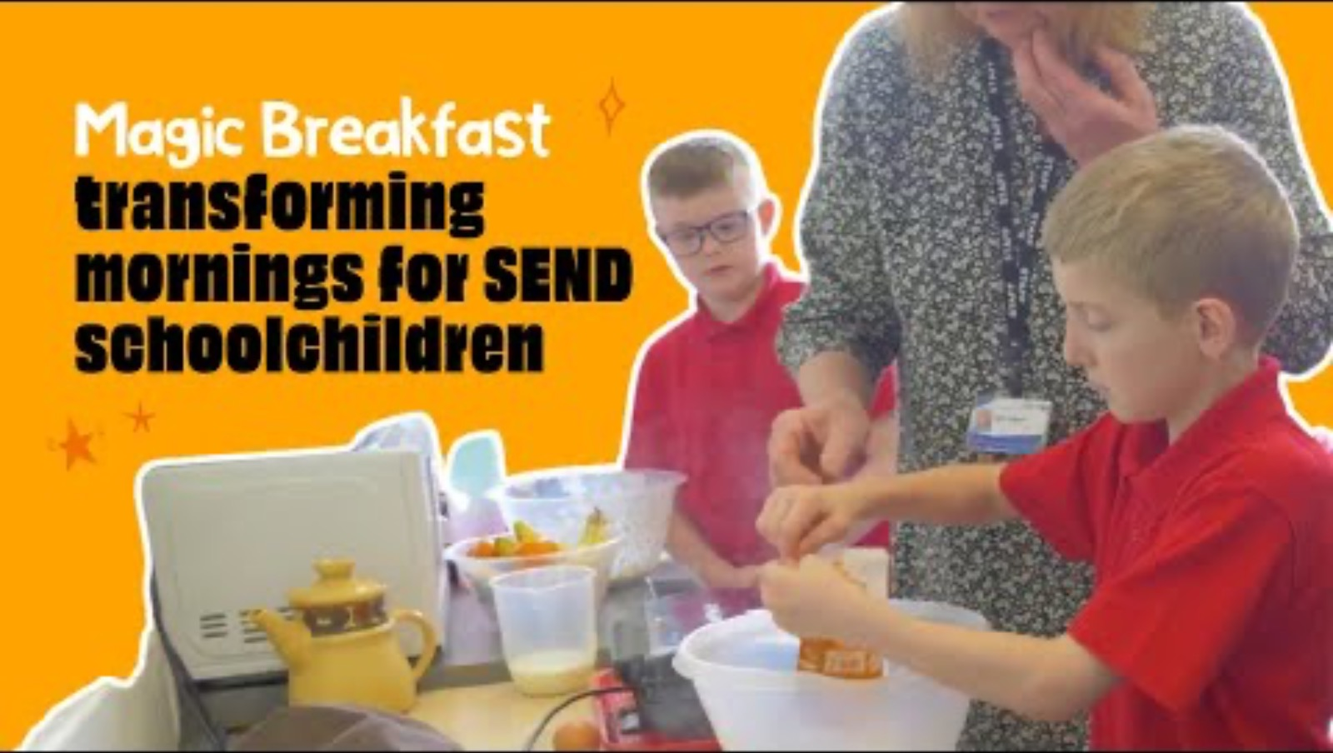
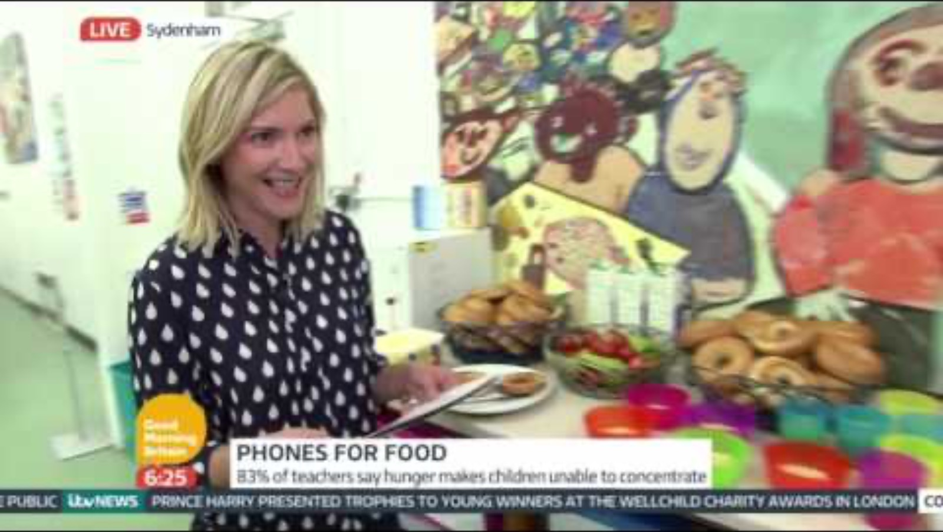
Key Issues and Challenges Uk:
https://www.magicbreakfast.com/
Magic Breakfast: SEND Inclusion
Lisa Faulkner: How Breakfast Clubs Help Kids

Slide 20
Policy, Practice and Debate
Parliamentary and policy initiatives (universal access, early adopters)
Are breakfast clubs sustainable at scale?
Points for debate: efficacy, inclusion, government responsibility
Links:
Labour Rollout
House of Lords Debate:
https://contact.org.uk/about-contact/news-and-views/contact-speaks-in-house-of-lords-as-breakfast-clubs-launch/

Slide 21

Policy, Practice and Debate: Eamonn Holmes Debate

Slide 22
Arguments presented…
Parental Responsibility: Holmes strongly argues that feeding children should be the “basic primary parental responsibility.” He questions why parents “can’t give their kid some toast in the morning” and suggests relying on the state to feed children erodes essential parental duties.
Limits of State Provision: He expresses concern that if the state continues to take on roles traditionally held by families, it becomes a slippery slope, asking, “where does it stop in this country?”
Use of Taxpayer Money: He questions the justification for public funding of breakfast clubs, especially when politicians claim there is no money, yet always “find money to do other things like this.”
Societal Change Critique: Holmes hints at a wider political agenda, claiming governments (especially Labour) prefer the state to look after children rather than parents, reflecting distrust of more interventionist policies.

Slide 23
Counterarguments…
Addressing Child Poverty: The guest points out that a significant share of UK teachers spend their own money on food for children in need, highlighting the scale of hunger in schools and arguing this justifies state intervention.
Pragmatism Over Ideology: She says the pilot is a response to real needs, not a philosophical attempt to diminish parental roles, and emphasizes the importance of ensuring all children have enough food to learn.
Benefits for Working Parents: The breakfast clubs also provide valuable childcare—saving families up to £450 a year—which can help parents to work and balance family life.
Societal Responsibility: While agreeing that parental responsibility is ideal, she argues the state must step in where children “aren’t being fed,” aligning this with a basic duty of a responsible society.

Slide 24
“Are breakfast clubs financially viable and inclusive for all pupils?”
What improvements would you recommend for policy and practice?

Slide 25
Read a study critically
Intervention: What exactly was offered—food, a club, childcare, or a combined package?
Population: Which ages, schools and communities were included?
Outcome: What was measured, by whom and over what period?
Comparison: What might have happened without the offer?
Inference: Does the design support description, association or a causal claim?
Implementation: Was the service used as intended, and by whom? (availability and actual attendance or usage)

Slide 26
Further Online Resources and Reading
Magic Breakfast Charity
https://www.magicbreakfast.com/childrens-wellbeing-and-schools-bill-what-you-need-to-know/
Food Active Policy Analysis
https://foodactive.org.uk/the-first-in-line-the-breakfast-clubs-early-adopters-scheme-explained/
DfE Blog: Free School Breakfast Clubs
https://educationhub.blog.gov.uk/2025/09/free-school-breakfast-clubs/
School Food Matters
https://www.schoolfoodmatters.org/news-views/news/free-school-meal-access-takes-centre-stage-parliamentary-debates

