Slide 1
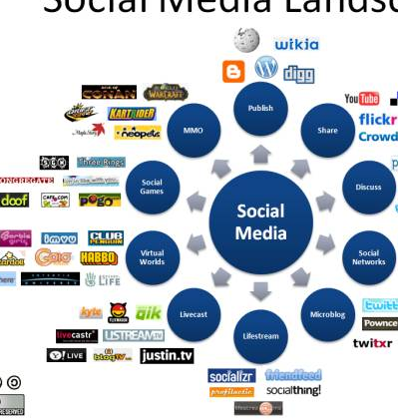
Social Media in
Project Management

Slide 2
How do I know?
Past experience and importantly current involvement in project management.
Professional activities with the BCS Project Management Specialist Group and the BCS Best Practices User Group.
UK and Welsh Gov project involvement.

Slide 3
Points to Consider
Project Managers spend the majority of their time communicating?
The ability of a project manager to successfully deliver a project is directly proportional to their ability to effectively communicate with stakeholders?
Social media presents an opportunity for improving that communication?

Slide 4
Some Basics
Communications delivered through social media are potentially a valuable resource for developing trust between project team members.
Trust, communication, relationships – why are these important in project management?

Slide 5
Social Media, Business & Projects
Social media is affecting the way people communicate, develop relationships and build trust in home and work settings.
What began as a set of tools for friends to stay connected has evolved into a means for businesses to communicate internally/externally.
Social media is changing the way we communicate, thus affecting the processes involved with information services supporting project management

Slide 6
Social Media, Business & Projects
Managing relationships to build trust is especially important for projects managers, because it is becoming increasingly common for project team members to be distributed.
A lack of physical contact makes it more difficult to establish strong relationships that lead to high levels of trust, making the communication process more challenging (Grabner &Kaluscha, 2003).

Slide 7
Social Networks & Social Media
Social media is transforming consumer behaviours and business communication patterns. The growth of social media platforms such as Facebook and its equivalents have been well documented.
A 2009 survey by McKinsey of 1700 executives worldwide showed that about 64% of these companies were using social media for effective internal communications (Culnan et al., 2010).

Slide 8
Social Media and Lewin’s Model of Change Management
Driving Forces:
  Information can become more searchable and sharable.
  Can help with innovation and creativity.
  Builds involvement
  Builds community
Restraining Forces:
  Organisational lack of understanding of the benefits of social media for projects.
  Organisational Culture
  Slow adoption of new tools.

Slide 9
Conclusion
Project management requires communication practices that go beyond transaction confirmation to include managing relationships, building trust, and managing stakeholder expectations.
It’s likely that project managers can enhance the communication effectiveness of teams by incorporating social media.
It’s important for project managers to understand the relationships among communication practices, trust development and the affect that social media have on them as they apply to their projects.

