Slide 1


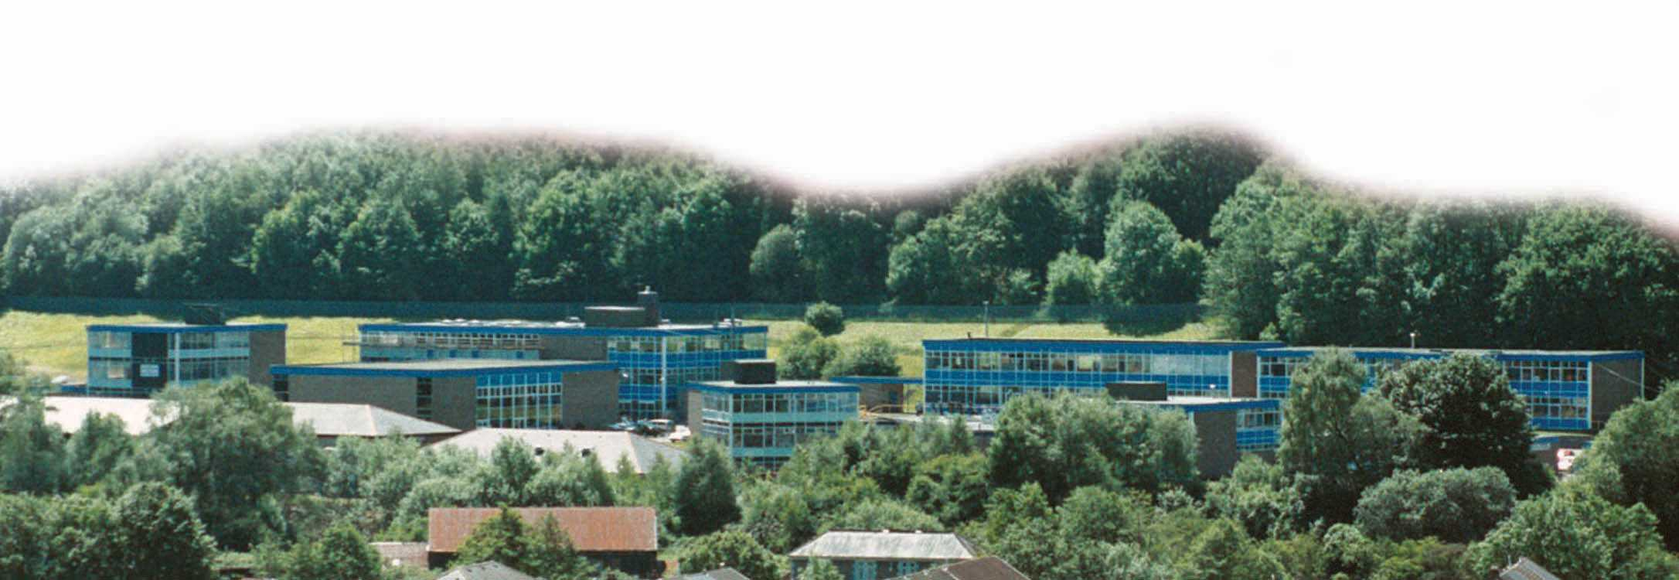
ITE
Treorchy Network
Bridging 1

Slide 2

Ice Breaker
Two Truths and a Lie

Slide 3
Agenda

Slide 4
The Credible Teacher
What three examples did you choose on Day 1
https://www.youtube.com/watch?v=omPdemwaNzQ

Slide 5
Day 1 Feedback
WWW
EBI

Slide 6
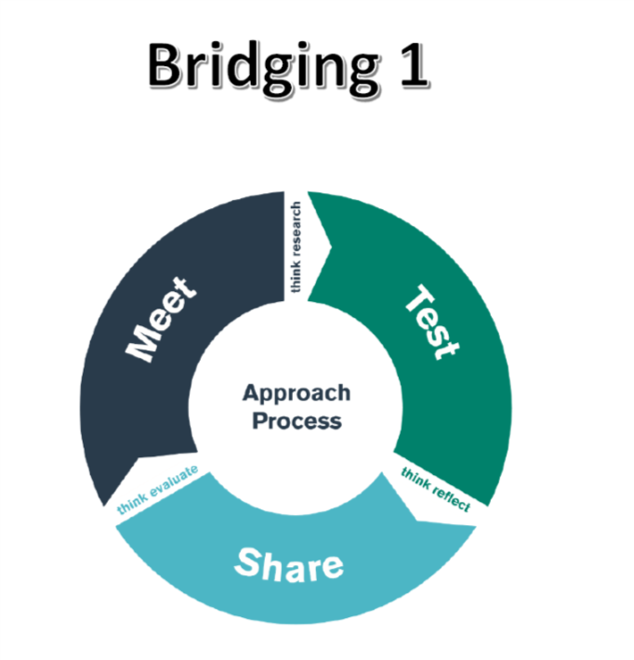
Bridging Work
Tomorrow & 2nd Oct ‘19
TODAY
Oct 3rd ‘19
Notes:
Elaine go through student diet

Slide 7
Outlining the purpose, aims and outcomes of Bridging 1.
Link theory to practice (ECAD6007)

Slide 8
Lesson Observation Expectations

Slide 9
Mary raised her hand to sharpen her pencil
Incident
Describe incident. Suggest explanation and the meaning within the immediate context.
It is the way she is supposed to ask the teacher if she can do so.
It means that Mary is conforming to the class rule.
Critical
Incident
It is an example of the limits to student autonomy.
Find a more general meaning and classification / significance of incident.
Position: I think students should be more independent
Adapted from Tripp, 2012
Notes:
Explain here how something trivial can lead to deep analysis.

Slide 10
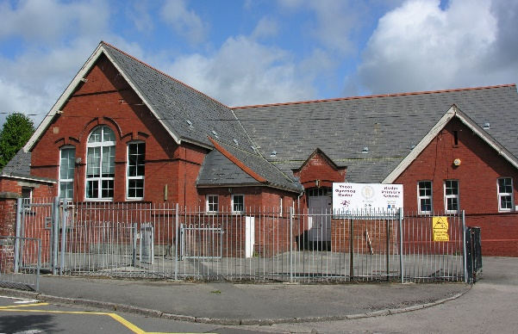
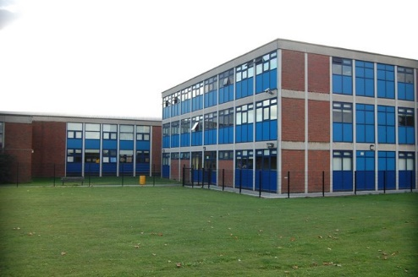
BRIDGING
ECAD6007-C
Observations
What am I looking for in this observation?
ADAPTED FROM
Fletcher-Wood (2016: 125)
Classroom culture: Are the students focused on learning?
Objectives: Is there a clear purpose to the lesson? How do the lesson activities promote that purpose?
Direction: Are the students clear about what they are doing and how to do it well?
Access and challenge: Are all students able to engage in the lesson? Are all students challenged? Assessment: How does the teacher assess student understanding before, during and after the lesson? How is this used in their teaching?
Specifics: Are there particular telling moments and examples which it would be helpful to discuss?

Slide 11
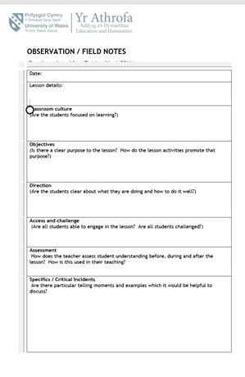
Observation / Field Notes
Adopt a neutral tone and be ‘tentative’ and respectful in your language.
For every lesson, there may be a number of critical incidents you identify. Choose one of these for the focus of your ARC.
Submit 4 Observation sheets.
4
Sheets
Notes:
This is what they’ll need to submit and do in lessons. Using questions on previous slide to structure observation.

Slide 12
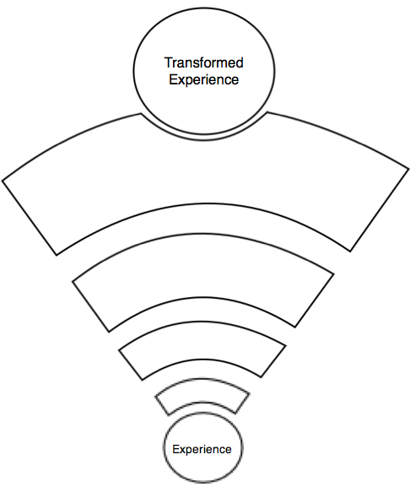
Assisted Reflective Conclusions Model (ARC)
Evaluate and analyse
“What could be kept the same to ensure effective teaching and learning in the future?”
Feelings
“What are your feelings regarding the incident?”
Conclusions
Actions
Connect to theory
Conclusions and actions
“What are your possible solutions to the issue identified?”
“What could be done next?”
Evaluate + Analyse
Remember and Understand
“Can you list the aspects of the incident in the context of learning?”
Identify causes
Remember + Understand
Contextualise
Feelings
Teacher
Learner
Notes:
The model has also been designed with width. One side focusing on the learner, the other the teacher. This is to prompt the trainee to have a balanced approach to their reflection. One piece of ARC reflection will focus on the learner throughout the chosen experience. The next should focus on the student-teacher as the teacher.

Slide 13
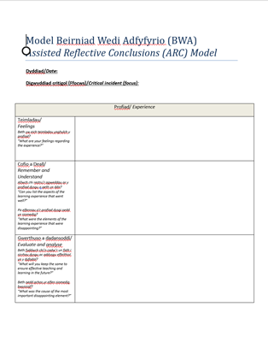
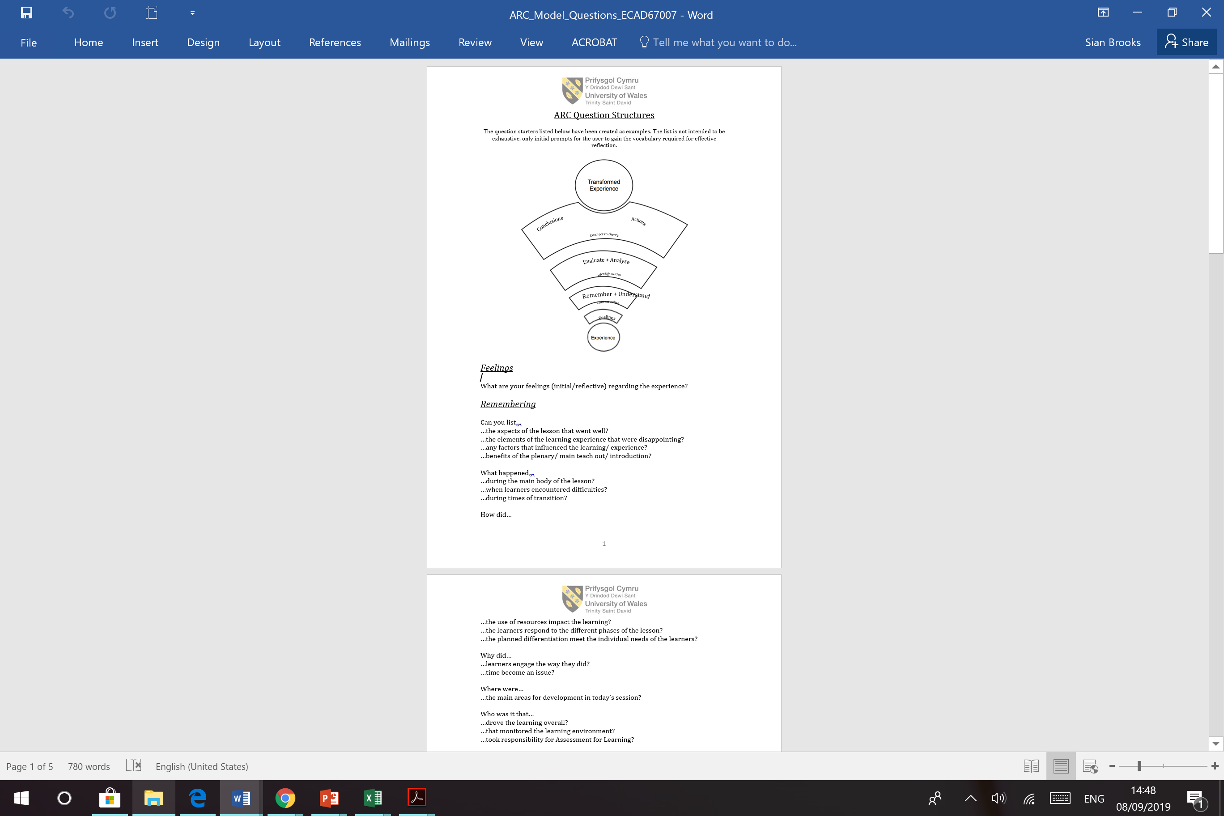

4 Critical Incident
Reflection sheets
Use question
prompts
Notes:
Talk through the 4 Critical Incident sheets they will fill in.

Slide 14
QTS
Add MORE HERE
Exceeding Expectations
On track
Not on track
Cause for Concern

Slide 15
Introduction to Effective Observation.

Slide 16
Effective Observations
Bridging 1
Meet
25/09/19

Slide 17
Session’s aims
By the end of this session you will have learnt:
Some effective observation techniques you’ll be able to use in your own observations.
The impact these techniques can have on teaching and learning.

Slide 18
Tomorrow (26.09.19)…
You will
Observe an experienced teacher at their work.
Observe the teacher’s skills.
Focus on a particular aspect of teaching and learning that will be discussed today.

Slide 19

Observation challenges
What might you find challenging about observing a lesson?

Slide 20
Giving the observation a specific focus
Here are some things you could focus on in an observation:
Communication
Questioning and Wait Time
The teacher’s movements
These may well form part of a critical incident you may observe.

Slide 21
Mary raised her hand to sharpen her pencil
Incident
Describe incident. Suggest explanation and the meaning within the immediate context.
It is the way she is supposed to ask the teacher if she can do so.
It means that Mary is conforming to the class rule.
Critical
Incident
It is an example of the limits to student autonomy.
Find a more general meaning and classification / significance of incident.
Position: I think students should be more independent
Adapted from Tripp, 2012
Notes:
Explain here how something trivial can lead to deep analysis, and this will be revisited later on in the day.

Slide 22
Observing communication:
Teacher pupils
Some things to consider:
the purposes of communicating e.g. to instruct, persuade, encourage, transmit information
possible barriers to effective communication e.g. linguistic, environmental & physical and how these are addressed
non-verbal means of communication e.g. facial expressions, movement of teacher and pupils
explanations e.g. of key vocabulary, activities to be undertaken

Slide 23
Observing communication:
Pupils pupils
Communication between pupils – sociometry
How about using a Sociogram?
A sociogram is a charting of the inter-relationships within a group. Its purpose is to discover group structure and interactions.

Slide 24
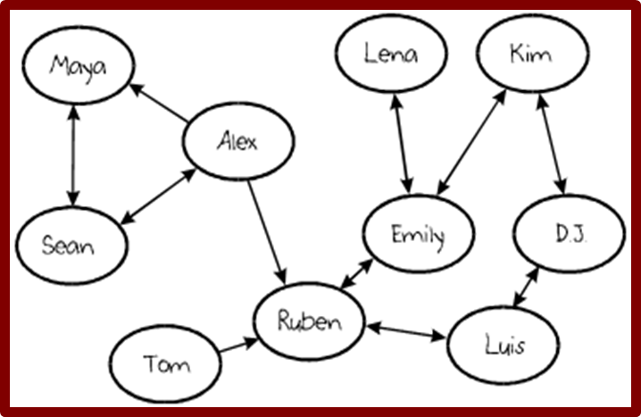
Sociogram

Slide 25
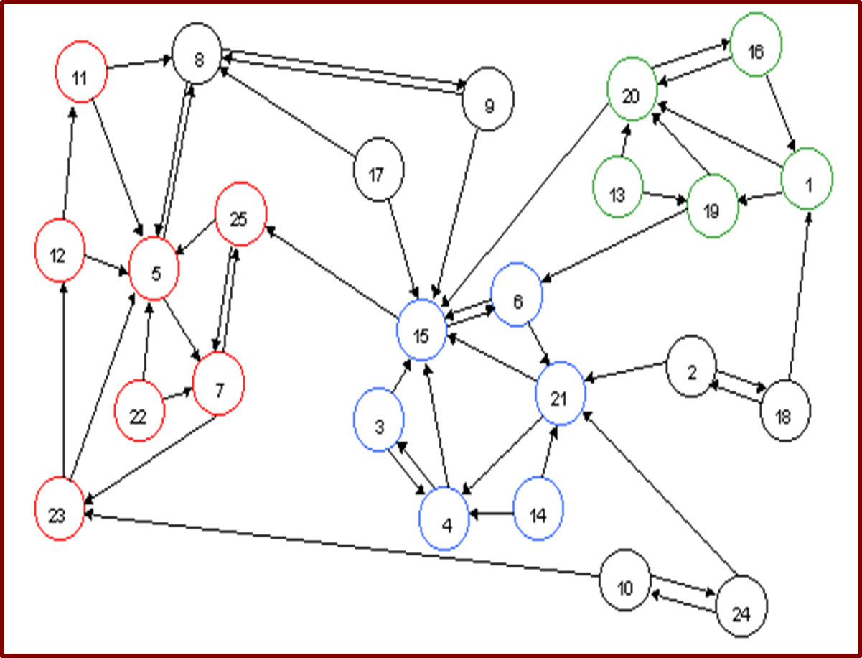

Slide 26

What about non-verbal communication?
Notes:
Verbal Communication – this includes aspects such as volume, projection, pitch, speed, tone, clarity and expressiveness.
Non-verbal Communication – this includes, for example, appearance,
gesture, posture, facial expression and mannerisms, particularly in relation to how you present yourself as a teacher.

Slide 27
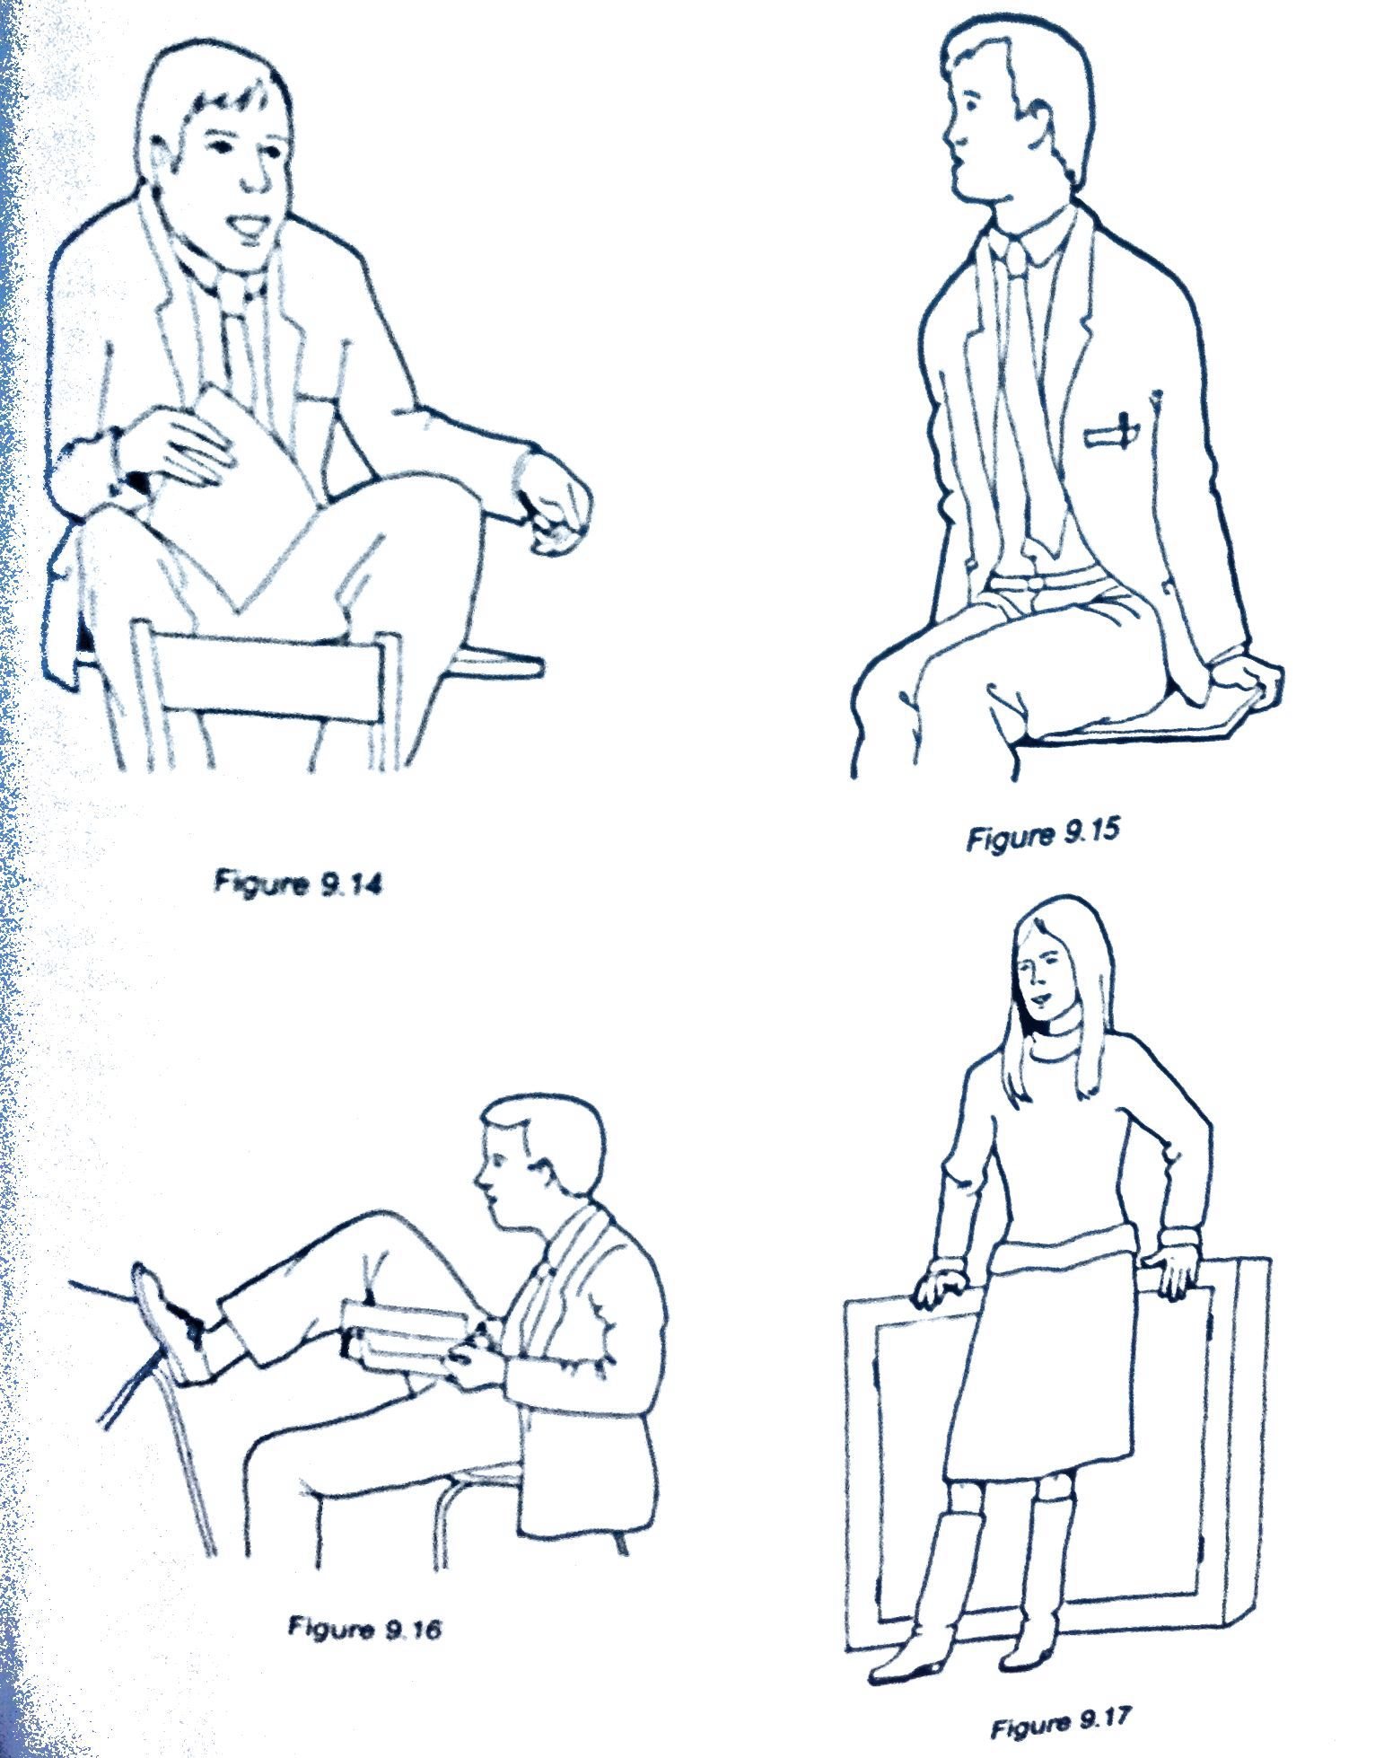

NEILL, S. R. S. J., & CASWELL, C. (1993). Body language for competent teachers. London, Routledge

Slide 28
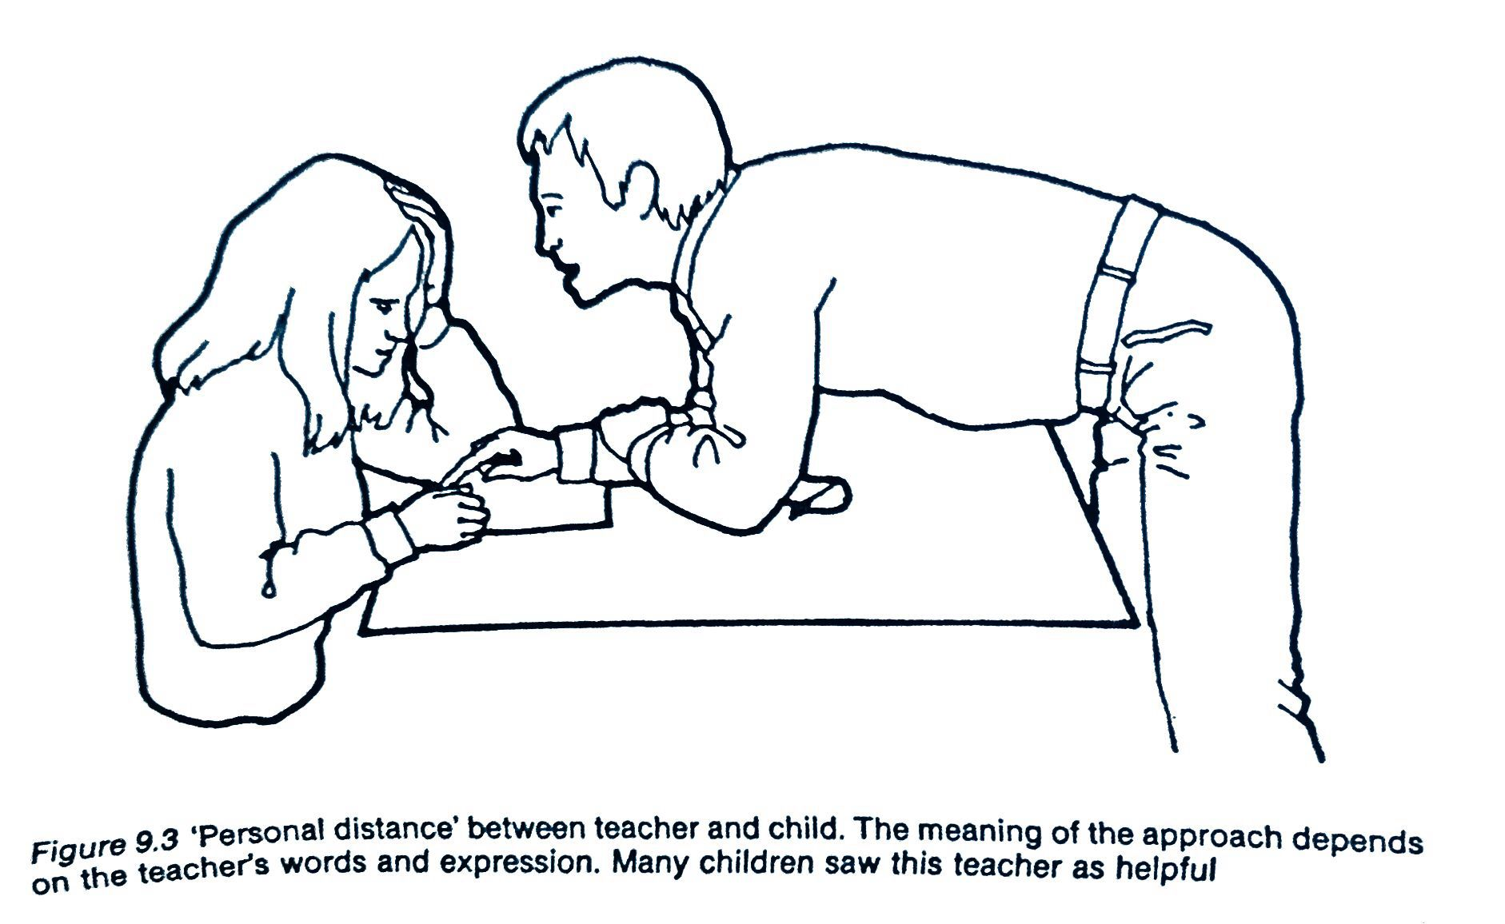
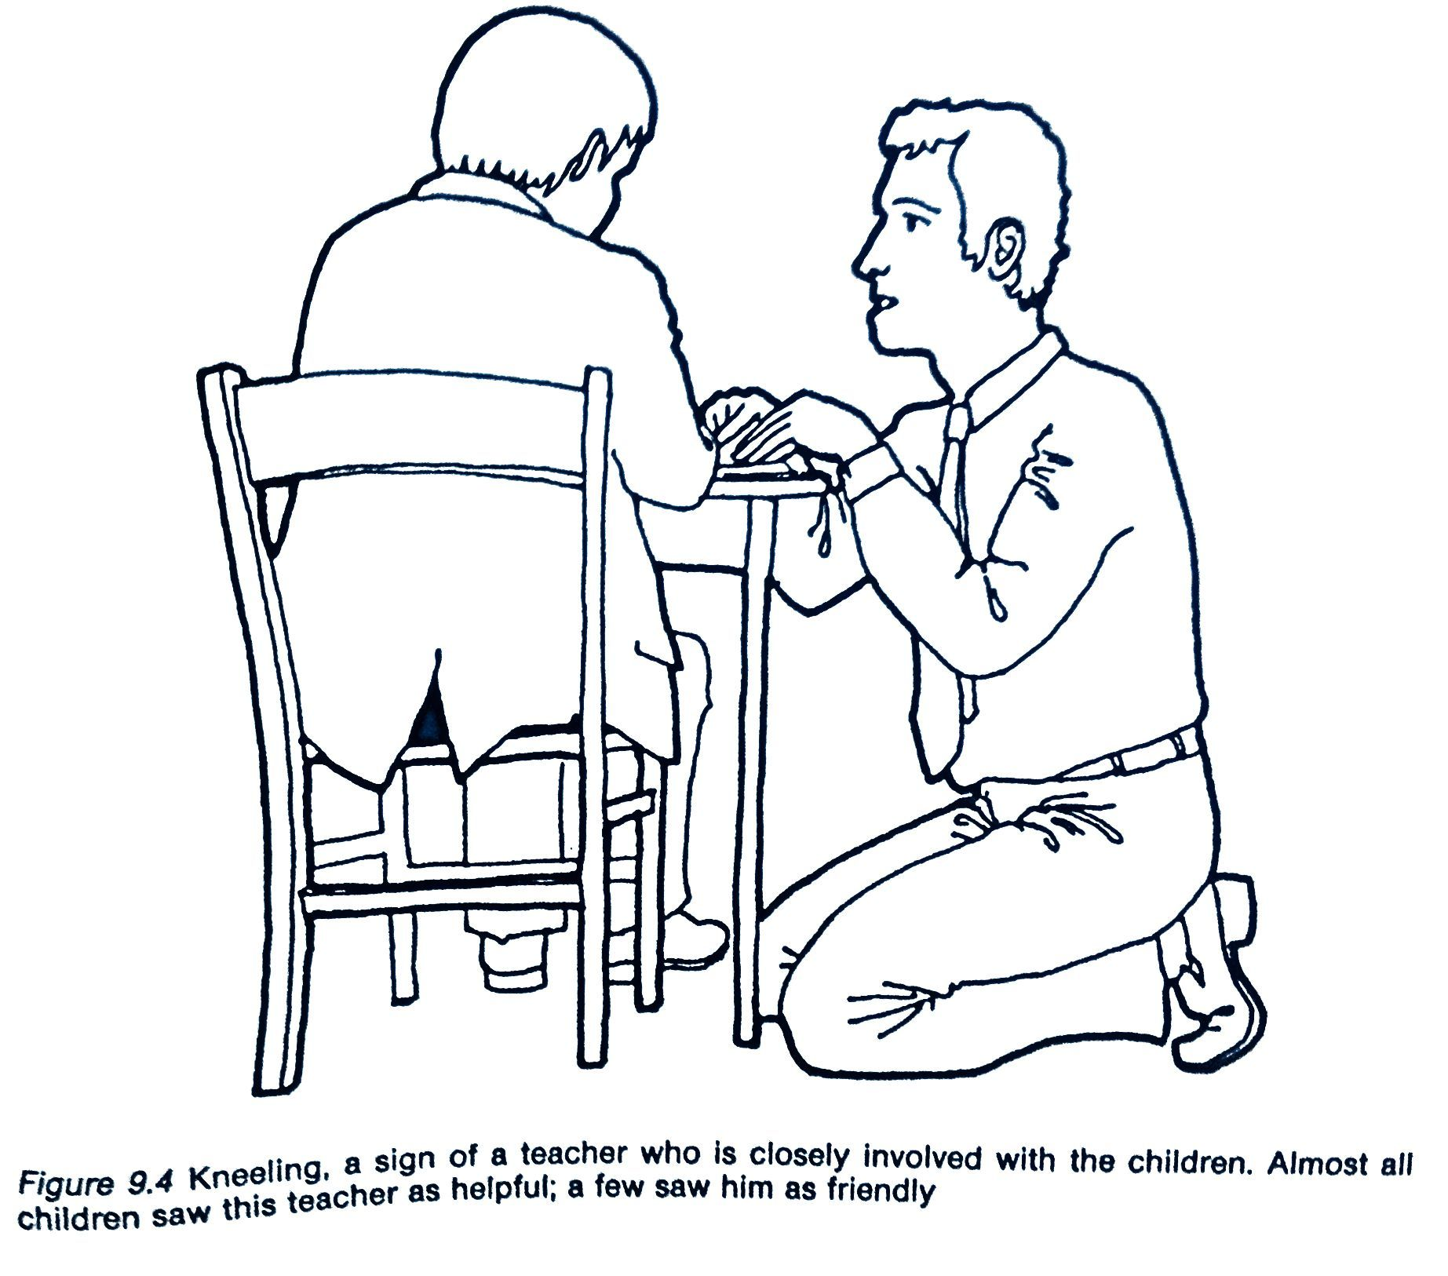
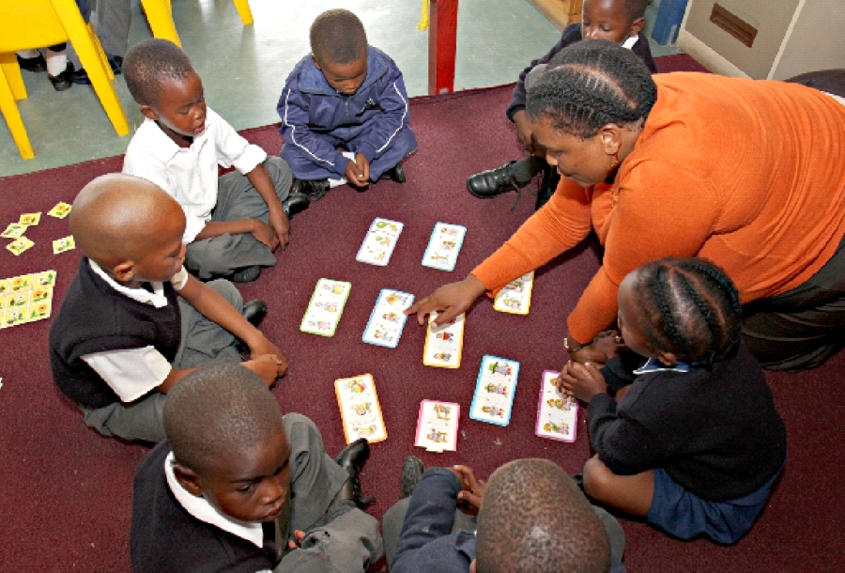

Slide 29
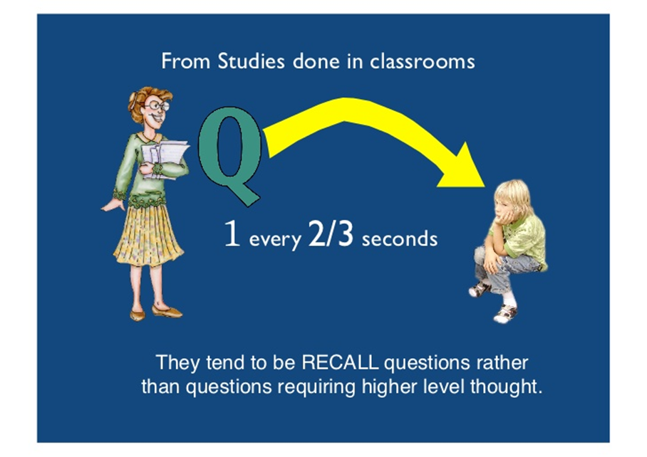
Observing questioning
Questioning skills, e.g. types of question, waiting time.

Slide 30
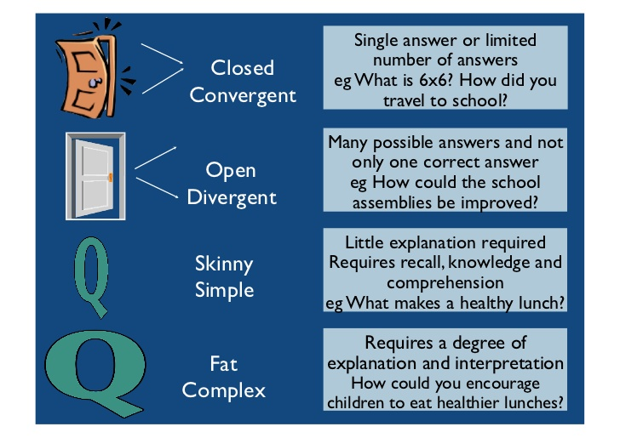
Types of question
Notes:
Wragg (1984) concluded that questioning equates to approximately 30% of teaching and learning time.

Slide 31
Wait Time
The average time teachers give between asking a question and taking an answer is 0.9 seconds.
Rowe (1972) argues that teachers should wait for at least 3 seconds before taking an answer.

Slide 32
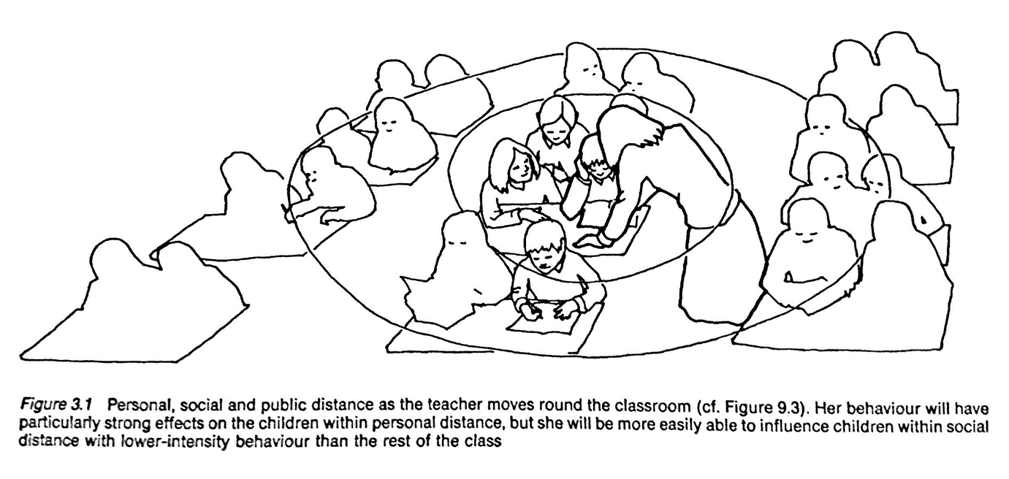
Observing the teacher’s movements
The teacher’s positioning in the classroom affects the teaching and learning.
Notes:
Personal, social and public distance as the teacher moves around the classroom = his/her behavior has a strong impact on children within personal distance, and makes it easier to influence children within social distance.

Slide 33
Positioning
This is a a simple classroom management technique that helps in the distribution of questions around the class. In Fig. 2 are diagrams of a teacher talking to a class whilst standing in two different positions. If she stands as in diagram B, she has a much better view of the group. By moving to a new position relative to the pupil group, the teacher is able to gain a better view of the group. This means that targeting questions to specific pupils is easier, so is watching reactions to questions, and to the answers that other pupils are giving. Control of the group is easier also, should this be necessary.

Slide 34
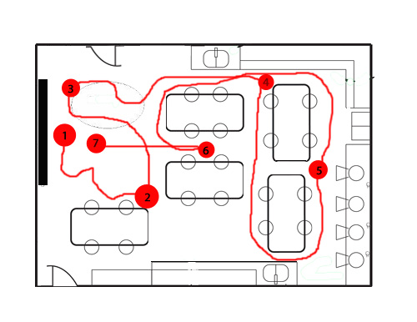
Tracking the Teacher’s Movements
The teacher movement technique is a tracking record of where a teacher positions himself or herself and where the teacher moves throughout the lesson.
Number the teacher’s initial location as 1 and draw a circle around the number. Draw a continuous line from there to the next stop and label it 2 with a circle around it and so on.

Slide 35
Tracking the Teacher’s Movements

Slide 36
BRIDGING 1
ECAD6007-C
Observations
What am I looking for in this observation?
ADAPTED FROM
Fletcher-Wood (2016: 125)
Classroom culture: Are the students focused on learning?
Objectives: Is there a clear purpose to the lesson? How do the lesson activities promote that purpose?
Direction: Are the students clear about what they are doing and how to do it well?
Access and challenge: Are all students able to engage in the lesson? Are all students challenged? Assessment: How does the teacher assess student understanding before, during and after the lesson? How is this used in their teaching?
Specifics: Are there particular telling moments and examples which it would be helpful to discuss?
Notes:
Make links between what has been shown in the previous slides and the categories for observation noted on this slide. Ask student-teachers to note some possible areas they may focus on during their observations.

Slide 37
Observations
Lesson 3 |  | Room
RML (MFL) | Yr7 | 6S1
EGR (Welsh) | Yr7 | 1 04
NJB (Music) | Yr8 | Mu2
MW (Drama) | Yr7 | DS3
AMT (Eng) | Yr9 | 9 53

Slide 38
Break/Egwyl

Slide 39
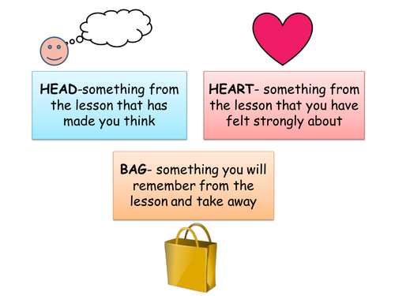
Feedback

Slide 40
Picasso Task

Slide 44
Lunch / Cinio

Slide 45
Lesson Observation 2
Lesson 5 |  | Room
KAC (Eng) | Yr7 | 9 52
KES (Eng) | Yr7 | 9 55
LED (sci) | Yr8 | S2
ANK (Ma) | Yr9 | 217
JN (Ma) | Yr9 | 211

Slide 46
Feedback

Slide 47
Tomorrow !

Slide 48
Plenary

