Slide 1
Component 1: Basil’s Bakery
Student Name: Gull Badeen
Student ID: 2540572
Lecturer’s Name: Annamarie Dufficy
Module Code: LCLM 4004
Module Name: Problem Solving and Decision-Making

Slide 2

What this presentation examines
Today I will examine why a previously successful bakery has not regained sales momentum.
The presentation considers:
  • changes in the local market
  • PESTEL as an external scanning tool
  • a Fishbone Diagram as a diagnostic tool
  • evidence-led findings for Basil

Slide 3
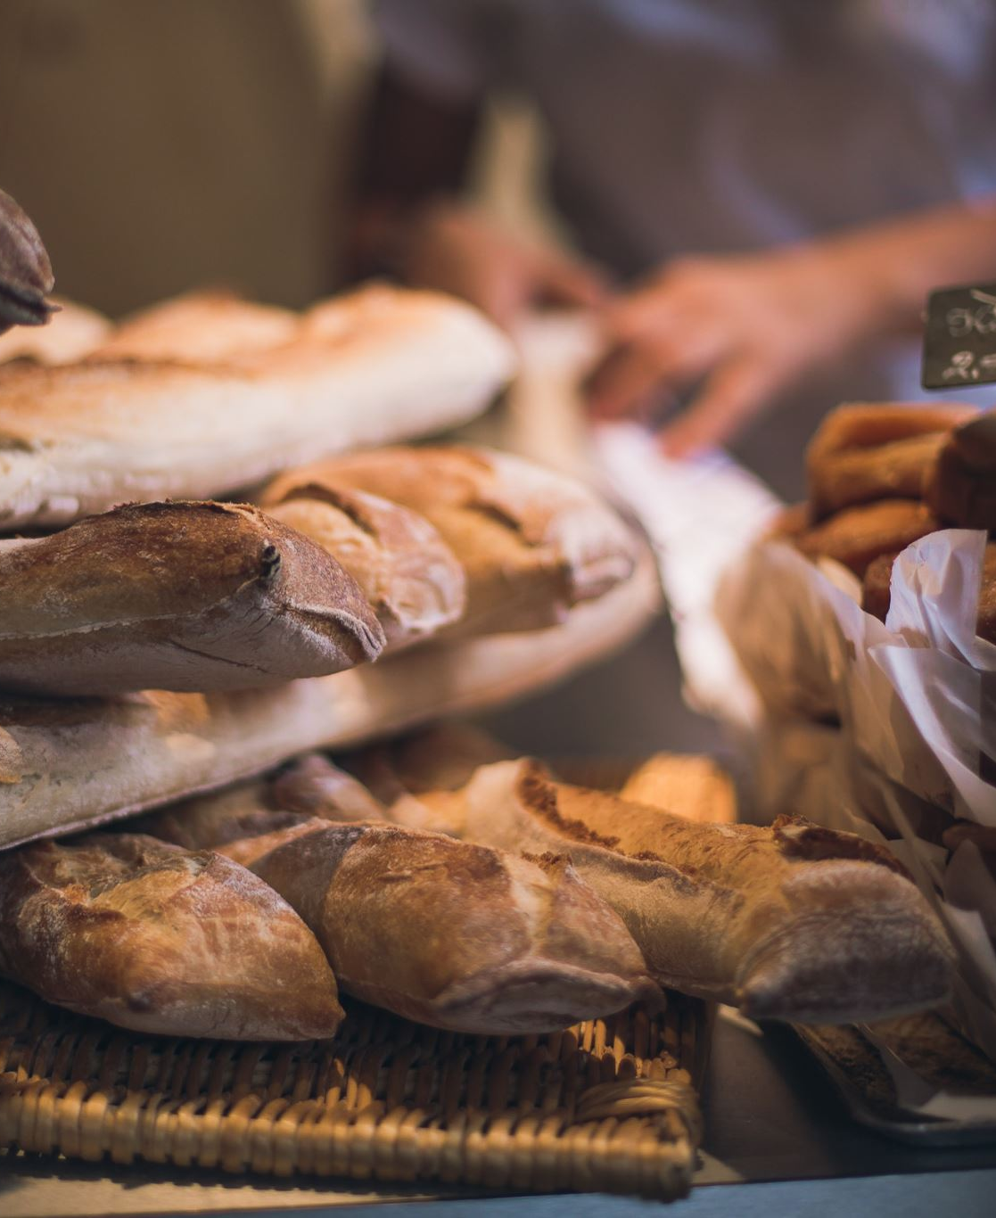
Basil’s Bakery: business position
Basil’s Bakery combines artisan baking with organic ingredients. Its traditional customer base came from three nearby groups: retail-park shoppers, shop staff and workers from the industrial area.
The business performed well until 2019. Since the pandemic, the bakery has experienced lower footfall, a changing weekday customer routine and much higher operating costs. Although sales recovered after lockdowns, they have remained roughly one quarter lower than the 2019 benchmark.
Source: Basil’s Bakery Case Study (2026)

Slide 4
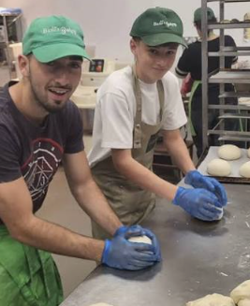
Why sales have failed to recover
Why Have Sales Stagnated?
Sales are around 25% below 2019 levels
External pressures
↓
Retail park is quieter and shops are closing
Hybrid working has reduced weekday customers
Costs of rent, utilities and organic stock have risen
Internal limitations
↓
Business relies on customers visiting in person
No delivery service for former regular customers
Busy-period queues and missed pre-orders lose sales
Impact: Fewer sales + higher costs = reduced profitability
Source: Basil’s Bakery Case Study (2026)

Slide 5
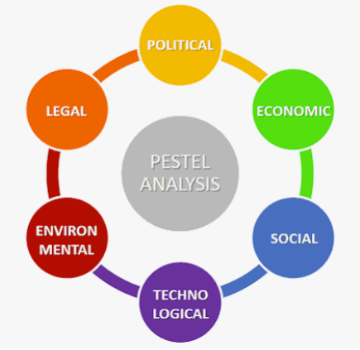
PESTEL as a decision-support tool
PESTEL maps the macro-environment surrounding an organisation. It prompts decision makers to examine public policy, the economy, consumer behaviour, technology, environmental conditions and law.
  Why it adds value
  • keeps external change visible when reviewing business performance
  • provides a common language for discussing risks and opportunities
  • supports early-stage strategic planning
  Critical perspective
  • the framework can produce a long list without identifying priorities
  • it does not explain how factors interact
  • managers need current evidence to avoid assumptions
  Source: Adair (2022)

Slide 6
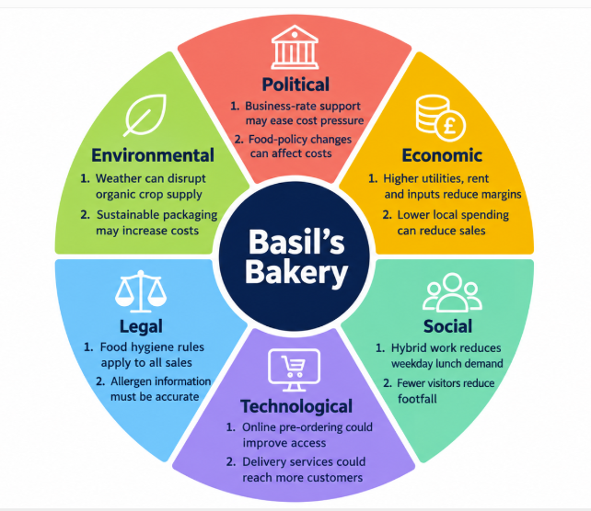
External pressures and openings
Sources: Brooks, Weatherston and Wilkinson (2011); Basil’s Bakery Case Study (2026)

Slide 7
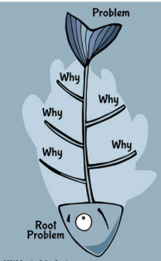
Fishbone Diagram as a root-cause tool
A Fishbone Diagram starts with one outcome and works backwards through categories of possible causes. It is commonly used to investigate recurring service, process and quality problems.
  Strengths
  • makes complex problems easier to discuss
  • prevents a team from focusing on one obvious cause
  • connects operational factors with customer experience
  Limitations
  • it reflects hypotheses, not proof
  • causes may overlap across branches
  • prioritisation requires evidence such as transaction patterns and customer feedback
  Source: Sproull (2018)

Slide 8
Sales stagnation: a root-cause map
Service
Workload
Demand
Peak-time queues
Baking needs onsite time
Home-working days
Pre-order calls missed
One-person capacity
Fewer lunch visits
Sales remain below the 2019 level
Higher supplier prices
No web ordering
Reduced passing trade
Organic stock uncertainty
No delivery option
Shop closures
Inputs
Access
Local area
Sources: Sproull (2018); Basil’s Bakery Case Study (2026)

Slide 9
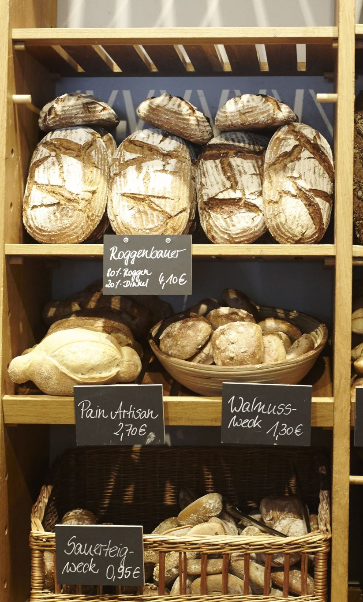
Key findings from the analysis
Basil’s Bakery depends on a local footfall level that no longer exists consistently
Hybrid work has changed when and where former customers buy lunch and snacks
Service capacity and limited ordering channels can convert customer interest into missed sales
The PESTEL and Fishbone analyses both indicate that the problem has multiple connected causes
    Sources: Basil’s Bakery Case Study (2026); Brooks, Weatherston and Wilkinson (2011); Belton and Stewart (2002)

Slide 10
Adair, J.E. (2022) Decision making and problem solving: Break through the barriers and banish uncertainty at work. 5th edn. London: Kogan Page.
Basil’s Bakery Case Study (2026) Assessment case material. Provided by the module tutor.
Belton, V. and Stewart, T.J. (2002) Multiple criteria decision analysis: An integrated approach. New York: Springer.
Brooks, I., Weatherston, J. and Wilkinson, G. (2011) The international business environment: Challenges and changes. 2nd edn. Harlow: Financial Times/Prentice Hall.
Sproull, R. (2018) The problem-solving, problem-prevention, and decision-making guide: Organized and systematic roadmaps for managers. New York: Taylor & Francis.
References

Slide 11

Questions and answers
Notes:
I will answer questions respectfully and relate my response to the evidence in the case and the analysis tools.

