Slide 1
Social Media 2
Marketing in practice

Slide 2

Customer service
73% of customers fall in love with a brand and remain loyal because of friendly customer service reps. (RightNow)
90% of Americans use customer service as a factor in deciding whether or not to do business with a company. (American Express)
According to a study by J.D. Power, 67 percent of consumers have used a company’s social media site for servicing

Slide 3
Some golden rules
Reply quickly
Plan in advance
Find and monitor mentions
Consider a separate social media account for customer care
Create guidelines (what is the TOV, common questions)
Pivot customer to private message when appropriate
Make it personal, consider using your first name

Slide 4
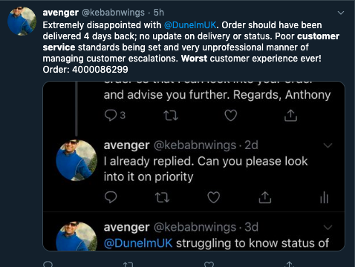
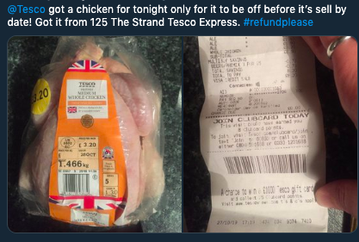
Class exercise

Slide 5
Social storm

Slide 6
Class question?
What do I mean by social storm?
Can you find an example of a social storm?
Why might a social storm be a big deal to a company?

Slide 7
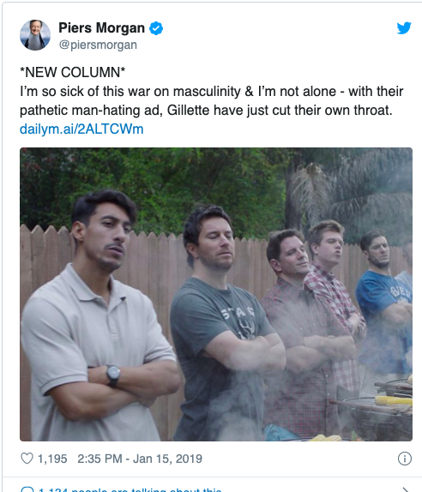
Example
https://youtu.be/koPmuEyP3a0
30 million views online
1.4 million YouTube dislikes
783k likes
Caused a massive stir across social media
Celebrities waded in
#BoycottGillette created

Slide 8
How to weather the storm
Crisis communication plan – please refer to previous lecture notes
Respond quickly
Listen to what is being said
Monitor carefully
Agree responses
Escalate responses to SMT when needed

Slide 9
Influencers – Class question
What is an influencer?
Who do you follow and do they promote any products?

Slide 10
Influencer
Review objective and set goals
Find the right influencer
Research the influencer, do they work on similar brands, what else do they do? How engaged are their followers
Determine cost
Approach
If appropriate consider an influencer agency

Slide 11
Class exercise
Arrange yourselves into 4 groups
You will be researching different type of social media tools and then reporting back to the class
  What does that type of tool do? What functionality might it have?
  What may it be useful for?
  What companies provide it?
TABLE 1 – Social media monitoring tool
TABLE 2 – Content schedule tool
TABLE 3 – Analytics tool
TABLE 4 – Trend/influencer tool (Buzz Sumo)

