Slide 1
Beating a clear path to the
ADHD pathway
A critical reflection of some SEBD issues at a primary school in Neath Port Talbot

Slide 2

"He hasn't got ADHD..."
Previous SLT:
Punitive disciplinary style; Believed in the medical model of ALN; Indeed low regard for ALN in general.
Current SLT:
Holistic approach; Believes in the social model.
Notes:
I chose this topic as it is the main issue I have at my school now. Whilst there has been a change of senior management, from an old regime which believed in a medical model for ALN and a punitive discipline system to a holistic style following a social model for ALN (possibly a Biopsychosocial model?) which is far more supportive of additional learning needs, there is one stumbling block and that is the notion of ADHD.
Picture from VectorStock.com/20000098 Ref for models

Slide 3
ADHD 'didn’t exist until 1994'
1798
Alexander Crichton in 1798. “the incapacity of attending with a necessary degree of constancy to any one object”
1809–1894
Fidgety Phil (Heinrich Hoffmann 1809–1894)
1878–1967
Hyperkinetic disease of infancy (Franz Kramer 1878–1967, and Hans Pollnow 1902–1943)
1970s
In the 1970s emphasis on the attention deficit in affected children.
1987
Attention deficit hyperactivity disorder (1987: DSM-III-R)
1994
Attention deficit hyperactivity disorder (1994: DSM-IV)
Notes:
In 1844, the German physician Heinrich Hoffmann created some illustrated children’s stories including “Fidgety Phil” (“Zappelphilipp”)
In 1932, the German physicians Franz Kramer and Hans Pollnow reported “On a hyperkinetic disease of infancy”
They point out that the symptoms of this “hyperkinetic disease” had previously been observed and described by several authors, but the disorder had not been distinguished from other diseases with similar symptoms, such as the effects of some types of encephalitis. They observed no bodily symptoms, sleep disturbances, or nocturnal agitation, which were specific to the postencephalitic behavior disorder
Very similar to the current concept of ADHD.
In a paper addressed to the Canadian Psychological Association, Douglas argued that deficits in sustained attention and impulse control were more significant features of the disorder than hyperactivity
In addition, these symptoms were the ones showing the best response to stimulant treatment
Early 90s was also a time for changes in Education bills and supplemental security income benefits for ADHD in the US so there were advantages in having a diagnosis more so than just having an explanation for your 'naughty' child. One in three in some parts of the US e.g. North Carolina whereas others e.g. California more in line with the rest of the world at – defies logic

Slide 4
DSM-5 (2013) definition
Symtoms must be present in more than one setting.
There are 3 types: Inattentive; Hyperactive and Combined.
It has to interfere with functioning and development.
In children 6 or more symptoms must be present for at least 6 months to an extent that is disruptive and inappropriate.
Notes:
According to the American Psychiatric Association Diagnostic and Statistical Manual of Mental Disorders, Fifth Edition a.k.a. DSM-5, …
6 or more symptoms needed for children up to age 16 and have been present for at least 6 months to an extent that is disruptive and inappropriate .
ICD- 10 classification (WHO manual)

Slide 5
Inattention
fails to give close attention
has trouble holding attention
does not seem to listen
does not follow through on instructions
has trouble with organization
avoids tasks that require mental effort
loses things
easily distracted
forgetful
DSM-5 (2013)
Notes:
fails to give close attention to details or makes careless mistakes
has trouble holding attention on tasks or play activities
does not seem to listen when spoken to directly
does not follow through on instructions and fails to finish schoolwork
has trouble organizing tasks and activities
avoids, dislikes, or is reluctant to do tasks that require mental effort
loses things necessary for tasks and activities
easily distracted
forgetful in daily activities

Slide 6
Hyperactivity and Impulsivity
fidgets or squirms
leaves seat
runs or climbs
unable to play quietly
"on the go as if driven by a motor”
talks excessively
blurts out answers
has trouble waiting his/her turn
interrupts
DSM-5 (2013)
Notes:
fidgets with or taps hands or feet, or squirms in seat
leaves seat in situations when remaining seated is expected
runs about or climbs in situations where it is not appropriate
unable to play or take part in leisure activities quietly
"on the go" acting as if "driven by a motor”
talks excessively
blurts out an answer before a question has been completed
has trouble waiting his/her turn
interrupts or intrudes on others (e.g., butts into conversations or games)

Slide 7
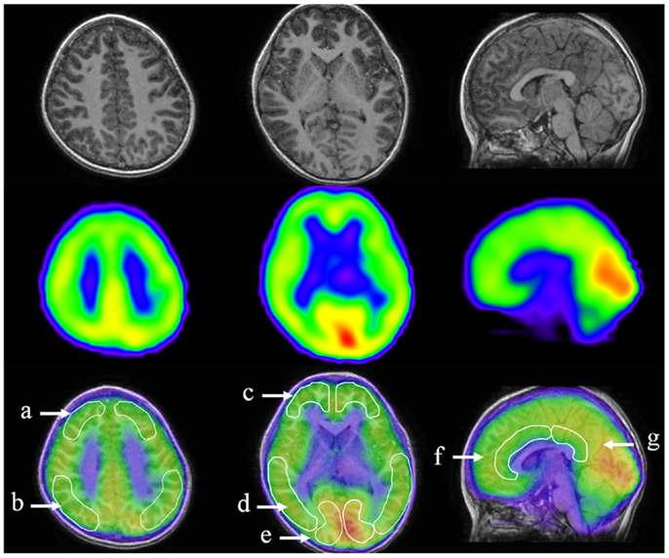
Neuroanatomical, neurophysiological evidence
Notes:
EEG, TMS and other neurological tools have been used to show that there are neurological differences with sufferers of ADHD.
However, these are not accurate at present to use for any diagnoses.
As technology advances, who knows what they'll be able to see.
This Photo by Unknown author is licensed under CC BY.

Slide 8
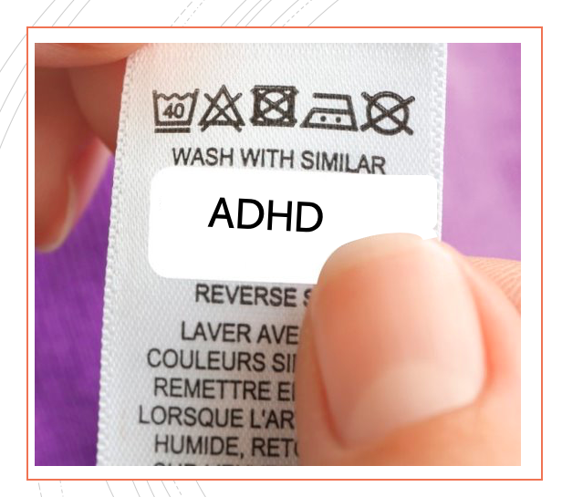
'Labelling’
Notes:
These Photo by Unknown author is licensed under CC BY-SA.

Slide 9
Debating Special Education
Michael Farrell (2010)
'Unhelpful classification'
'Problems with assessment'
'Negative effects of labelling'
Notes:
I) Give example of DCD child late: can be seen bashing and crashing then coming into class as adding insult to injury
2) Takes an example of ODD, who's prevalence varies from 2% -16% so what is being identified and classified can't be very valid or it raises questions about the assessment.
3) Co-occurrence is a problem and he actually cites ADHD in his book, re. The overlap with ODD and states " This may reflect conceptual overlap or possible underlying factors that predispose a child to several disorders and may ultimately lead, in the future, to the use of a newly developed category.
4)DSM-V
5) Benefits of classification

Slide 10
So what?
Notes:
So it's crucial to get the 'label' right

Slide 11
Other explanations for attention difficulties:
ACEs
Attachment
Sensory Processing Disorders
Speech and Language difficulties
Cross-categorisation with co-morbid conditions such as ODD,ASD, Dyslexia, Dyspraxia etc.
Anxiety and depression
Lack of social or school experience
Or simply... poor parenting
Notes:
Other explanations for the difficulties, symptoms if you like
Ref for the co-morbidity
Poor parenting is not that simple could involve ACEs or genetics.

Slide 12
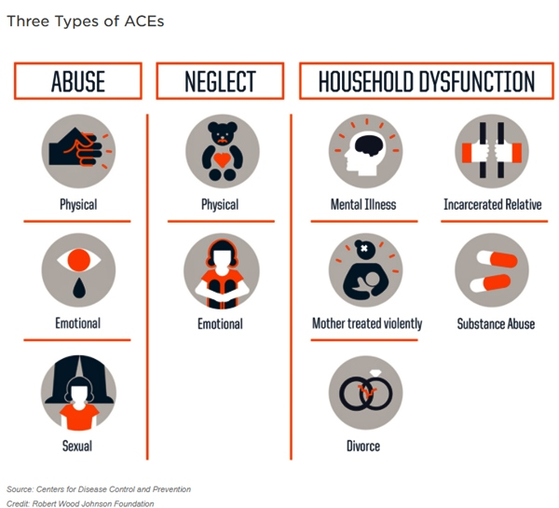
ACEs
Notes:
This Photo by Unknown author is licensed under CC BY.
Hypervigilance and lack of interest in work (AB)
Although it has also been shown that 'individuals growing up in institutional care displayed elevated levels of ADHD ; I.e. their inattention and overactivity put them over the ADHD clinical threshold Sonuga-Barke, E. and Harold, G in Chapter 4 Oxford Textbook. Although, it was concluded that it exacerbated underlying genetic factors.
Symptoms noticed back hundreds of years ago where most children experienced what would now be classed as ACEs

Slide 13

Genetics
Banaschewski et al. (2018)
Notes:
This Photo by Unknown author is licensed under CC BY-NC-ND.
'Family studies have consistently demonstrated that relatives of those with ADHD are more likely to have the disorder, be that parents, siblings or half-siblings' (Langley, K. (2018) within the Oxford Textbook of Attention Deficit Hyperactivity Disorder Ed. By Banashchewski et al.)
Twin studies give 'robustness to this and suggesting a heritability of 70 –80%
Research has identified hundreds of genes which either show direct heritability or an increased prevalence to environmental factors from every thing from month of birth to mother smoking. Many have identified genes with a link to dopamine transporters or receptors.

Slide 14
Sensory Processing Disorders
Sensory Modulation Disorder
Over-responder
Under-responder
Sensory Discrimination Difficulties
These children don’t learn from the information they get from their senses
Sensory-Based Motor Disorder
i)The “slumper”
ii) The "fumbler"
StockKranowitz, C. (2018) and Rodden, J (2019)
Notes:
According to StockKranowitz, C. (2018) 3 Types of Sensory Disorders that Look Like ADHD ADDITUDEMagazine (Accessed on January 12th, 2020).
Rodden, J (Updated Nov 2019) What is Sensory Processing Disorder? ADDITUDEMagazine (Accessed on January 12th, 2020).
Sensory Modulation Disorder
Over-responder: avoids things by covering ears, closing eyes etc.
Under-responder: appears to disregard things unless they are very loud, very hot etc. Sensory craver: wants as many sensations as possible (the bumper and crasher)
Sensory Discrimination Difficulties
These children don’t learn from the information they get from their senses e.g doesn’t use proprioception to evaluate how mu
Sensory-Based Motor Disorder
i)The first is postural disorder — let’s call this child the “slumper” ii) Dyspraxia – the "fumbler"

Slide 15
Attachment
Behaviour
Play and task behaviours
Attachment behaviours
Emotional state
Attitude to attendance at school
Observational Checklist Golding et al (2000000)
Notes:
Behaviour:
Resists boundaries, non-compliant
Difficult behaviour that is overly challenging
Unpredictable, easily triggered emotional outbursts
Loses concentration easily
Impulsive, often acts without thinking
Restless, highly active
Play and task behaviours:
Possessive about playing with other children
Wants to join in but struggles to get along with others
Overly controlling and bossy with other children
Can be quite boisterous and rough towards other children. May be seen as bullying
When does interact with another child, tends to be easily led
Overly enthusiastic about new play or tasks
Reluctant to engage in new or play tasks
Finds it difficult to settle to task,
Overly competitive, always wants to be first
Tends to get over-involved in task to exclusion of others
Attachment behaviours:
Doesn’t look back, takes little notice of caregiver
Cries, hard to soothe. Appears not comforted
Stays close to adult, tries to gain attention, talks a lot
Difficult to relate to, avoids eye-contact
Overly demanding and attention needing
Likes to be in control/ in charge
Asks personal questions even though does not mean to be rude - Shows little interest in visitor
Appears overly distressed - Acts as if nothing has happened
Needs lots of soothing and resists being comforted - Appears not to need soothing
Emotional state:
Appears overly anxious, worried or distressed
Appears very sensitive, easily upset
It is easy to tell how the child is feeling
Tends to hurt others
Tends to hurt self
Attitude to attendance at school:
Can become very disruptive or oppositional when directed by adults

Slide 16
Boxall and nurture groups
'The Boxall Profile is a unique psycho-social assessment tool used by teachers and other education professionals in schools to accurately determine children and young people's social and emotional functioning and well-being' (Bennathan, 2018)
Previous research has shown that Social Emotional Wellbeing in childhood is a key predicator of mental health in later life (e.g. Goodman, Joshi, Nasim and Tyler, 2015)
Notes:
Developmental
Diagnostic
Mental health

Slide 17
Mental health issues
Anxiety causing the ADHD symptoms or ADHD difficulties causing the ADHD symptoms.
Co-morbidity with depression and anxiety is described and associated with adverse outcomes...possibly a third disorder?
Notes:
LP and his dad
Oxley and Stringaris Chapter 22 of the Oxford Textbook of ADHD

Slide 18

Pandora's Box!
Notes:
Whilst there may be a myriad of causes that have similar manifestations as ADHD and need to be ruled out...
many of them are described as co-morbid with ADHD!
so not only has this experience strengthened my resolve to show the evidence for FG but it's also made me question others.
This Photo by Unknown author is licensed under CC BY-SA.

Slide 19
Conclusion
Most of the authors for each chapter of the Oxford ADHD textbook (2018) talk of current lack of evidence:
Sonuga-Barke and Harold cite current lack of evidence regarding the role of environmental factors.
Shaw and Szekly concede that neuroimaging tools are still being developed.
Merell and Sayal identify 'pressing need for a review of school-based interventions for ADHD'
Notes:
Most of the authors for each chapter of the Oxford ADHD textbook (2018) talk of lack of evidence.
Sonuga-Barke and Harold cite current lack of evidence regarding the causal role of environmental factors in the development of the disorder will, it is hoped, stimulate the required therapeutic intervention. Such as computerised cognitive training.
Neuroimaging tools although found links with neurobiology underlying ADHD they are still being developed.
Merell and Sayal 'pressing need for a broad systematic review encompassing the full range of study designs and types of participants in studies of school-based interventions for ADHD

Slide 20

Notes:
By getting all the other thing which support Social and Emotional Behavioural Difficulties right we can say to our untrained eye we most definitely think it is a duck and pass it to ND to check...As we are not clinicians!
These Photo by Unknown author is licensed under CC BY-SA.

Slide 21
NPT ADHD pathway

Slide 22


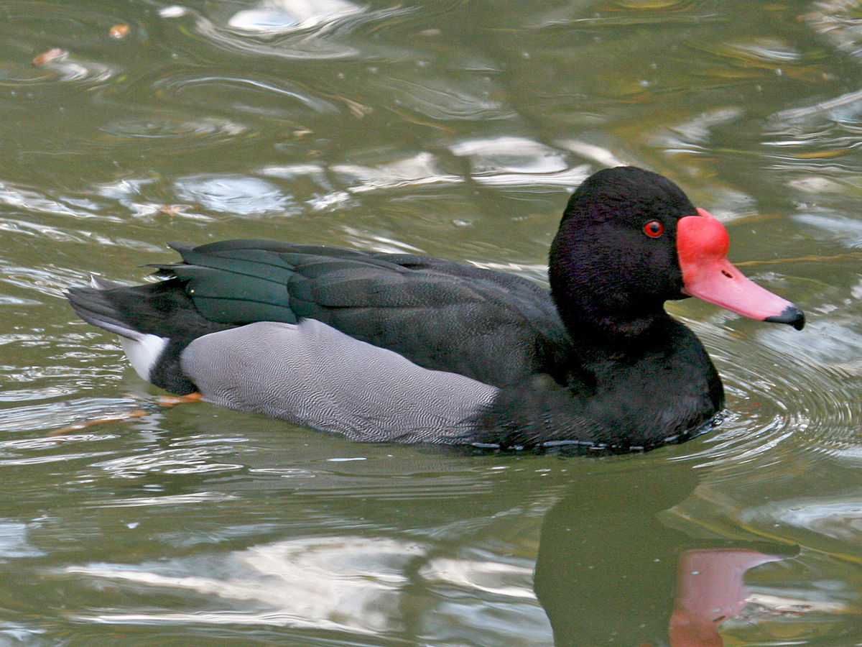


NPT ADHD pathway
Notes:
These Photo by Unknown author is licensed under CC BY-SA.

Slide 23
References
American Psychiatric Association (2013) Diagnostic and Statistical Manual of Mental Disorders Fifth Edition. Washington DC, APA.
https://beaconhouse.org.uk/wp-content/uploads/Brainstem-Calmer-Activities.pdf
Banaschewski, T., Coghill, D., Zuddas, A. (2018) Attention Deficit Hyperactivity Disorder. Oxford University Press, Oxford.
Farrell, M. (2010) Debating Special Education. Routledge, Oxon.
Bennathan, M (2018) The Boxall Profile Handbook (revised) London: The Nurture Group Network Ltd.
Golding, K., S. et al. (2013) Observing Children with Attachment Difficulties in School: A tool for identifying and support emotional and social difficulties in children aged 5-11. Kingsley Philadelphia
Goodman, A., Joshi, H. Nasim, B. & Tyler, C (2015) Social and emotional skills in childhood and their long-term effects on adult life. Early Intervention Foundation.
Lange, K.W., Reichl, S., Lange, K. M.,Tucha, L. and Tucha, O. Attention Deficit and Hyperactivity Disorders 2010 Dec; 2(4) 241-255 Published online 2010 Nov 30 Springer Open Choice PMC3000907 doi:10.1007/s12402-010-0045-8
Cont...

Slide 24
Ruby, F. J. M. (2019) Now you see us: Identifying and responding to the scale of social, emotional and mental health needs in primary school children. Nurtureuk.London.​
Rodden, J (Updated Nov 2019) What is Sensory Processing Disorder? ADDITUDEMagazine (Accessed on January 12th, 2020).​
StockKranowitz, C. (2018) 3 Types of Sensory Disorders that Look Like ADHD ADDITUDEMagazine (Accessed on January 12th, 2020).

